Slide 1








Your Rights & Your Voice
Notes:
This assembly is about your rights and your voice!

Slide 2
What will we talk about today?
3
4
1
Where did the Child Friendly Leeds '12 wishes' come from?
Children's
Day: Reimagined and 'Hear Us'
What are human rights and why do we need them?
What are the 'Rights of the Child'?
2
Our pop-up exhibition
5
Let's get started…
Notes:
Once you have run through the 5 points on the slide mention that children have extra rights to help their understanding of why we are talking about rights twice.

Slide 3
What are human rights?
1
Something to protect you.
Something that we all have.
Something that makes sure we are all treated equally.
Something to help us all live good lives.
Why do we have them?
Notes:
Ask for hands up.....Explain what they are and that we all have them to help protect us, to make sure we are treated equally and fairly and to help us all lives good lives. Let's look back at when and why they were created......

Slide 4
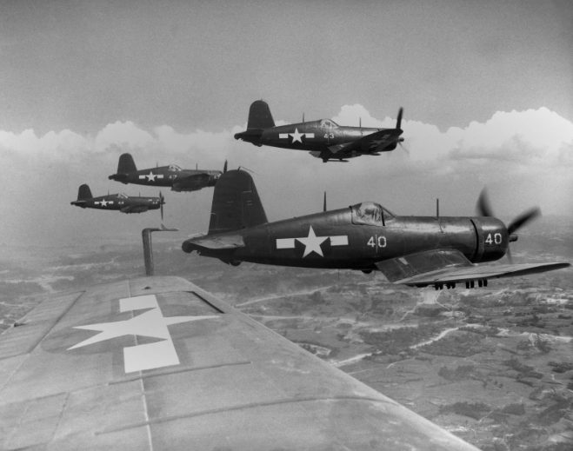
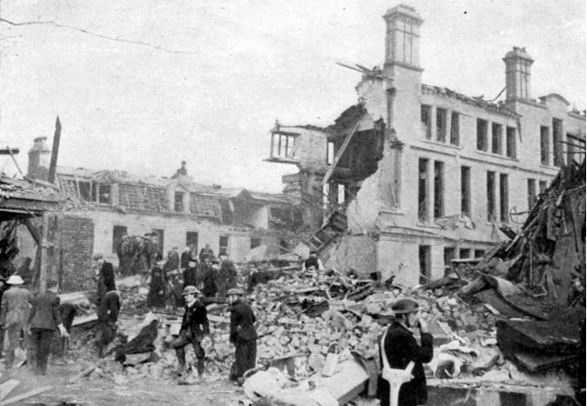
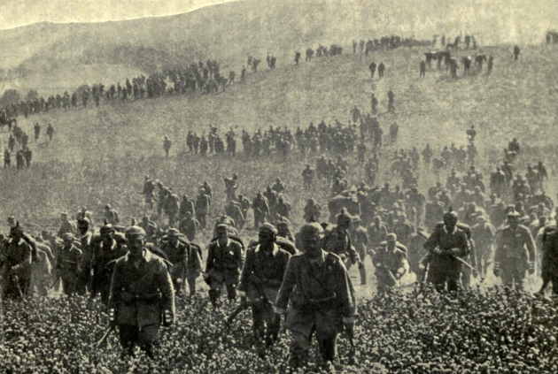
Let me take you back…
1
…25th April, 1945………………………
Notes:
As World War II was about to end in 1945 the people across the world wanted peace. Representatives of 50 countries gathered in California and came up with the idea of forming a group, with representatives from each of the countries, which they wanted to call the 'United Nations'. The aim of having a group of people from 50 countries was to work as a team to prevent another world war like the one they had just lived through. To help achieve this they created a list of 30 human rights to recognise people's right to freedom, to make choices about their lives and to develop their potential as human beings.

Slide 5












6 months later.....
1
The 'United Nations' was formed.
51countries joined, including:
…
…..24th October 1945
Notes:
The countries that joined the 'United Nations' had to sign the agreement. Some of the countries who joined include: China, UK and Northern Ireland, France, USA, Argentina, Poland, India, Canada, Ethiopia, South Africa, Greece, Brazil. Full list here: Founding Members - UN Membership - Research Guides at United Nations Dag Hammarskjöld Library Poland joined the original 50 countries in October 1945 making the total number of partner countries 51. The United Nations created a list of 30 human rights to recognise people's right to freedom, to make choices about their lives and to develop their potential as human beings.

Slide 6





The United Nations (UN) Human Rights…
1
There are 30 Human Rights including:
Countries do not have to make the rights into laws, but some do.
………………..10th December, 1948……
Notes:
The Universal Declaration of Human Rights was declared in 1948 . There are 30 Human Rights. The images represent a few of the human rights: Everyone has the right to belong to a religion; You have the right to think and voice opinions freely; You have the right to privacy; Every adult has the right to a job.
In the UK, human rights are protected by the Human Rights Act 1998, so it is part of our 'rule of law' (British Values link).

Slide 7

Rights of the Child…
2
The 'United Nations Convention for Children's Rights' (UNCRC) was established in 1989.
Children's Rights: What is the UNCRC? - BBC Bitesize
…20th November, 1989…………………
Notes:
The United Nations Convention for the Rights of the Child says that every child should be recognised, respected and protected as a rights holder and as a unique and valuable human being. It applies to all persons under the age of 18.
Pre-load the video on this BBC page (scroll down to find it) and play it if possible: Children's Rights: What is the UNCRC? - BBC Bitesize

Slide 8
Why are these rights important?
2
Every child has 54 rights, including the right to…
express themselves
be protected from violence and bad treatment
a good standard of life
a free education
Notes:
Here are 4 examples from the 54 rights (sometimes called 'articles') that are given to children – remember a right is something that all children have, and these cannot be taken away from you.
To answer the question, encourage children to think about their history topics (e.g. Victorians, Tudors – how were children treated 100+ years ago?.
The correct answer is 34 years (this is when the UN adopted the Unicef convention of the Rights of the Child).

Slide 9

Rights of the Child…
2
Article 12 –
you have the right to give your opinion and for adults to listen with respect
Notes:
The Rights of the Child have 54 'articles' – each one is like a rule that must be followed so that the Rights are being respected. This assembly is called 'Your Rights, Your Voice'. Looking at the pictures what do you think article 12 is all about?
You can ask children to show with their hands up if they think this is an important issue for children and young people.
Tell children that the next section about the Child Friendly Leeds 12 wishes links to article 12. Ask them to put their hand up if they spot the link.

Slide 10
Where did the Child Friendly Leeds '12 Wishes' come from?
3
How could we make Leeds the best city to grow up in?
What would your wish be?
Notes:
Child Friendly Leeds is a city-centre based campaign, led by the council, that aims to make Leeds a child friendly city by involving children and young people in decision-making and creating a positive environment for them. The 12 wishes, decided by children and young people in Leeds, are all about making Leeds the best city to grow up in in the whole of the UK. What would your wish be to make Leeds amazing to grow up in?

Slide 11
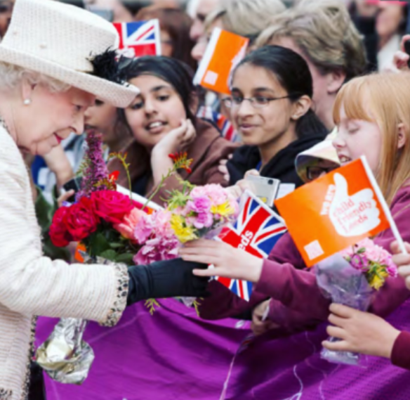


3
Child Friendly Leeds 12 Wishes…
In 2012, Leeds set out to be the best 'Child-Friendly
City'!
Queen Elizabeth II visited to begin the child-friendly mission:
……………………………2012…

Slide 12
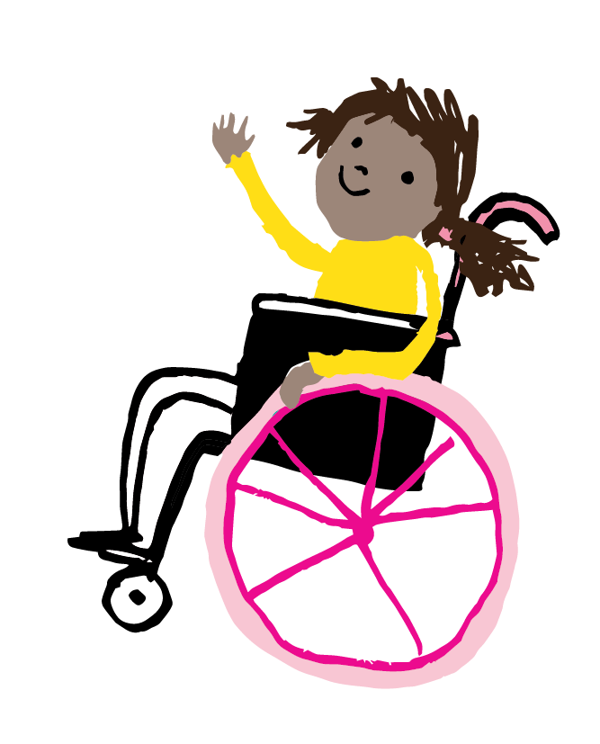
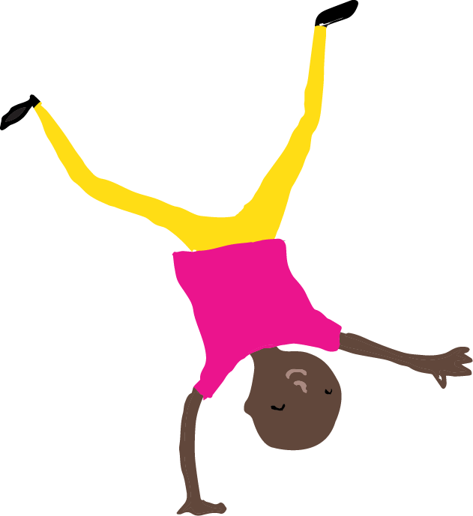

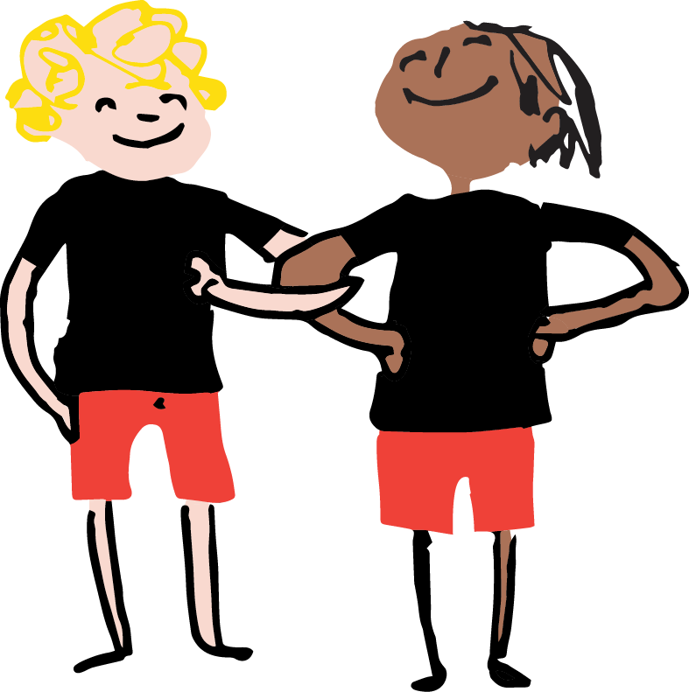
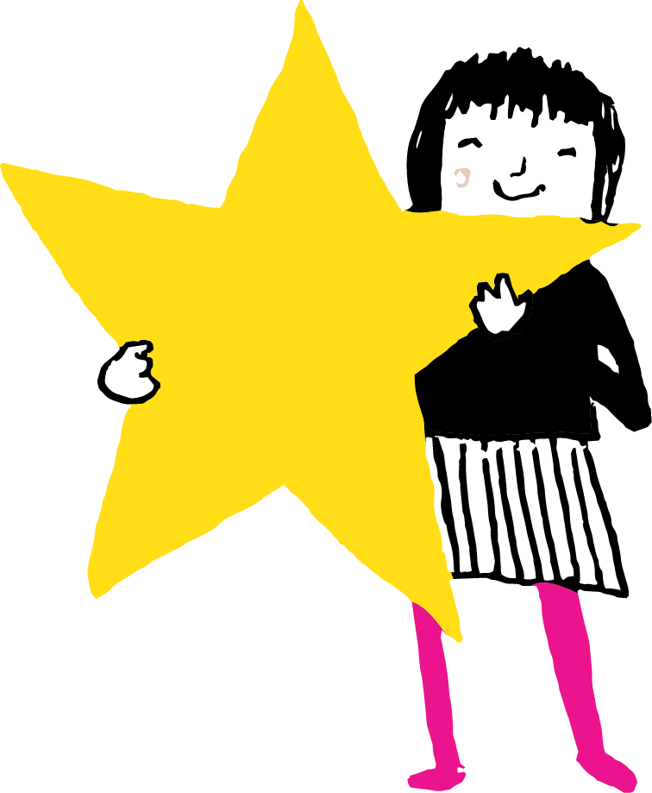
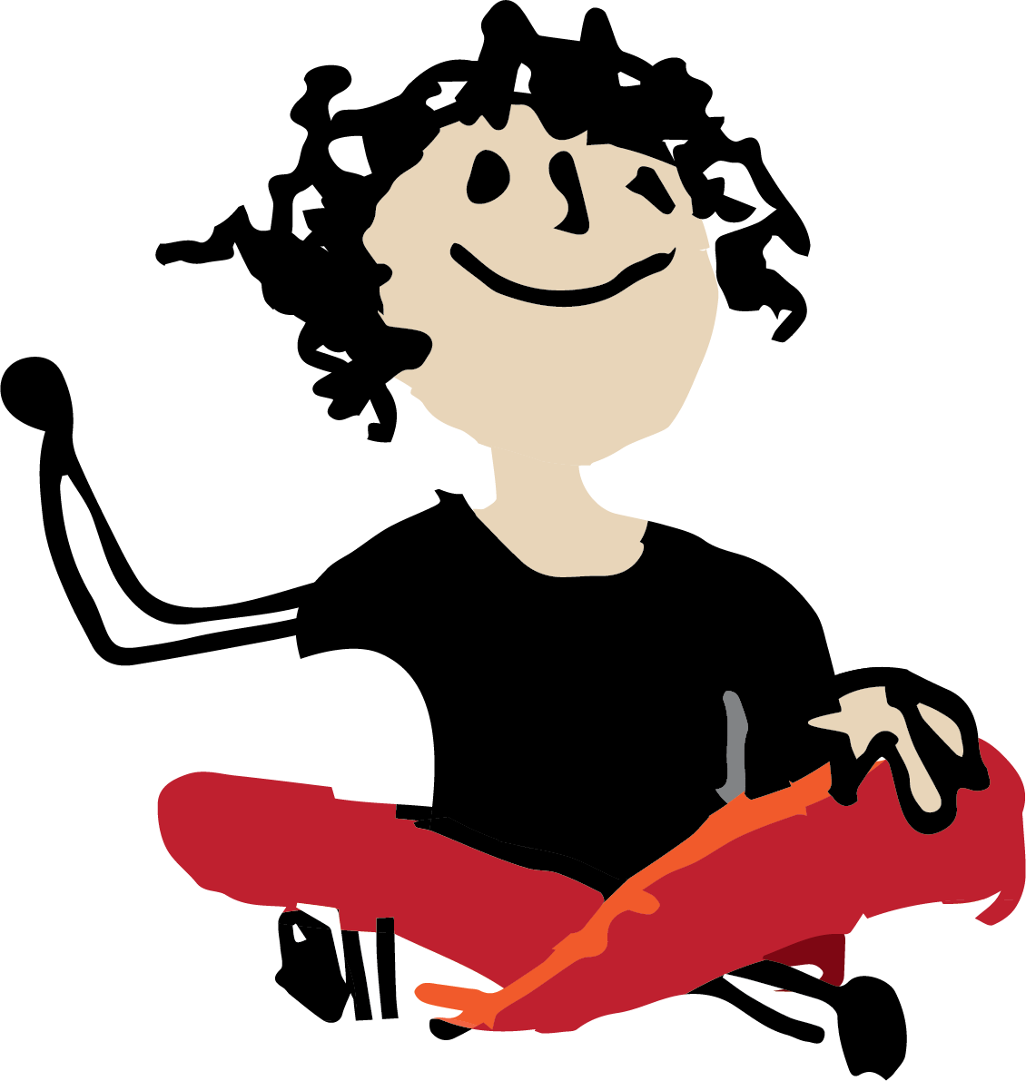
3
Child Friendly Leeds 12 Wishes…
Children's ideas were listened to and used to create the 12 wishes.
……………………………2012………
Notes:
The 12 wishes are the 12 most important things to children and young people in Leeds. These 12 things are listened to and respected.

Slide 13
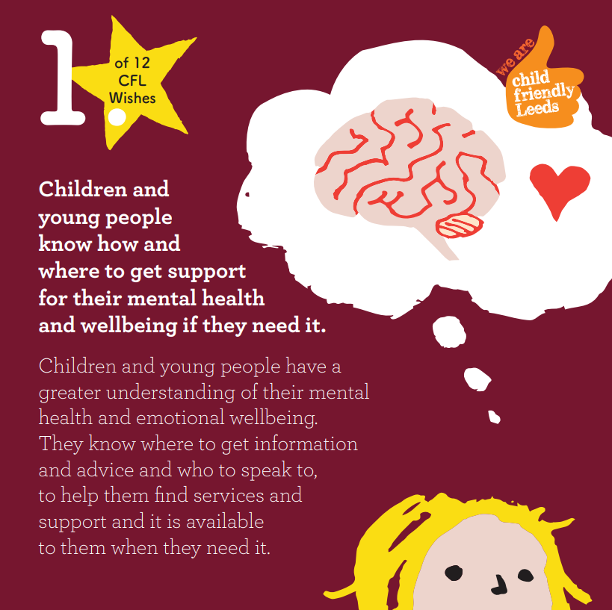
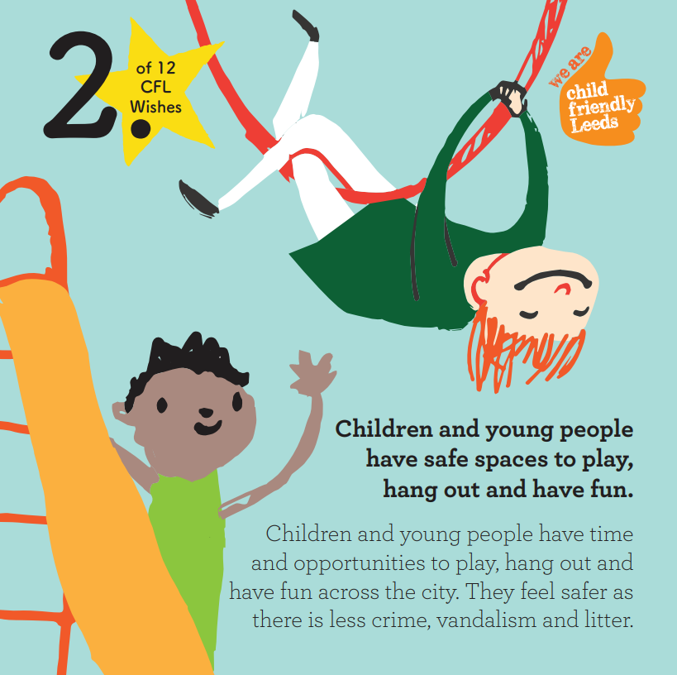
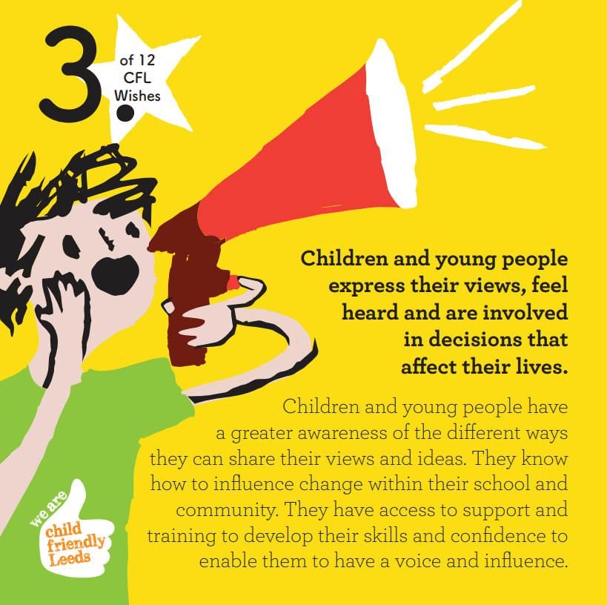

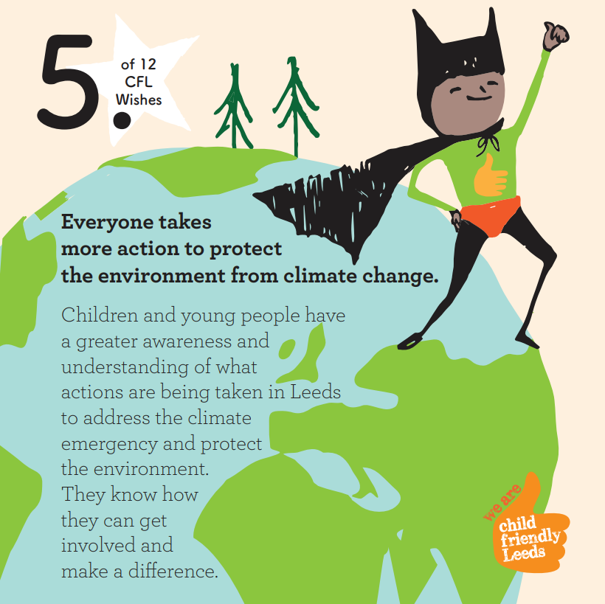
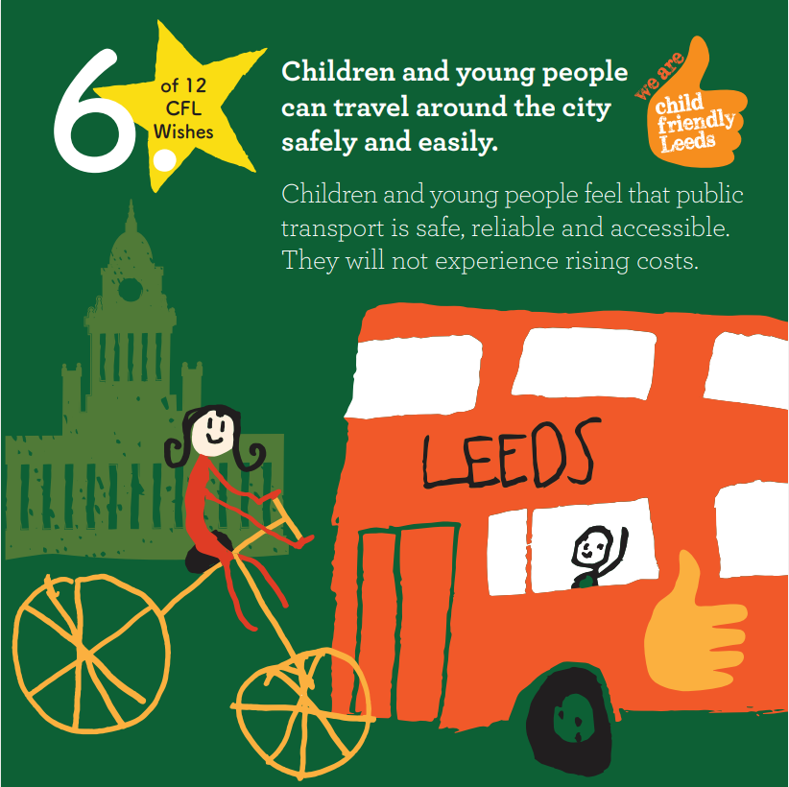
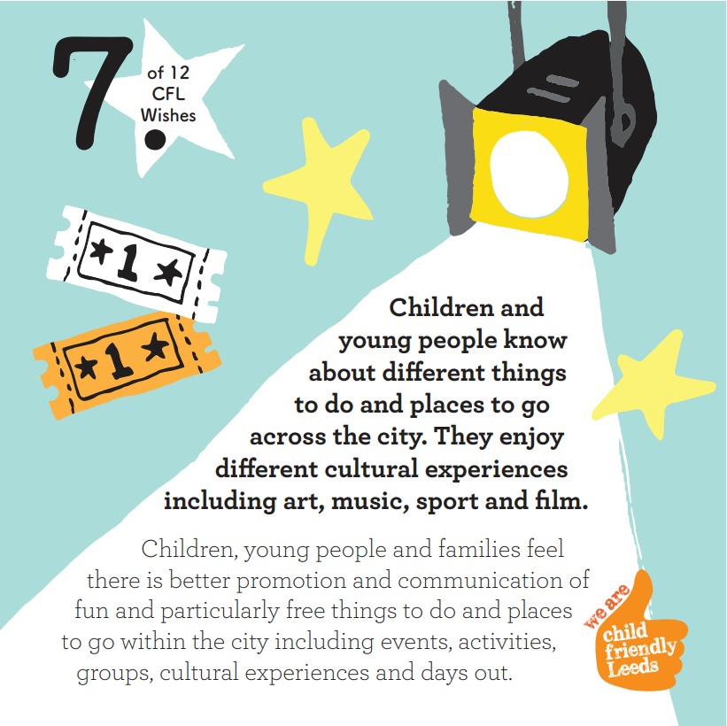
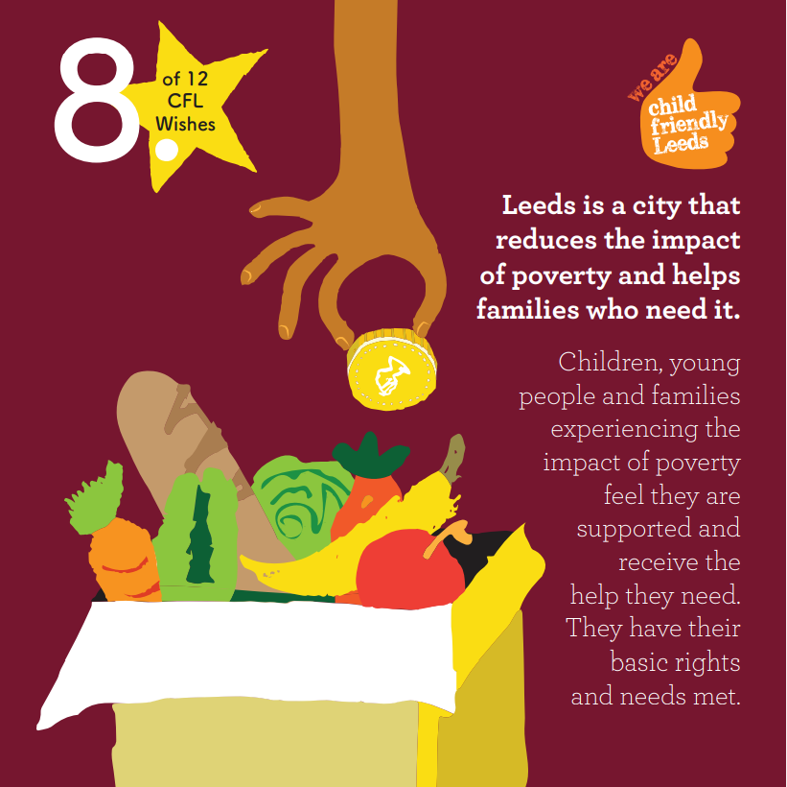


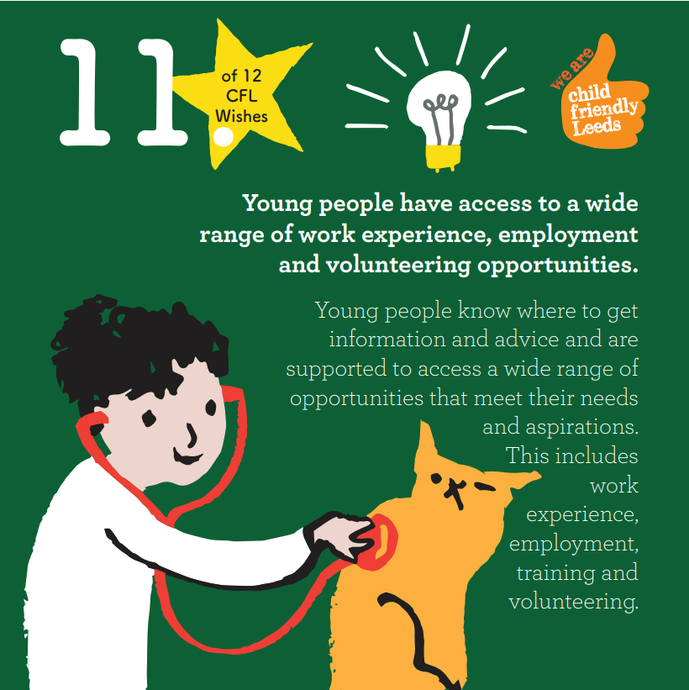
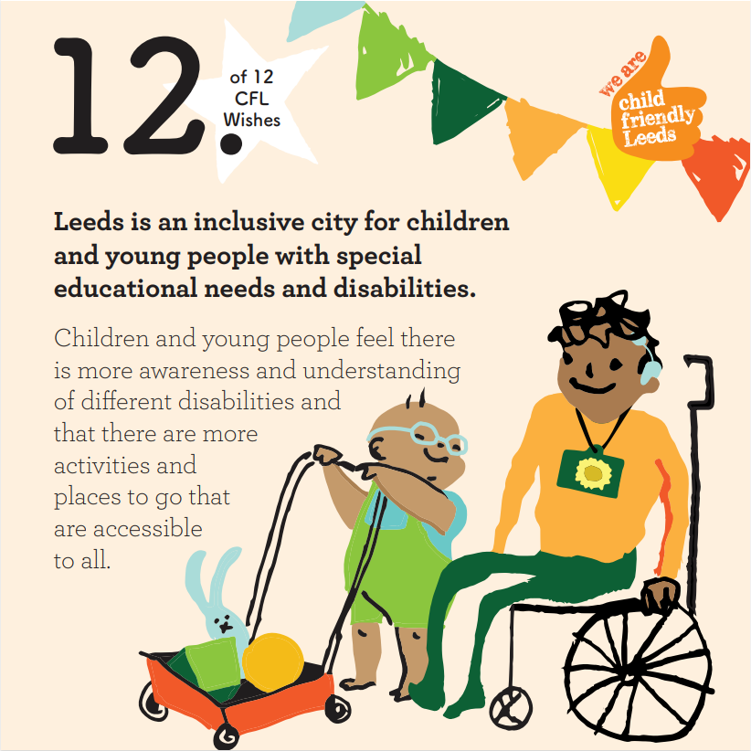
3
Child Friendly Leeds 12 Wishes…
celebrate differences and anti-bullying
safe & easy travel
protect the environment
mental health
safe space to play
feeling heard
reduce poverty
being inclusive
work experience
things to do/places to go
healthy choices
learning that meets our needs
Notes:
These are the 2022 Child Friendly Leeds wishes. Each of these wishes has someone in the council who is in charge of making sure it is taken seriously. Ask children if they can see any issues up there, which are important to them.
Child Friendly Leeds hold youth voice group meetings for each one where you can go along and hear what the council's plans are and have your say. The next one is January 9^{th 2024.}

Slide 14
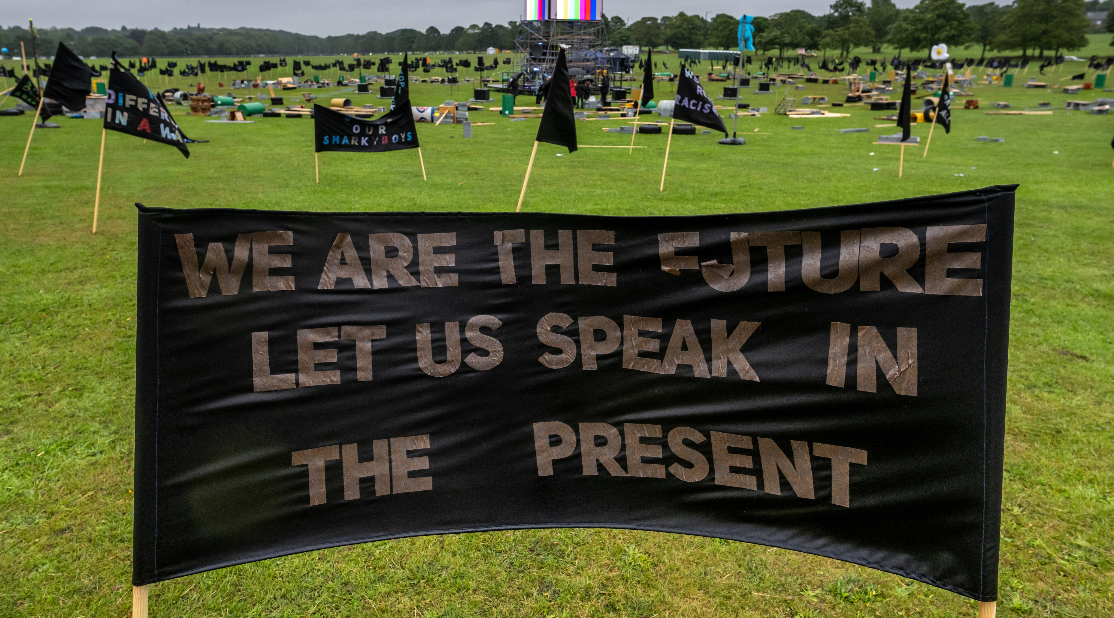
4
Children's Day: Reimagined 2023…
Children made banners expressing their hopes, fears and dreams for the future.
………………14th July, 2023…
Notes:
As part of the LEEDS 2023 year of cultural activities the Children’s Day: Re-imagined project was about giving children the chance to have their voice heard. The day was designed by artists, Fevered Sleep, and young people aged 11-14, who chose to create the Children’s Day: Re-imagined project with children to celebrate the children of Leeds, to hear their voices, show their power and let them tell adults about their hopes, dreams, demands and desires to change the world in future. Children were told that they could share their concerns and have their voices heard in a world that often doesn’t hear them. Kira Vaclavik, Professor of Children’s Literature and Children’s Culture at Queen Mary’s University, spoke to the children in schools about children’s rights – about their right to express their views and have their feelings and wishes heard – as written in the United Nations Convention for the Rights of the Child 1989.

Slide 15
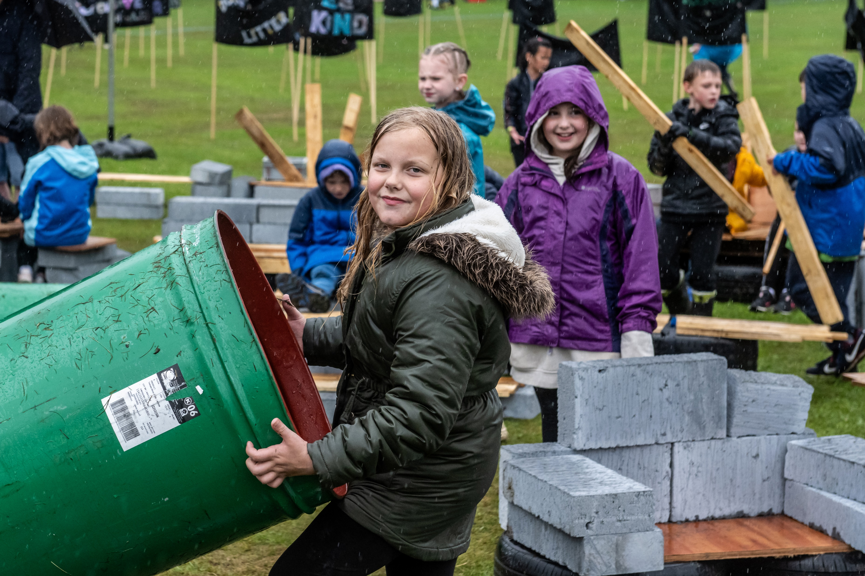
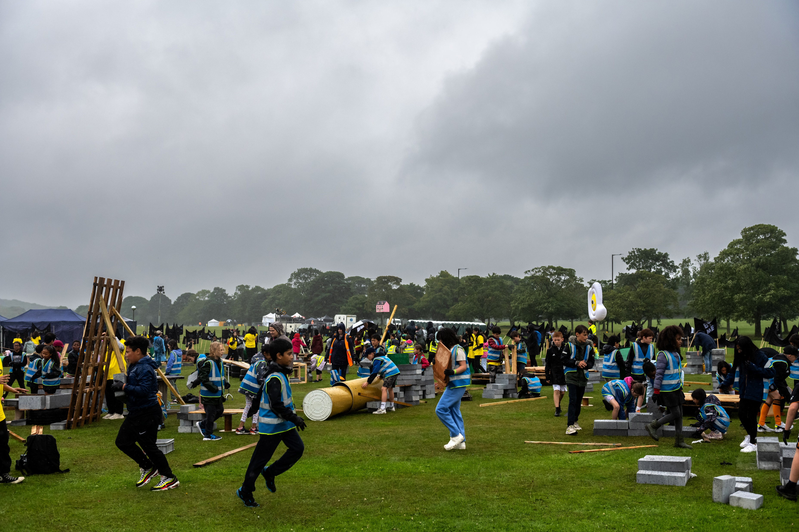
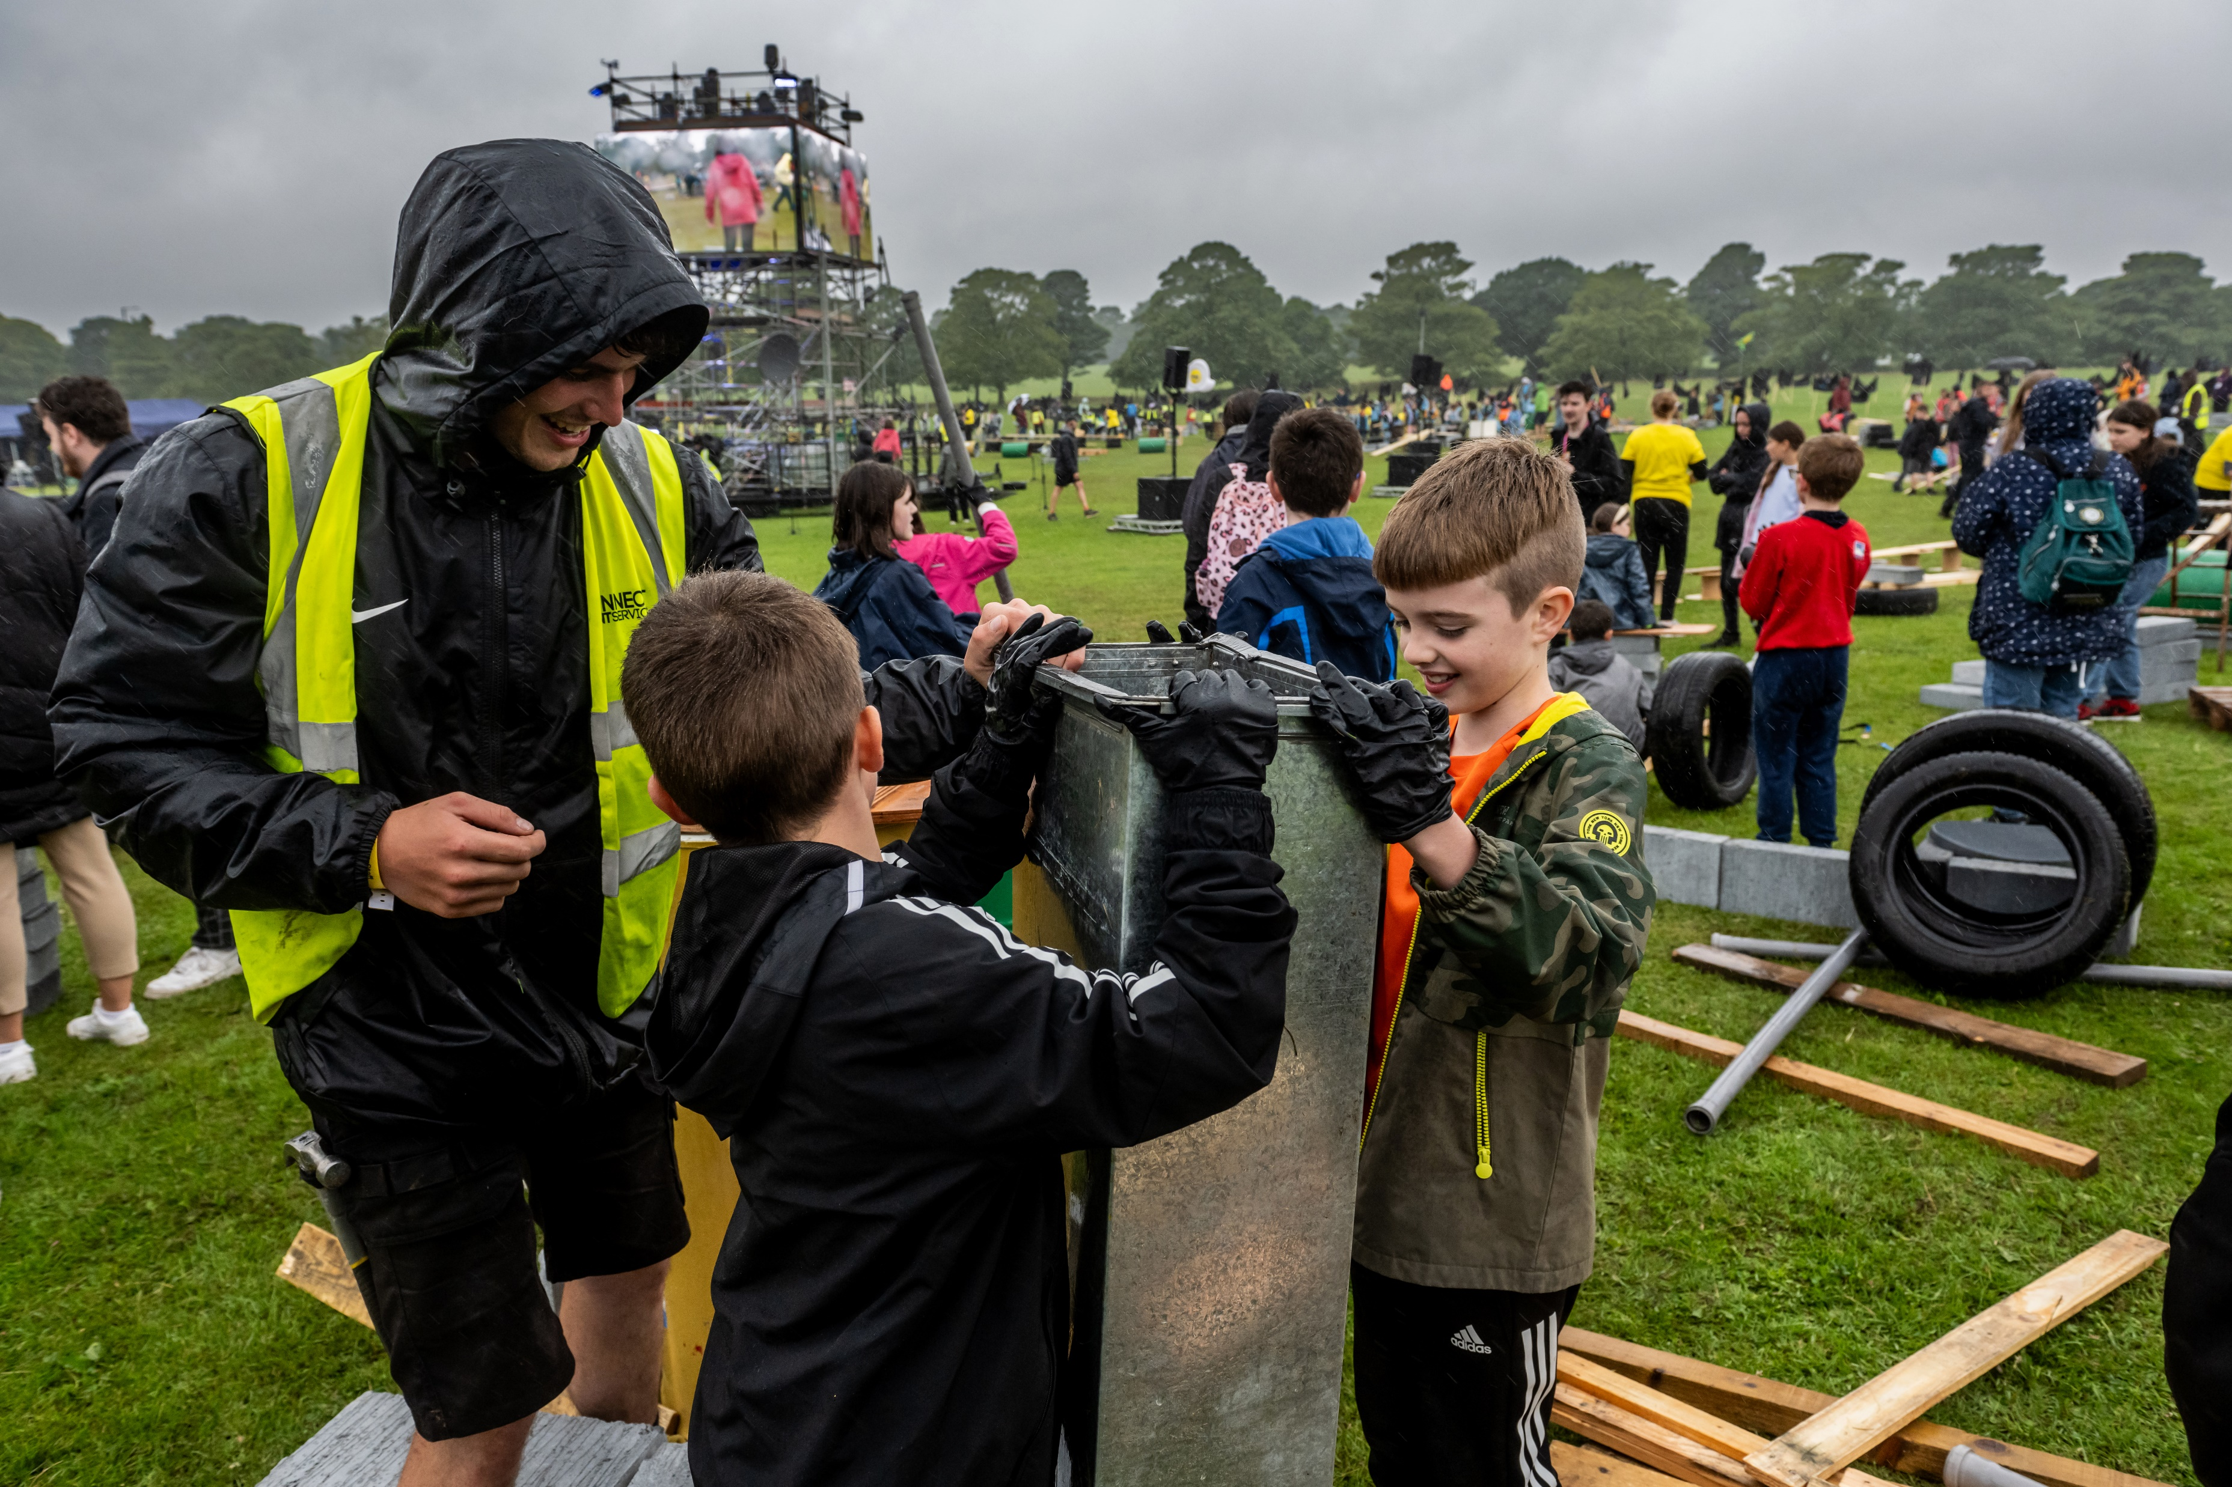
4
Children's Day: Reimagined 2023…
Children built dens and camps, displayed their banners (despite the rain!)…..
…...and in the evening watched films created by young creatives.
…………………14th July, 2023
Notes:
Children were told that on 14th July they would be able to install their banners that they had made expressing their thoughts and opinions, to build dens and camps, play, rehearse and sing a new song ‘Hear Us’, and listen to a young person’s samba band. Friends and family and the public would be invited to see the camp, read the banners and watch films and hear spoken word performances from young people in the evening.

Slide 16
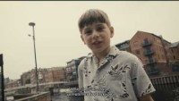
4
Children's Day: Reimagined 2023…
Notes:
The Next Chapter - Lence | LEEDS 2023 - YouTube This is one of the films made by the LEEDS 2023 Young Creatives for Children's Day Re-imagined.

Slide 17
4
Children's Day: Hear Us
Daylight fades and the stars appear
The world goes silent, it’s just us here. Are you listening? X 2
We’ve got lots to say
Cos today is the day, it is our day, It is our day X 4
[1.50] We want to be heard and be seen
Our hopes, fears and all our dreams
No worry or panic, we can do almost anything (x2)
There’s a big difference between hearing and listening
Now is the time to take us seriously
Notes:
'Hear us' was the song specially written and composed for Children's Day: Reimagined and we are going to learn and sing it now!

Slide 18
4
Children's Day: Hear Us
[2.45]
One, we want truth
Two, we want justice
Three, we want freedom
Four, we want peace
Five, you can trust us
Six, don’t silence us

Slide 19
4
Children's Day: Hear Us
[2.57]
We’re speaking up and need to be free
We want to be heard and be seen
Our hopes, fears and all our dreams
No worry or panic, we can do almost anything
There’s a big difference between hearing and listening
Now is the time to take us seriously

Slide 20
4
Children's Day: Hear Us
Daylight fades and the stars appear ​
The world goes silent, it’s just us here. Are you listening? X 2 ​
We’ve got lots to say ​
Cos today is the day, it is our day, It is our day X 4​
We want to be heard and be seen
Our hopes, fears and all our dreams
No worry or panic, we can do almost anything (x2)
There’s a big difference between hearing and listening
Now is the time to take us seriously
One, we want truth
Two, we want justice
Three, we want freedom
Four, we want peace
Five, you can trust us
Six, don’t silence us
We’re speaking up and need to be free

Slide 21





Let's check out the pop-up exhibition…
5
Credits:
Children’s Day: Reimagined was commissioned and produced by LEEDS 2023. Supported by National Lottery Community Fund, Arts Council England, Foyle Foundation and FirstBus.
This resource pack was commissioned by Leeds 2023 and created by Rowan Beaumont, in partnership with Child Friendly Leeds.
Children’s Day: Re-imagined Credits:
Creative Leads – Fevered Sleep
Composer – Emily Levy
Set design for this tour – Drewit Studio

