Slide 1
The Cities Beneath Our Feet
Inside an ant colony

Slide 2

Every colony starts with a Queen.
She digs out the first chamber and begins to lay eggs.
A single Queen can lay up to 300,000 eggs in one day, and some can live up to 30 years.
Only the Queen can lay eggs, meaning all the other ants are her daughters.

Slide 3
The first ants to mature act as general workers, hollowing out new chambers, caring for the queen and her brood and gathering food.

Slide 4
Brood chambers are built to care for the larvae and Nurse caste ants feed and clean them.
As the colony grows the workers begin to take on specific jobs and some are bred specially to do certain tasks. We call these different workers ‘castes’.

Slide 5
Foragers leave the colony in search of food.
Farmer ants store the food and tend to fungus farms to feed to the rest of the colony

Slide 6

Larger and older colonies will expand into more specialised chambers to suit their needs
Waste and burial chambers keep the rest of the colony clean.
Spare chambers provide more room for workers to rest
Winter chambers are dug deep down and are much warmer.

Slide 7



Crazy Castes
Queen
Cast determination is very complex and is influenced by things like larval diet and how many of each caste are already in the colony.
There are castes for every job in the colony and some can look very different even if they’re the same species!
Nurse
Worker
Farmer
Forager

Slide 8
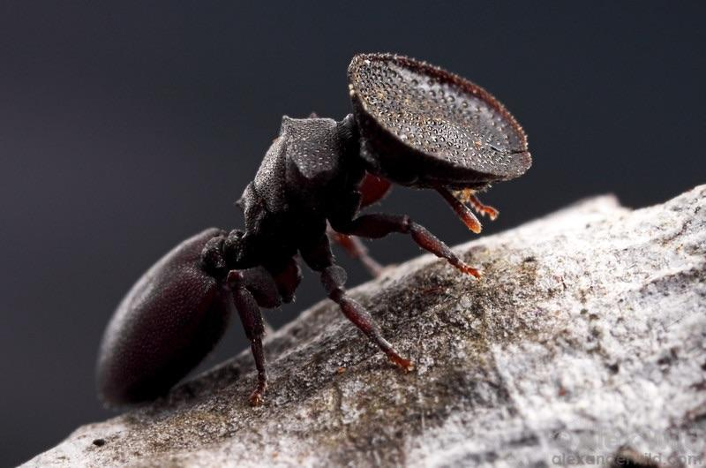
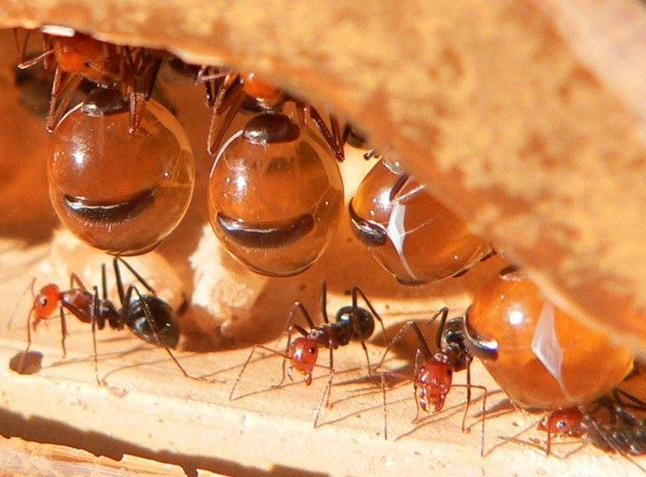
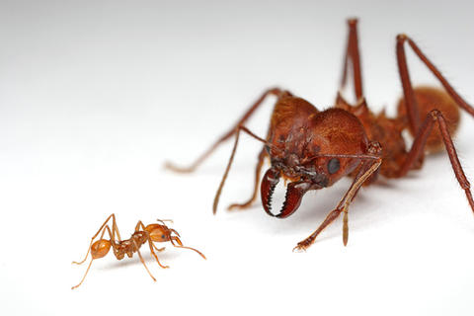
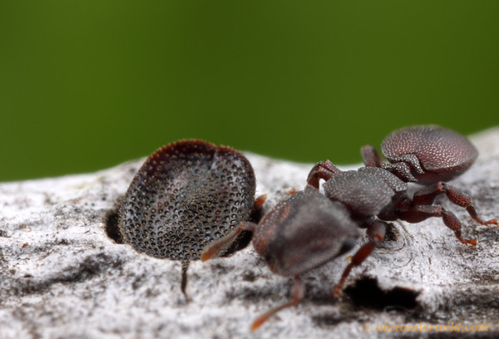
Crazy Castes
These Leaf Cutter ants are from the same colony, one is a worker and the other is a soldier.
Turtle ants have a specialised ‘door guard’ caste.
Honey Pot ants fill themselves like water-balloons to store liquid for the other ants to drink
There are just a few of the hundreds of different castes ant colonies of different species might have.

