Slide 1
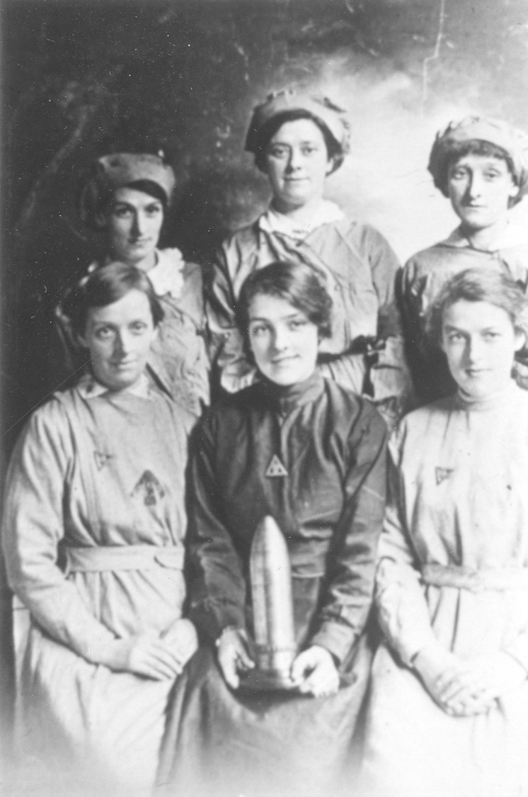
The Barnbow Lasses:
What role did women play in World War I?
By Joanne Parker, Weetwood Primary School
By kind permission of Leeds Libraries www.leodis.net

Slide 2
National Curriculum Objectives
Key Stage 2 History
  Events beyond living memory that are significant nationally or globally
  Significant historical events, people and places in the locality
Key Stage 2 Art and Design
Key Stage 2 Music

Slide 3
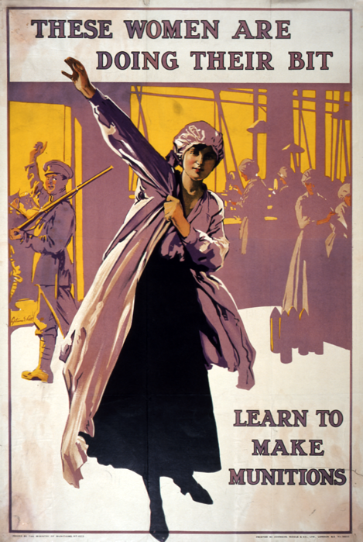
What role did Leeds’ women play in WWI?
This is a propaganda poster from 1916 calling for women on the home front to join the munitions workforce.
Image courtesy of the National Archives

Slide 4
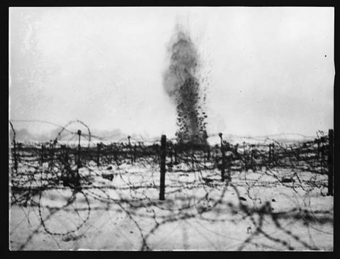
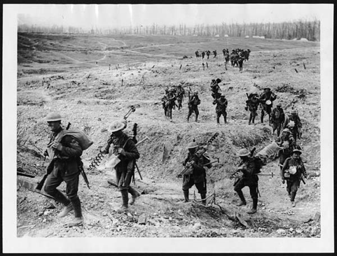
The need for shells
“Shells, shells and yet more shells”
By 1915, not only was Britain at war with Germany, but there was a shortage of artillery shells on the Allied front lines.
The Times newspaper headline in 1915 said,
“Need for Shells. British Attacks Checked. Limited Supply The Cause. A Lesson From France.”
The images on the right are from 1914 and show shelling and soldiers crossing no-mans land.
Images courtesy of National Library of Scotland. https://www.flickr.com/

Slide 5
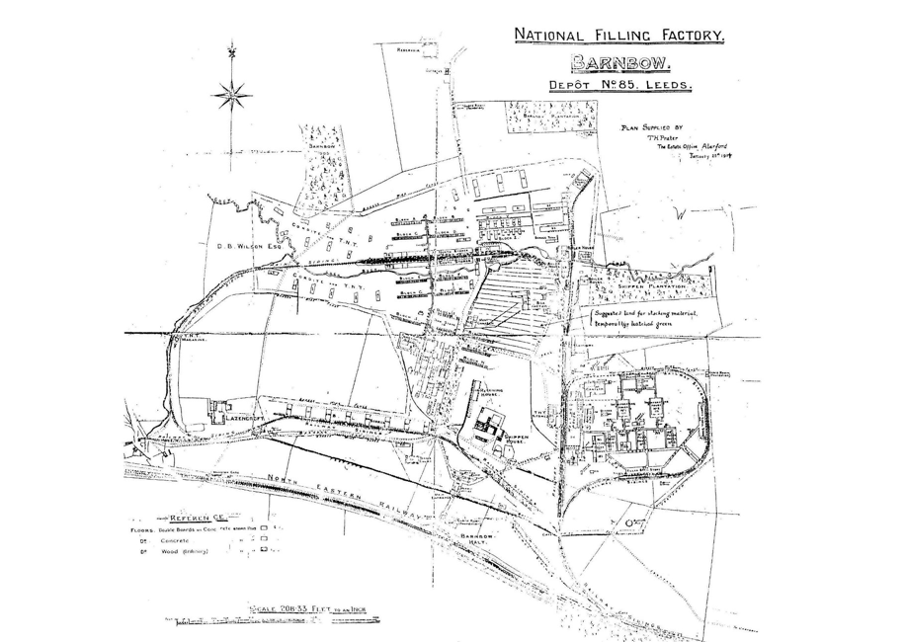
The first national shell filling factory in Leeds
Sir Algernon Firth, a major West Riding manufacturer, and the Honourable Rupert Beckett, head of a great banking firm in Leeds, seized the opportunity.
They were asked to oversee the construction of the first national shell filling factory in Leeds.
Image courtesy of Tony Cox, Barwick In Elmet Historical Society
http://www.barwickinelmethistoricalsociety.com/4746.html

Slide 6
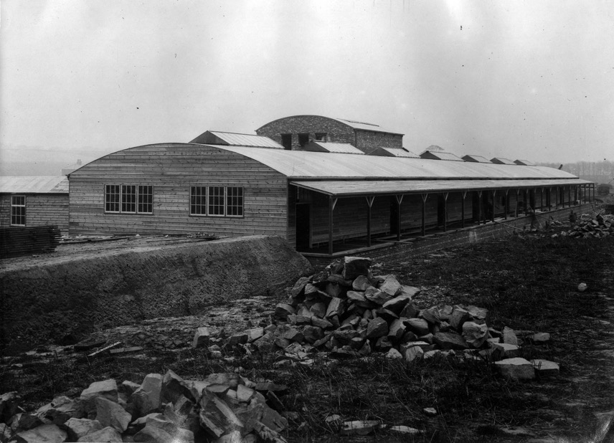

The site of the factory then…
In August 1915 they selected a site at Barnbow, between the Crossgates and Garforth areas of Leeds, to construct a factory the size of which was described as ‘a city within a city’.
The site was (A football pitch is 1 and a half acres):
  200 acres?
  400 acres?
  800 acres?
The Barnbow site. By kind permission of Leeds Libraries www.leodis.net
Notes:
ANSWER: 200 acres

Slide 7
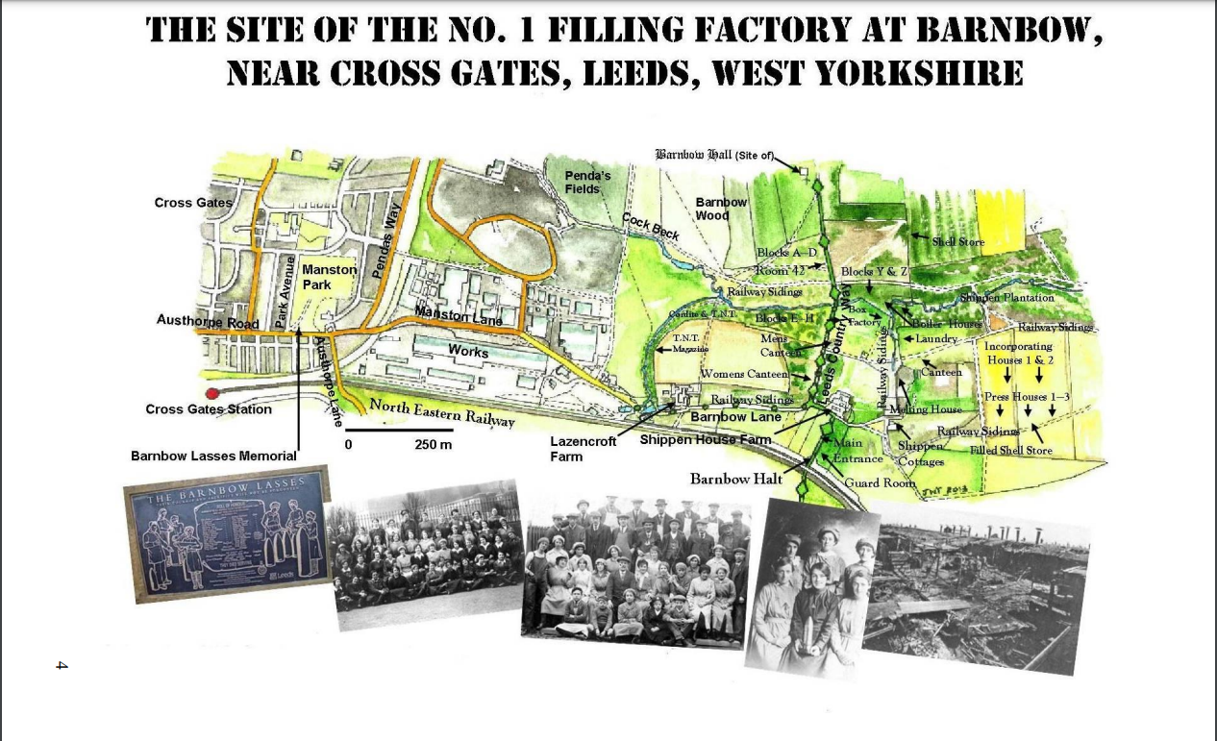
With kind permission from Leeds Library Service Tom Palmer Resources

Slide 8

Find out about…..
Can you find out what has happened to the factory?
Use a map to locate where the site was.
Is there any evidence on the internet about the site now?
Can you find out about some of the people who worked at the Barnbow Munitions Factory?

Slide 9
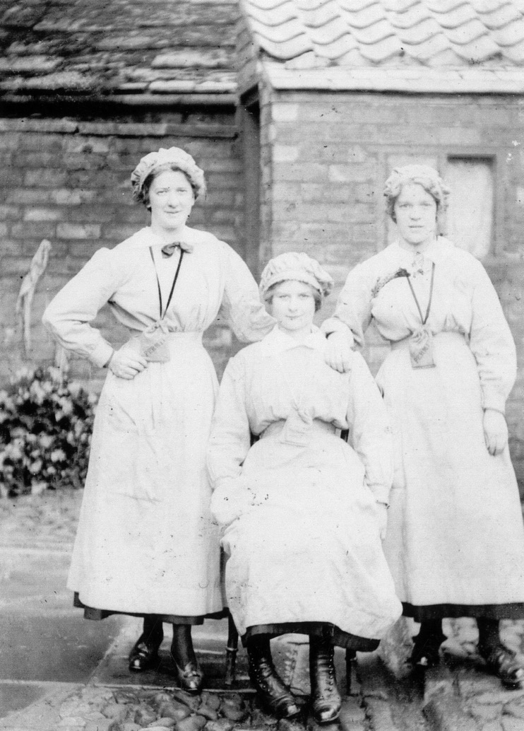

Quiz time!
By kind permission of Leeds Libraries www.leodis.net

Slide 10
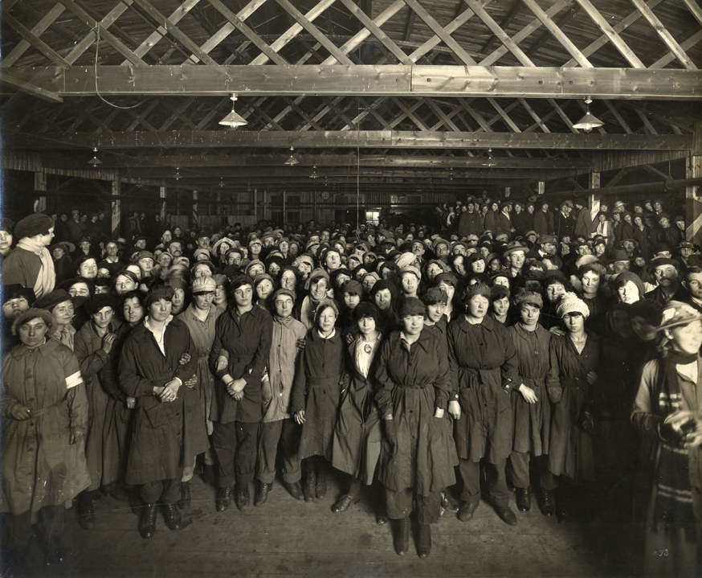
Question 1
6 million bricks were used in the construction of 56 rooms in 8 blocks.
How many people worked at the factory?
400
400
8,000
16,000
By kind permission of Leeds Libraries www.leodis.net
Notes:
ANSWER:
16000

Slide 11
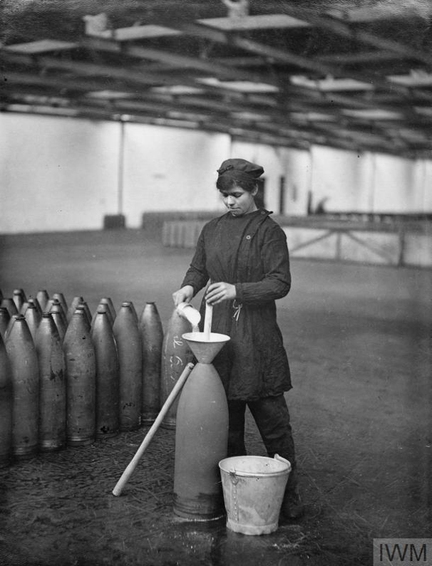
Question 2
Workers earned on average £3 per week. With bonuses for handling explosives that went up to £10-12. This is the equivalent of £310 per week today.
What % of the workforce were women?
48%
%
400
48%
87%
93%
Image courtesy of Imperial War Museum
Notes:
ANSWER: 93%

Slide 12
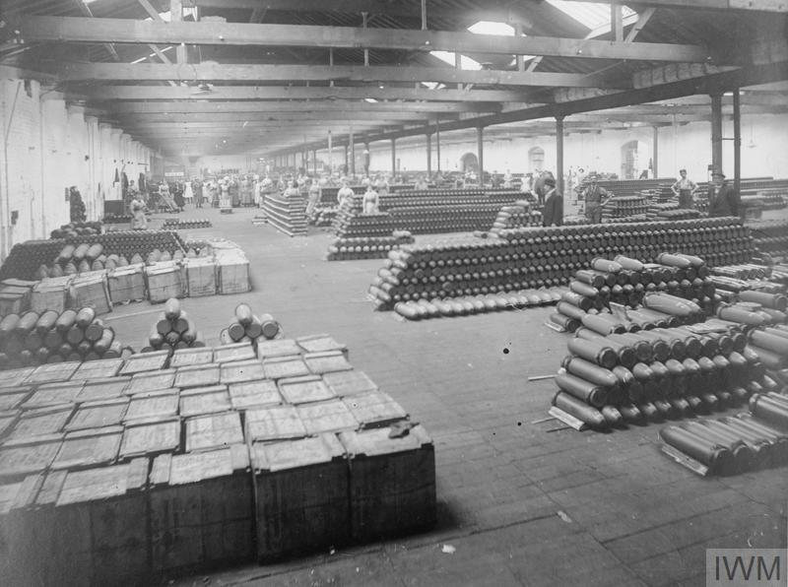
Question 3
Chemicals ( Ammonium Nitrate and TNT= Amatol) were crushed, dried and mixed to fill bombshells.
How many shells were produced by the end of the war?
400
4,750,000
24,750.000
47,000,000
Image courtesy of Imperial War Museum
Notes:
ANSWER: 47,000,000

Slide 13
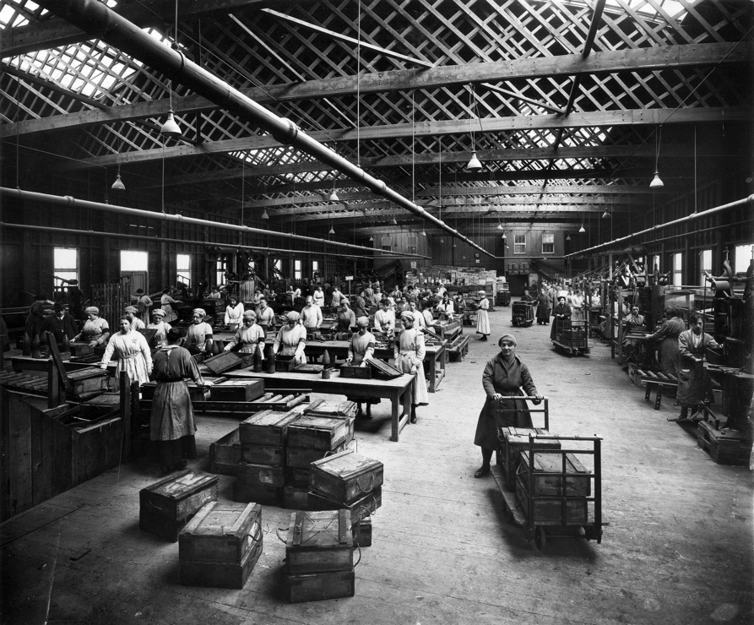
Question 4
How many bullets (known as breach loading cartridges) were produced by the end of the war?400
3,615,000
3,615,000
3,615,000
36,150,000
360,150,000
By kind permission of Leeds Libraries www.leodis.net
Notes:
ANSWER: 36,150,000

Slide 14
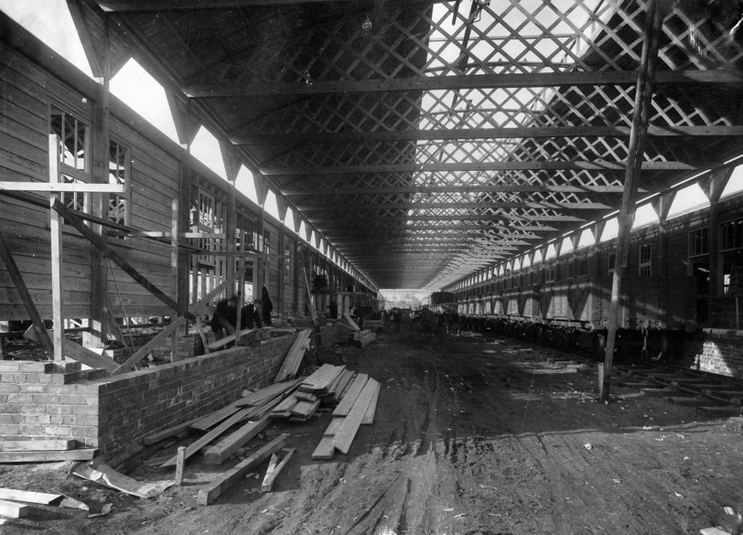
Question 5
Trains transported the women to and from work as well as transporting materials to the factory and munitions from the factory.
How many trains ran per day to transport the workers?
0
3,615,000
3,615,000
3
13
38
By kind permission of Leeds Libraries www.leodis.net
Notes:
ANSWER: 38

Slide 15

Question 6
Working at the factory with chemicals was hazardous in many ways. Which of the following statements are true or false?
Workers were nicknamed ‘canaries’ as their skin and hair turned yellow.
To stop this they were encouraged to eat bananas.
0
3,615,000
3,615,000
True/False
True/False
By kind permission of Leeds Libraries www.leodis.net
Notes:
BOTH ANSWERS ARE: True

Slide 16
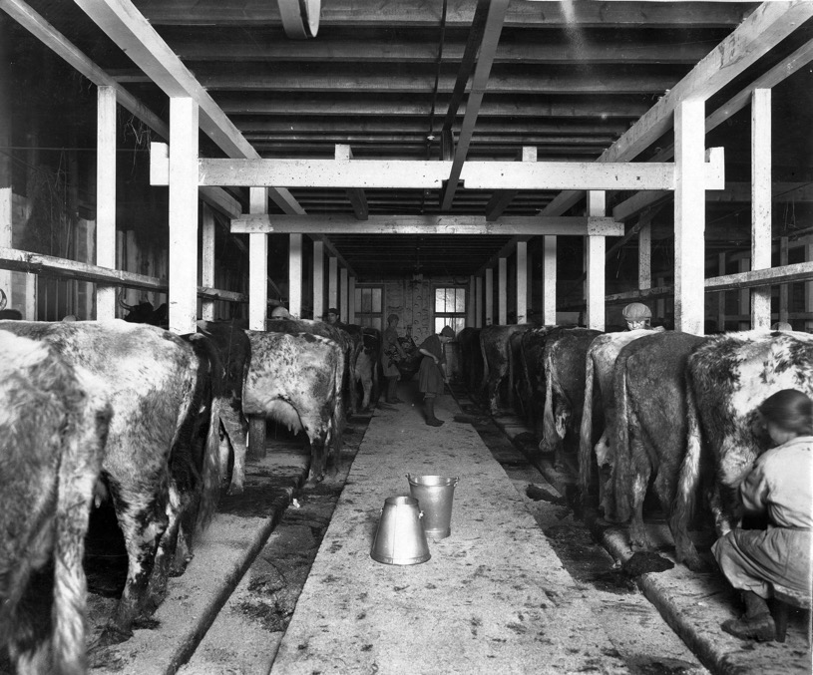
Question 7
The women were also encouraged to drink lots of milk, to stop the effect of the chemicals. Barnbow had its own farm with a herd of dairy cows producing 300 gallons of milk each day.
How many litres are there in 300 gallons?
13 Litres
1,364 Litres
50 Litres
By kind permission of Leeds Libraries www.leodis.net
Notes:
ANSWER: 1364 Litres

Slide 17
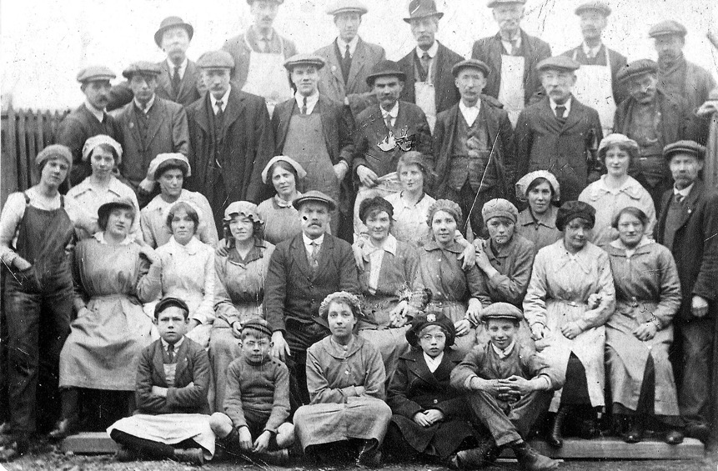
Question 8
As well as loading and packing munitions there were a variety of other jobs on offer. Which were they?
  Doctors
  Nurses
  Welfare officers
  Canteen workers
  Butchers
  Fire fighters
  Dairy girls
  Security men
  Dentists
  Farm hands & workers
  Pig keepers
  Slaughtermen
By kind permission of P.E. Holmes, www.leodis.net
Notes:
ANSWER: All these jobs existed at Barnbow

Slide 18
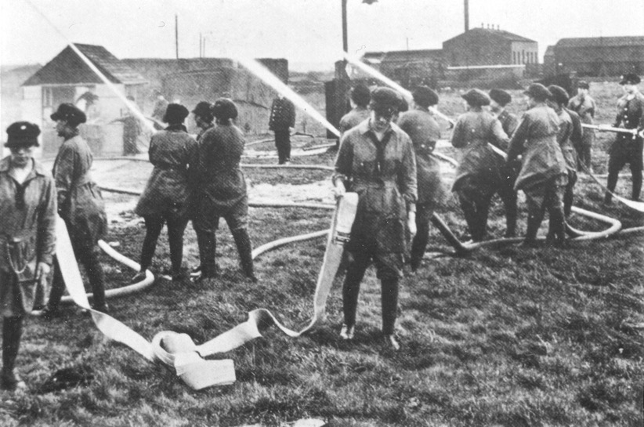
Question 9
Actually, each of those jobs existed at Barnbow!
Why do you think those roles were needed?
The image to the right shows the workers at Barnbow doing a Fire Drill in 1915.
By kind permission of Leeds Libraries www.leodis.net

Slide 19
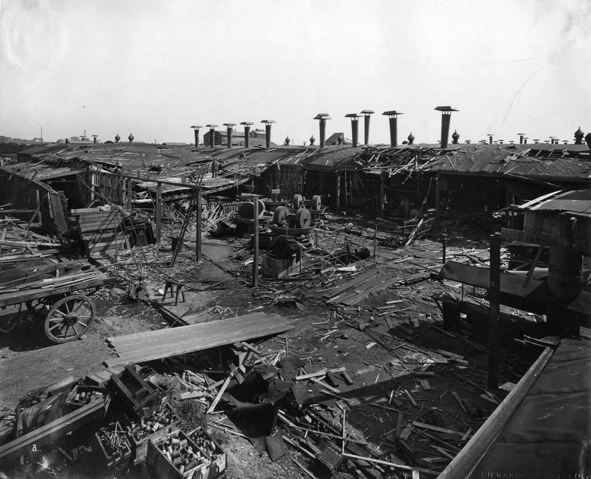
Disaster struck in 1916…
On the 5th December 1916, an explosion ripped through the factory.
A shell exploded in Hut 42 just before 22:30 on 5 December 1916, killing 35 women and injuring many more.
Explosions in March 1917 and May 1918 killed another two women and three men.
There is a memorial to the Barnbow Lasses in Manston Park, Leeds.
By kind permission of Leeds Libraries www.leodis.net

Slide 20

Roland Kellet’s memories
Lets think about the evidence that we have looked at so far:
  Photos
  Posters
  Maps
  Remains of the factory today.
Now listen to this interview with a Leeds resident, Roland Kellet, talking about his memories and the Barnbow workers.

Slide 21

Listen carefully...
We are the Barnbow lasses,
We are the Barnbow girls.
We know our manners,
We can spend our tanners,
We are respected wherever we go!
And when we walk down Briggate,
The doors and the windows open wide,
We can dance, we can sing,
We can do the Highland fling,
We are the Barnbow girls!

Slide 22

Talk to your partner
What can we learn from Roland’s song?
What do the lyrics tell us about working in a factory?
What do the lyrics tell us about what other people in Leeds thought about the Barnbow girls?
Who might have composed it?

Slide 23
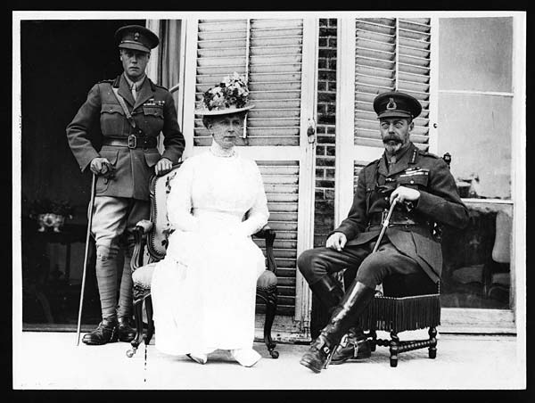
A royal visit to the Barnbow factory
King George V and Queen Mary visited Leeds in May 1918.
They toured cloth and munitions factories, the Town Hall, and a military hospital in the grounds of Beckett Park. This building was built in 1912 and is now part of Leeds Beckett University.
Images courtesy of National Library of Scotland https://www.flickr.com/

Slide 24

Over to you!
It is 1918 and King George V and Queen Mary are due to visit Leeds on the 31st May.
Imagine you are a Barnbow lass. It is rumoured that the King and Queen may visit Barnbow. You have been asked to put on some entertainment for them.
Add another verse to the song. Or can you write a song or poem that would be fit for royalty?

Slide 25

Over to you!
Think about this propaganda poster from the first slide.
Talk to your partner. Which techniques are used to influence people?
You can find out more here:
  https://blog.nationalarchives.gov.uk/image-female-munitions-worker/
  https://www.bbc.co.uk/news/uk-england-39434504
Image courtesy of the National Archives

Slide 26

Over to you!
Design a recruitment poster for the Barnbow factory.
Brainstorm your ideas before you draw your poster
Think about how you can convince the women of Leeds to work there.

