Slide 1
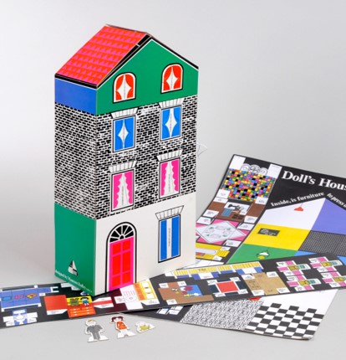
Maureen Roffey's
Doll's House
Mathematics project for Year 1 to 6
Free learning resources from, cultural and heritage organisations
^{mylearning.org}

Slide 2
How this project works
This project links to National Curriculum areas for all year groups, 1 to 6. The related NC statements can be found at the start of each section.
The aim is for pupils to create and decorate their own miniature house, which is formed with a net.
They can explore areas of maths such as shape, pattern, symmetry and rotation to develop the designs for their houses. Each topic is self-contained, but can be taught sequentially for a longer running project.
You may wish to start by introducing the topic of nets so they can see the outcome, but they will need to have explored other topics before beginning designing.
^{mylearning.org}

Slide 3
National Curriculum Links
Mathematics
Key Stage 1
  Year 1 – Shapes, Pattern
  Year 2 – Shapes, Rotation, Pattern
Key Stage 2
Year 3 – Nets, Shapes, Rotation
Year 4 – Shapes, Symmetry
Year 5 – Nets, Shapes, Symmetry
Year 6 – Nets, Shapes
Follow the blue links to view the NC statements and related content.
Art & Design
Key Stage 1 - "to develop a wide range of art and design techniques in using colour, pattern, texture, line, shape, form and space; about the work of a range of artists, craft makers and designers"
Key Stage 2 - "about great artists, architects and designers in history"
^{mylearning.org}

Slide 4
Shapes
Key Stage 1
Year 1: recognise and name common 2-D and 3-D shapes, including: 2-D shapes [for example, rectangles (including squares), circles and triangles], 3-D shapes [for example, cuboids (including cubes), pyramids and spheres]
Year 2: identify and describe the properties of 2-D shapes, including the number of sides, and line symmetry in a vertical line; identify and describe the properties of 3-D shapes, including the number of edges, vertices and faces; identify 2-D shapes on the surface of 3-D shapes, [for example, a circle on a cylinder and a triangle on a pyramid]; compare and sort common 2-D and 3-D shapes and everyday objects
Year 2 Non-statutory Guidance: Pupils identify, compare and sort shapes on the basis of their properties and use vocabulary precisely, such as sides, edges, vertices and faces; Pupils read and write names for shapes that are appropriate for their word reading and spelling. Pupils draw lines and shapes using a straight edge.
Lower Key Stage 2
Year 3: recognise angles as a property of shape or a description of a turn; identify right angles; identify horizontal and vertical lines and pairs of perpendicular and parallel lines; identify whether angles are greater than or less than a right angle
Year 4: compare and classify geometric shapes, including quadrilaterals and triangles, based on their properties and sizes
Year 4 Non-statutory Guidance: Pupils continue to classify shapes using geometrical properties, extending to classifying different triangles (for example, isosceles, equilateral, scalene) and quadrilaterals (for example, parallelogram, rhombus, trapezium).
Year 5: identify 3-D shapes, including cubes and other cuboids, from 2-D representations; distinguish between regular and irregular polygons based on reasoning about equal sides and angles
Year 6: compare and classify geometric shapes based on their properties; illustrate and name parts of circles, including radius, diameter and circumference and know that the diameter is twice the radius
^{mylearning.org}

Slide 5

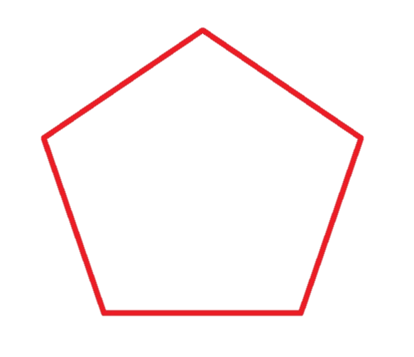

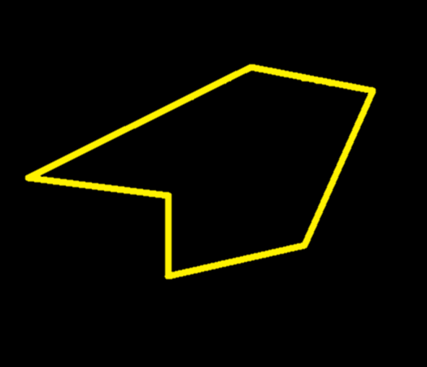
Shapes
Some shapes are regular. All sides of a regular shape are equal length, and the angles the sides meet at are the same.
Maureen Roffey used a range of different shapes in the design of her doll’s house.
Some shapes have sides of different lengths which may meet at different angles – they are called irregular.
^{mylearning.org}

Slide 6
Shapes
Have a go at the interactive shape hunt of Maureen Roffey's doll's house.
Can you name all of the shapes labelled on the picture?
Are all the shapes regular or irregular?
Can you find a:
Semi-circle?
Rectangle?
Trapezium?
Triangle?
Square?
Pentagon?
Doll's House Shape Hunt
^{mylearning.org}

Slide 7
Patterns
Year 1 Non-statutory Guidance: They recognise and create repeating patterns with objects and with shapes.
Year 2: order and arrange combinations of mathematical objects in patterns and sequences
Year 2 Non-statutory Guidance: Pupils should work with patterns of shapes, including those in different orientations.
^{mylearning.org}

Slide 8
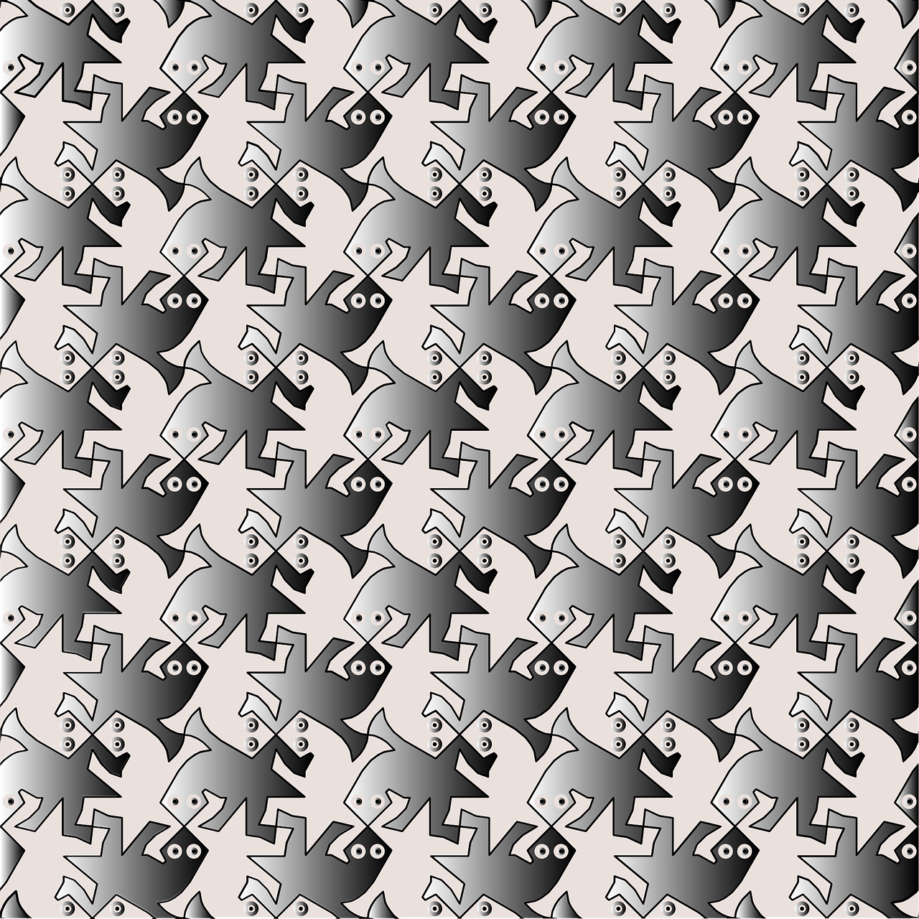
Patterns
In maths, a pattern is a series of items (such as shapes or numbers) that may follow a certain order or rule. Sometimes a patterns can also be called a sequence.
In shapes, there are patterns called tessellations, where the repeated shapes fit together in a pattern without gaps or overlaps – such as bricks in a wall.
Look at artists like M. C. Escher to learn more about tesselations.
^{mylearning.org}

Slide 9
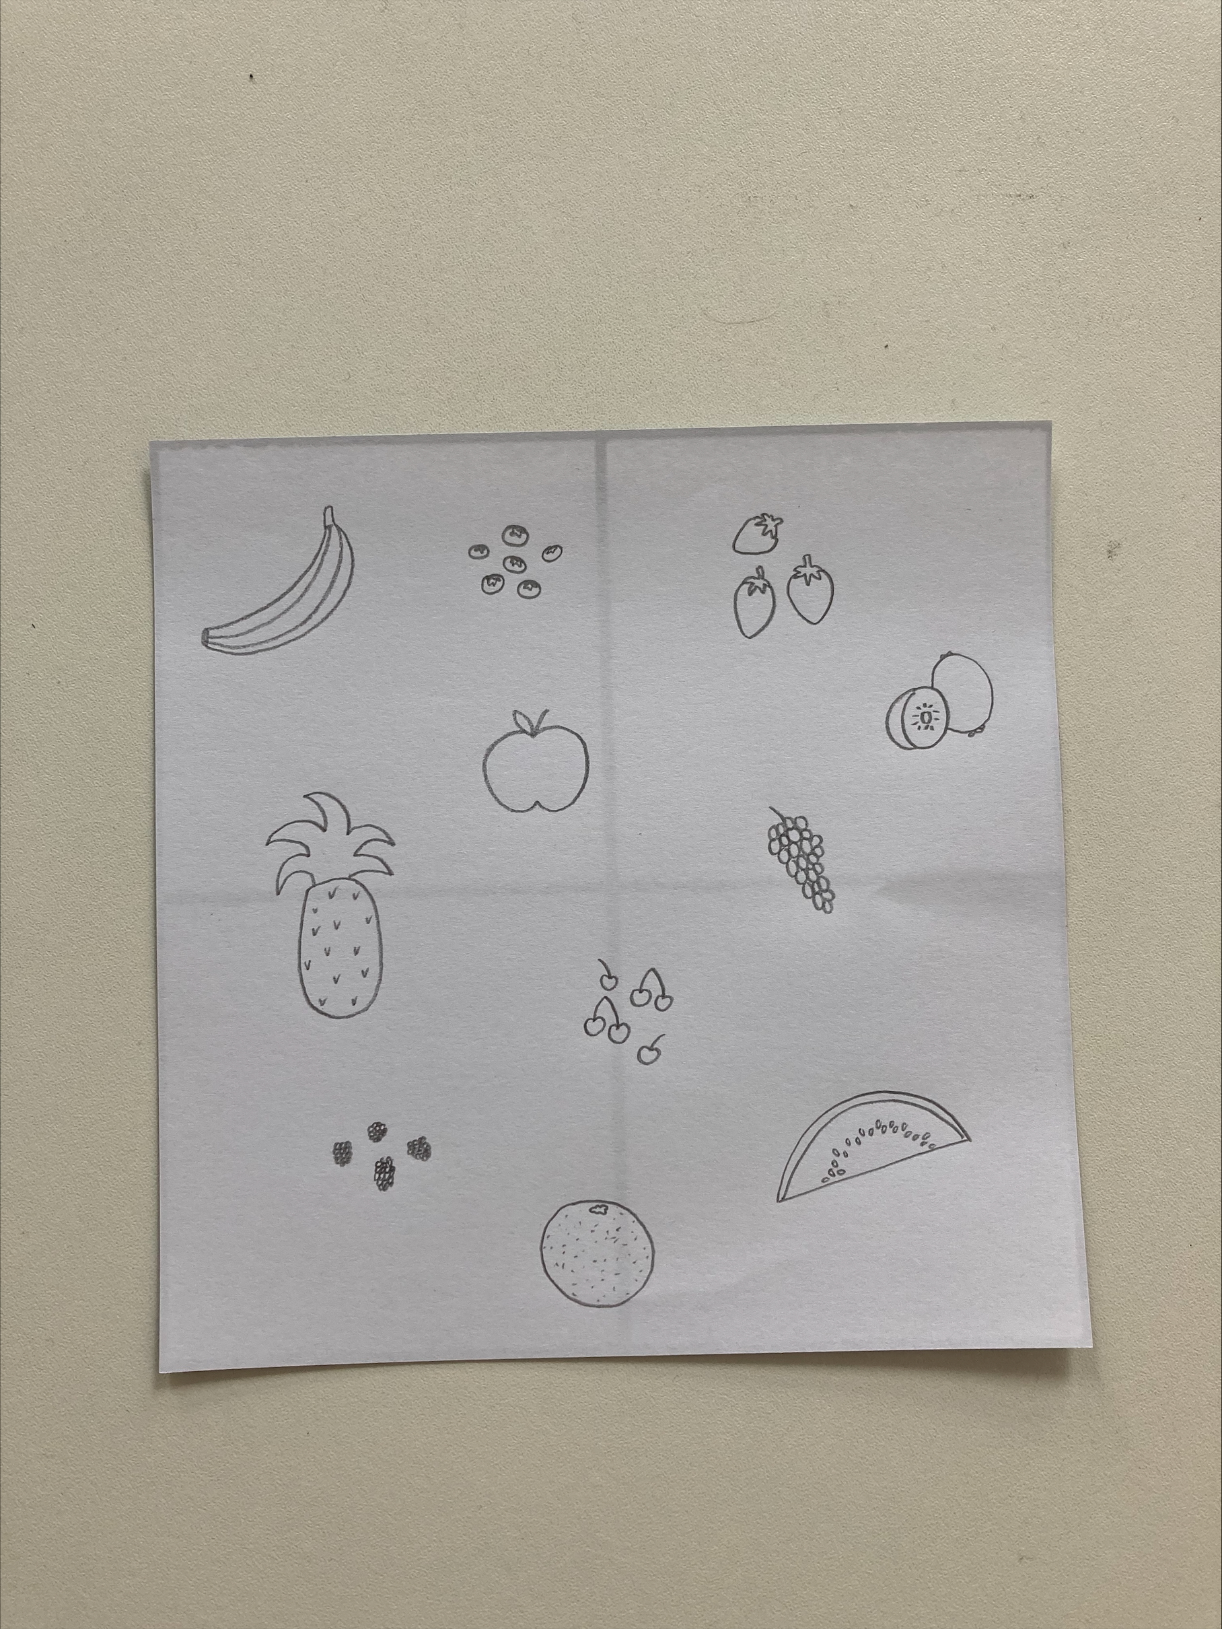
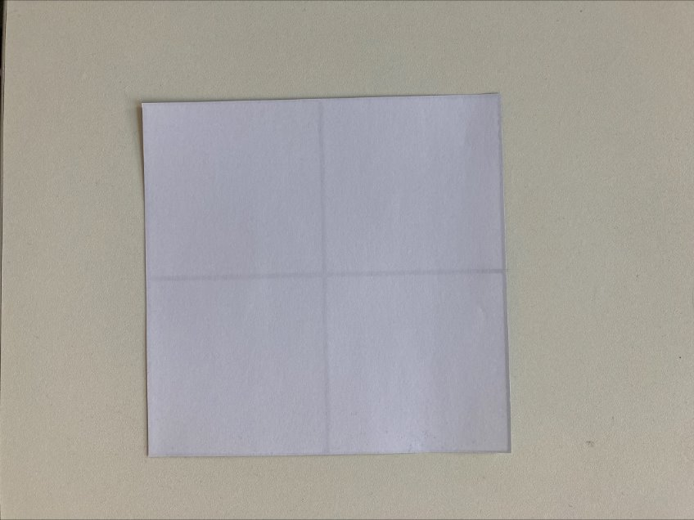
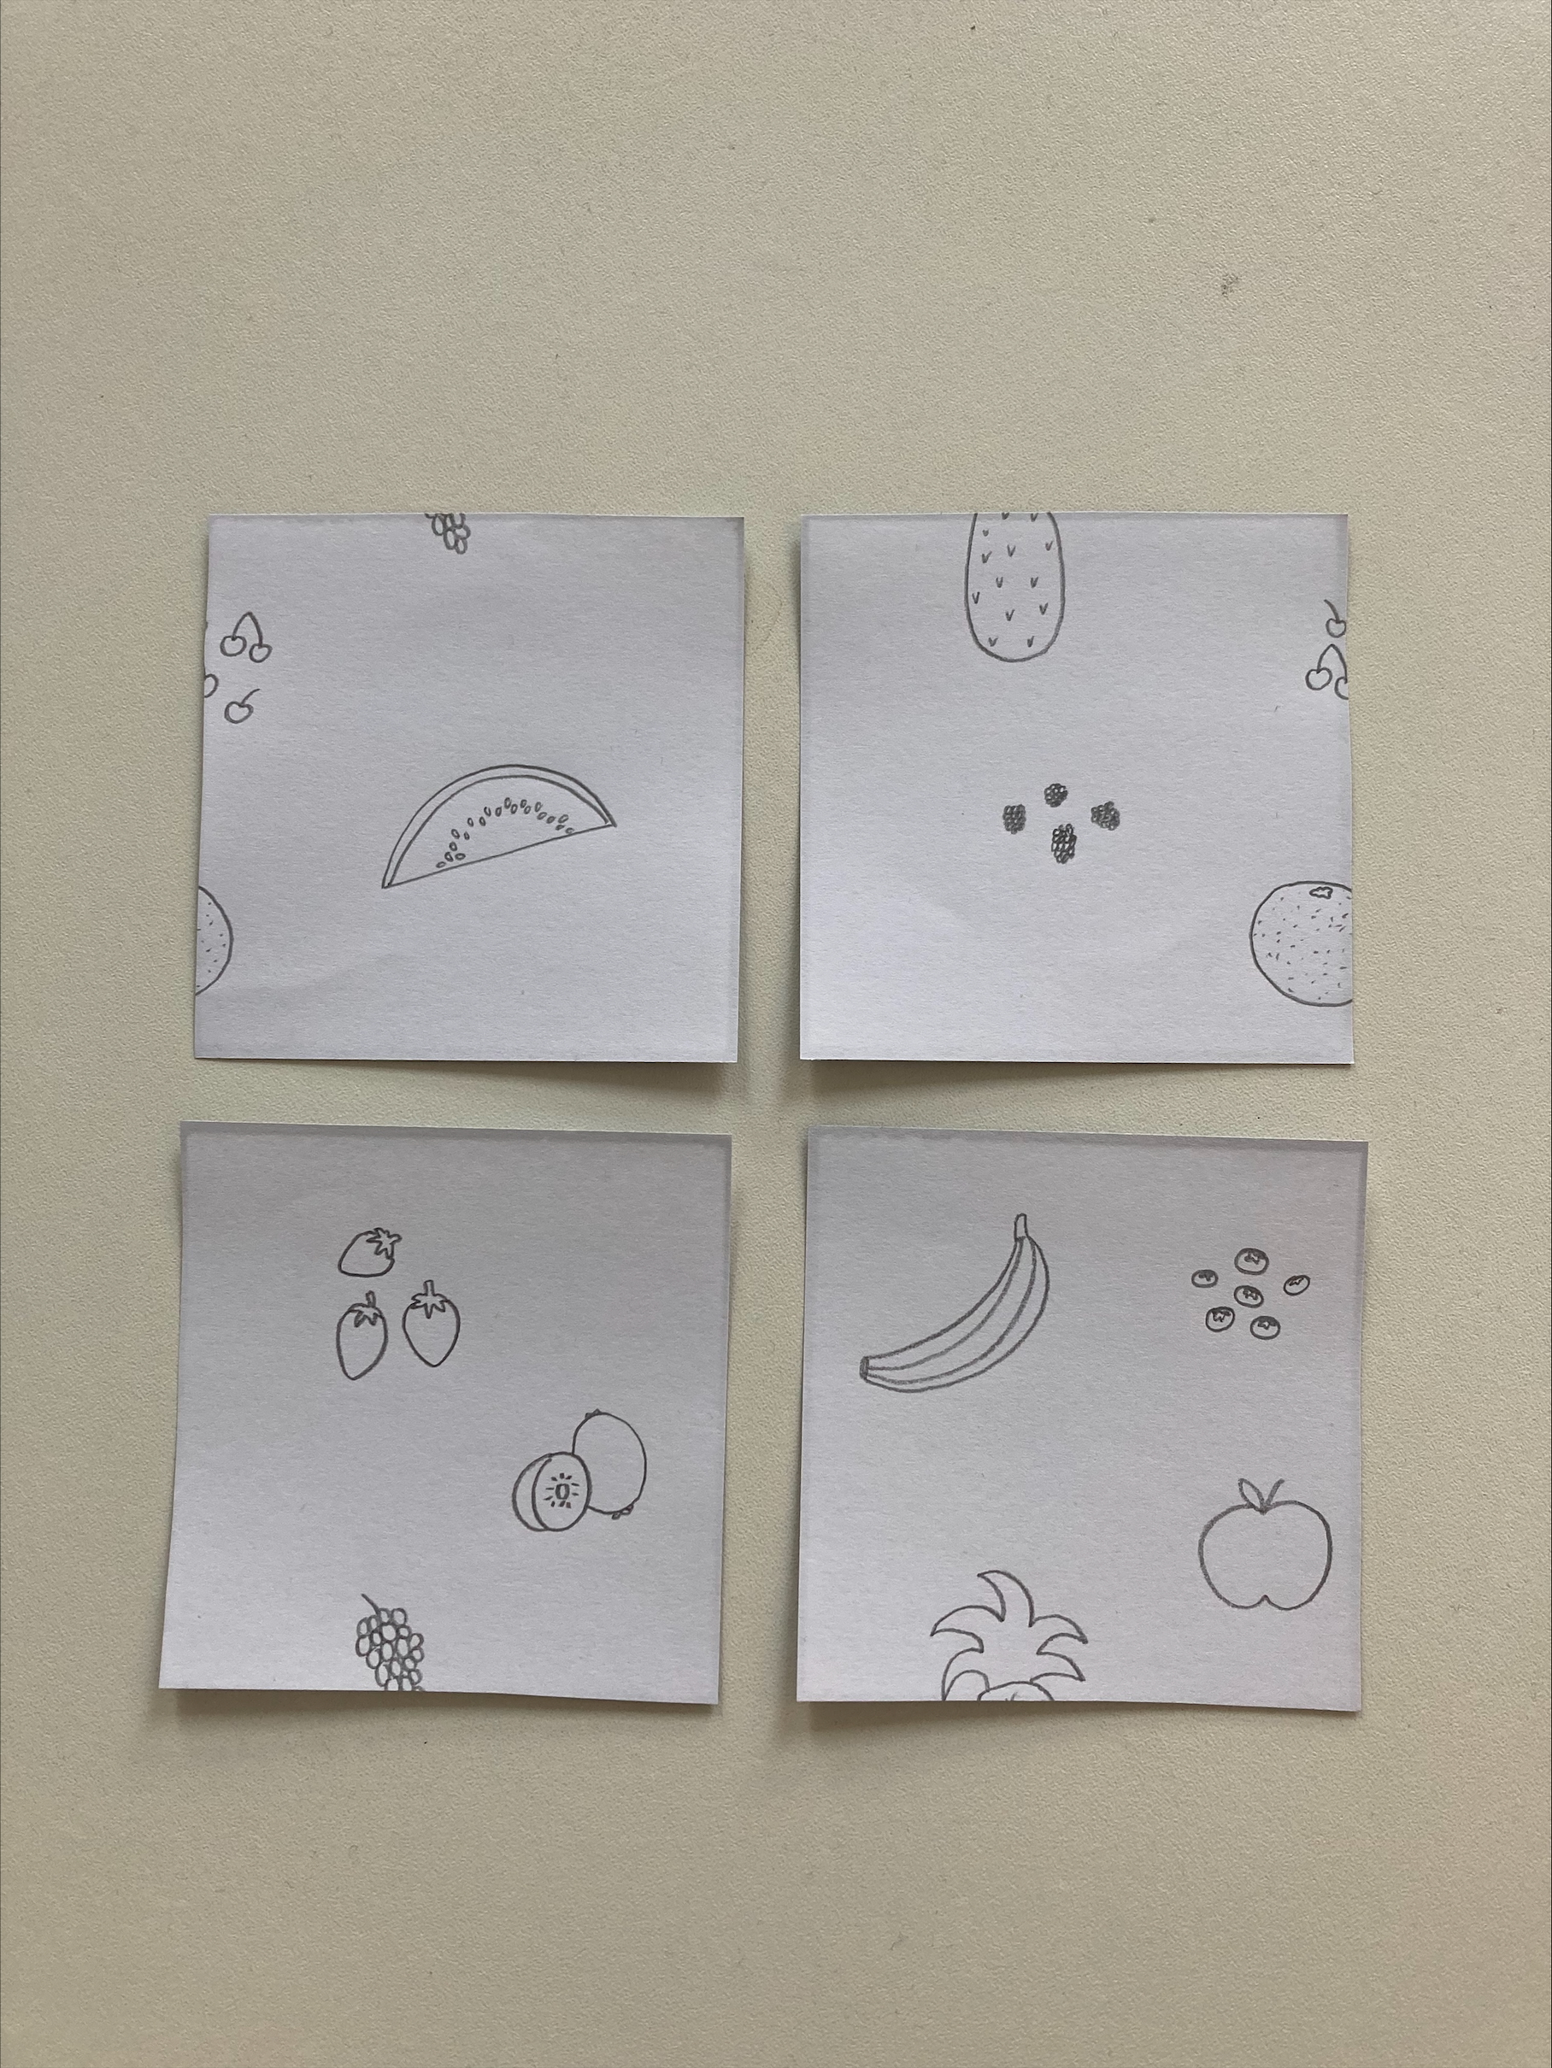
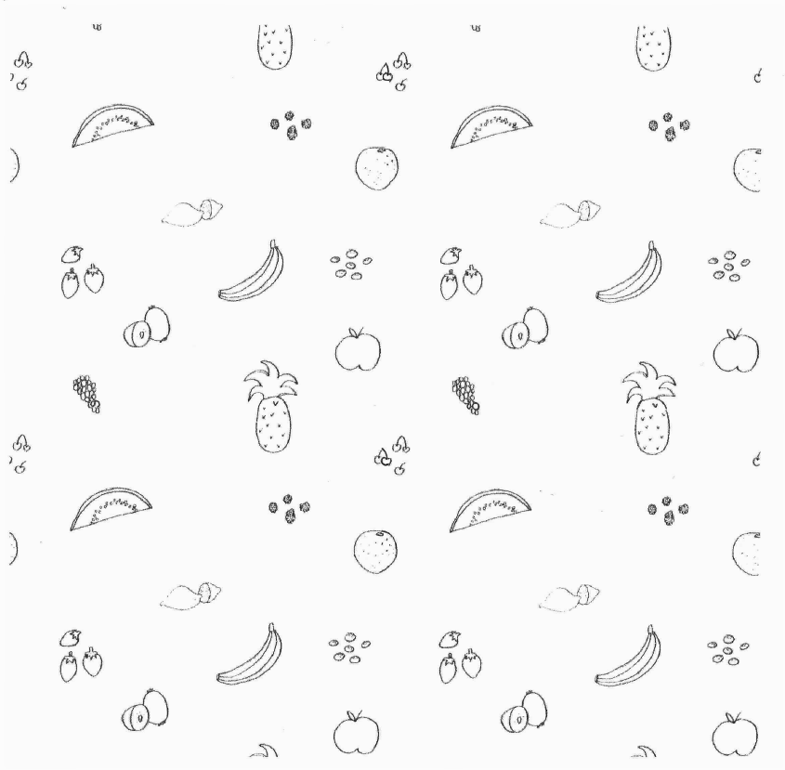
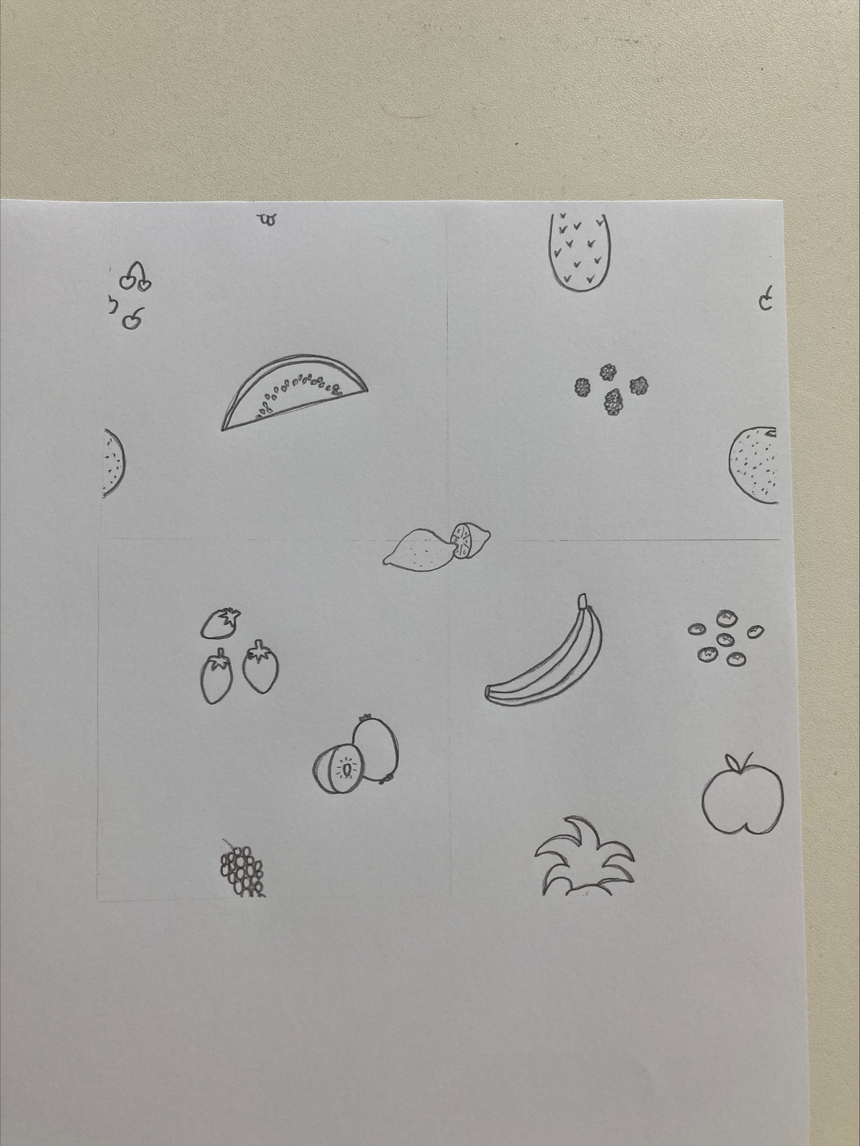
Create a repeating pattern tile
Start with a square piece of paper. | 2. Draw your design. | 3. Cut the paper into quarters, and swap the diagonal pairs.
4. Attach or scan together the pieces, and add a design in the middle. | 5. You now have a tile you can repeat seamlessly! | 6. Add colour to finish it off.
^{mylearning.org}

Slide 10
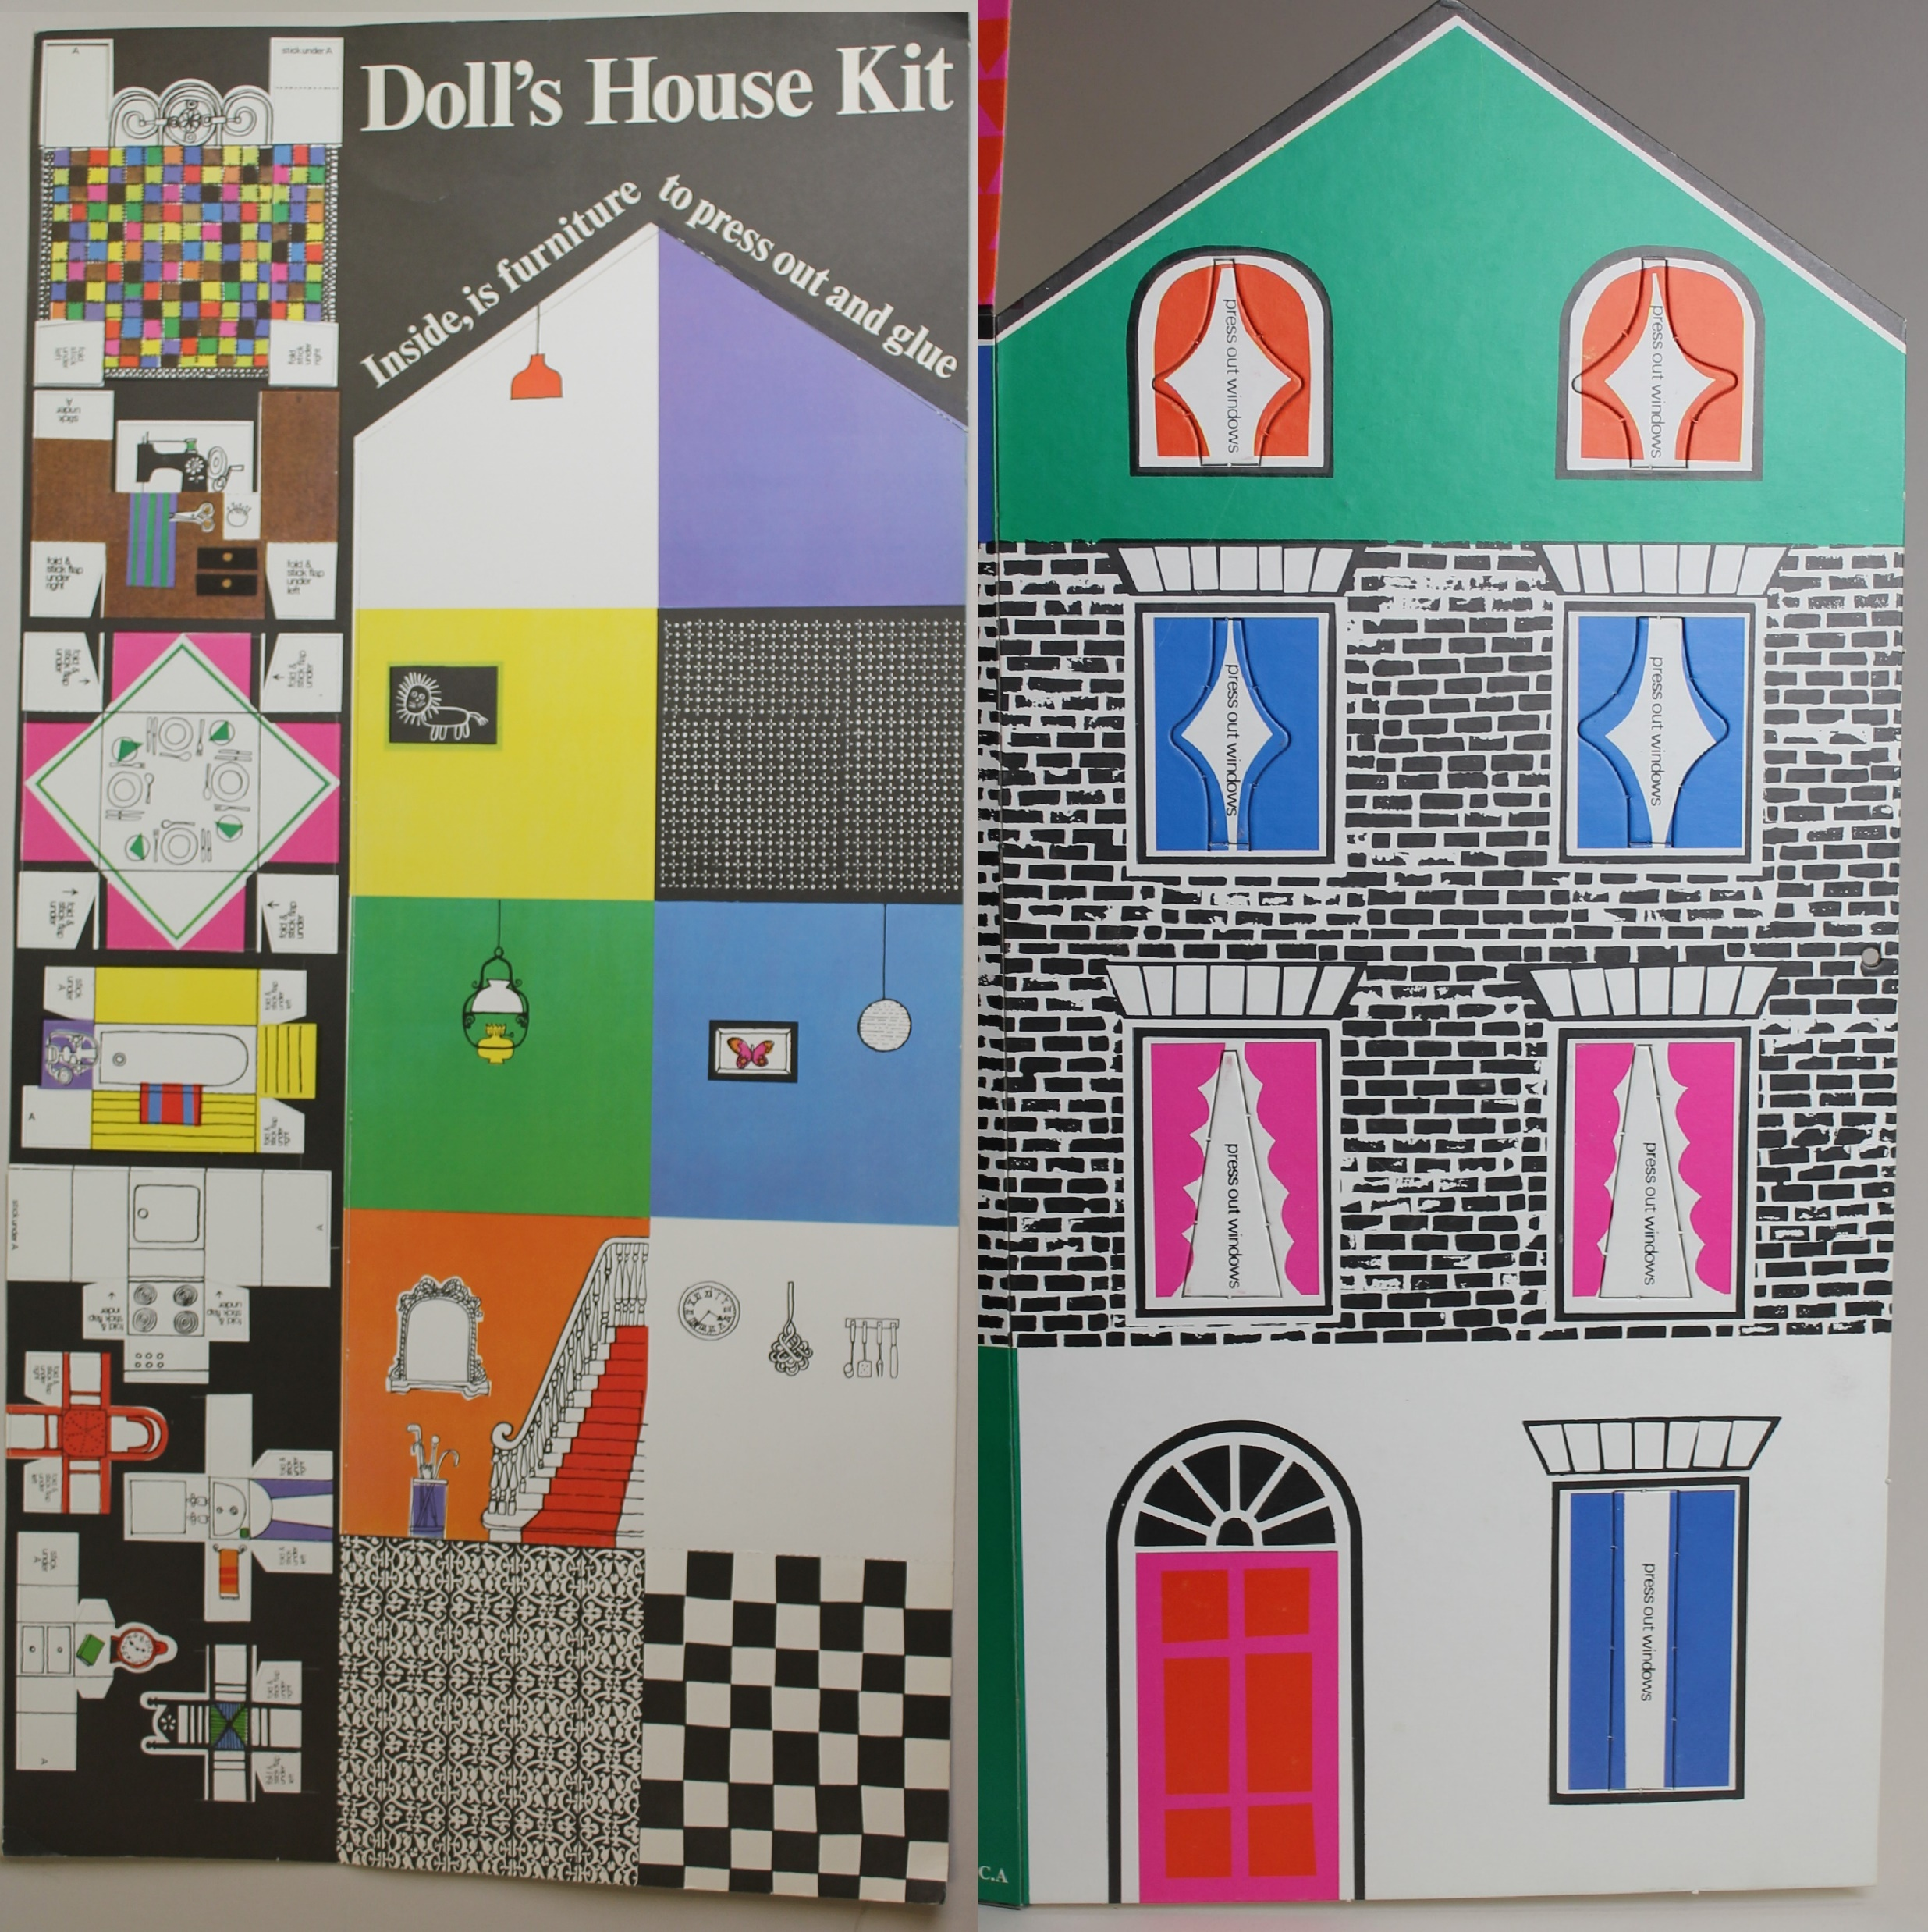
Patterns
Where can you see patterns in the design of the Maureen Roffey doll’s house?
Can you spot some tessellations?
Doll's House Pattern Hunt
When you design your own house, try to include some patterns and tessellations in your décor – you could think about bricks or tiles, floorboards or carpets, and wallpapers!
^{mylearning.org}

Slide 11
Symmetry
Year 4: identify lines of symmetry in 2-D shapes presented in different orientations
Year 5: identify, describe and represent the position of a shape following a reflection or translation, using the appropriate language, and know that the shape has not changed
^{mylearning.org}

Slide 12
Symmetry
What makes a shape symmetrical?
A shape is symmetrical if a line could be drawn down the middle of it, and either side would be a perfect reflection of the other. This could be in any direction, and the line is called the ‘line of symmetry’. This is sometimes called the ‘mirror line’ because if you placed a mirror on it, the reflection would complete the whole shape.
Can you find any symmetrical shapes in Maureen Roffey’s doll’s house design?
Do any of the shapes have more than one line of symmetry?
Doll's House Symmetry Hunt
^{mylearning.org}

Slide 13
Rotation
Year 2: use mathematical vocabulary to describe position, direction and movement, including movement in a straight line and distinguishing between rotation as a turn and in terms of right angles for quarter, half and three-quarter turns (clockwise and anti-clockwise)
Year 3: recognise that 2 right angles make a half-turn, 3 make three-quarters of a turn and 4 a complete turn
^{mylearning.org}

Slide 14
Rotation
Some patterns are made by using rotations. A rotation is a turn.
If you place your pencil into the middle of a piece of paper and hold it down in a fixed position, you can rotate or turn your paper around. After one full turn, 360 degrees, it will be back where it started. This is rotating the paper around its centre, and the paper stays in the same place (just in a different position).
You could also rotate the paper from a different point, for example if you placed the pen at the edge instead, or even from a point outside of the shape.
^{mylearning.org}

Slide 15
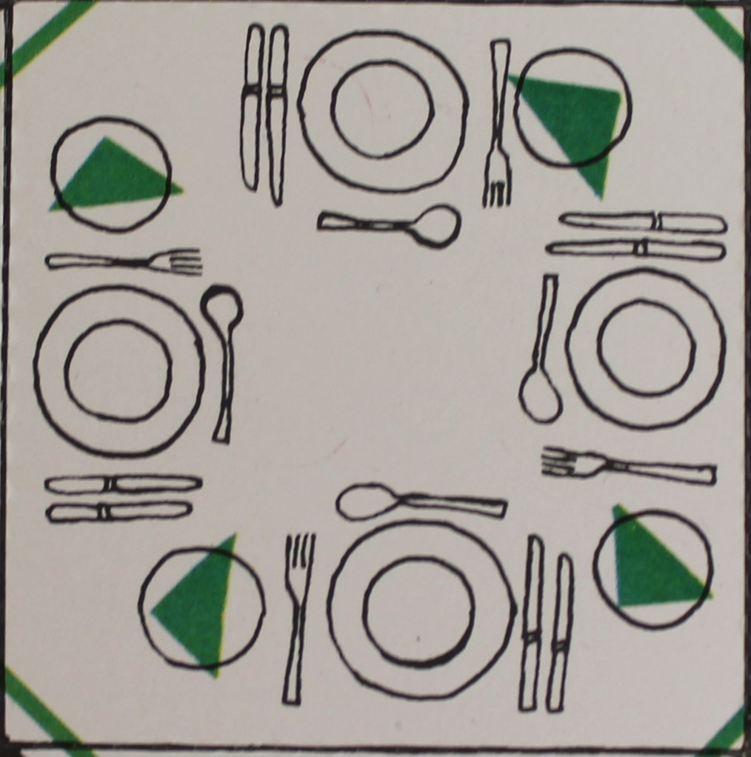
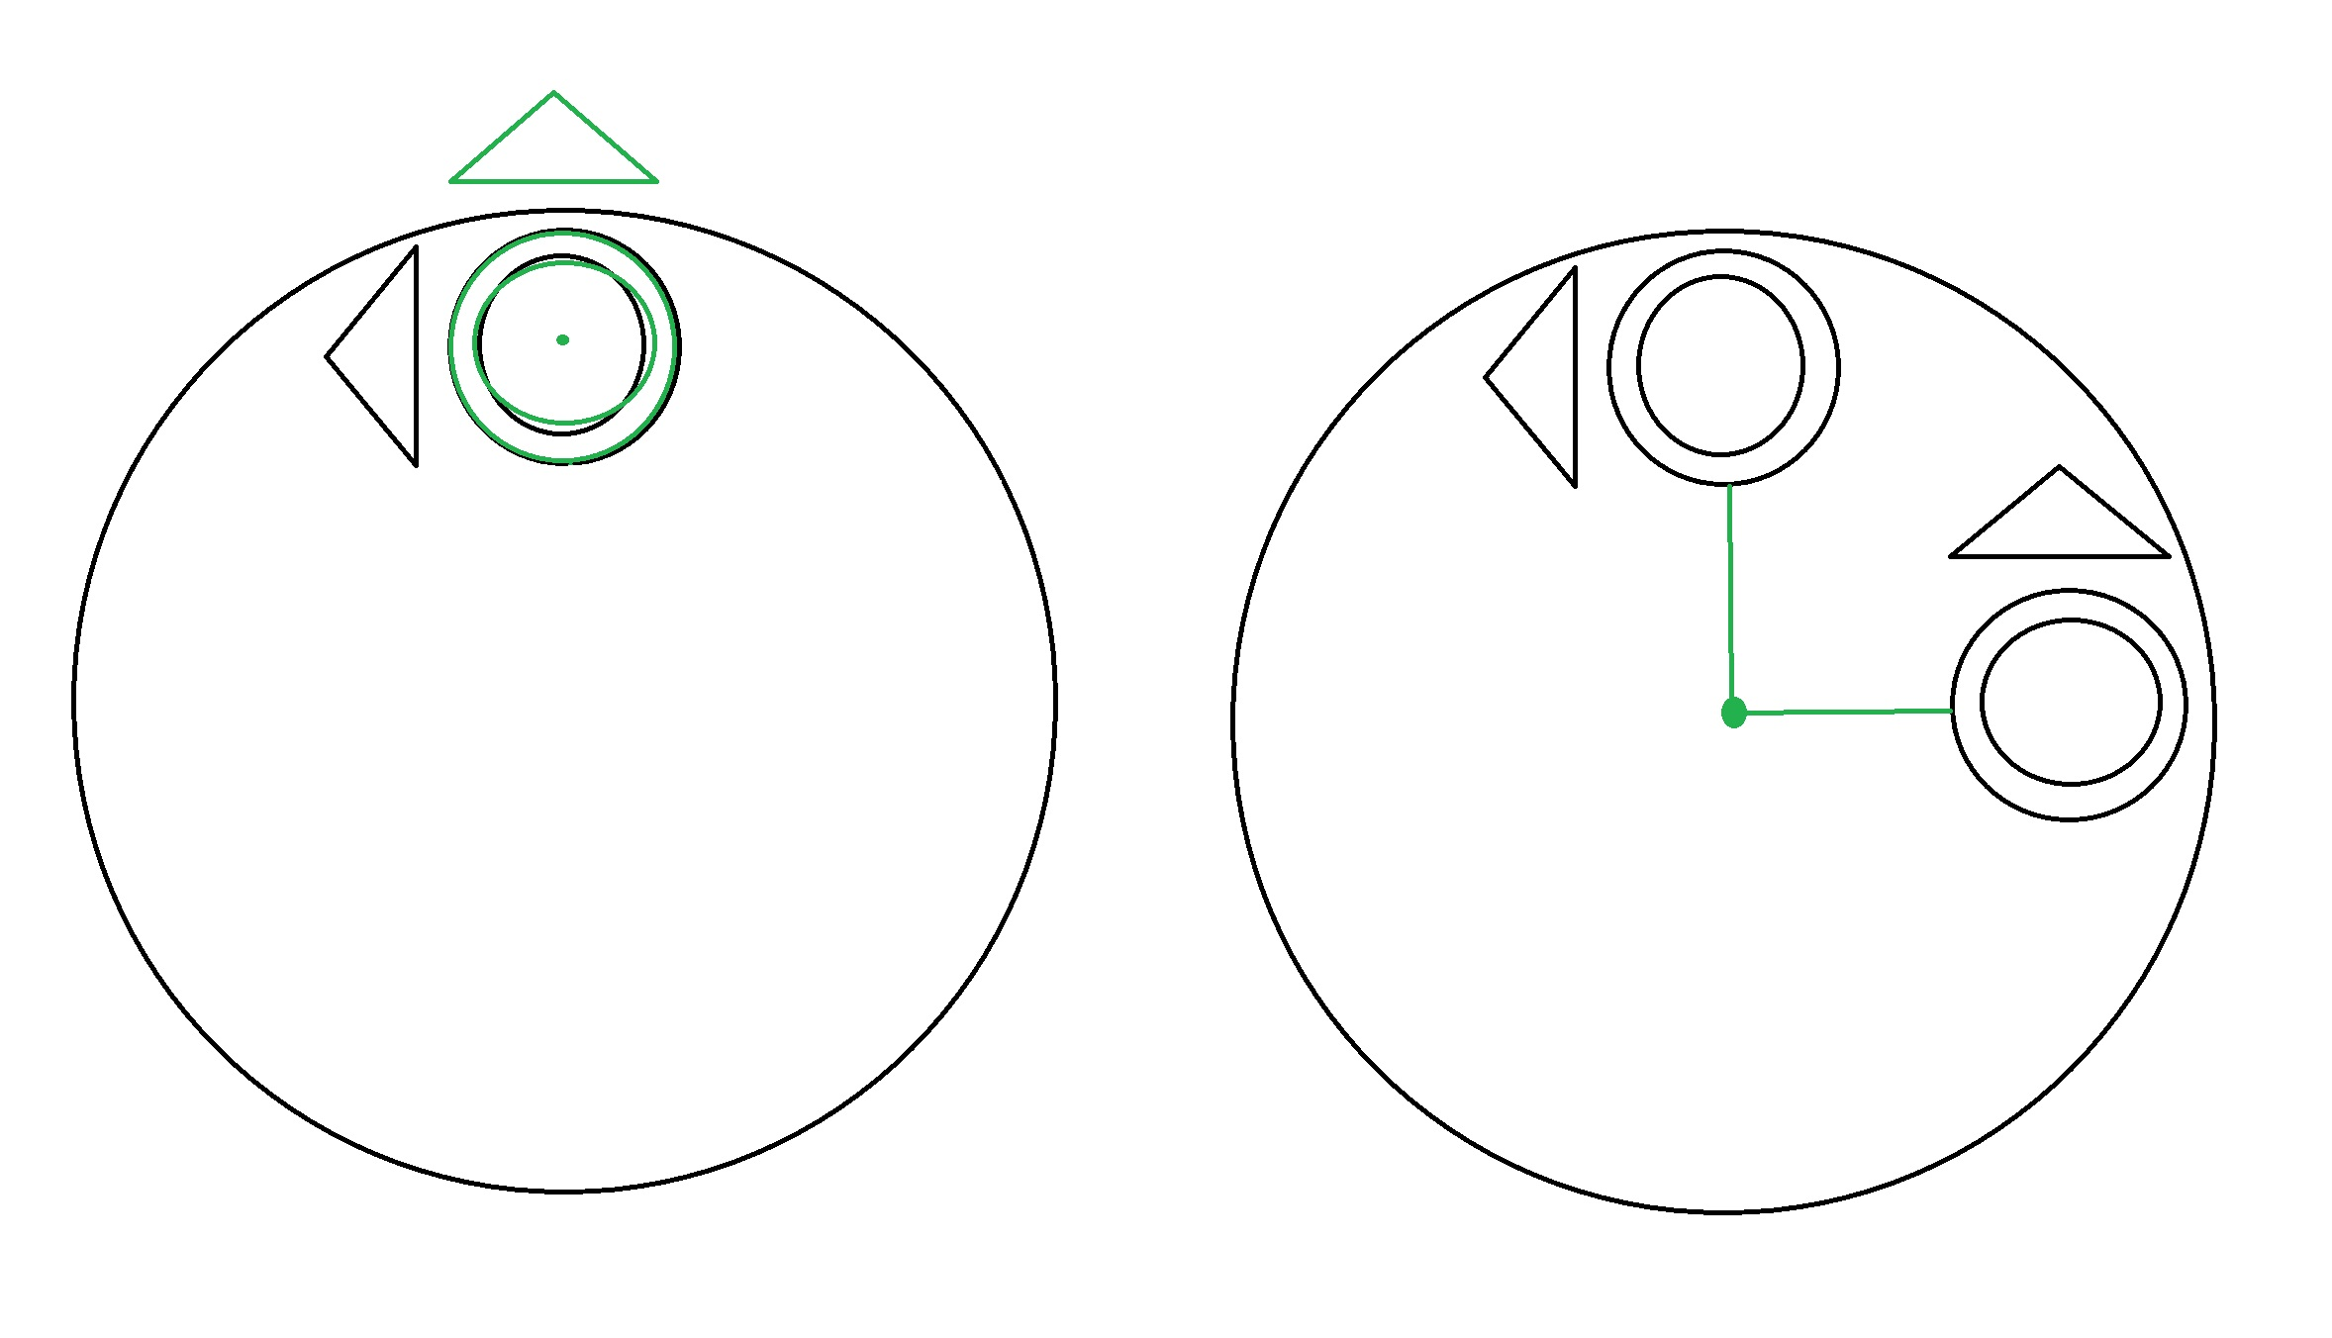
Rotation
Have a look at the place settings on the dining table. The plate, cutlery and napkin are repeated four times around the table, each one facing out. They have been rotated one quarter turn each time, with the middle of the table being the centre of the rotation. This allowed the plates to move to the different seats at the table, not just be rotated and stacked on the same spot!
^{mylearning.org}

Slide 16
Rotation
Are there any other uses of rotations in the doll’s house?
Can you think of any other places it could be used effectively?
Have a go at including rotations in your design.
^{mylearning.org}

Slide 17
Nets
Year 3: draw 2-D shapes and make 3-D shapes using modelling materials; recognise 3-D shapes in different orientations and describe them
Year 5: identify 3-D shapes, including cubes and other cuboids, from 2-D representations
Year 5 Non-statutory Guidance: Pupils become accurate in drawing lines with a ruler to the nearest millimetre, and measuring with a protractor. They use conventional markings for parallel lines and right angles
Year 6: recognise, describe and build simple 3-D shapes, including making nets; draw 2-D shapes using given dimensions and angles
Year 6 Non-statutory Guidance: Pupils draw shapes and nets accurately, using measuring tools and conventional markings and labels for lines and angles.
^{mylearning.org}

Slide 18
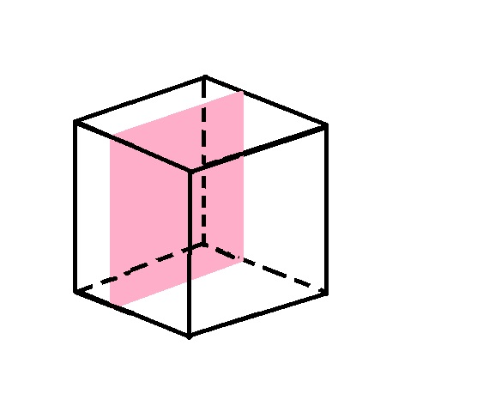
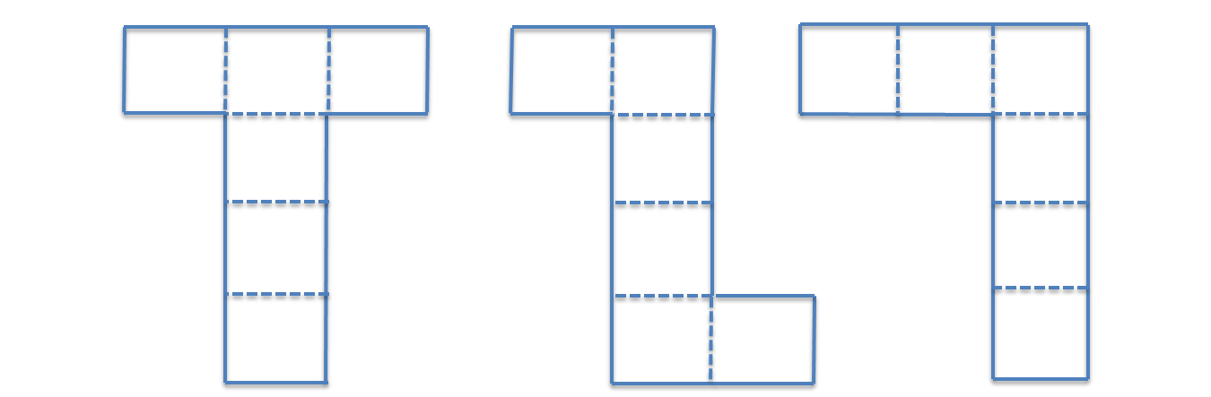
Nets – What is a net?
The net of a 3D shape is what it would look like if it was unfolded and laid flat.
There are many types of nets for the different 3D shapes.
A net is made from polygons (2D shapes with straight sides) that can be folded and joined to make a polyhedron (a 3D shape with polygon faces).
Some examples of polyhedrons are cubes, cuboids and prisms.
Cones and spheres are not polyhedrons as their faces are not polygons – they are curved.
This is a cube and some examples of nets which could be folded to make a cube.
^{mylearning.org}

Slide 19
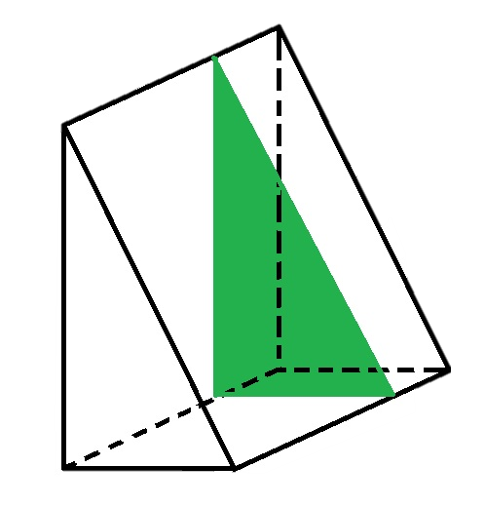
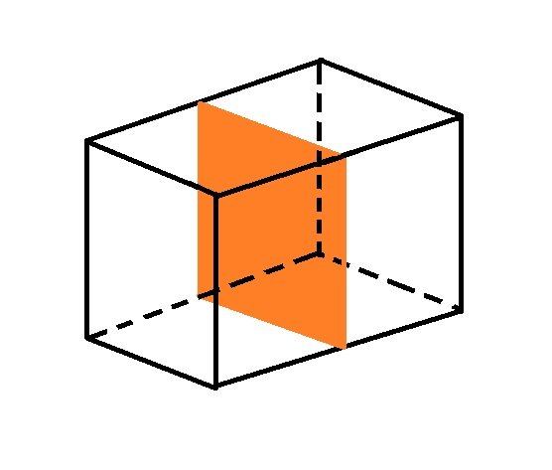
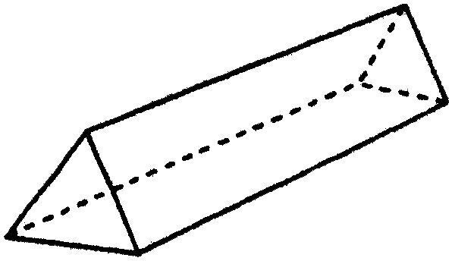
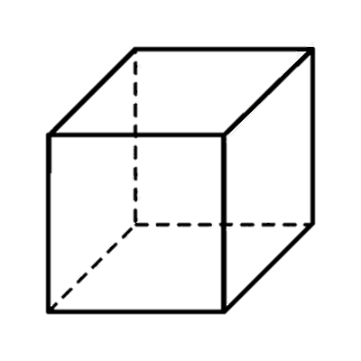
Nets - Prisms
A prism is any shape where its two opposite ends are equal shapes, called bases, and the sides in between these bases are parallelograms. Parallelograms are quadrilaterals with two pairs of parallel sides – so squares and rectangles are also parallelograms. You can see that this shape above is a prism, as its ends are equal shapes (triangles) and the other sides joining these ends are three rectangles. It would be called a triangle-based prism.
Prisms should have the same cross-section all the way along – meaning if they were cut at any point along their length, the shape revealed inside was exactly the same as the bases.
^{mylearning.org}

Slide 20
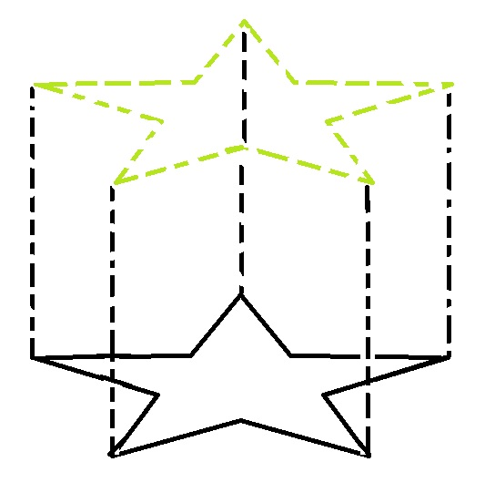
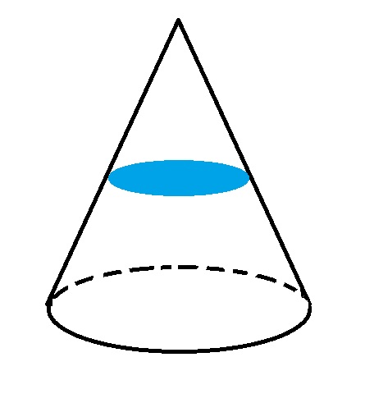
Nets - Prisms
You could draw a shape (made of straight lines) on a piece of paper, and imagine it extending up out of the page. That would be a prism!
You can see that a cone could not be a prism, because its cross section is not the same size as its ends.
^{mylearning.org}

Slide 21
Nets – Maureen Roffey's Doll's House
Maureen Roffey’s doll’s house uses a net to create a 3D doll’s house.
Thinking about what we have learned about polyhedrons, what do you think the proper shape name is of the doll’s house?
We will work it out together on the next slide.
^{mylearning.org}

Slide 22
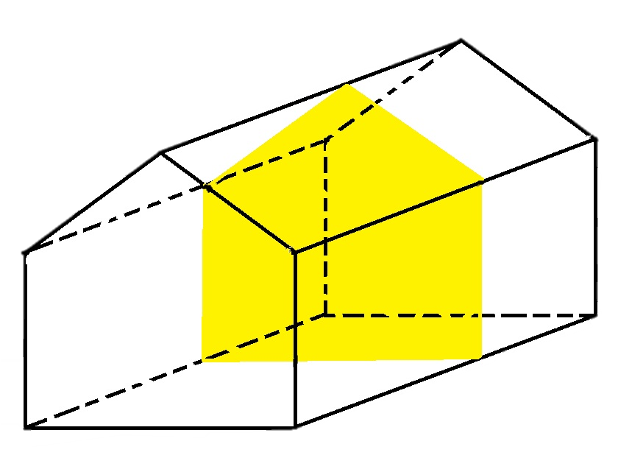
Nets – Maureen Roffey's Doll's House
The front face (called a base) is a five-sided shape. The angles and lengths are not equal. This is an irregular pentagon.
The faces between the bases are rectangles. They have two sets of parallel sides so are parallelograms.
This means the doll’s house shape is an irregular pentagonal prism.
^{mylearning.org}

Slide 23
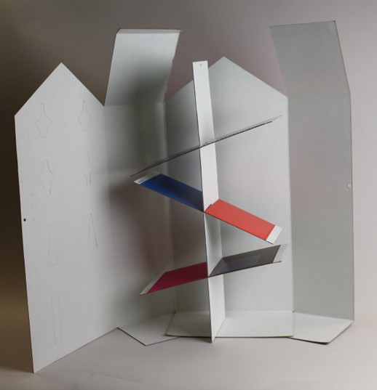
Nets – Maureen Roffey's Doll's House
Maureen Roffey's doll's house net perfectly creates a house shape. She then included extra pieces which slotted together to make floors inside, as well as lots of decoration to stick in, such as floors and wallpaper, and other nets to create furniture.
You are going to create your own miniature house from a net. It will have a house shape, and some floors to stick inside.
First, you will decorate the insides of the house, then cut it out so you can decorate the outside which is on the back.
^{mylearning.org}

Slide 24
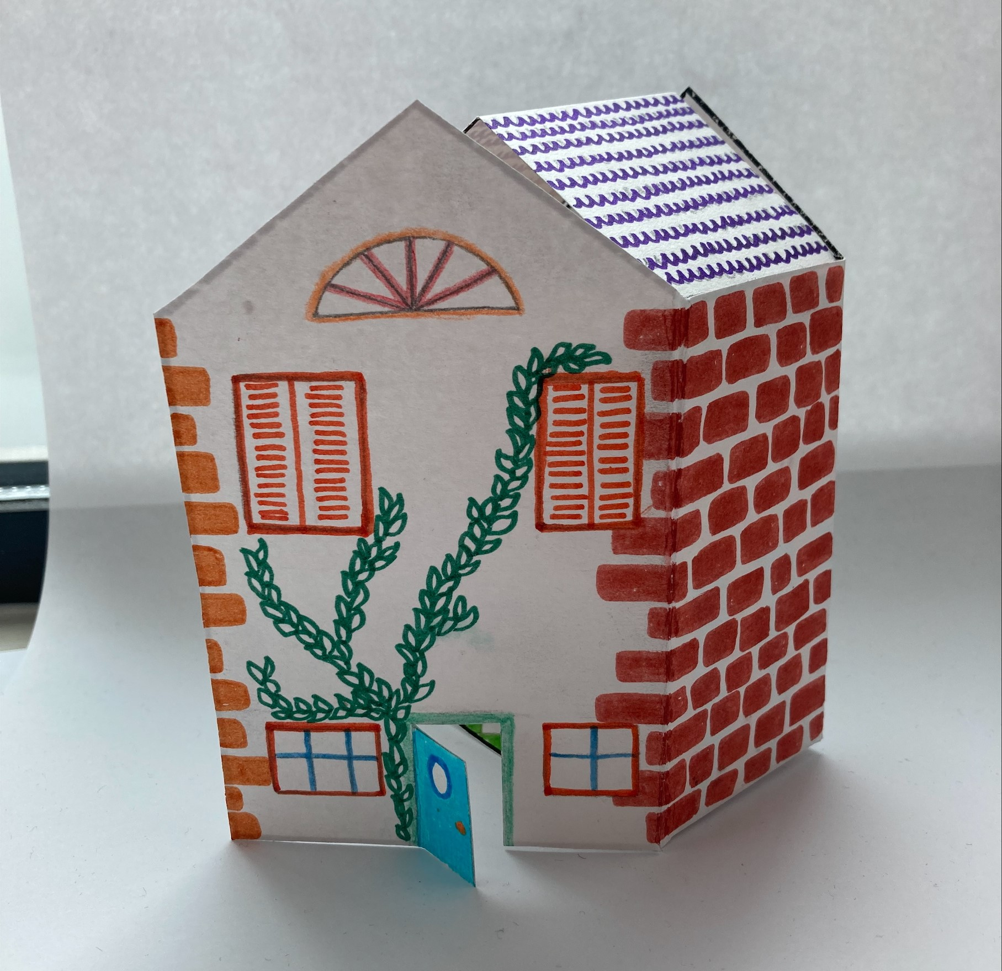
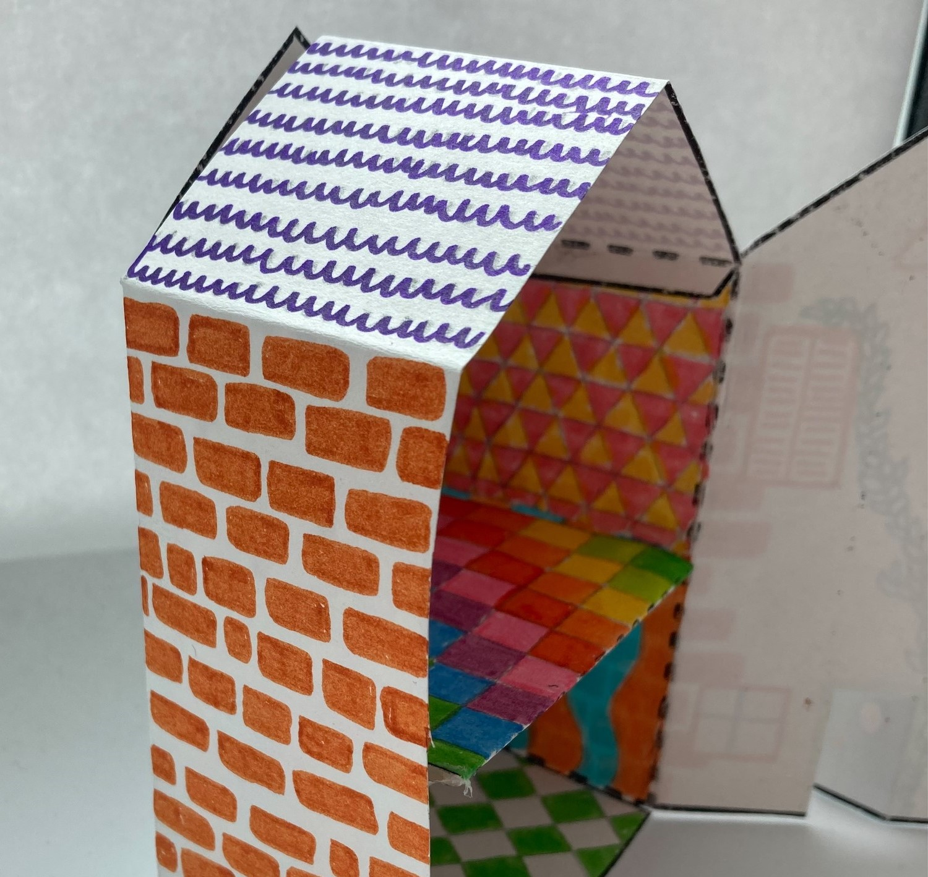
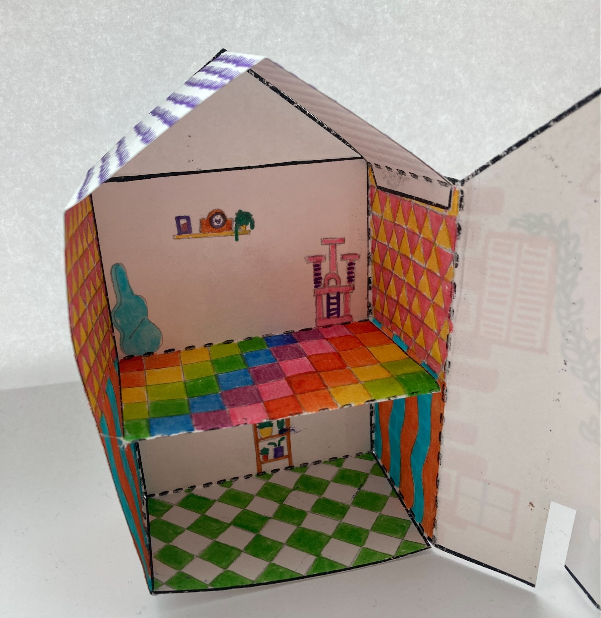

Slide 25

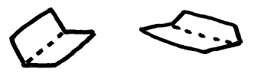

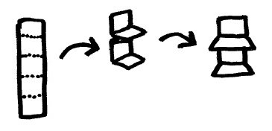
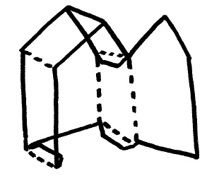
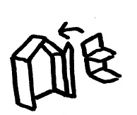
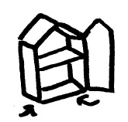
Nets - Instructions
Decorate the inside of your house, following the guide on the next slide. | 2. Cut out the solid lines. | 3. Fold the dotted lines.
4. Open out and decorate the outside of the house. | 5. Create the floors to go inside. | 6. Fold the house fully and glue the roof tab to the opposite inside wall.
7. Glue the walls inside the house to create the floors. | 8. Stick the side wall tabs to the base of the house. | 9. Well done!

Slide 26
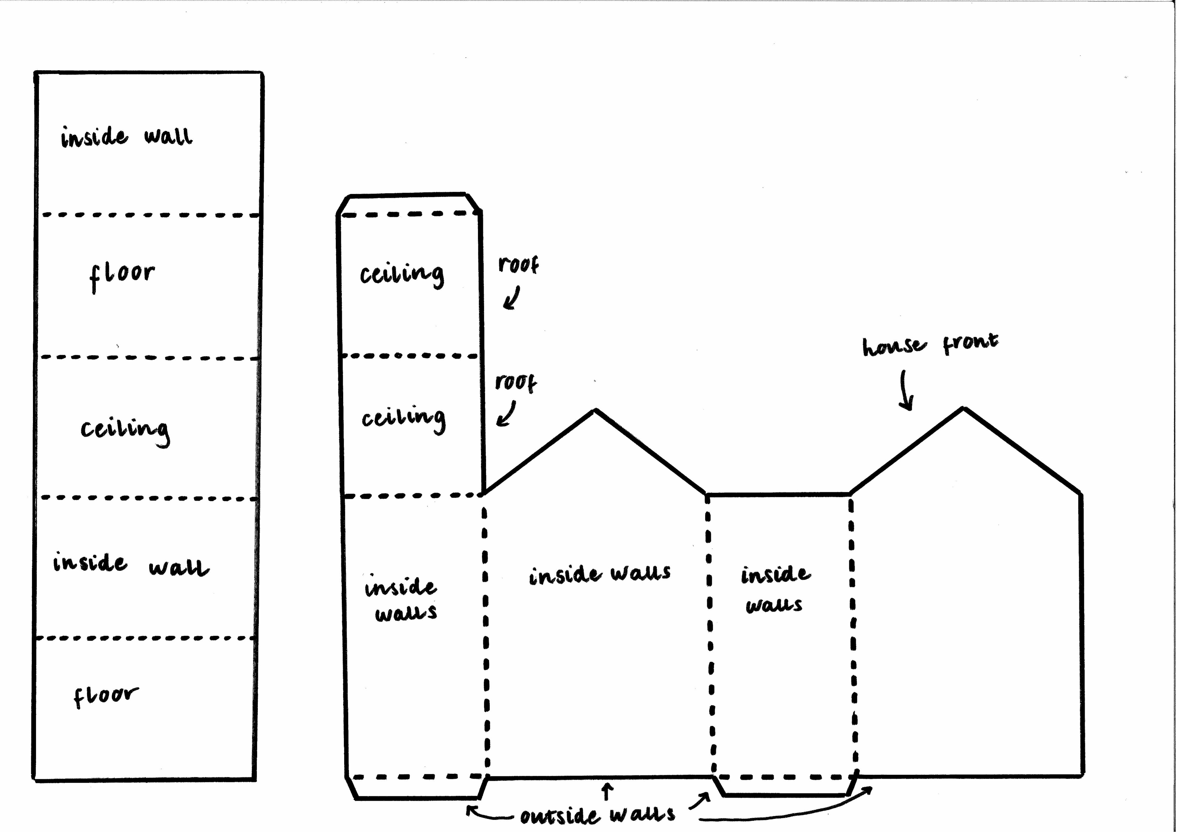
Nets – Design Guide
Arrows indicate what is on the reverse side of the section.

Slide 27
Nets - Extension
You could design your own net to create a different building.
It could be a different doll’s house, garden shed, shop or whatever you like!
You will need a ruler, a pencil and some scrap paper to begin your calculations.
You could start by measuring the net template as a guide.
^{mylearning.org}

