Slide 1
Streets of London 1870-1900
Mapping life in Victorian Covent Garden
A Resource using the Charles Booth London Poverty Maps and Photographs from Street Life in London (1870)
Images and archive material used belong to LSE Library, unless otherwise stated. This is an open access resource under the terms of the Creative Commons Attribution-NonCommercial-ShareAlike 4.0 International (CC BY-NC-SA 4.0) License, which permits use, distribution and reproduction in any non-commercial medium, provided the original work is properly cited.
lse.ac.uk/library
@LSELibrary
Library
Notes:
1
Theme: partnership working
Case Study: LSE Library using partnerships to build schools and public engagement programme
Hello
Thank you for the invitation and opportunity to share our recent work with you
I am Maria Bell
Learning and Engagement team at LSE Library
Background – libraries and learning – information / digital literacy – now includes school and public engagement.

Slide 2
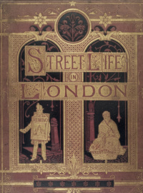
Life in the Streets of London
John Thomson was a talented and influential photographer, who had spent ten years travelling in, and taking photographs of, the Far East.
Adolphe Smith was a socialist journalist and they worked together on a project to photograph the street life of the London poor.
The volumes were published in monthly parts as Street Life in London in 1870 and were an early example of social and documentary photography.

Slide 3
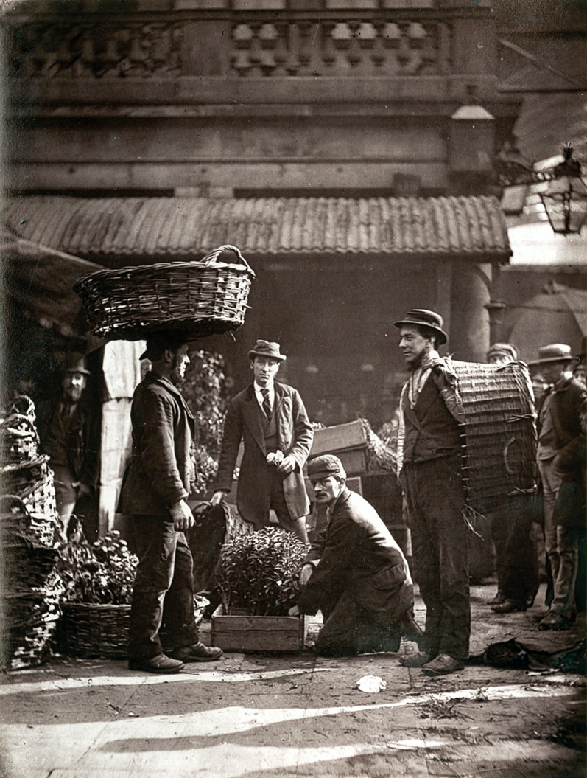
Covent Garden – Labourers in early morning

Slide 4
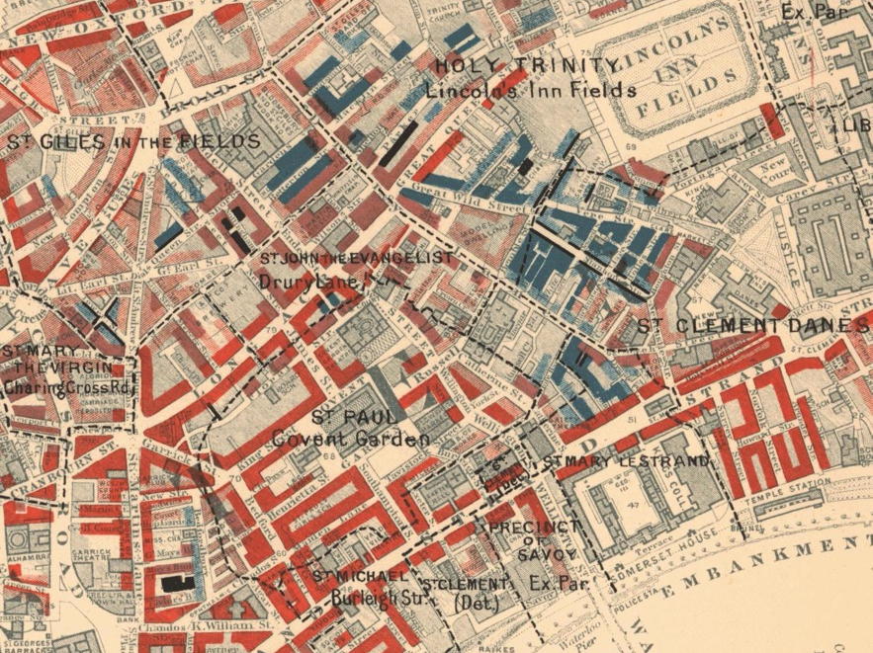

Slide 5
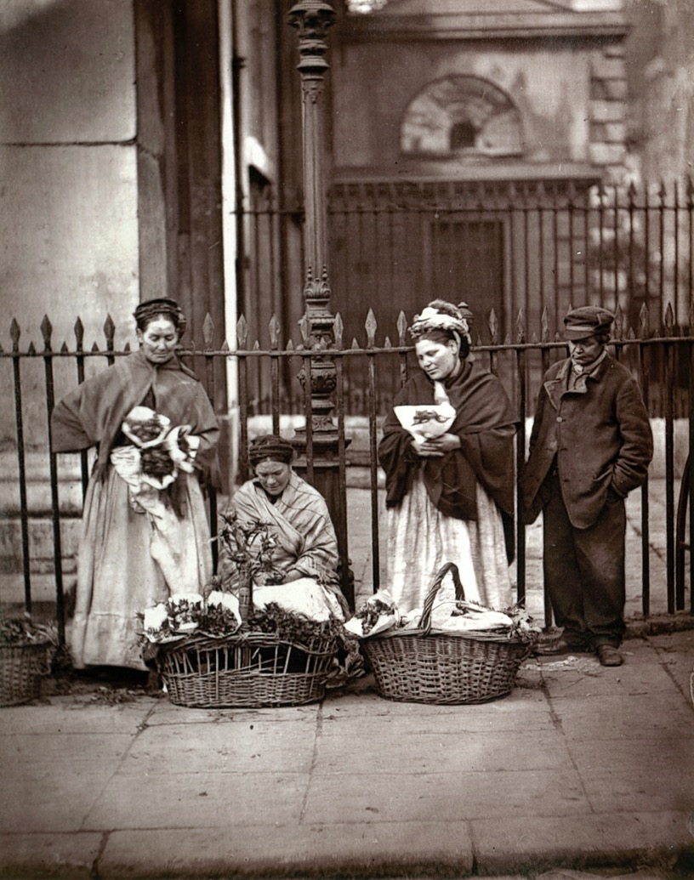
Flower Girls, outside the church of St Pauls in Covent Garden

Slide 6
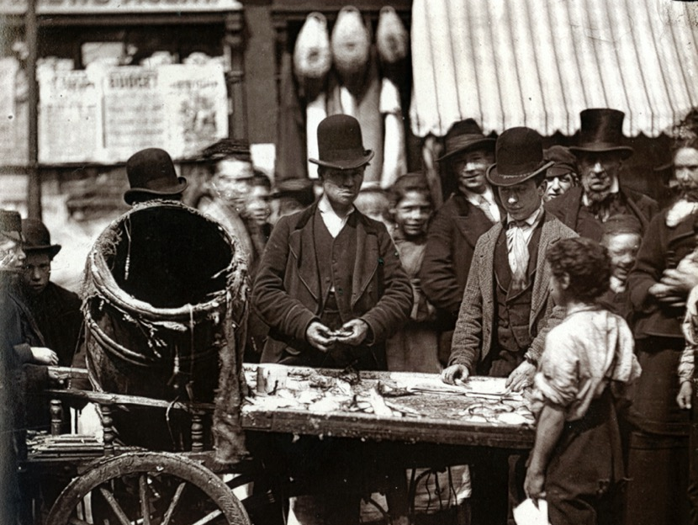

Slide 7
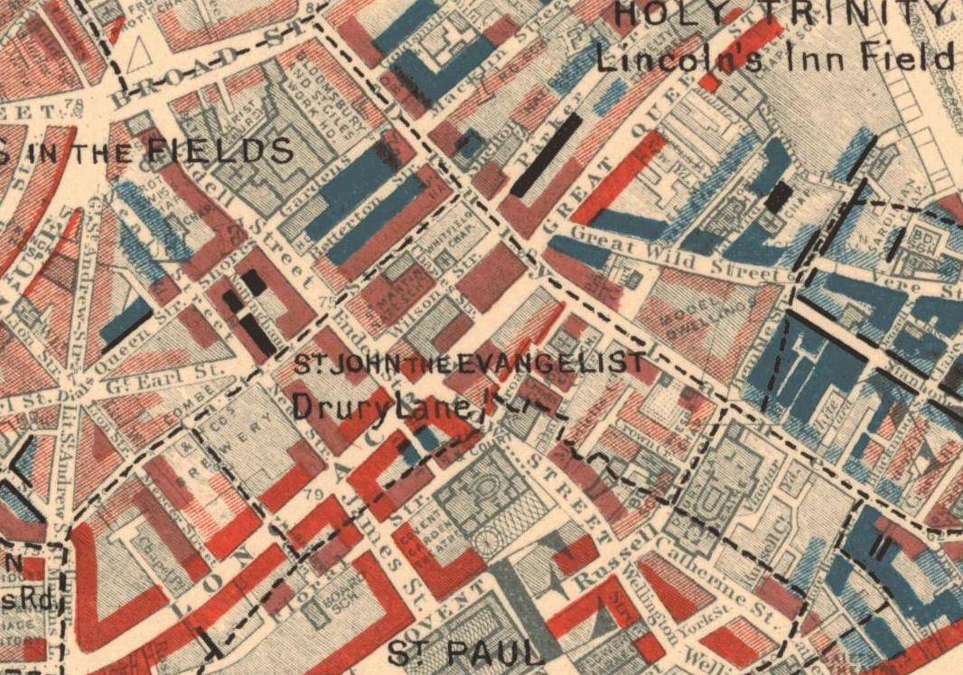

Slide 8
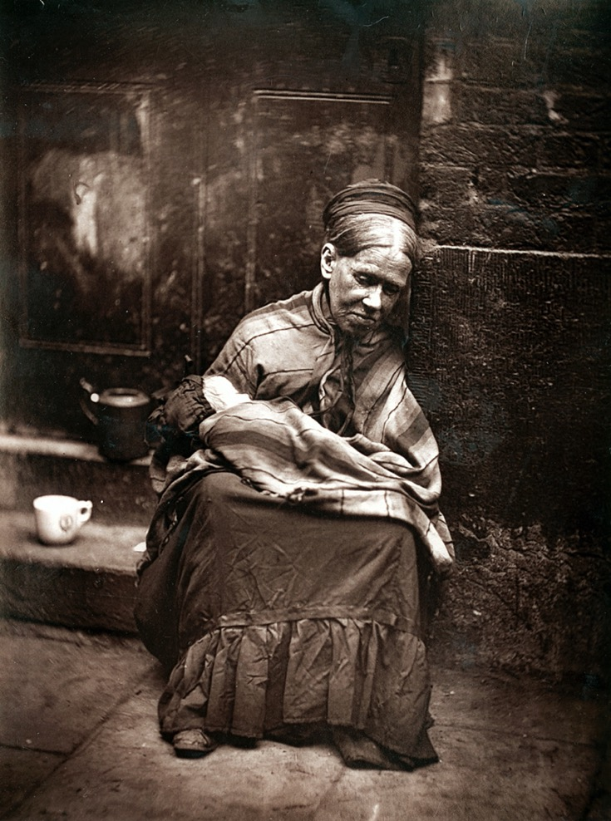
The ‘Crawler’ on the stairs of the workhouse on Endell Street

Slide 9
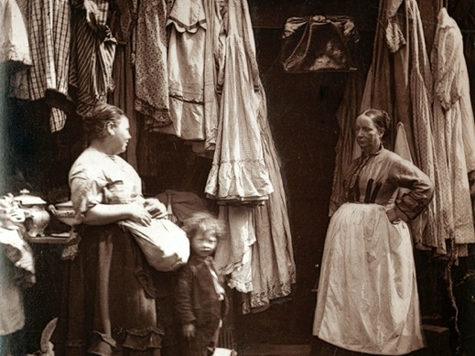

Slide 10
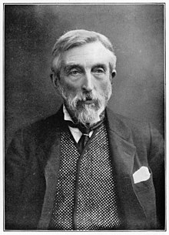
Charles Booth: Philanthropist and Social Reformer

Slide 11
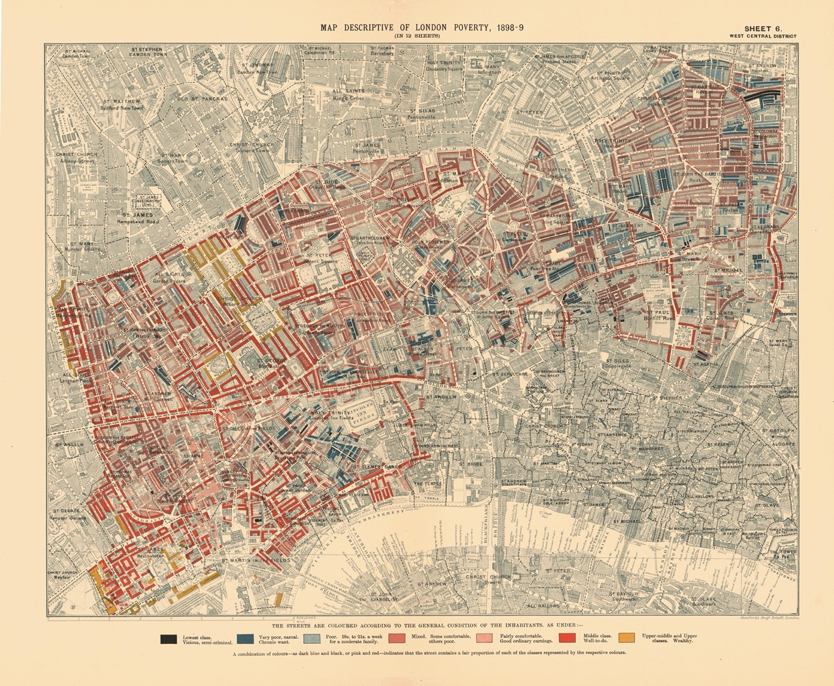

Slide 12
The Social Pyramid
Classification Colour
Lowest class. Vicious, semi-criminal. Black
Very poor, casual. Chronic want. Dark blue
Poor. 18s.- 21s. a week for a moderate family. Light blue
Mixed. Some comfortable others poor. Purple
Fairly comfortable. Good ordinary earnings. Pink
Middle class. Well-to-do. Red
Upper-middle and upper classes. Wealthy. Yellow

Slide 13
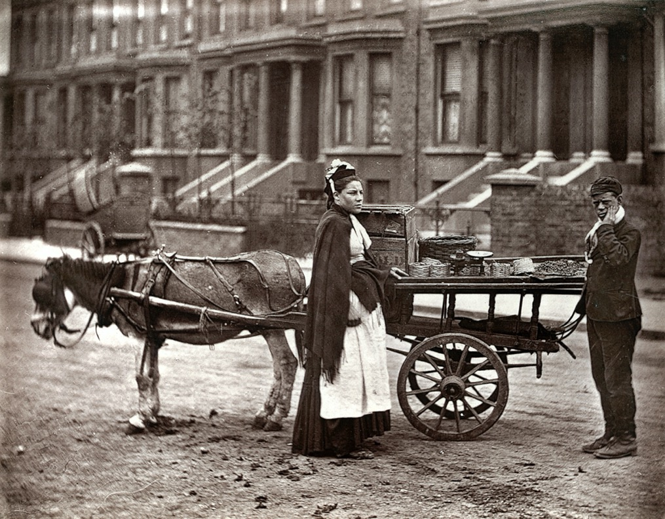
Strawberry Sellers

Slide 14
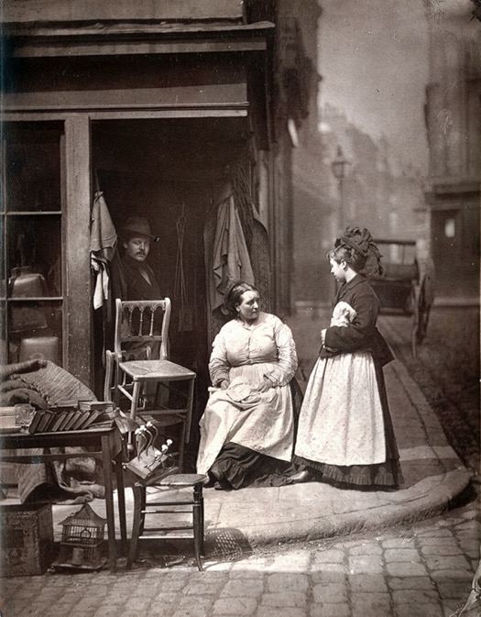
Furniture Shop
About to be demolished in 1870 as too near growing shopping area

Slide 15
