Slide 1
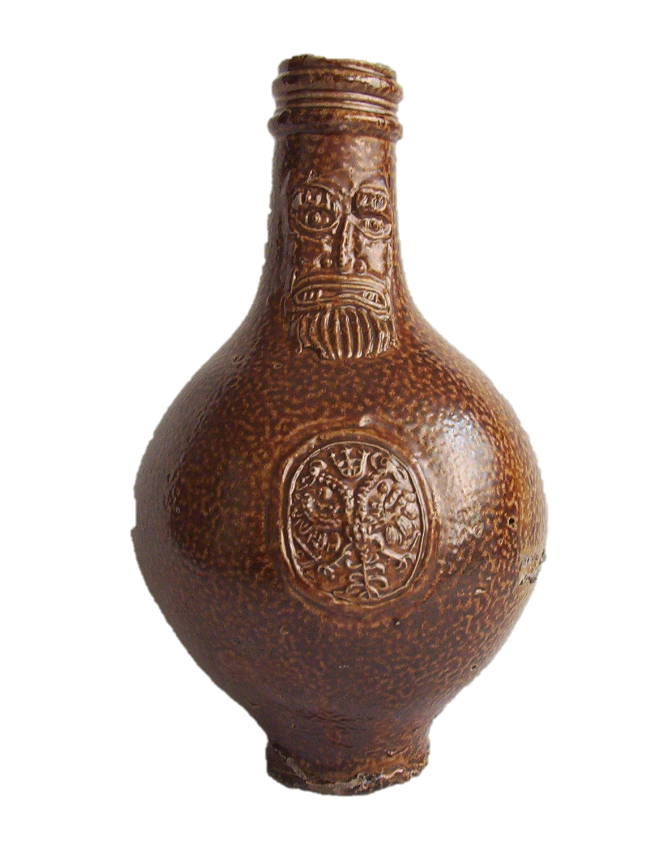
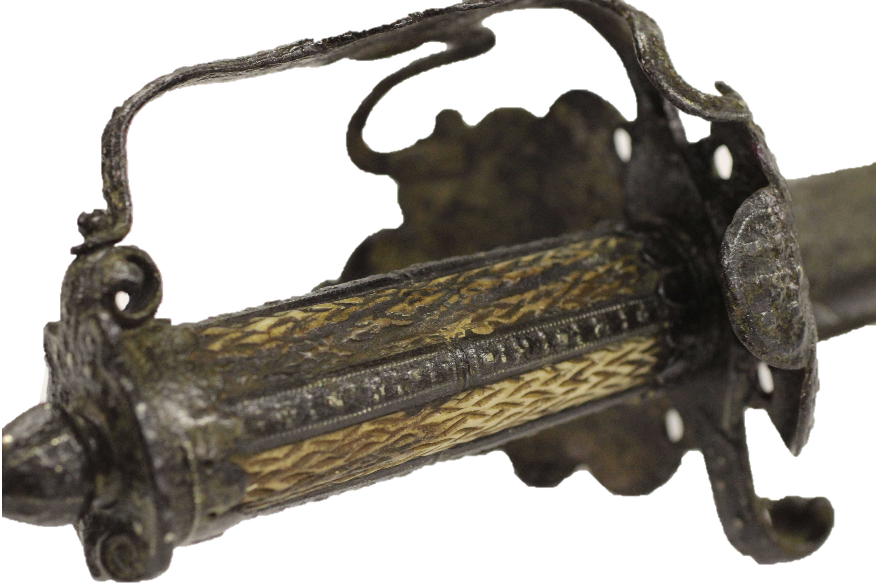

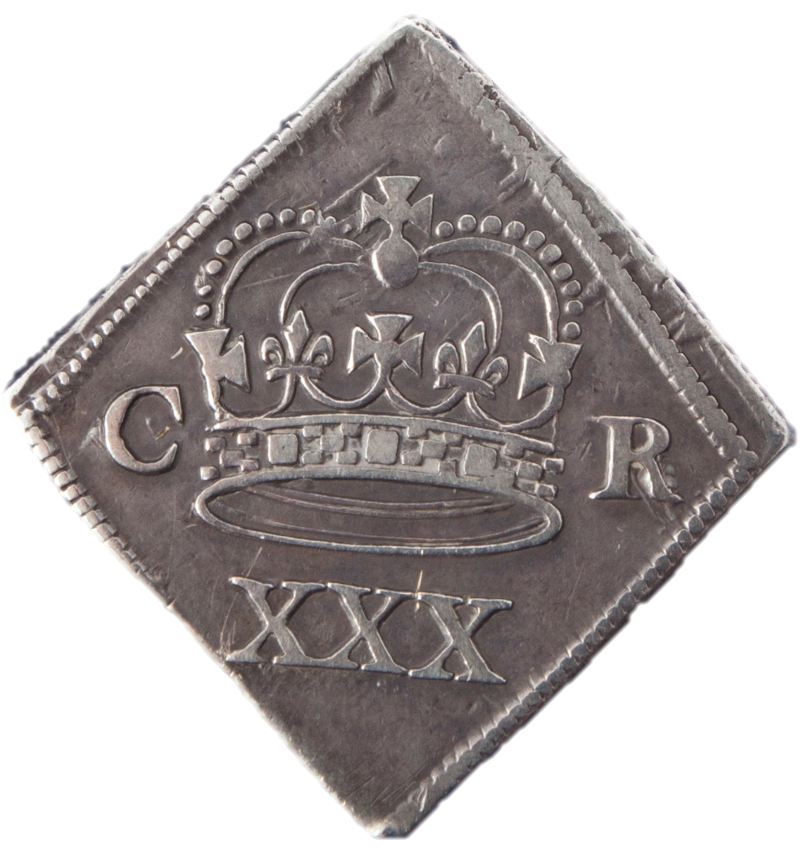


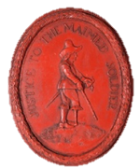
Sieges

Slide 2
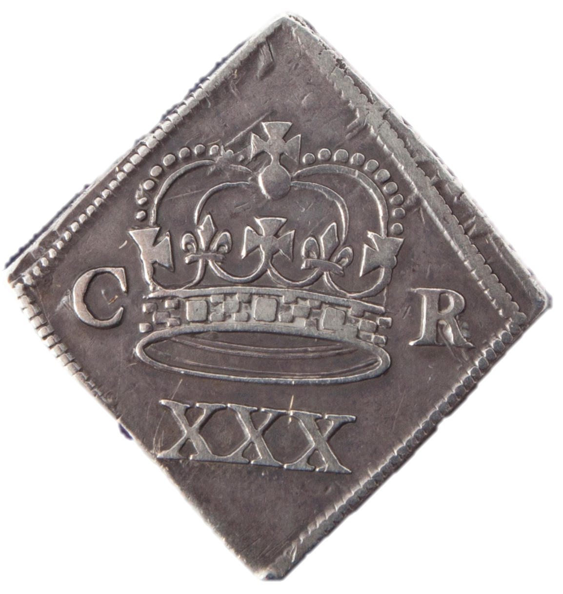
Finding out out about the past from objects
We can use the things people left behind to find out about what happened in the past.
Use the ‘Star Object’ Sheet to help you look closely at these objects.
Use the following activities to find out what stories these objects can tell.

Slide 3
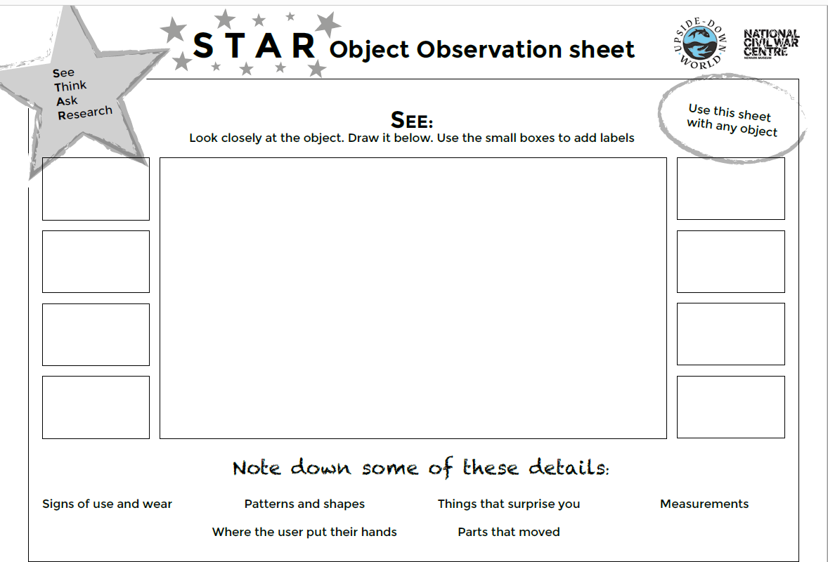

Slide 4
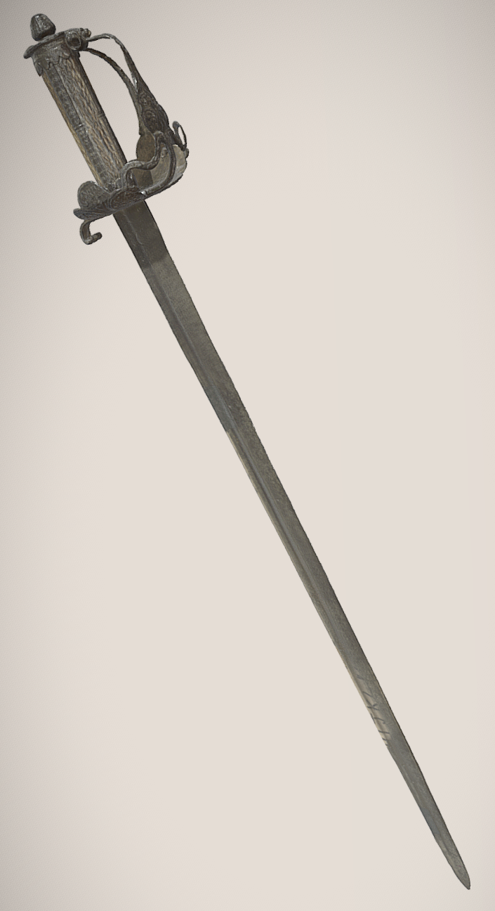
These objects were found in or near Newark, Nottinghamshire. Click on an object to study it closely.

Slide 5
Now click on each object to find its activities

Slide 6
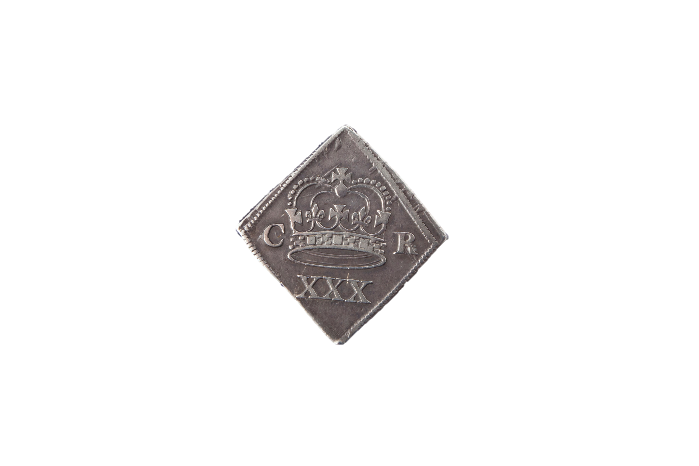
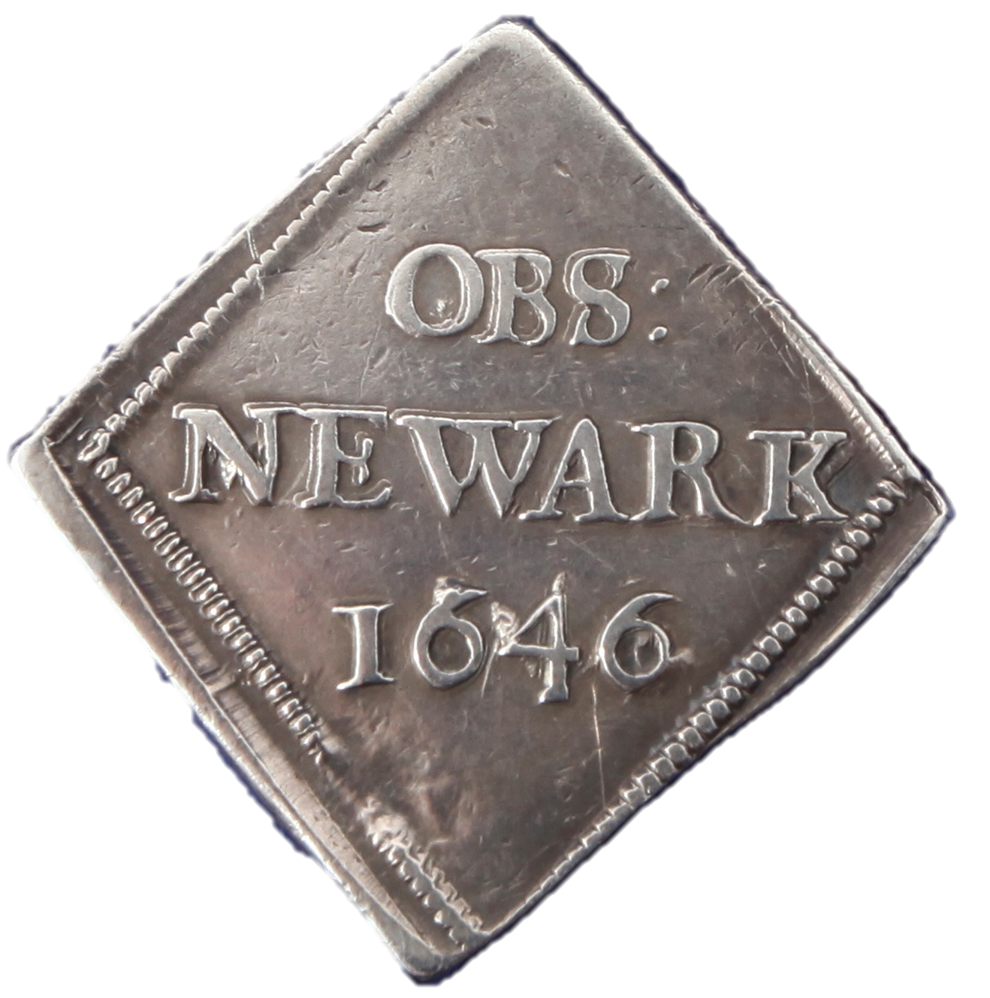

Slide 7
Click here to find out more about siege coins in general
Click here to find out more about Newark siege coins

Slide 8
When towns were under siege, traders and shoppers could no longer come to market.
This led to a shortage of coins.
Without money, it was impossible to buy food or pay soldiers.
To solve this problem, some towns created their own coins.
Silver plates and cups were cut up and turned into special siege money.

Slide 9
There were hundreds of sieges during the British Civil Wars but siege money is quite rare.
It was only produced in Newark, Carlisle, Scarborough, Colchester and Pontefract.

Slide 10
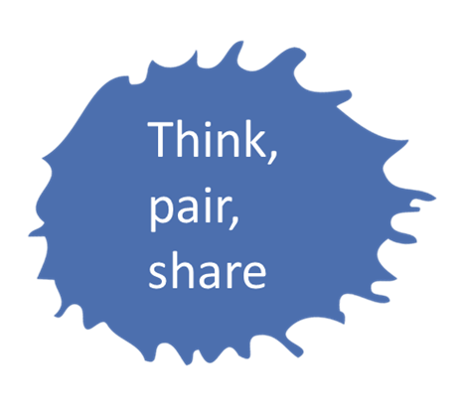
Strange Shapes
Siege coins were minted in shapes like this.
Why do you think this was?
Clue!
These places were cut off from the outside world and could only use the materials they already had.

Slide 11

Cutting straight sides shapes meant less material was wasted

Slide 12
Choose any straight sided, tessellating shape.
Include the year and an image of the besieged place.
Show if you are Royalist or Parliamentarian.
Make lots of coins out of one side of a cereal box and share them with your friends!
Design your own Siege Coin

Slide 13
Newark Siege Coins
C R stands for Carolus Rex, Latin for
‘King Charles’
OBS is short for OBSESSUM,
Latin for
‘Under Siege’
1646 was the year of Newark’s 3rd siege
XXX shows how much money this coin was worth. There were coins like this minted for different amounts of money
Click here to find out more about siege coins in general

Slide 14
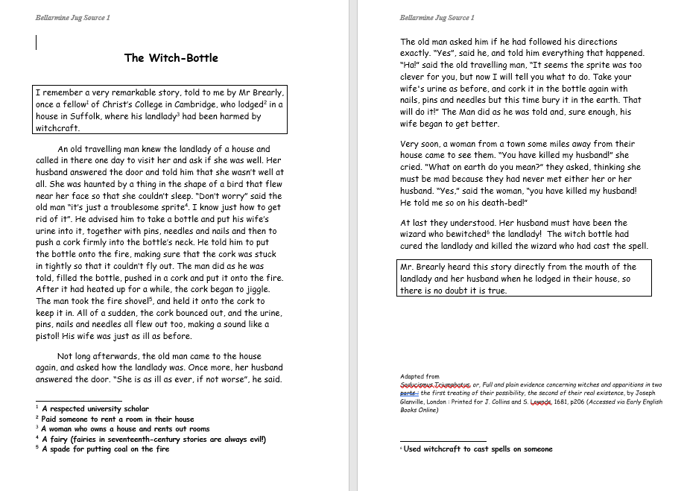
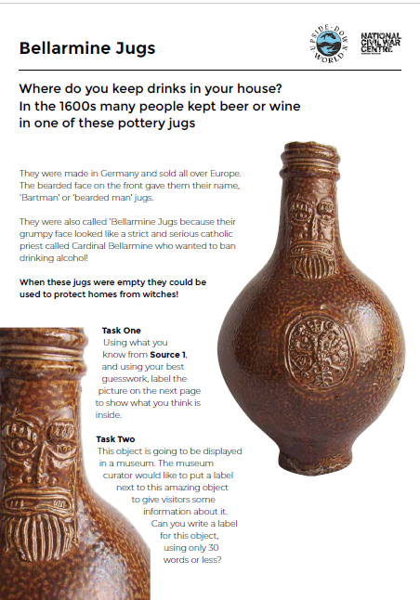
Bellarmine Jugs
.
Read Source 1, a seventeenth- century account.
Complete the tasks on the Bellarmine Jug sheet

Slide 15
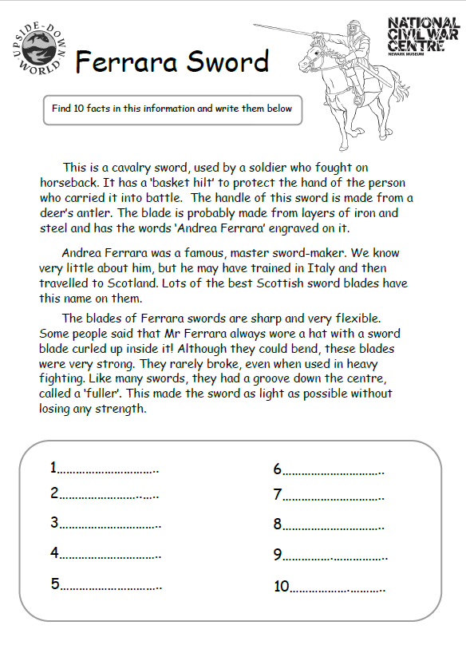
.
This Ferrara sword was found near Newark in Nottinghamshire. It had probably been brought there by one of the Scottish Parliamentarian soldiers besieging Newark in 1646.
Read the information sheet about Ferrara Swords. Find 10 facts about these swords and write them on the sheet.
Ferrara Sword

Slide 16
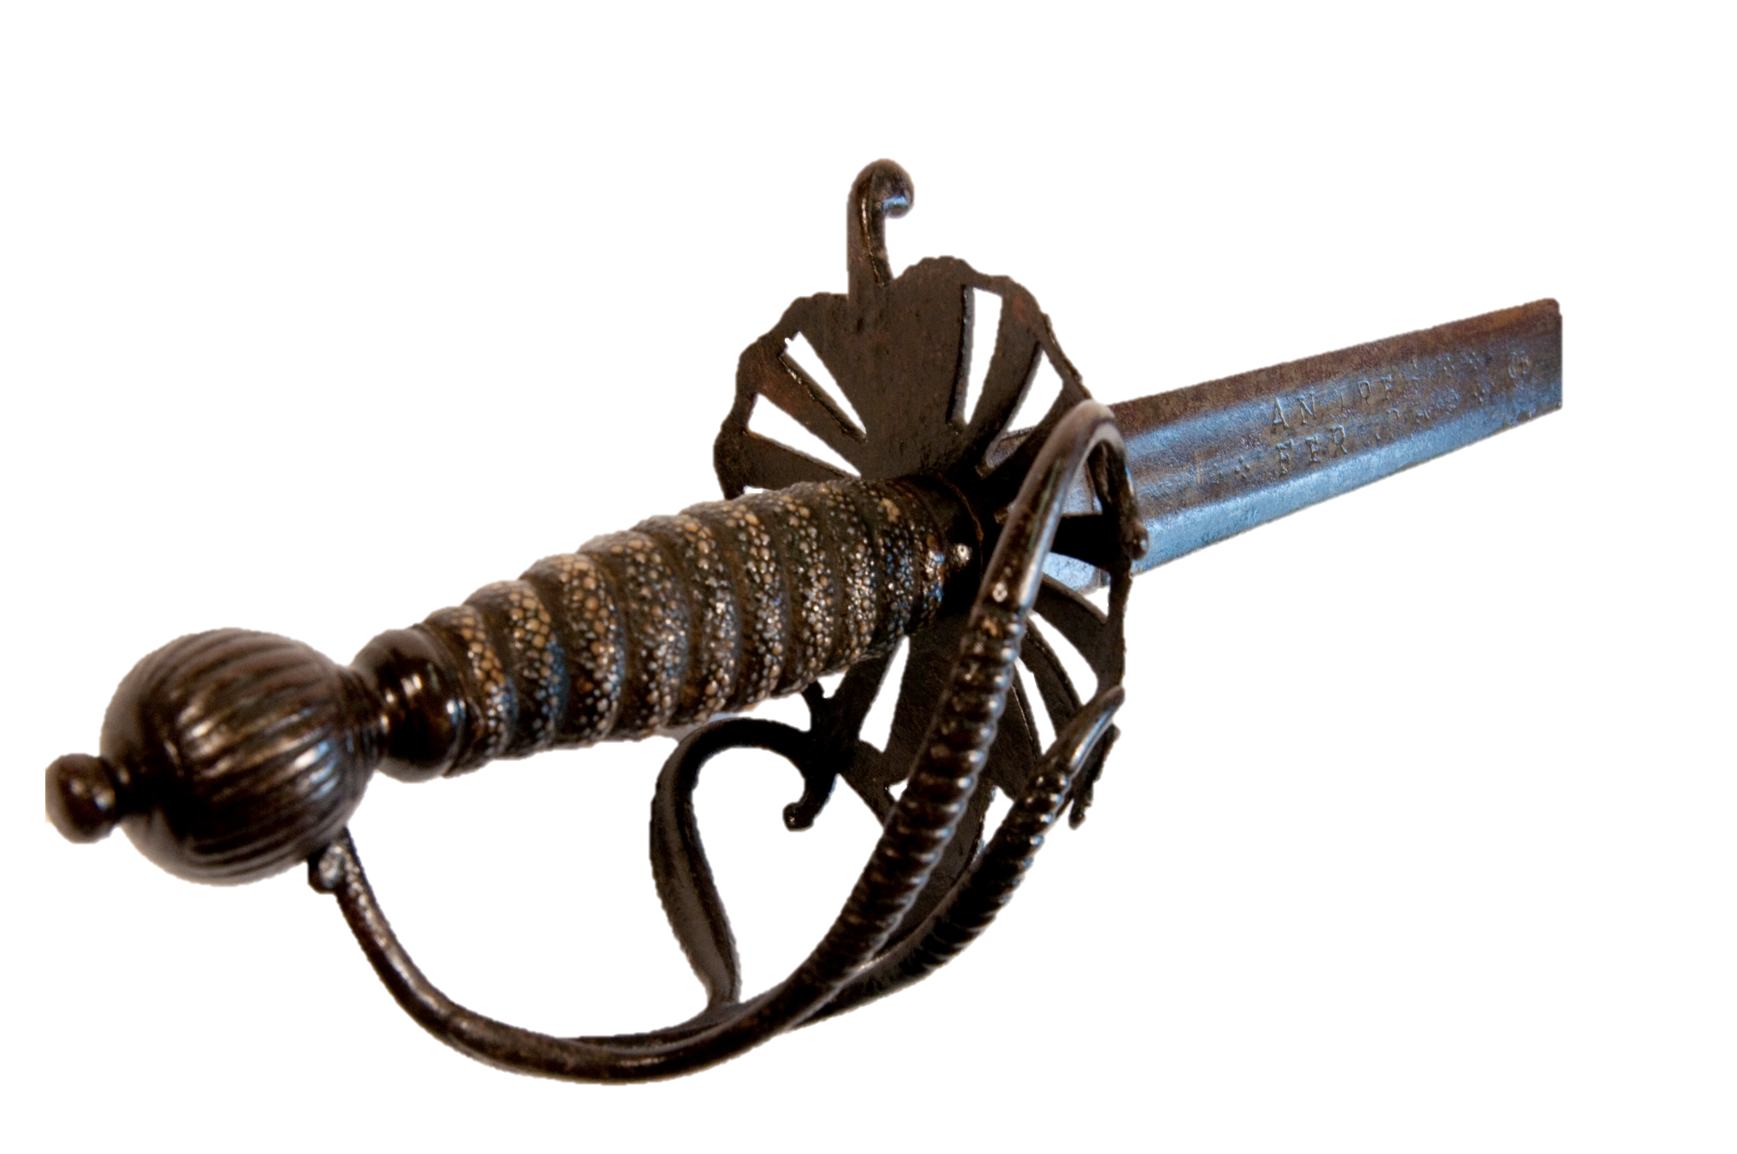
10 Ferrara Facts
10 Ferrara Facts
This is a cavalry sword
Its blade is very strong
It is made of iron and steel
The blade is bendy
The blade rarely broke, even in heavy fighting
The groove on the blade is called a fuller. It made the sword has light as possible without losing any of its strength
This Ferrara sword has a handle covered in snake skin! Why do you think this was?

Slide 17

10 Ferrara Facts
Lots of the best Scottish swords had this name on them
Andrea Ferrara may have trained in Italy and travelled to Scotland
Mr Ferrara had a sword blade wrapped inside his hat
‘Andrea Ferrara’ may have been a label or brand instead of a real person.
The skin’s bumpy texture stopped the sword from slipping out of the hand

Slide 18
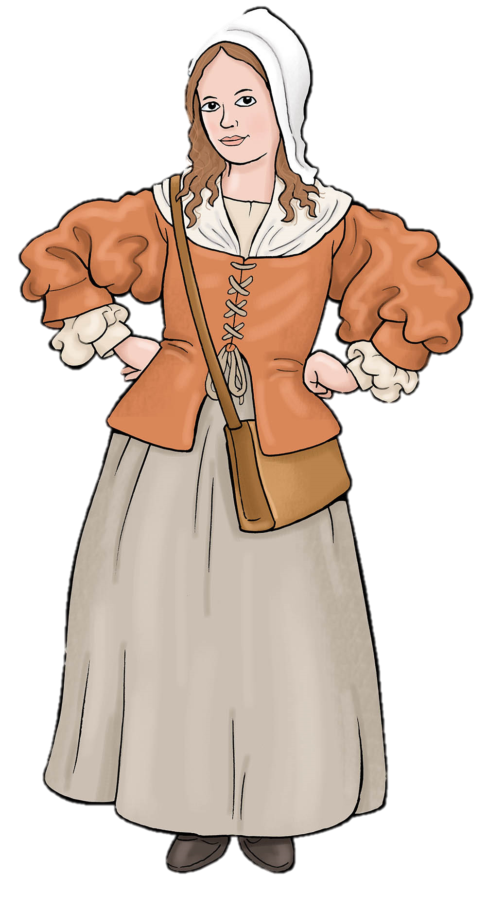
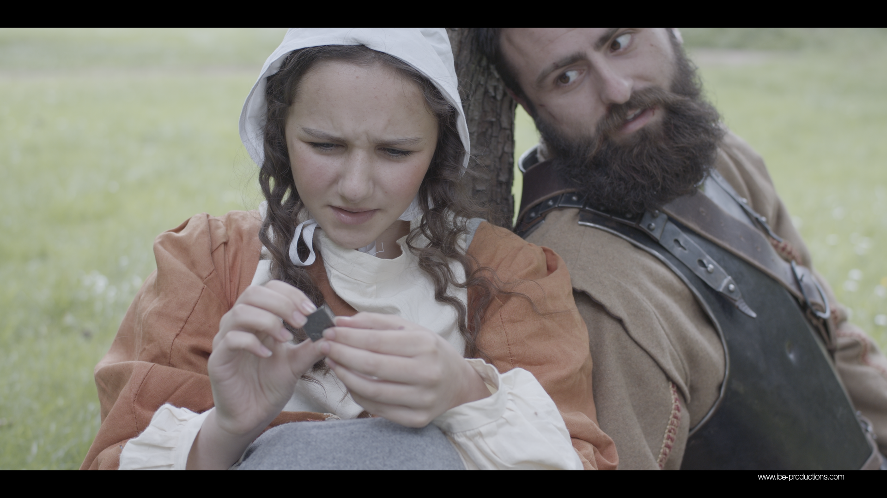
Object Stories
See these objects in use
Watch the film.
Read Mary’s
diary.

