Slide 1
Chronology Task:
How Putty Was Made at Thwaite Watermill
Choose preferred activity:
Card-sort: print slides landscape, 4 to a page, and guillotine.
Human Timeline: print full slides (1 to a page) for students to hold one each and line themselves up in order.
Please note – most of these photos are not from the time period when putty was made. Also, the slides are currently in the correct order, so will need jumbling!

Slide 2
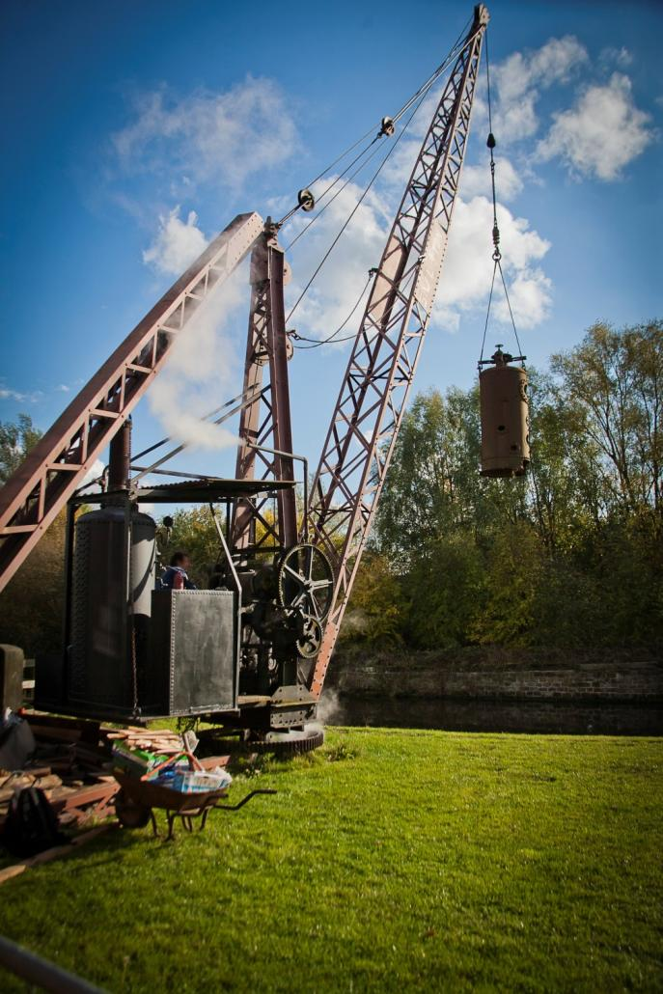
Chalk arrives at the mill by barge.
It is unloaded by the steam crane.
The chalk would be lifted off the boats just like this old boiler tank.

Slide 3
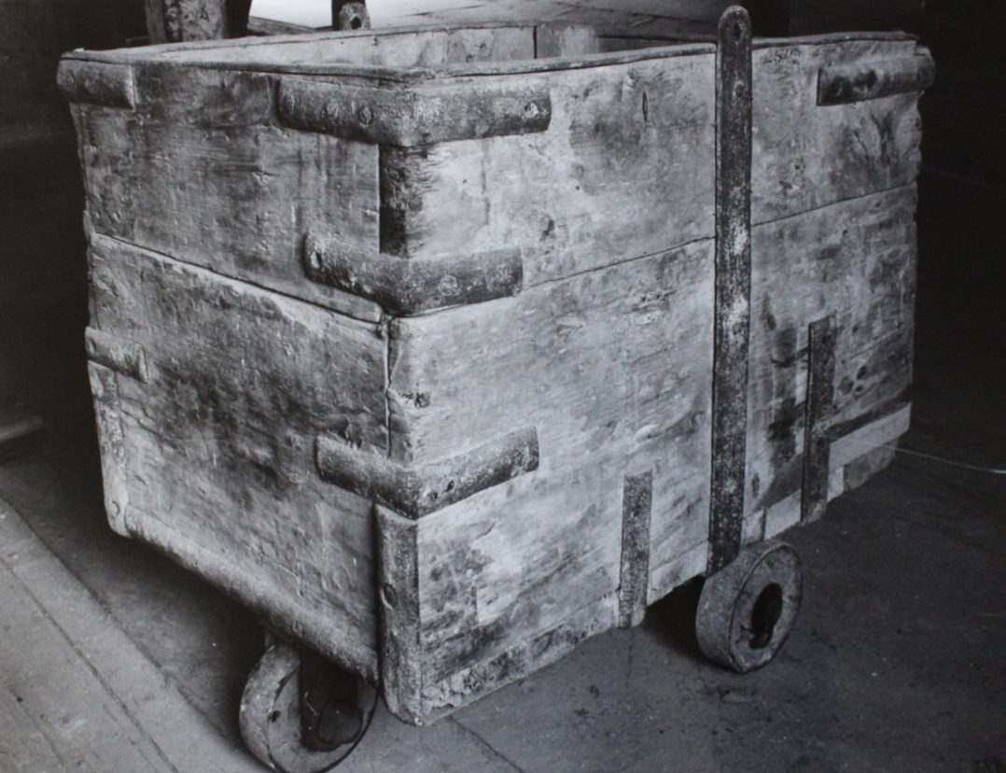
Chalk travels from the steam crane to the mill in a corf (little wagon) which runs on a rail track.

Slide 4
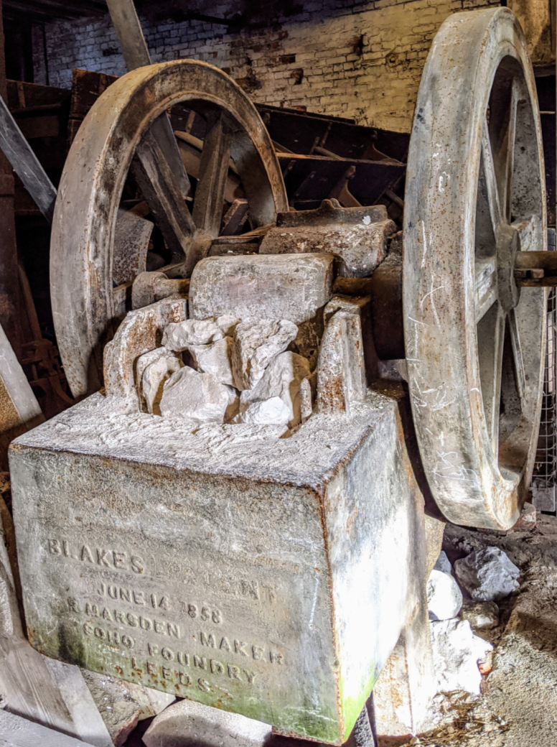
Chalk lumps are crushed into egg-sized pieces in a jaw crusher and then into pea-sized pieces in an impact granulator.

Slide 5
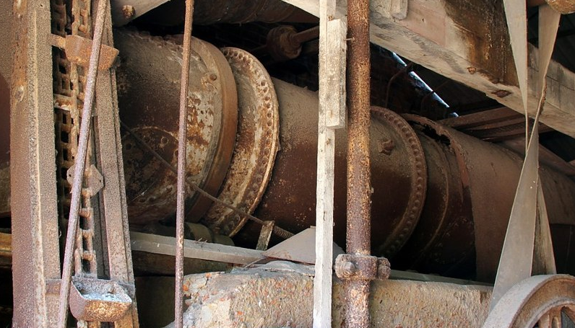
The pea-sized chalk pieces are dried out thoroughly in a rotary dryer to remove any moisture.
© Copyright Alan Murray-Rust and licensed for reuse under this Creative Commons Licence: https://creativecommons.org/licenses/by-sa/2.0/
(image taken from https://www.geograph.org.uk/photo/4662016 and cropped)

Slide 6
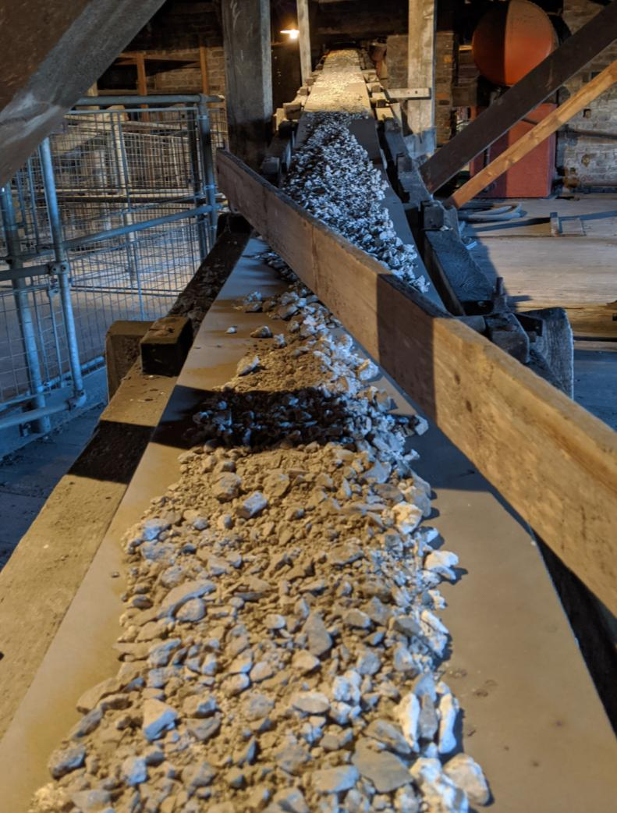
The dried chalk pieces travel to the top of the Raymond Mill on a conveyor belt.

Slide 7
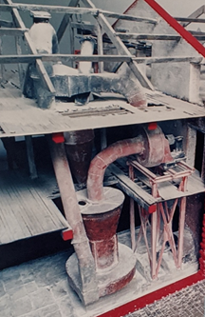
The chalk pieces enter the Raymond Mill, a huge machine which spans all three floors of the mill!
The Raymond Mill grounds the chalk down into a powder, known as whiting.

Slide 8
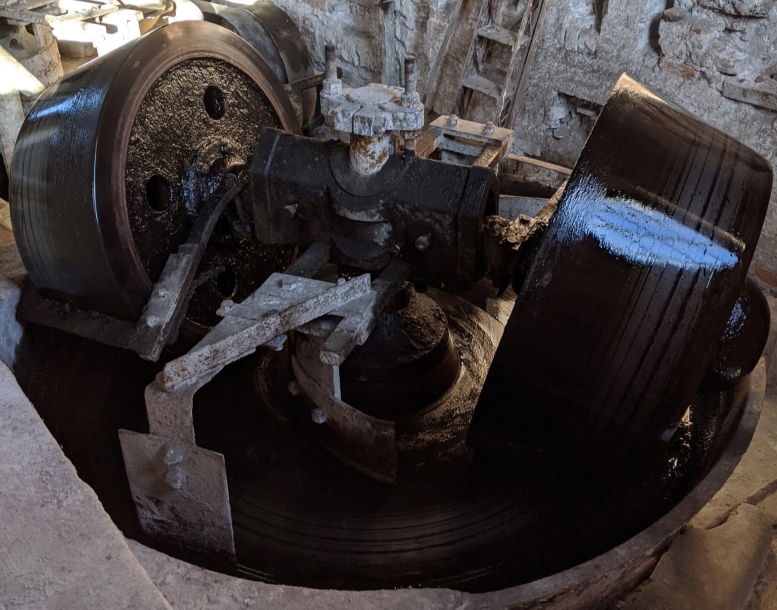
The whiting is mixed with linseed oil in a putty pan.

Slide 9
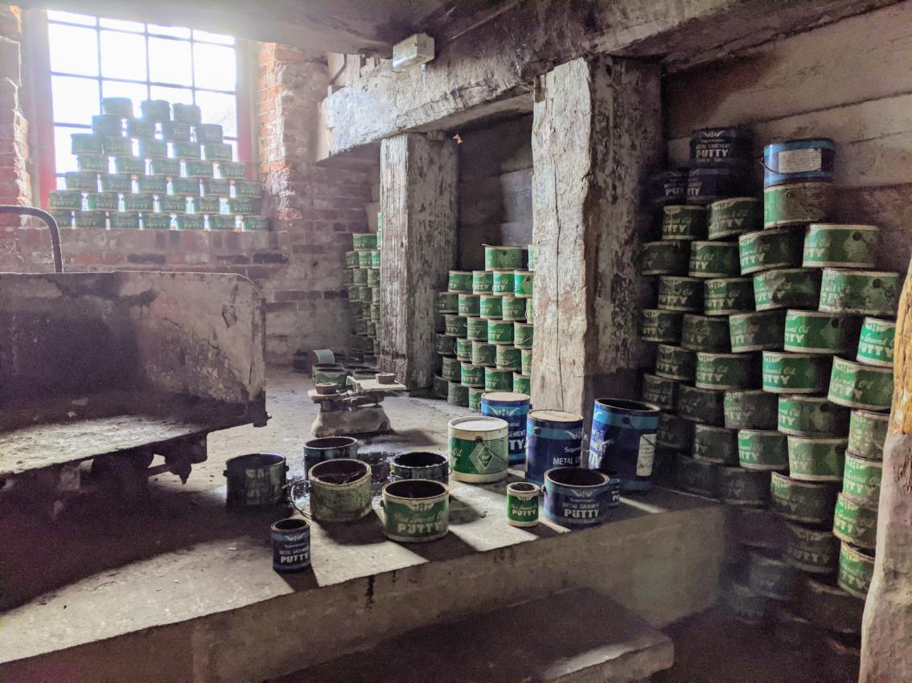
The putty drops down from the putty pan into the Putty Packing Room where workers scoop it into tins.

Slide 10
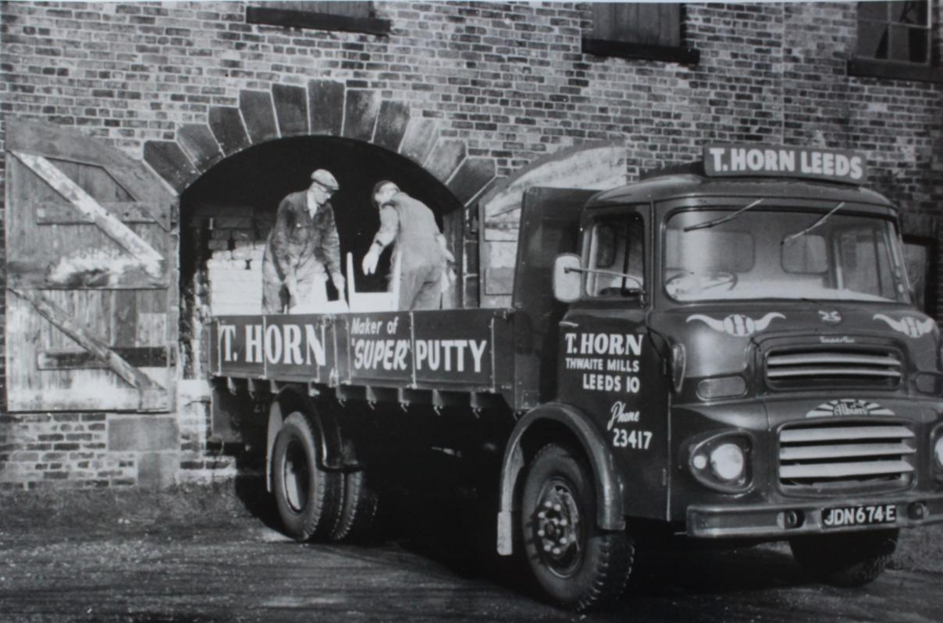
The tins of putty are stored in the warehouse. Eventually, they are loaded onto lorries to be delivered to customers.

