Slide 1

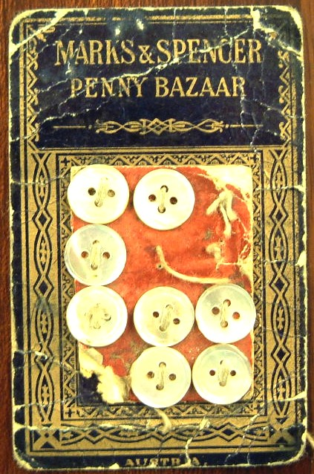

M&S PACKAGING TIMELINE
Pre-1900
The items that we sold in our Marks & Spencer Penny Bazaars were packaged very simply. Buttons were sewn onto card printed with our branding ‘Marks and Spencer’ and ‘Marks and Spencer Ltd’.

Slide 2
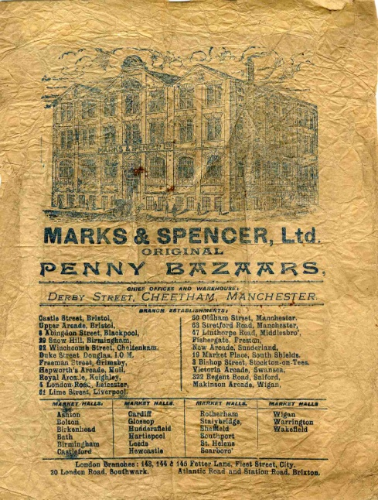
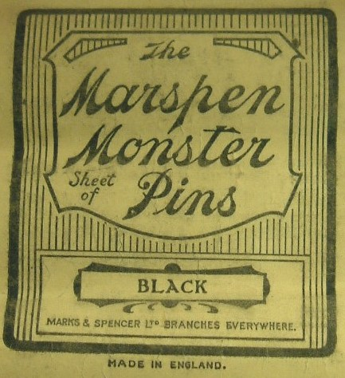
M&S PACKAGING TIMELINE
c1900
We used our other brand names alongside Marks & Spencer. They included Monster, Welbeck, Marspen and Daymar, and were used on packaging from the early 1900s.
Paper bags for Penny Bazaar items showed an illustration of the Head Office in Manchester. A list of all stores open at the time appeared below the picture.

Slide 3
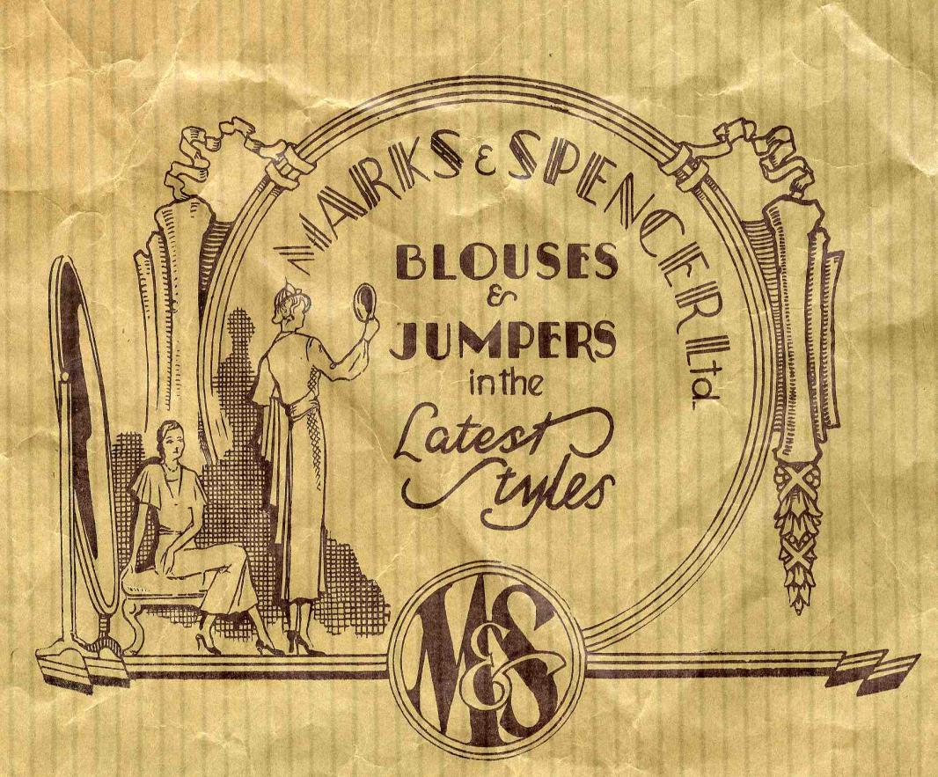
M&S PACKAGING TIMELINE
1930
In the 1930s we were selling luxury goods alongside our core homewares. We wanted to provide our customers with high-quality, beautifully designed goods that enhanced their lives. This illustrated paper bag features art deco designs and conveys a message of elegance and sophistication.

Slide 4
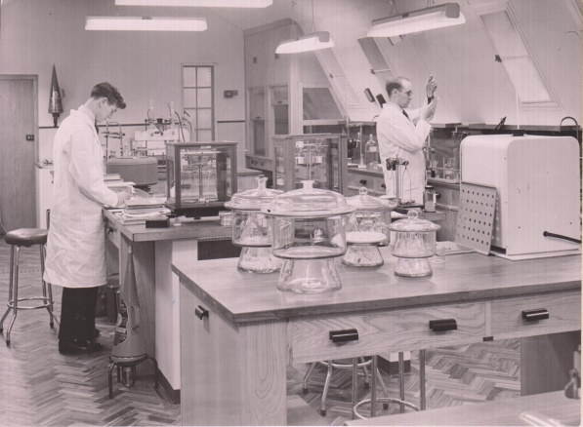
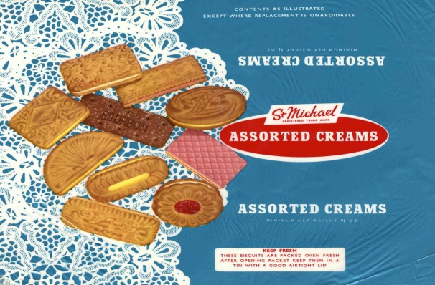
M&S PACKAGING TIMELINE
1949
After the Second World War we focused on our food packaging. We decided that the packaging of food was very important and should be as high quality as the food itself. Our scientists worked with food suppliers to experiment and find new types and ways of packaging. We wanted to make sure that our food was packaged in a clean and safe way.

Slide 5
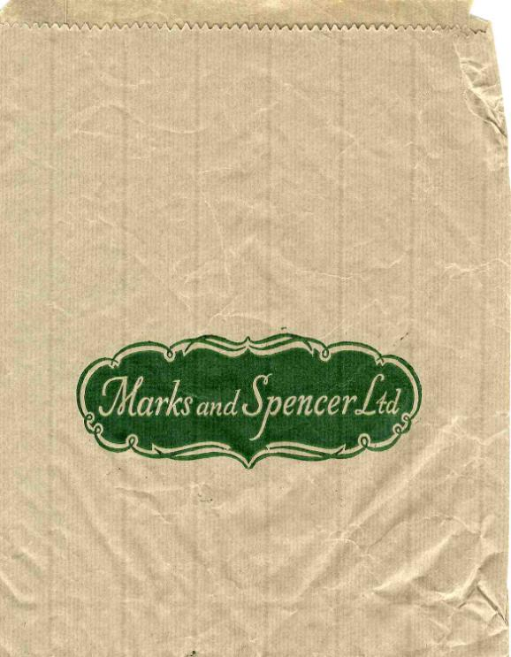
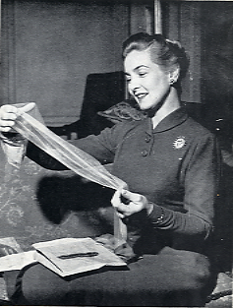
M&S PACKAGING TIMELINE
1955
In this year over 350,000,000 paper bags were used – that was 6 for every person in the country.

Slide 6
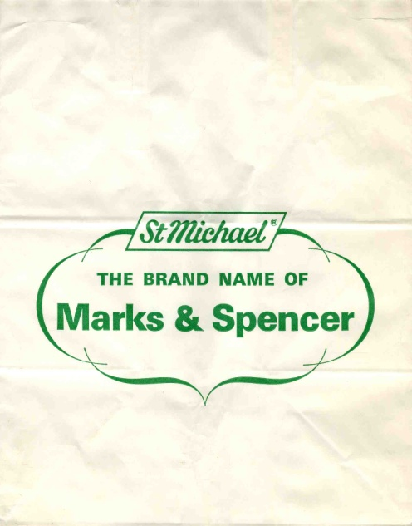
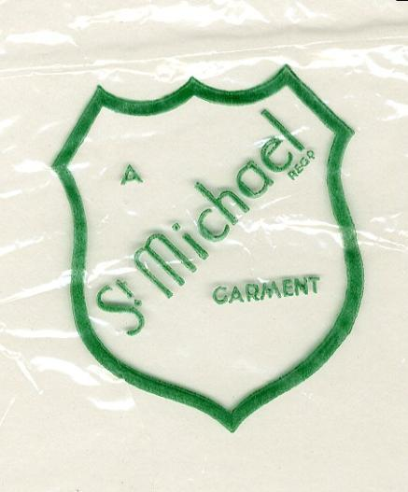
M&S PACKAGING TIMELINE
1959
In 1928 Simon Marks created our St Michael brand. It became a world-famous brand, known for quality and style. In 1959 St Michael is used more prominently on our carrier bags. M&S used nearly 3,000 tons of paper for 410 million bags and carriers in this year alone.

Slide 7
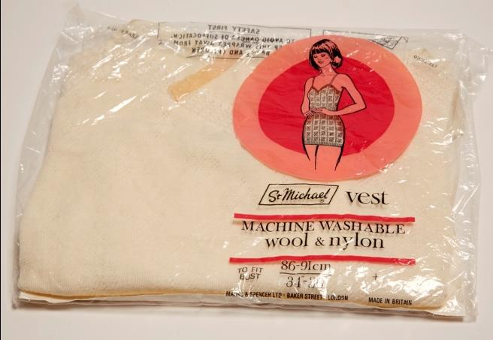
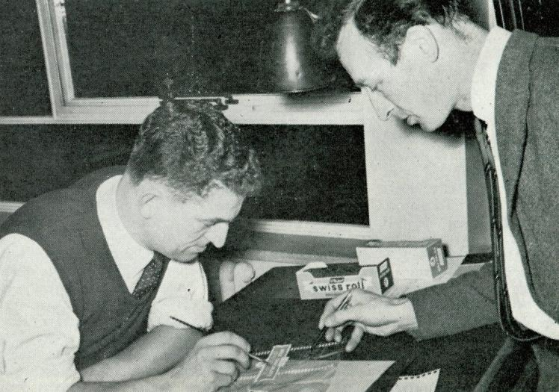
M&S PACKAGING TIMELINE
1960s
In 1960 M&S manufacturers spent five million pounds on packaging materials. We saw that packaging was really important to our customers as it kept clothes and food fresh and clean, it also made it easier for customers to find what they were looking for and kept stores looking tidier.
By 1966 we were looking for ways to change packaging so that products could be unpacked and presented more easily in stores. For example, we designed a dual-purpose box for fruit. This meant fruit could be transported and then displayed in the same box, saving time and packaging.

Slide 8
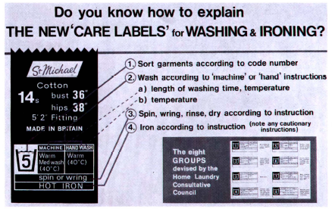
M&S PACKAGING TIMELINE
1968
We started putting new ‘care labels’ into our clothing. The symbols and information told customers how to wash and look after their clothes according to the type of fabric type it was made from.

Slide 9
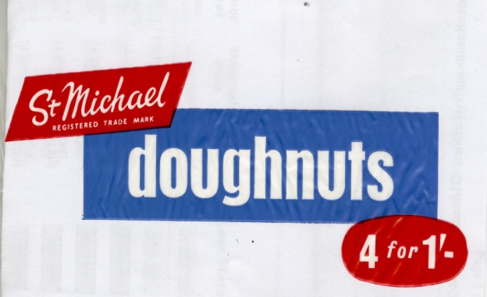
M&S PACKAGING TIMELINE
1969
Plastic was becoming more popular as a packaging material. We developed see-through wrappers for some of our foods so that customers could see exactly what they were buying. At the end of the 1960s the long-term plan for M&S is to stop using paper bags altogether and replace them with plastic carriers.

Slide 10
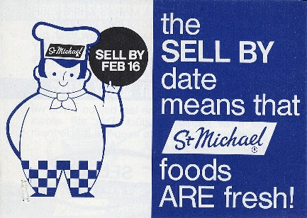
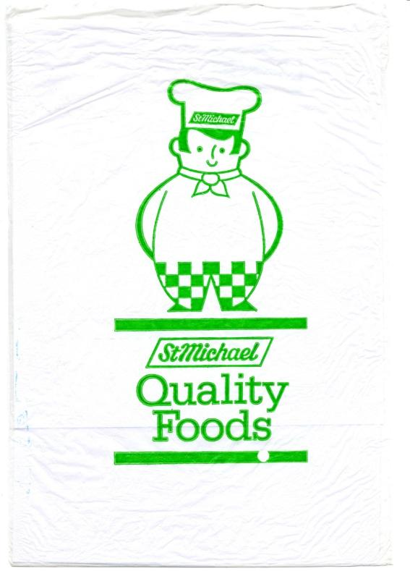
M&S PACKAGING TIMELINE
1973
We were the first major store to use sell-by dates. The first ones appeared in 1972, so the following year food bags were specially printed with the slogan ‘The sell-by date means that St Michael foods are fresh’.

Slide 11
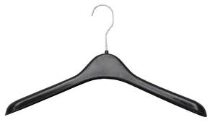
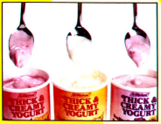
M&S PACKAGING TIMELINE
1981
We all know now how important it is to recycle as much as possible. Back in the early 1980s M&S started to recycle plastic clothes hangers, meaning that the company saved money and was also looking after the planet. By 1983 we were turning old hangers and yoghurt pots into new hangers!

Slide 12
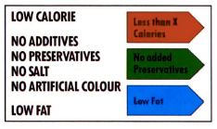
M&S PACKAGING TIMELINE
1986
To help our customers make healthier choices we began using colour-coded symbols to show more information about the nutritional value of foods.

Slide 13
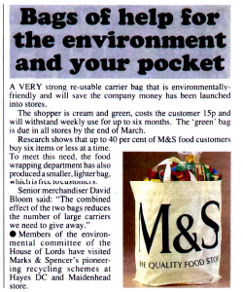
M&S PACKAGING TIMELINE
1991
We realised that we were giving away too many plastic bags. By the 1990s people were beginning to understand that plastic bags weren’t good for the environment, and so M&S created a strong re-usable carrier bag that cost 15p.
It was part of a new campaign to cut down on the wasteful use of carrier bags in stores. M&S employees were reminded to ‘Use your common sense – use the right size bag!’

Slide 14
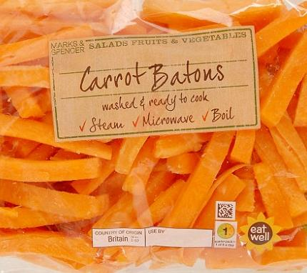
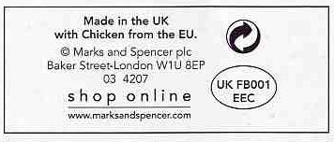
M&S PACKAGING TIMELINE
1999
In 1999 we were one of the few large companies to label our goods with the country that they came from. We still do this now, as we know that our customers like to know exactly where their food comes from.

Slide 15
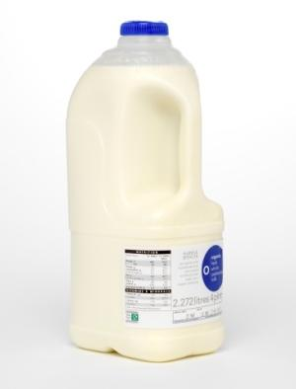
M&S PACKAGING TIMELINE
2007
In 2007 we launched Plan A. Plan A is the name we give to our ethical and environmental goals. It started out as a five year plan, and now that we’ve achieved our main aim of making M&S carbon neutral, we’ve set the next our ultimate goal of becoming the world’s most sustainable major retailer.
We started by making sure that all our packaging came from environmentally friendly sources, and we launched the world’s first plastic milk bottle made using recycled material.

Slide 16
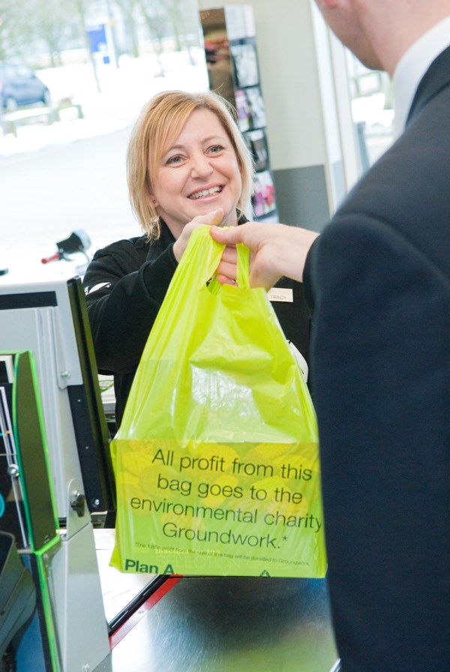
M&S PACKAGING TIMELINE
2008
We introduced a 5p charge for large food carrier bags with the profits from sales of the bags going to charity.

Slide 17
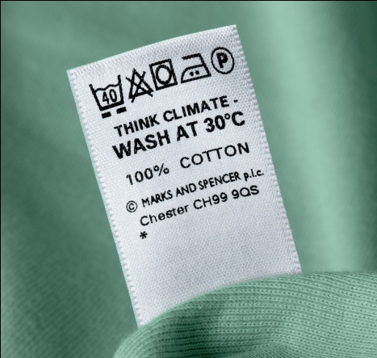
M&S PACKAGING TIMELINE
2010
We started to use polyester made from recycled drinks bottles to make over 300 million clothing care labels a year.

Slide 18
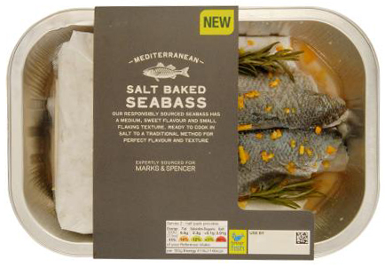
M&S PACKAGING TIMELINE
2015
We’re always looking for ways to reduce waste and make our packaging better for customers and for the planet. We’ve cut the amount of packaging we use in deliveries by 60% compared to 2008.
We’ve also developed innovative new packaging that helps to reduce food waste by keeping food fresh for longer.

