Slide 1

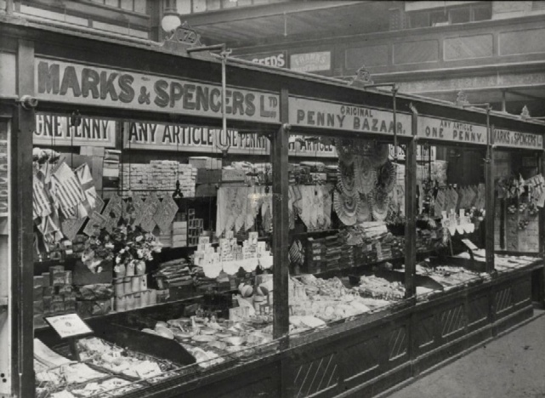

M&S FOOD TIMELINE
1884
M&S Penny Bazaar market stalls sold some types of packaged food, such as flour, spices and sweets.
Cardiff c.1900

Slide 2
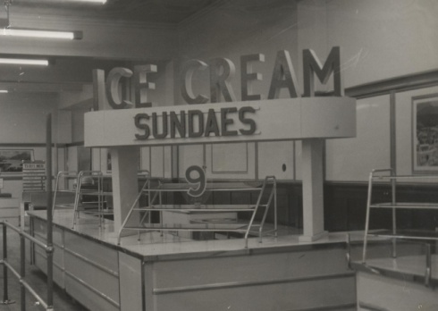
M&S FOOD TIMELINE
1927
Ice-cream counters opened in some stores. Two years later fresh sandwiches are sold alongside the ice-creams for the first time.

Slide 3
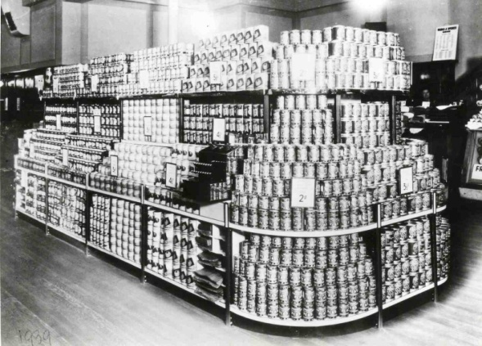
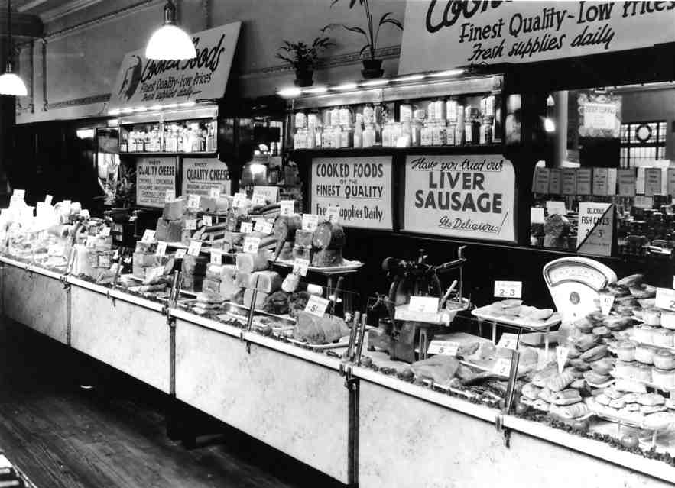
M&S FOOD TIMELINE
1931
Food departments opened in all M&S stores, selling tinned foods, fruit, vegetables and cakes.
Watford 1939
1934
A few years later we started selling cooked meats, sausages, pies, cheese and bacon in some stores too.
Blackpool 1938

Slide 4
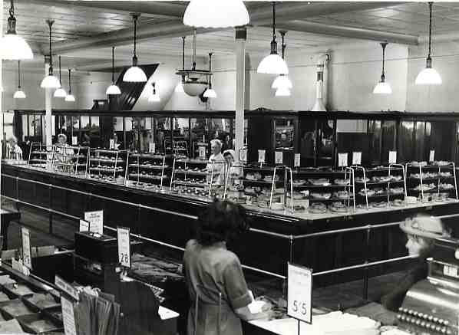
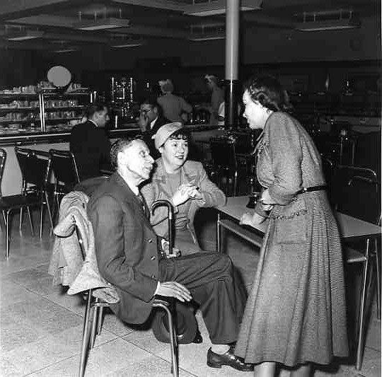
M&S FOOD TIMELINE
1935
The first M&S Café Bars opened in a small number of stores. Customers could order from popular meals of the time - chops, steaks or fish and chips.
Edmonton Café Bar
1940
Britain was now at war and food was rationed. Rationing didn’t apply to Café Bar and restaurant meals, so M&S Café Bars were very popular with customers as they could get a hot meal without using up their ration tokens.
Café Bar 1940s

Slide 5
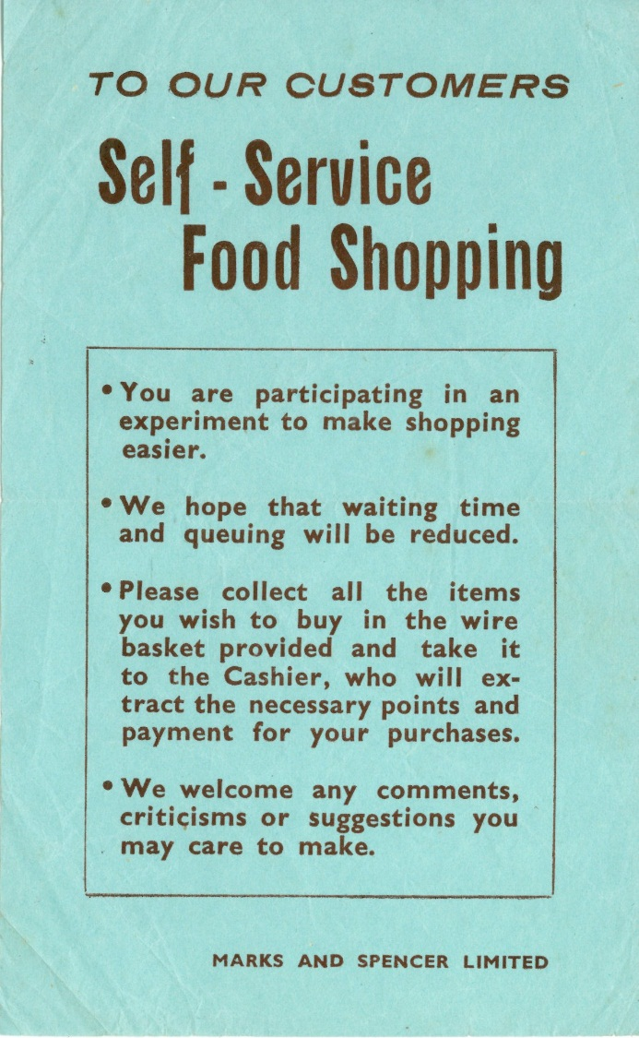
M&S FOOD TIMELINE
1948
For the first time, customers could choose their own food shopping from open shelves. This was a new idea – until 1948 you’d always had to ask a sales assistant to select your food for you. The first store to try this new way of shopping was Wood Green in London.
Customer Leaflet 1948

Slide 6
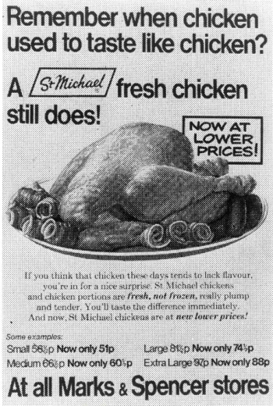
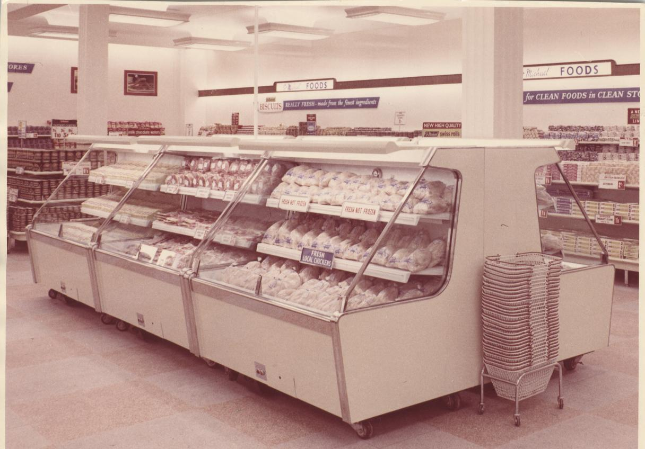
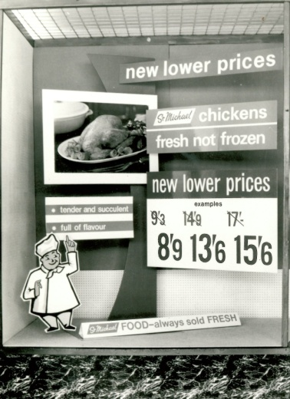
M&S FOOD TIMELINE
1960
Before the 1960s the only chicken you could buy in supermarkets was frozen. There was no way to keep the meat cool enough (to stop bacteria growing) as it was transported from farm to shop without freezing it. Customers preferred fresh chicken that wasn’t frozen, so M&S technologists invent the Cold Chain. They used new technology to create refrigerated lorries, store rooms and chilled shelving so that the chickens were kept at a safe temperature for customers.
Advertisement
Chilled Food Display
Window Display

Slide 7
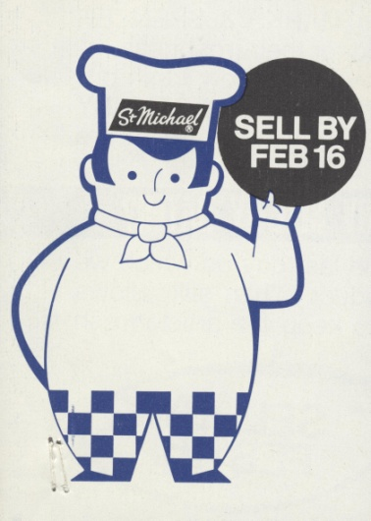
M&S FOOD TIMELINE
1972
We wanted our customers to know that our food was really fresh, and to let them know how long certain foods would be fresh for, so the Food Technology Department introduced ‘sell-by’ dates to food wrappers. Other food stores soon started doing this too, and it eventually became the law for food to have a sell-by date.
Sell-by Dates 1972

Slide 8
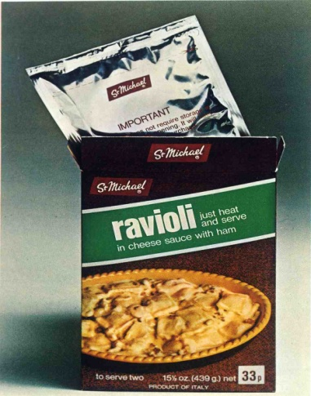
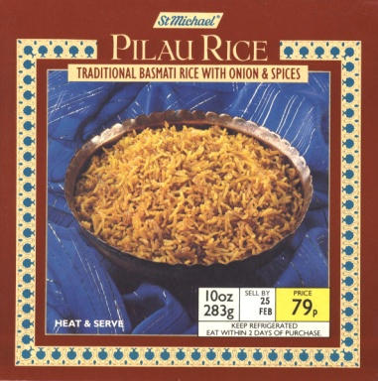
M&S FOOD TIMELINE
1974
In the 1970s more people were going on package holidays, which were a less expensive way of having a holiday abroad. M&S food ranges began to change as customers were more interested in food from other countries, for example frozen and chilled Indian dishes like chicken korma and pork vindaloo. Before microwaves were common we sold foil-wrapped, boil-in-the bag, ‘convenience foods’, such as Ravioli, which were quicker to prepare than frozen meals.
Food Packaging 1970s

Slide 9
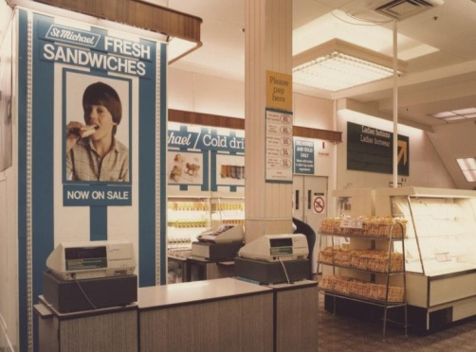
M&S FOOD TIMELINE
1980
Fresh sandwiches are sold in M&S stores again. The most popular filling is Prawn and Mayonnaise, launched in 1981.
Marble Arch 1982

Slide 10
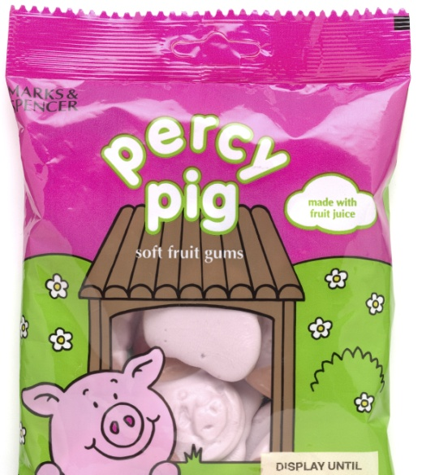
M&S FOOD TIMELINE
1993
Percy Pig is was created in 1993. He’s still one of our most popular characters and by 2014 over one billion Percy Pigs had been sold. He also has over 200,000 followers on Facebook!
Percy Pig Packaging

Slide 11
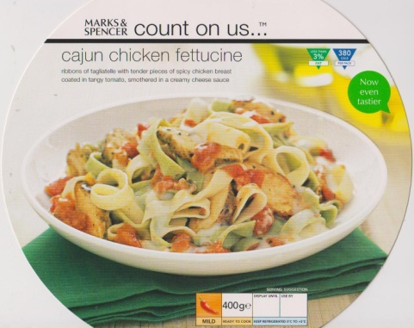
M&S FOOD TIMELINE
2000
M&S aims to help people make healthy choices, so we created the Count on Us range, with meals containing less than 3% fat and fewer calories.
Count on Us Packaging

Slide 12
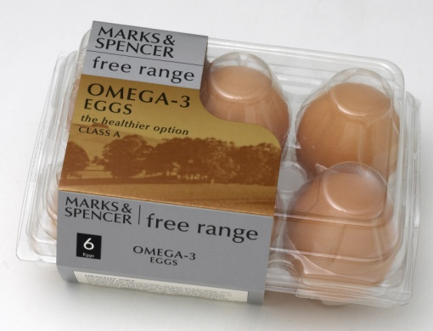
M&S FOOD TIMELINE
2002
Animal welfare is extremely important at M&S. We make sure that all animals that supply food products for us are well looked after. Since 2002 we’ve sold only free range eggs and we use them in all our food.
Free Range Egg Packaging

Slide 13
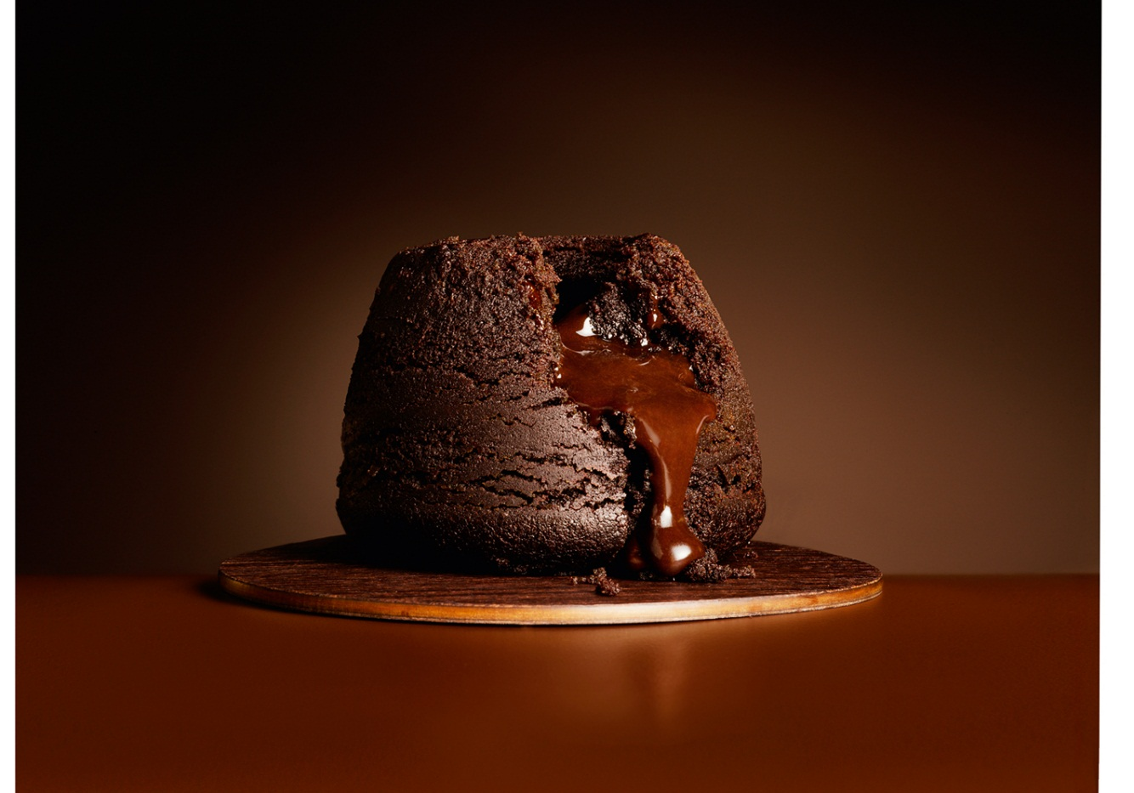
M&S FOOD TIMELINE
2004
Our first ‘This is not just food, this is M&S food’ advert was shown on television. One of the most famous adverts from this campaign featured the Melting Middle Chocolate Pudding. The weekend that the advert was shown, sales of the pudding increased 3000%!
Melting Middle Chocolate Pudding

Slide 14
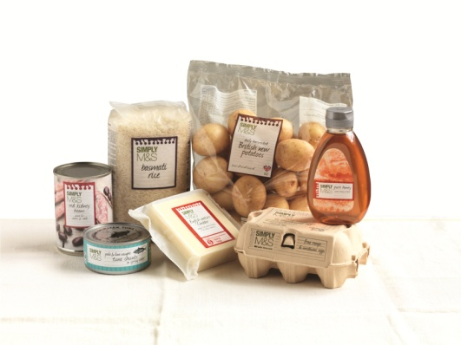
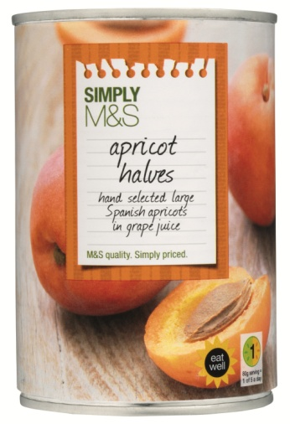
M&S FOOD TIMELINE
2012
We launched Simply M&S, a range of everyday foods and kitchen ingredients that offered M&S quality at great value prices.
Simply M&S Packaging

Slide 15
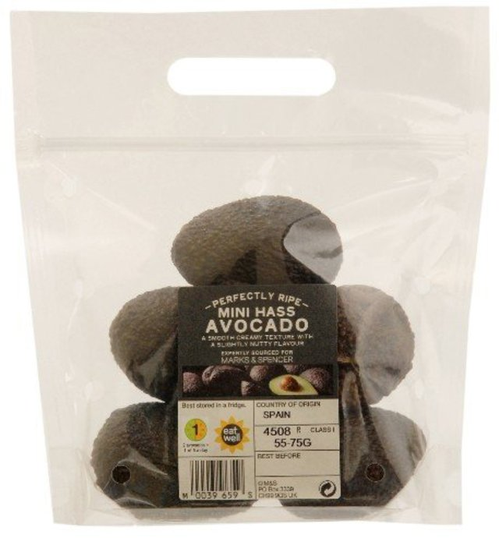
M&S FOOD TIMELINE
2016
In January 2016 M&S started selling mini avocados. We were the first food store to sell the new tiny fruit, that are naturally smaller. The mini avocados are the perfect size for a single portion, meaning that less food will be wasted.
M&S Mini Avocados

