Slide 1
















These details of fonts are from M&S biscuit tins. Look carefully at the enlarged details of fonts. Whilst still in the slide view (not slide show) copy and paste the font near their correct tin on the next page. To make it more difficult the pictures have been reversed!
Resource created by www.mylearning.org Images © M&S Company Archive

Slide 2
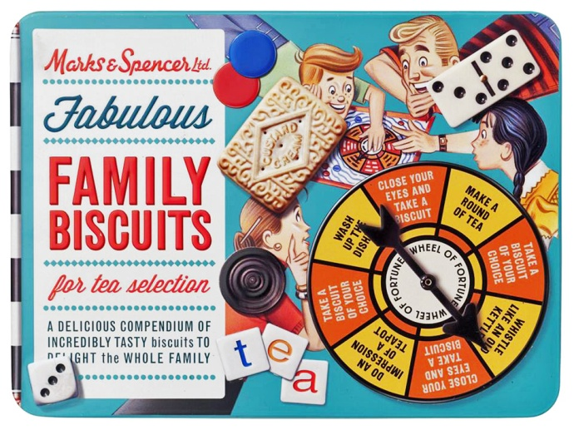
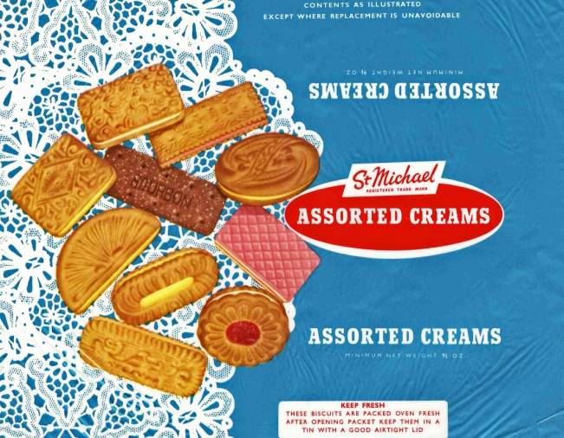

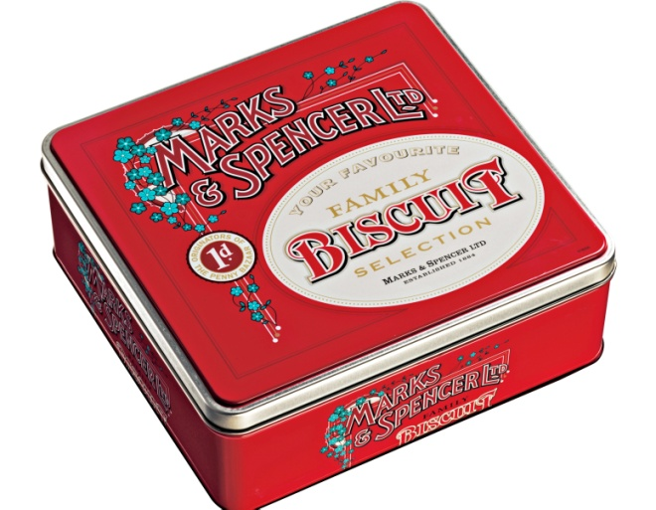
When you think you’ve chosen the right fonts for the correct tin click on all objects in your group, from the Home tab go to Arrange, choose Group from the drop down menu. Your main picture and fonts will then be grouped.
Resource created by www.mylearning.org Images © M&S Company Archive

Slide 3
Correct grouping of fonts to match tins
Resource created by www.mylearning.org Images © M&S Company Archive

