Slide 1
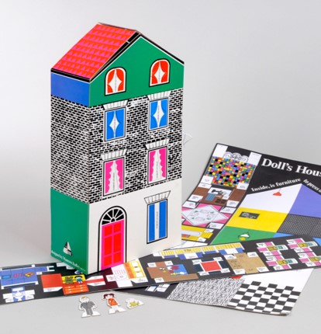
Doll's House Kit
Doll's House Kit
Doll's House Kit
Doll's House Kit
Doll's House Kit
Lower Key Stage 2
Free learning resources from, cultural and heritage organisations
^{mylearning.org}

Slide 2

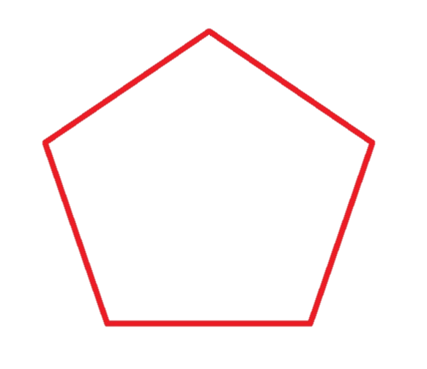

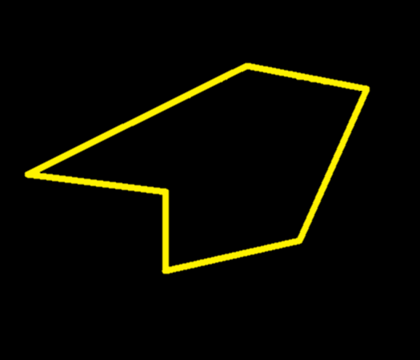
Shapes
Some shapes are regular. All sides of a regular shape are equal length, and the angles the sides meet at are the same.
Maureen Roffey used a range of different shapes in the design of her doll’s house.
Some shapes have sides of different lengths which may meet at different angles – they are called irregular.
Lower Key Stage 2
^{mylearning.org}

Slide 3
Shapes
Have a go at the interactive shape hunt of Maureen Roffey's doll's house.
Can you name all of the shapes labelled on the picture?
Are all the shapes regular or irregular?
Can you find a:
Semi-circle?
Rectangle?
Trapezium?
Triangle?
Square?
Pentagon?
Doll's House Shape Hunt
Lower Key Stage 2
^{mylearning.org}

Slide 4
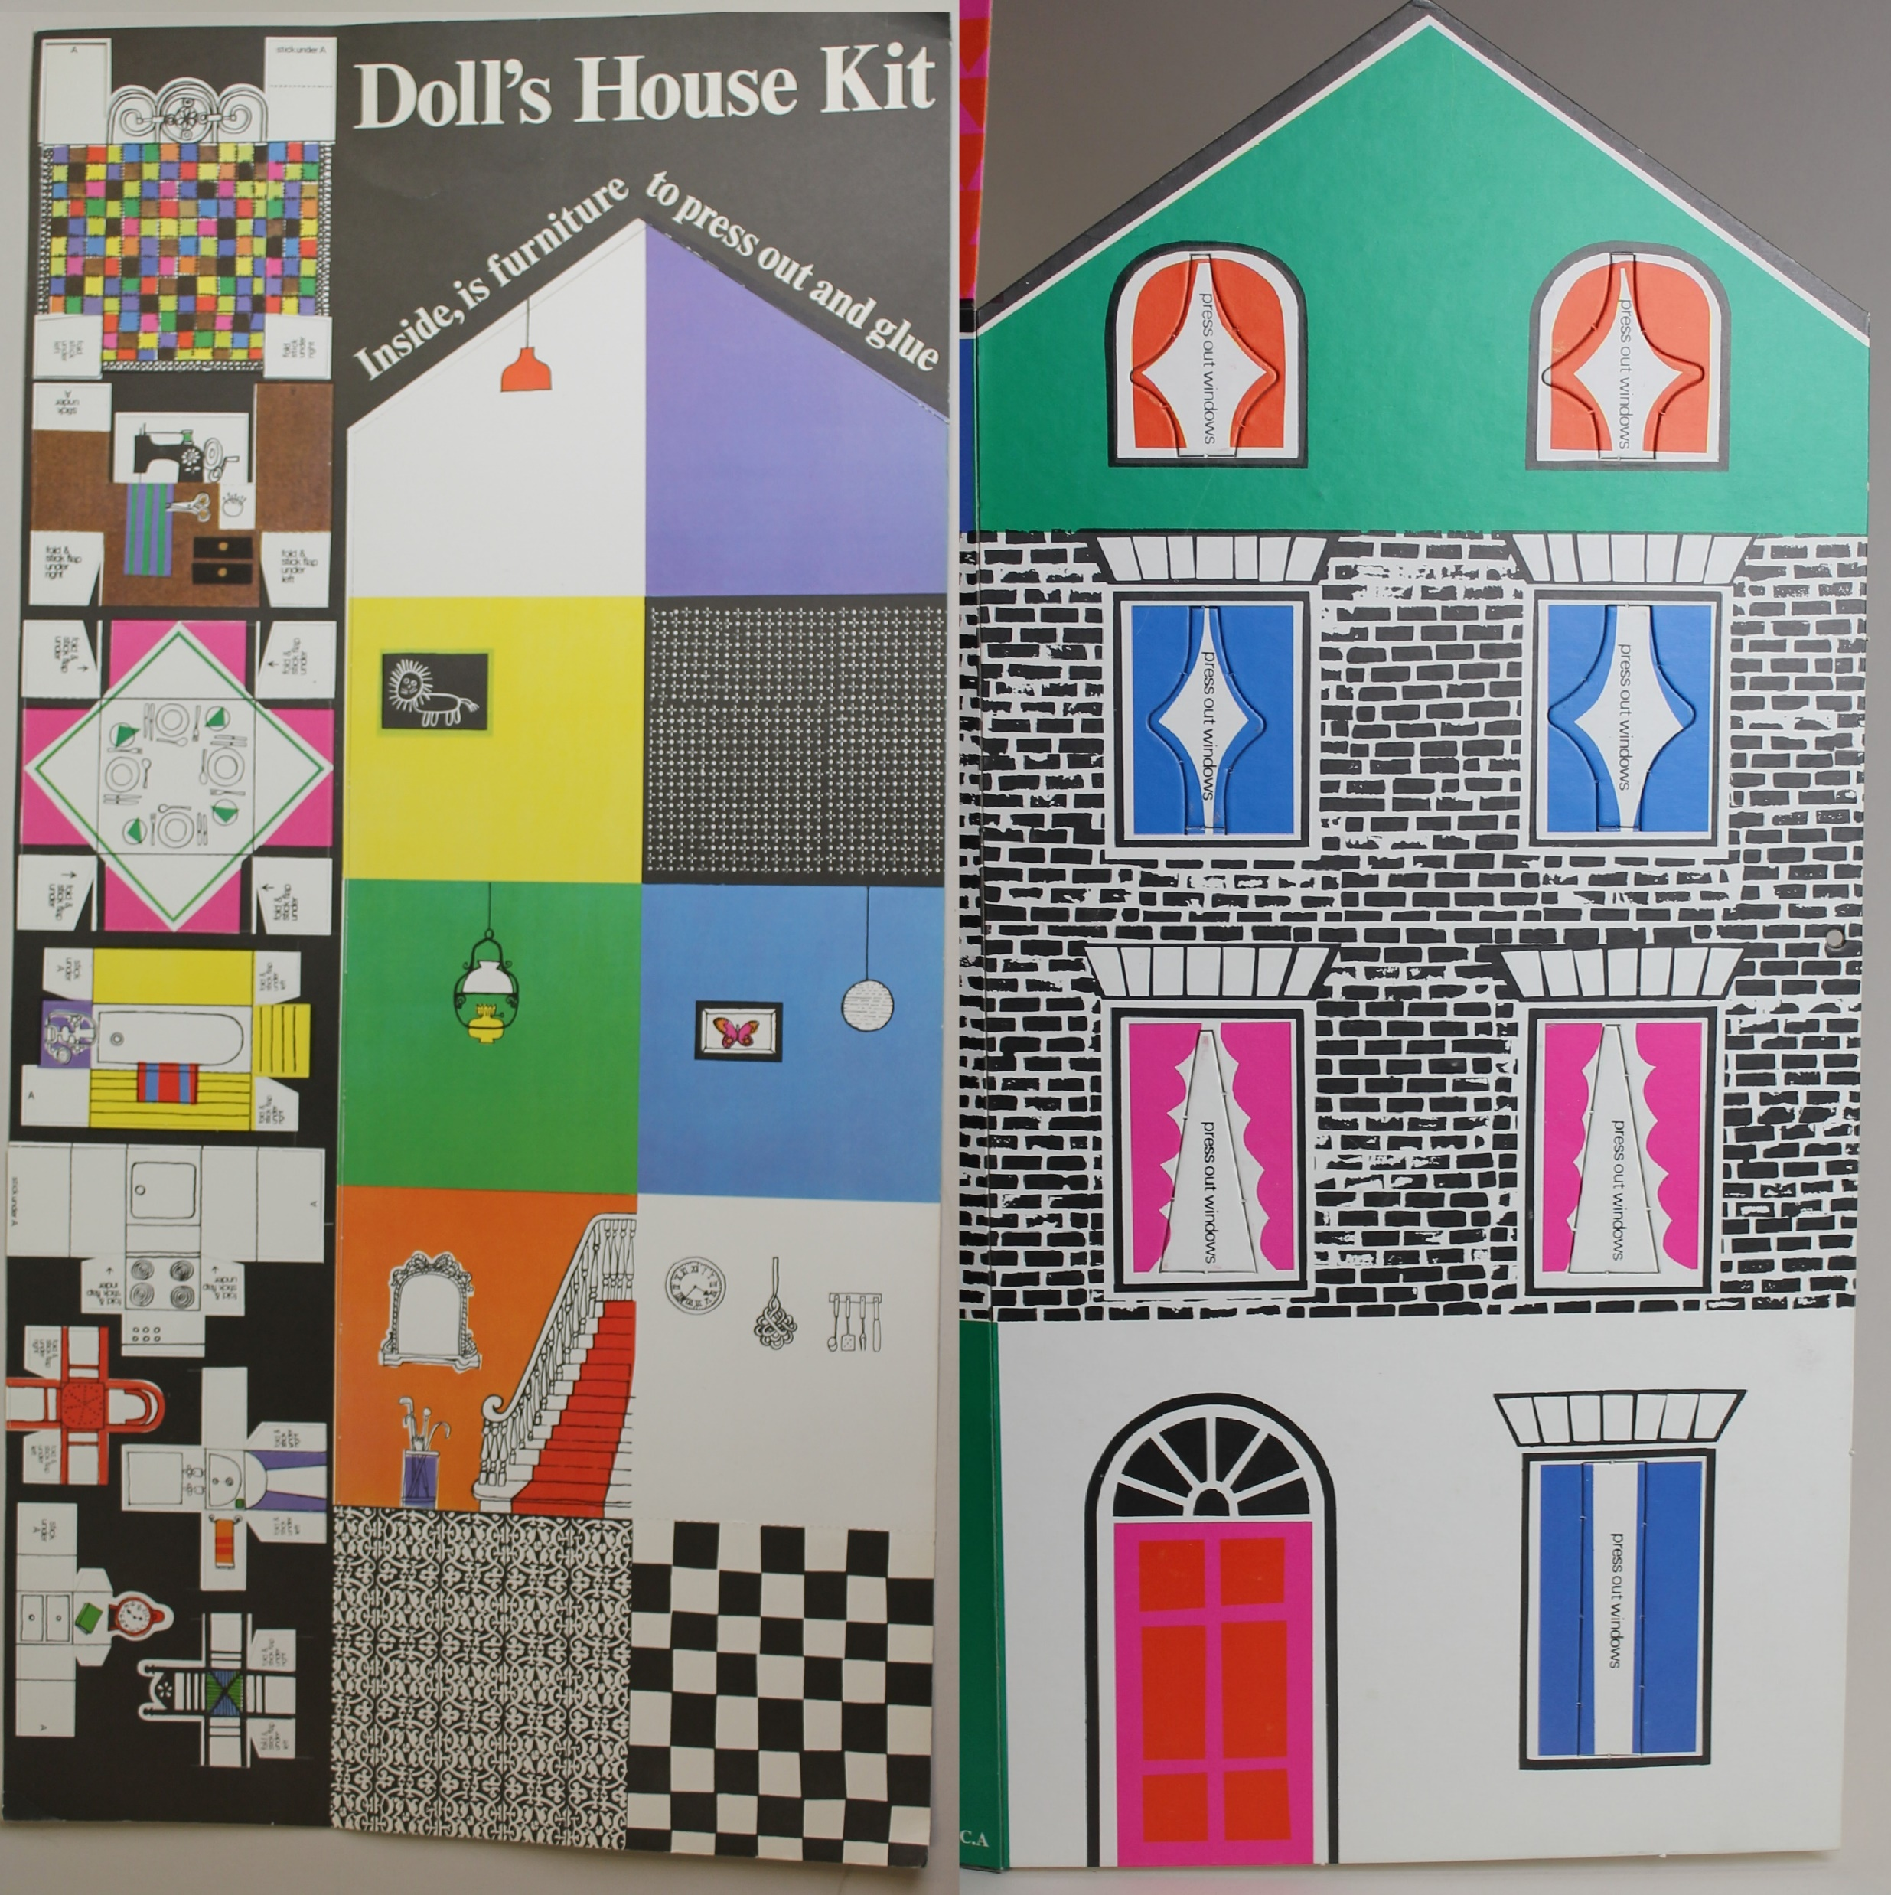
Symmetry
Can you find any symmetrical shapes in Maureen Roffey’s doll’s house design?
Do any of the shapes have more than one line of symmetry?
Doll's House Symmetry Hunt
Lower Key Stage 2
^{mylearning.org}

Slide 5
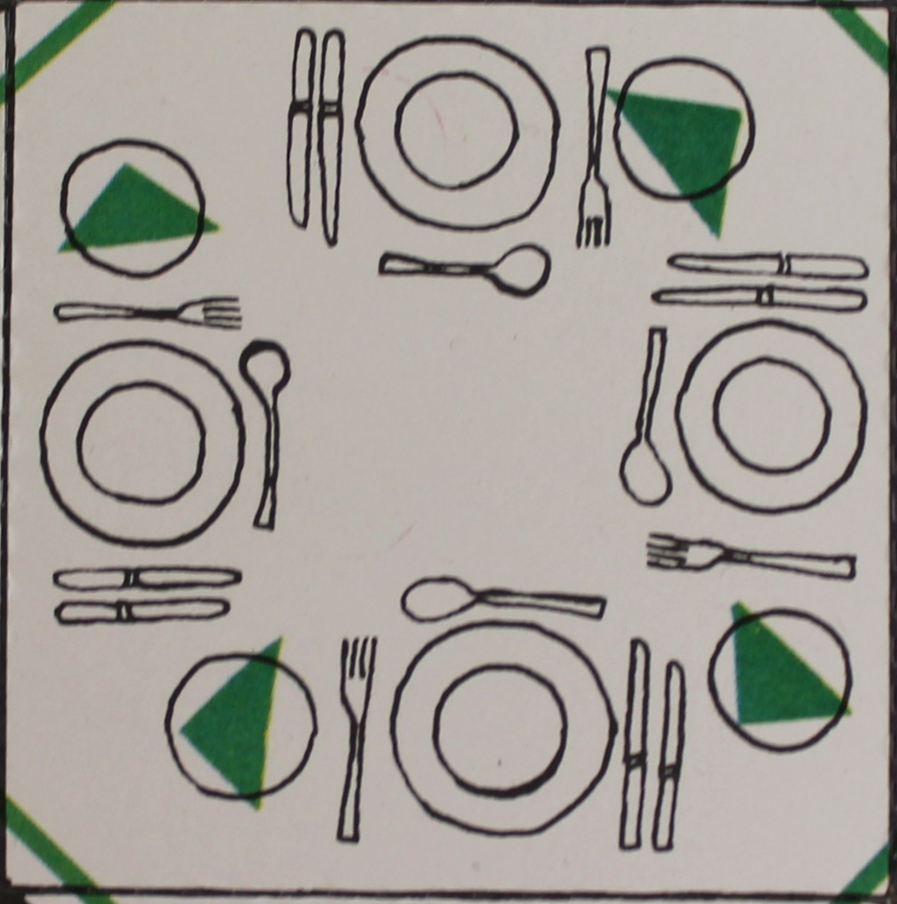
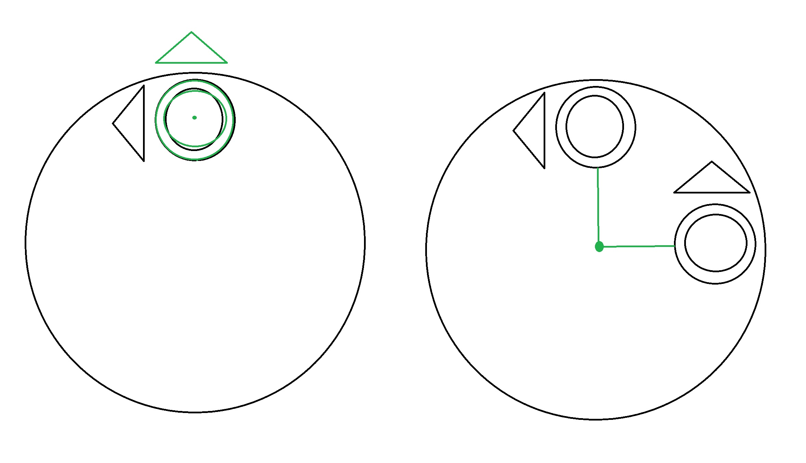
Rotation
Have a look at the plates on the dinner table.
Can you see any rotations?
The green lines and dots show rotation about two different points.
Lower Key Stage 2
^{mylearning.org}

Slide 6
Rotation
Are there any other uses of rotations in the doll’s house?
Can you think of any other places it could be used effectively?
Have a go at including rotations in your design.
Lower Key Stage 2
^{mylearning.org}

Slide 7
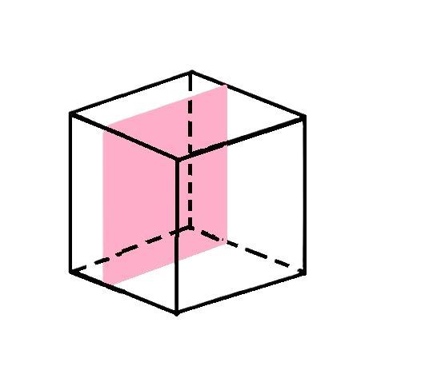
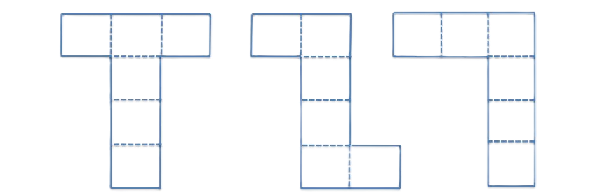
Nets – What is a net?
The net of a 3D shape is what it would look like if it was unfolded and laid flat.
There are many types of nets for the different 3D shapes.
This is a cube and some examples of nets which could be folded to make a cube.
Lower Key Stage 2
^{mylearning.org}

Slide 8
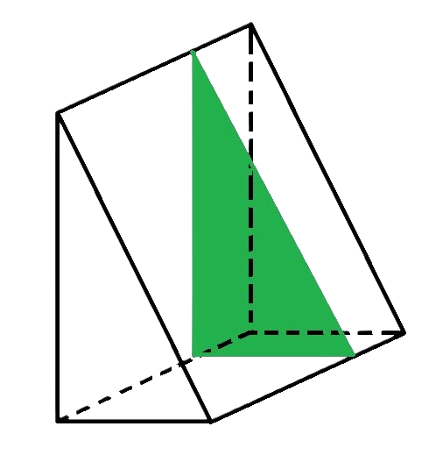
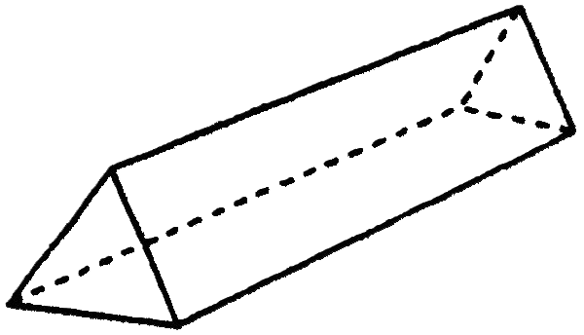
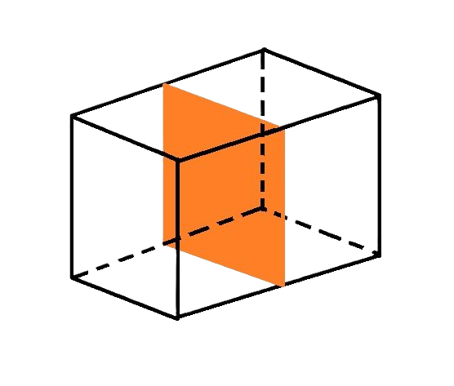
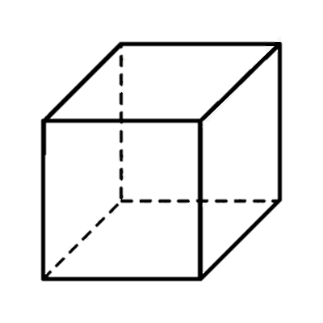
Nets - Prisms
A prism is any shape where its two opposite ends are equal shapes, called bases, and the sides in between these bases are parallelograms.
Prisms should have the same cross-section all the way along – meaning if they were cut at any point along their length, the shape revealed inside was exactly the same as the bases.
Lower Key Stage 2
^{mylearning.org}

Slide 9
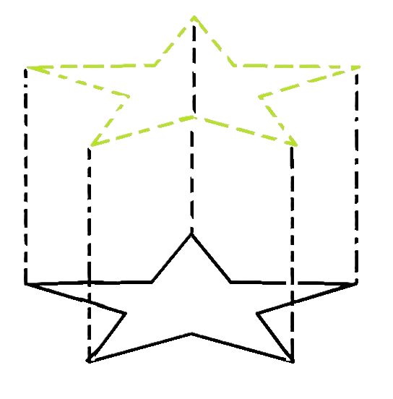
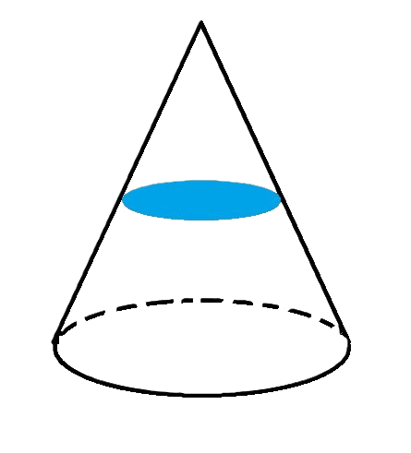
Nets - Prisms
You could draw a shape (made of straight lines) on a piece of paper, and imagine it extending up out of the page. That would be a prism!
You can see that a cone could not be a prism, because its cross section is not the same size as its ends.
Lower Key Stage 2
^{mylearning.org}

Slide 10
Question
Maureen Roffey’s doll’s house uses a net to create a 3D doll’s house.
Thinking about what we have learned about polyhedrons, what do you think the proper shape name is of the doll’s house?
We will work it out together on the next slide.
Lower Key Stage 2
^{mylearning.org}

Slide 11
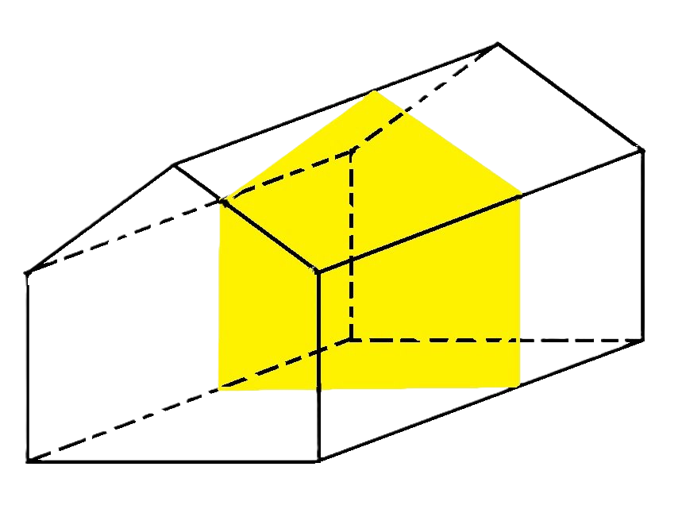
Answer
The front face (called a base) is a five-sided shape. The angles and lengths are not equal. This is an irregular pentagon.
The faces between the bases are rectangles. They have two sets of parallel sides so are parallelograms.
This means the doll’s house shape is an irregular pentagonal prism.
Lower Key Stage 2
^{mylearning.org}

Slide 12
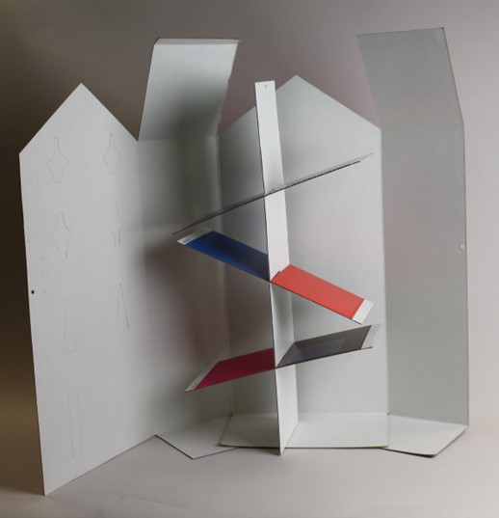
Nets – Maureen Roffey's Doll's House
Maureen Roffey's doll's house net creates a house shape. She then included extra pieces which slotted together to make floors inside.
You are going to create your own miniature house from a net. It will have a house shape, and some floors to stick inside.
First, you will decorate the insides of the house, then cut it out so you can decorate the outside which is on the back.
Lower Key Stage 2
^{mylearning.org}

Slide 13
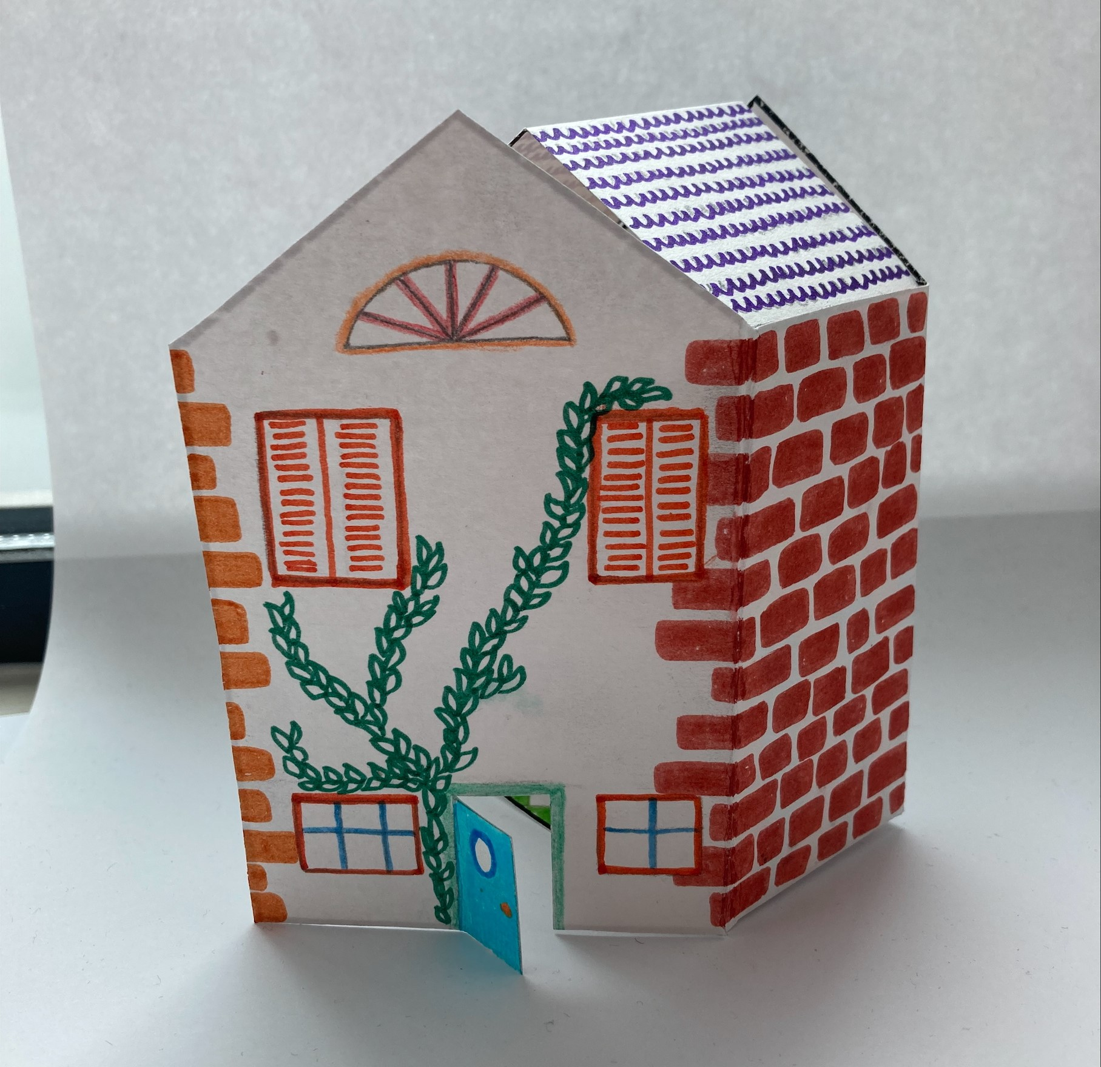
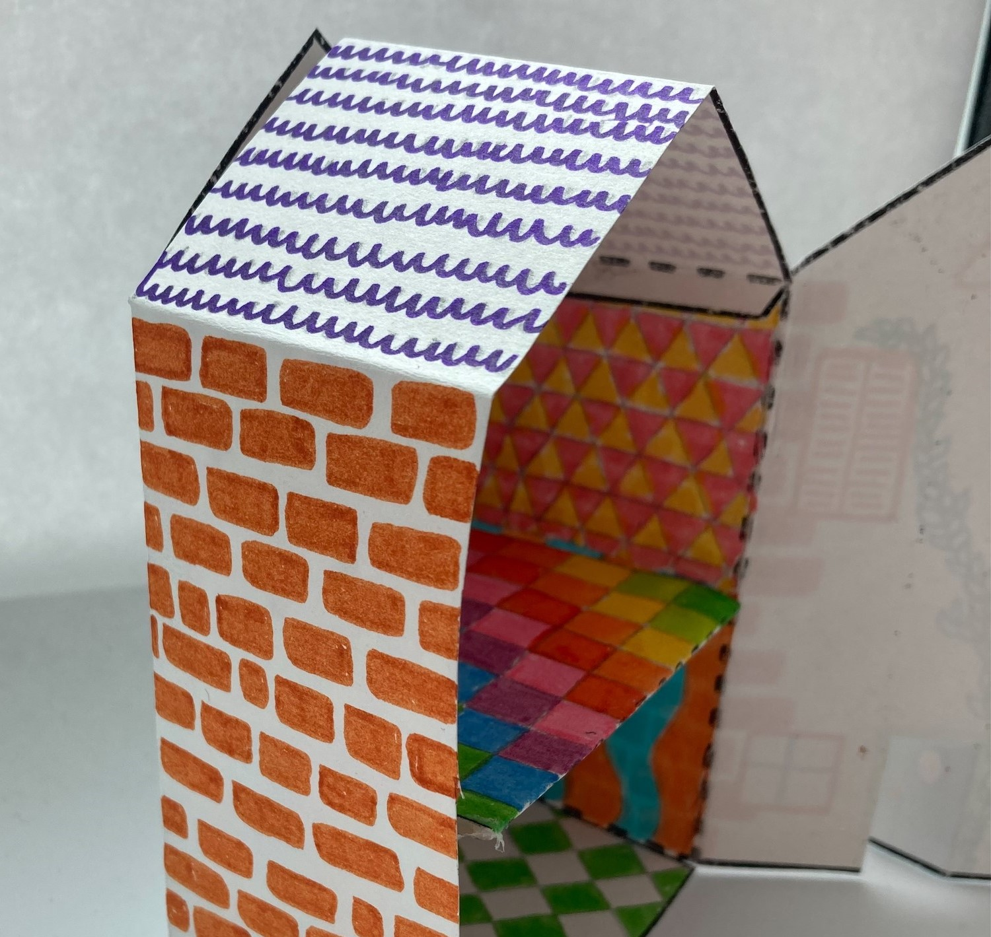
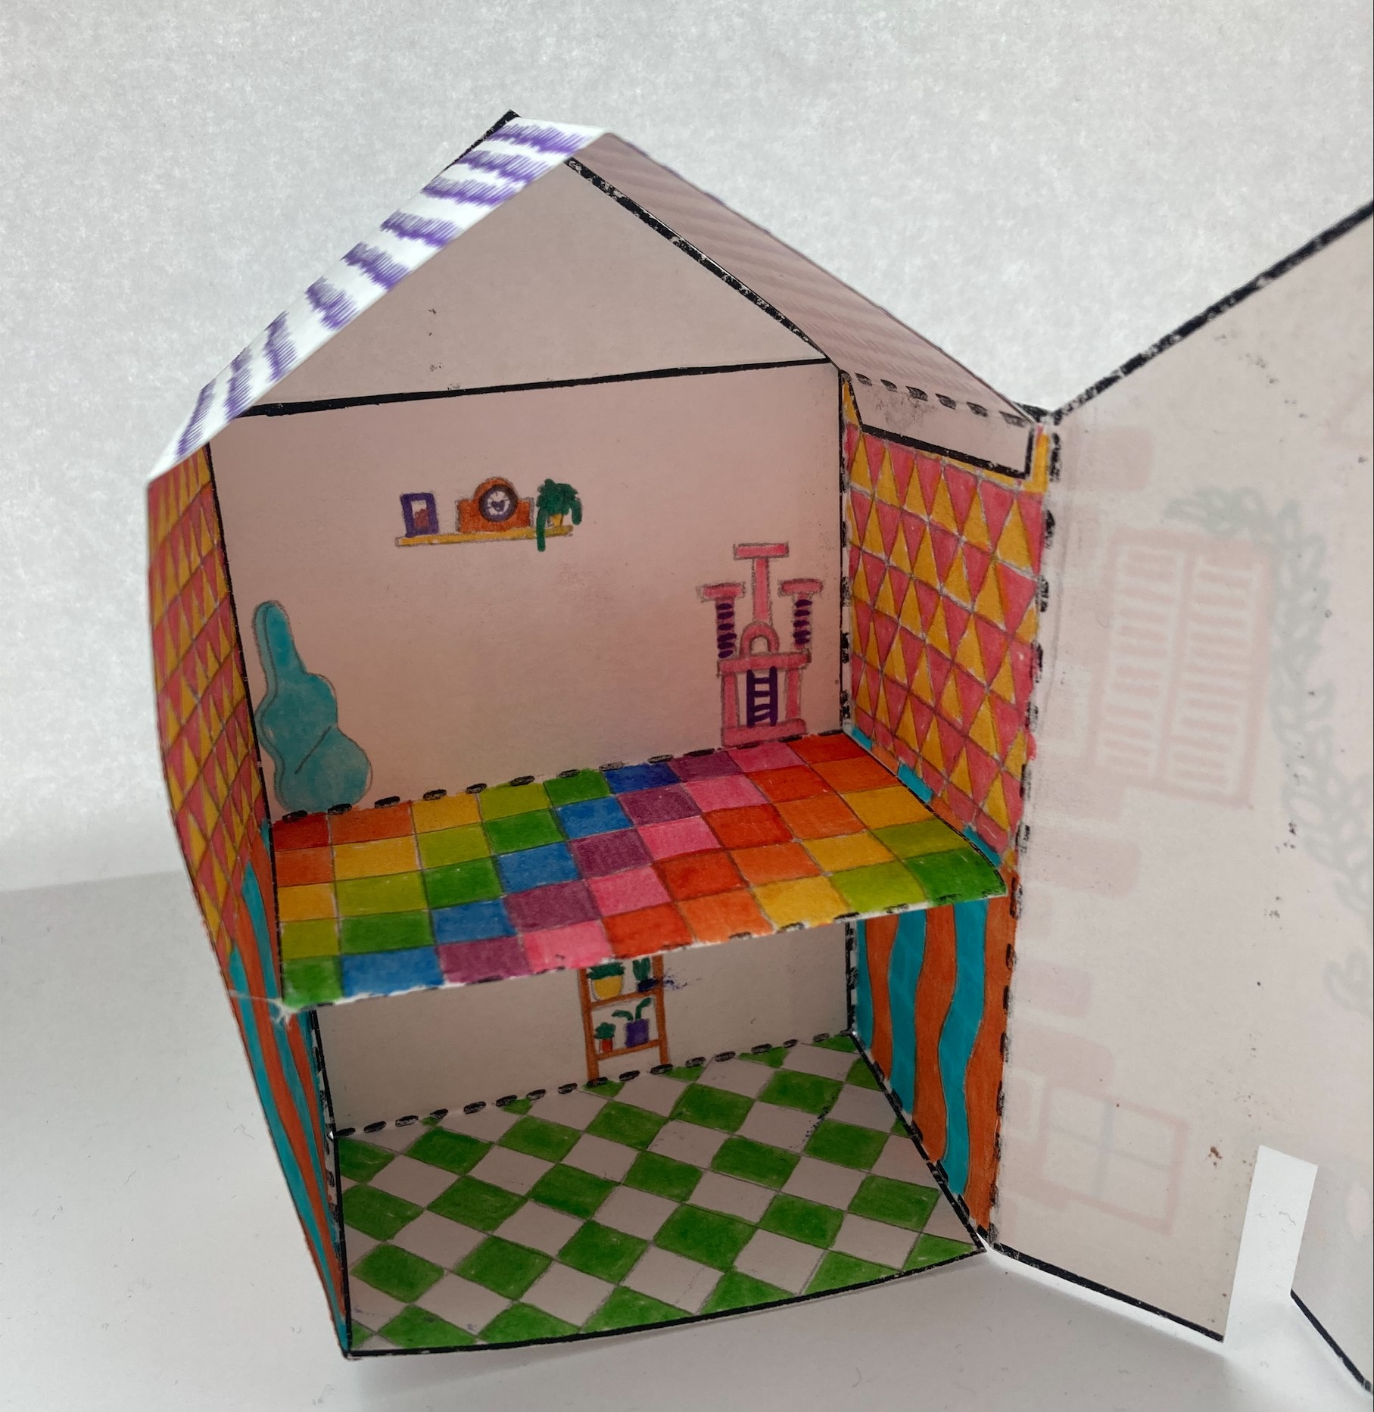
Lower Key Stage 2
^{mylearning.org}
^{mylearning.org}

Slide 14

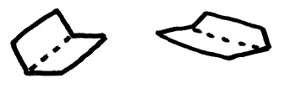

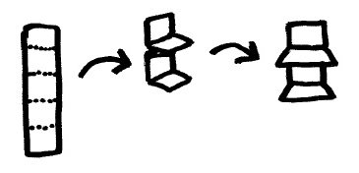
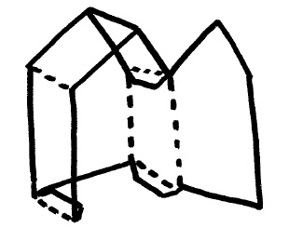
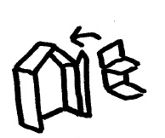
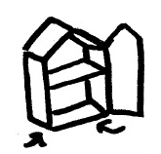
Nets - Instructions
Decorate the inside of your house, following the guide on the next slide. | 2. Cut out the solid lines. | 3. Fold the dotted lines.
4. Open out and decorate the outside of the house. | 5. Create the floors to go inside. | 6. Fold the house fully and glue the roof tab to the opposite inside wall.
7. Glue the walls inside the house to create the floors. | 8. Stick the side wall tabs to the base of the house. | 9. Well done!
Lower Key Stage 2

Slide 15
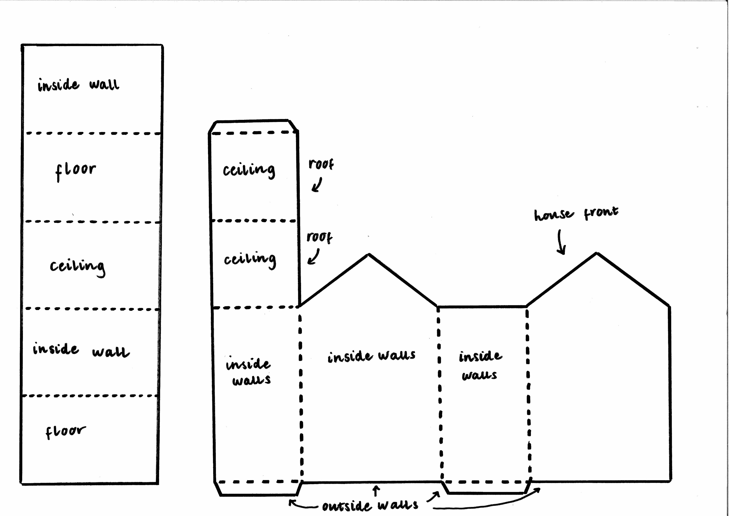
Nets – Design Guide
Arrows indicate what is on the reverse side of the section.
Lower Key Stage 2

Slide 16
Extension Ideas
Maureen Roffey's doll's house had lots of extra decoration to stick in, as well as nets of different furniture to make! You could try to make some furniture nets for your doll's house.
You could design your own net to create a different building. It could be a different doll’s house, garden shed, shop or whatever you like!
You will need a ruler, a pencil and some scrap paper to begin your calculations.
You could start by measuring the net template as a guide.
Lower Key Stage 2
^{mylearning.org}

