Slide 1
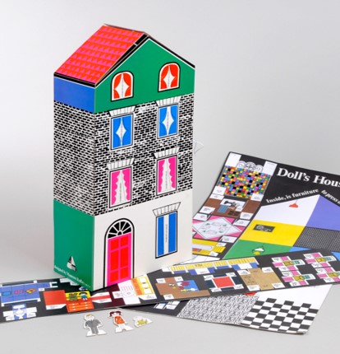
Doll's House Kit
Key Stage 1
Free learning resources from, cultural and heritage organisations
^{mylearning.org}

Slide 2

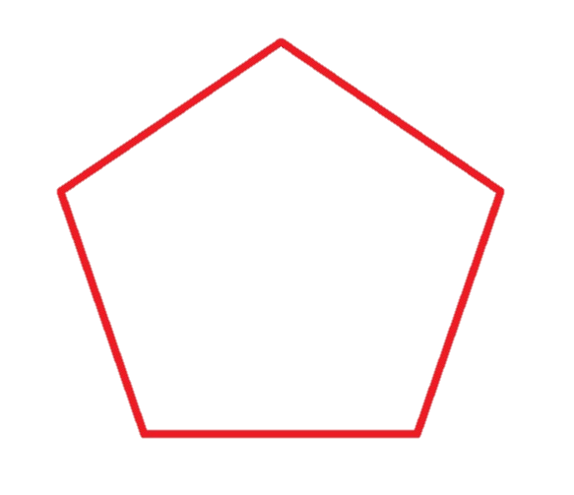

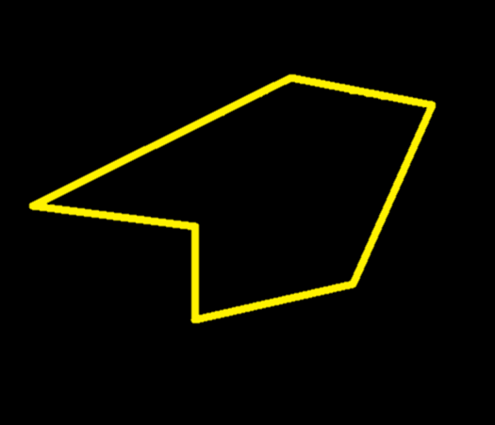
Shapes
Some shapes are regular. All sides of a regular shape are equal length, and the angles the sides meet at are the same.
Maureen Roffey used a range of different shapes in the design of her doll’s house.
Some shapes have sides of different lengths which may meet at different angles – they are called irregular.
Key Stage 1
^{mylearning.org}

Slide 3
Shapes
Have a go at the interactive shape hunt of Maureen Roffey's doll's house.
Can you name all of the shapes labelled on the picture?
Are all the shapes regular or irregular?
Can you find a:
Semi-circle?
Rectangle?
Trapezium?
Triangle?
Square?
Pentagon?
Doll's House Shape Hunt
Key Stage 1
^{mylearning.org}

Slide 4
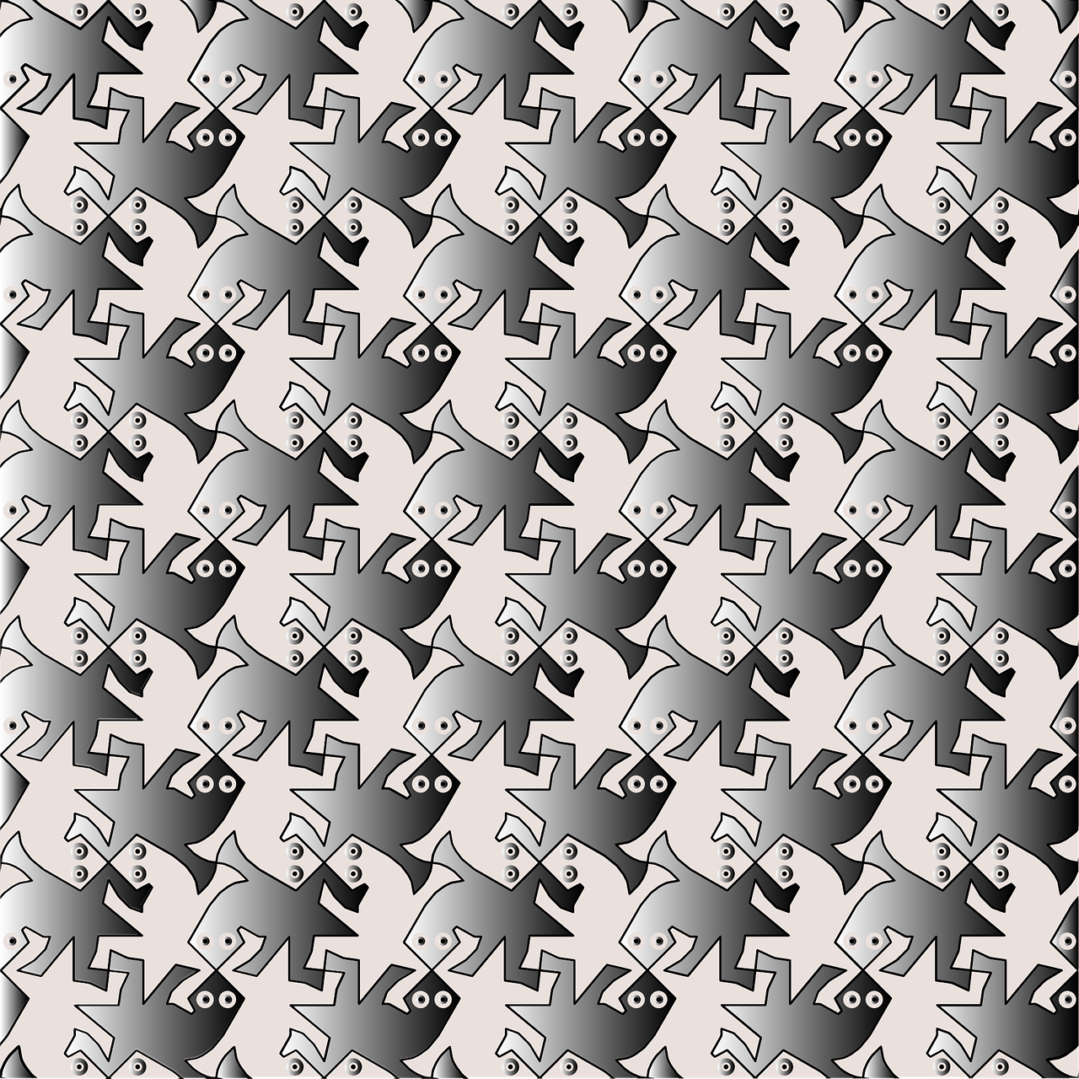
Patterns
A pattern is something that happens in a regular or repeated way.
This pattern is called a tessellations, where the repeated shapes fit together without gaps or overlaps.
What animal do you see in this pattern? Have a go at drawing your own tessellation with an animal shape.
Key Stage 1
^{mylearning.org}

Slide 5
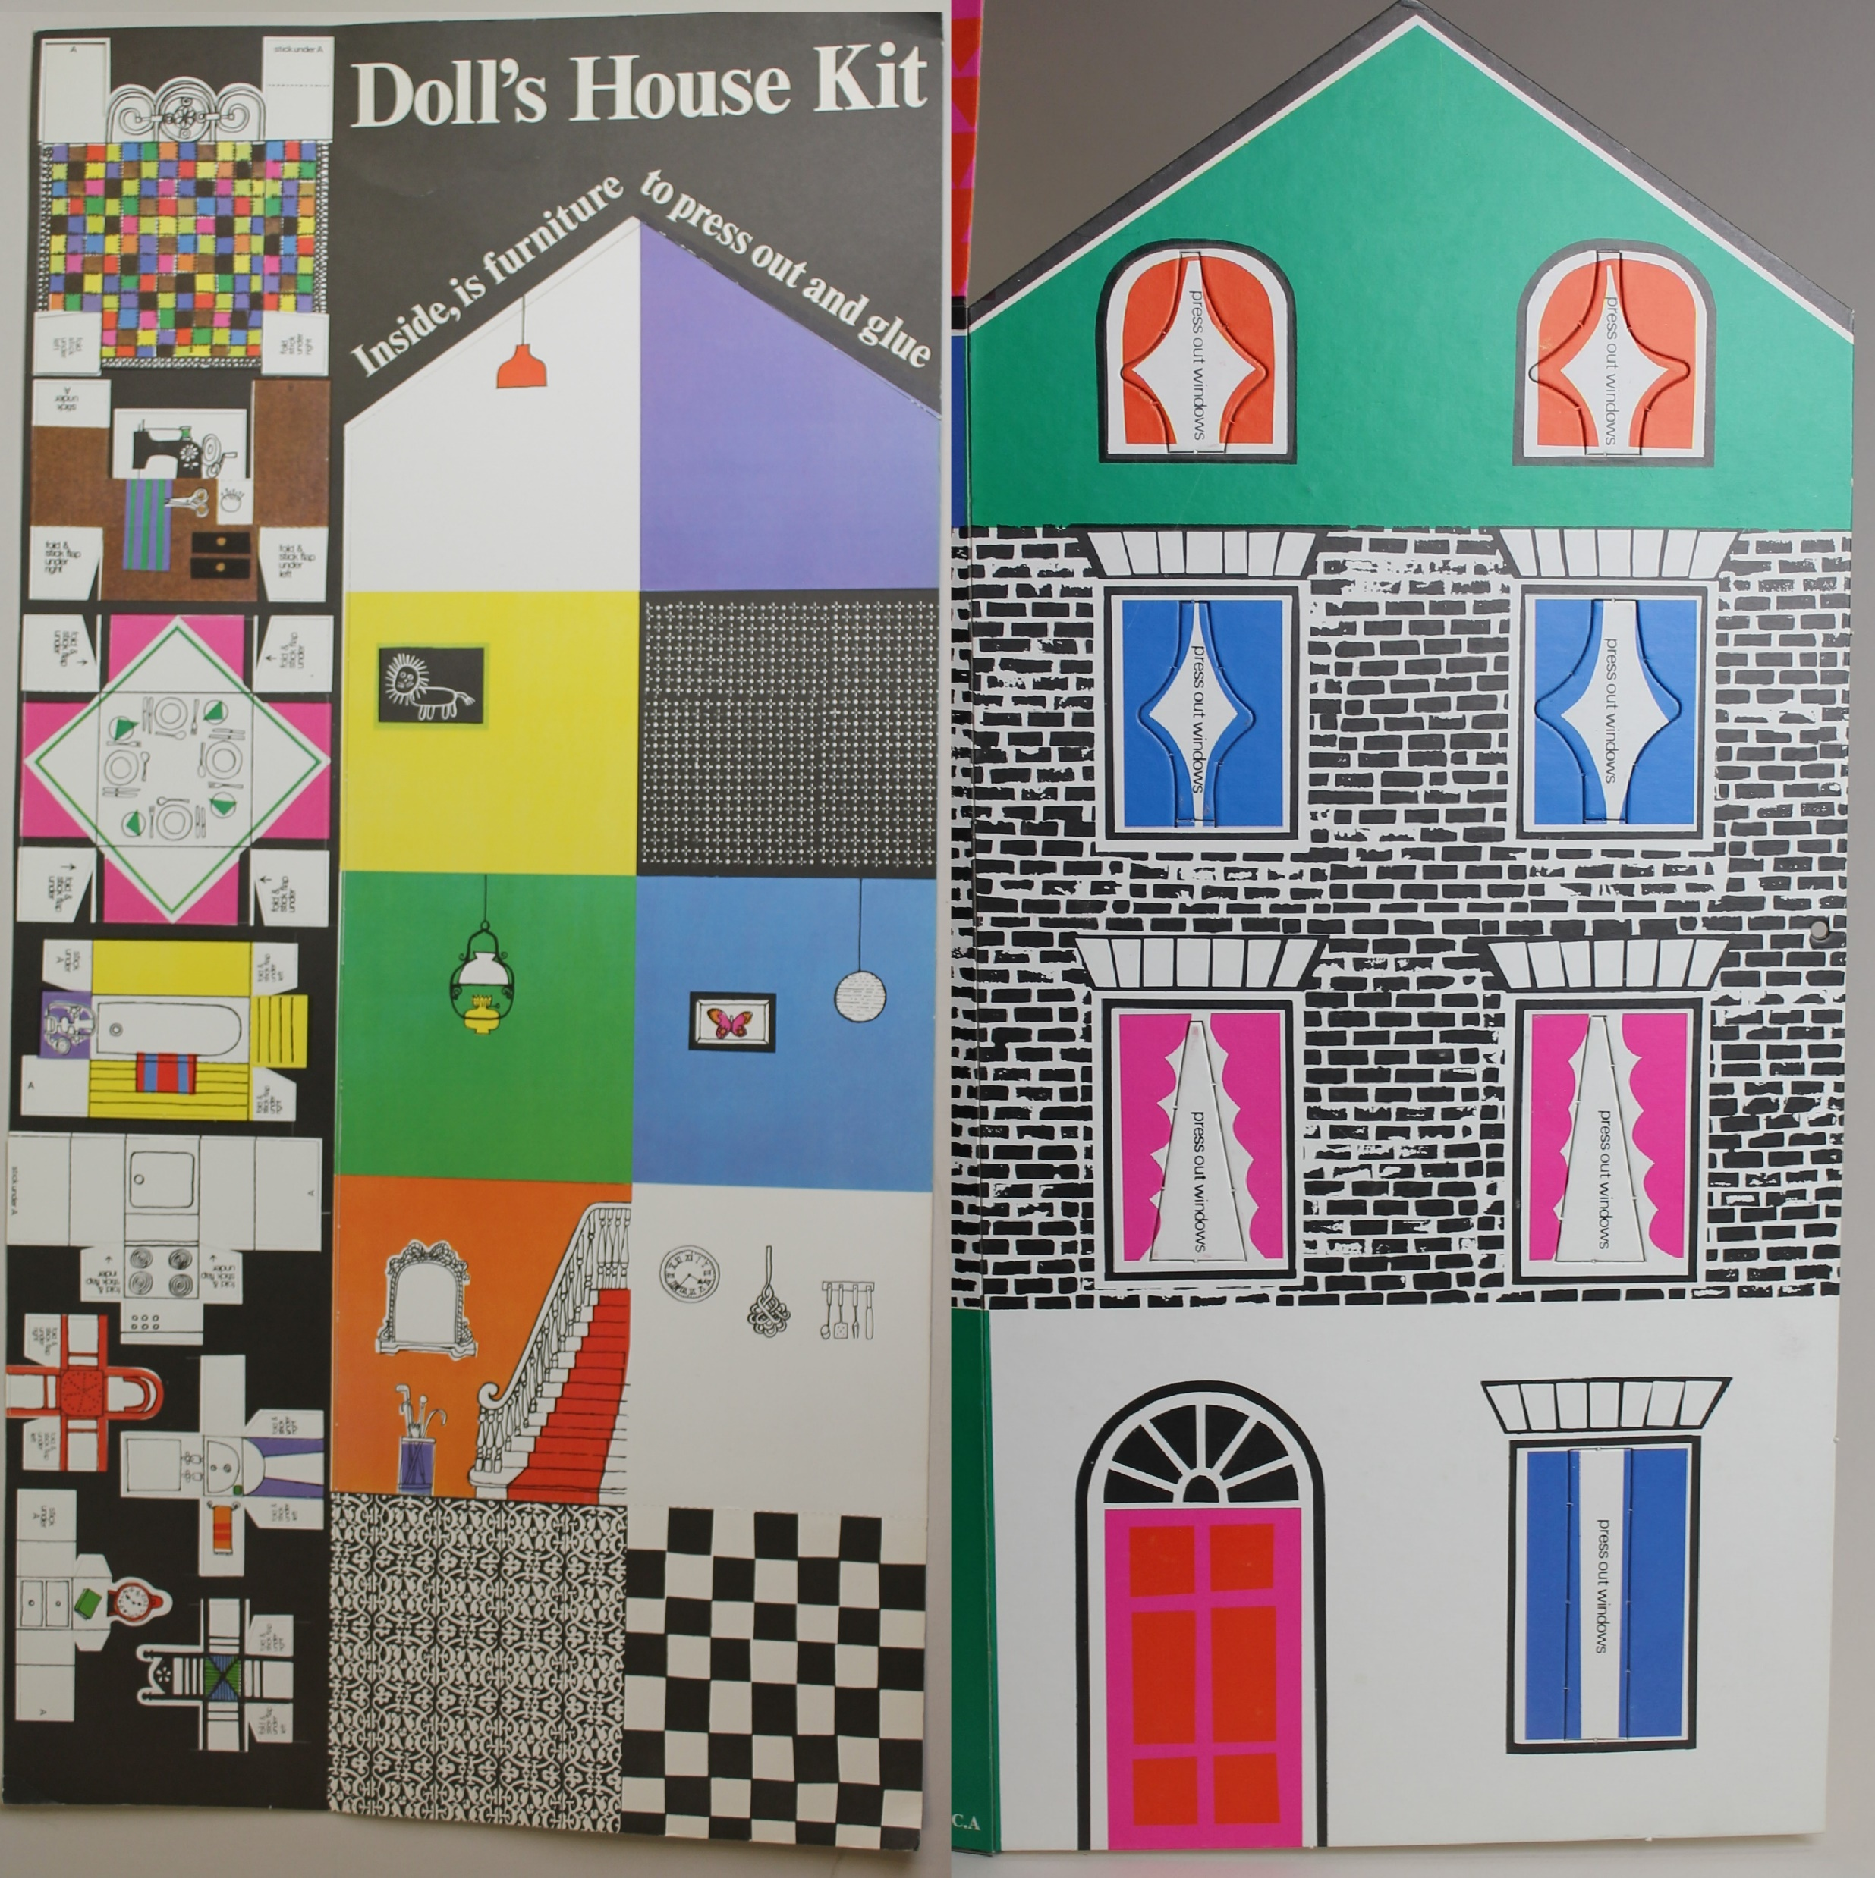
Patterns
Where can you see patterns in the design of the Maureen Roffey doll’s house?
Can you spot some tessellations?
Doll's House Pattern Hunt
When you design your own house, try to include some patterns and tessellations in your décor – you could think about bricks or tiles, floorboards or carpets, and wallpapers!
Key Stage 1
^{mylearning.org}

Slide 6
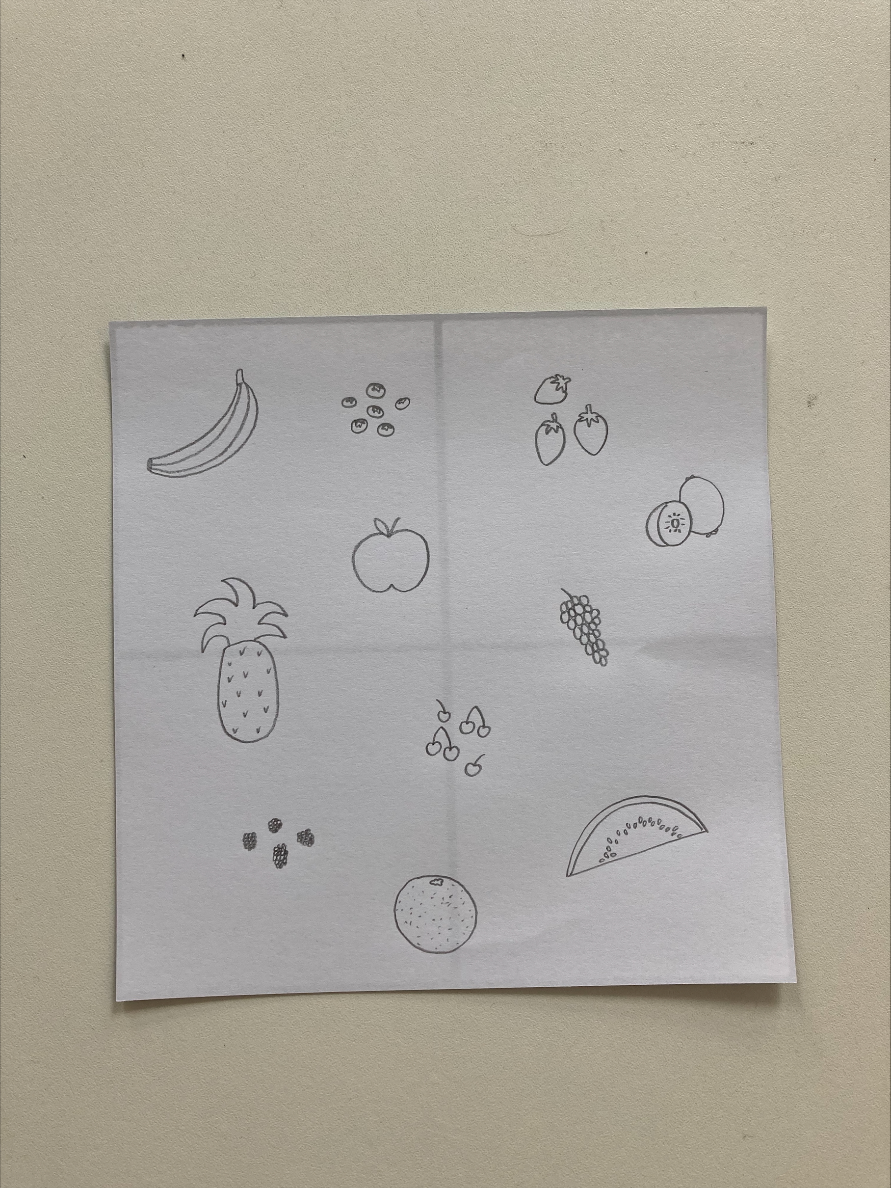
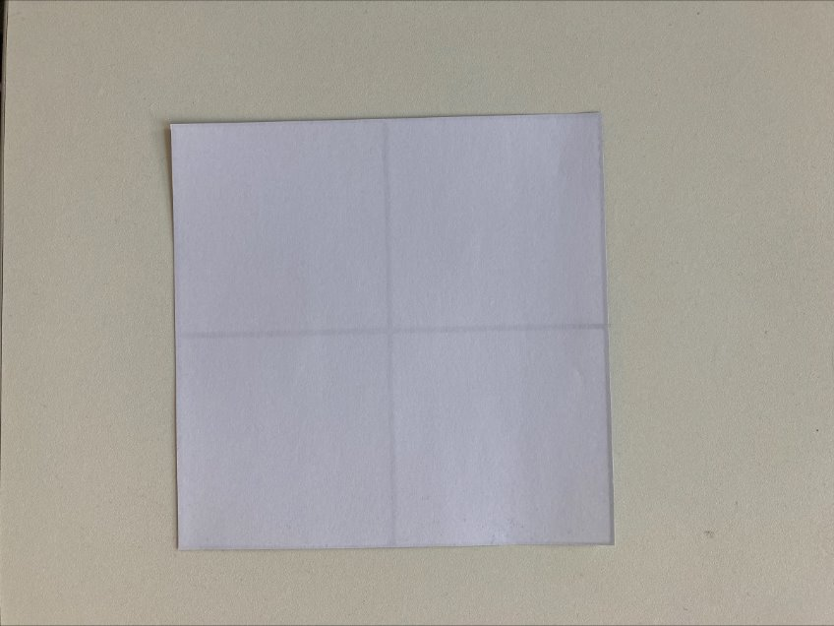
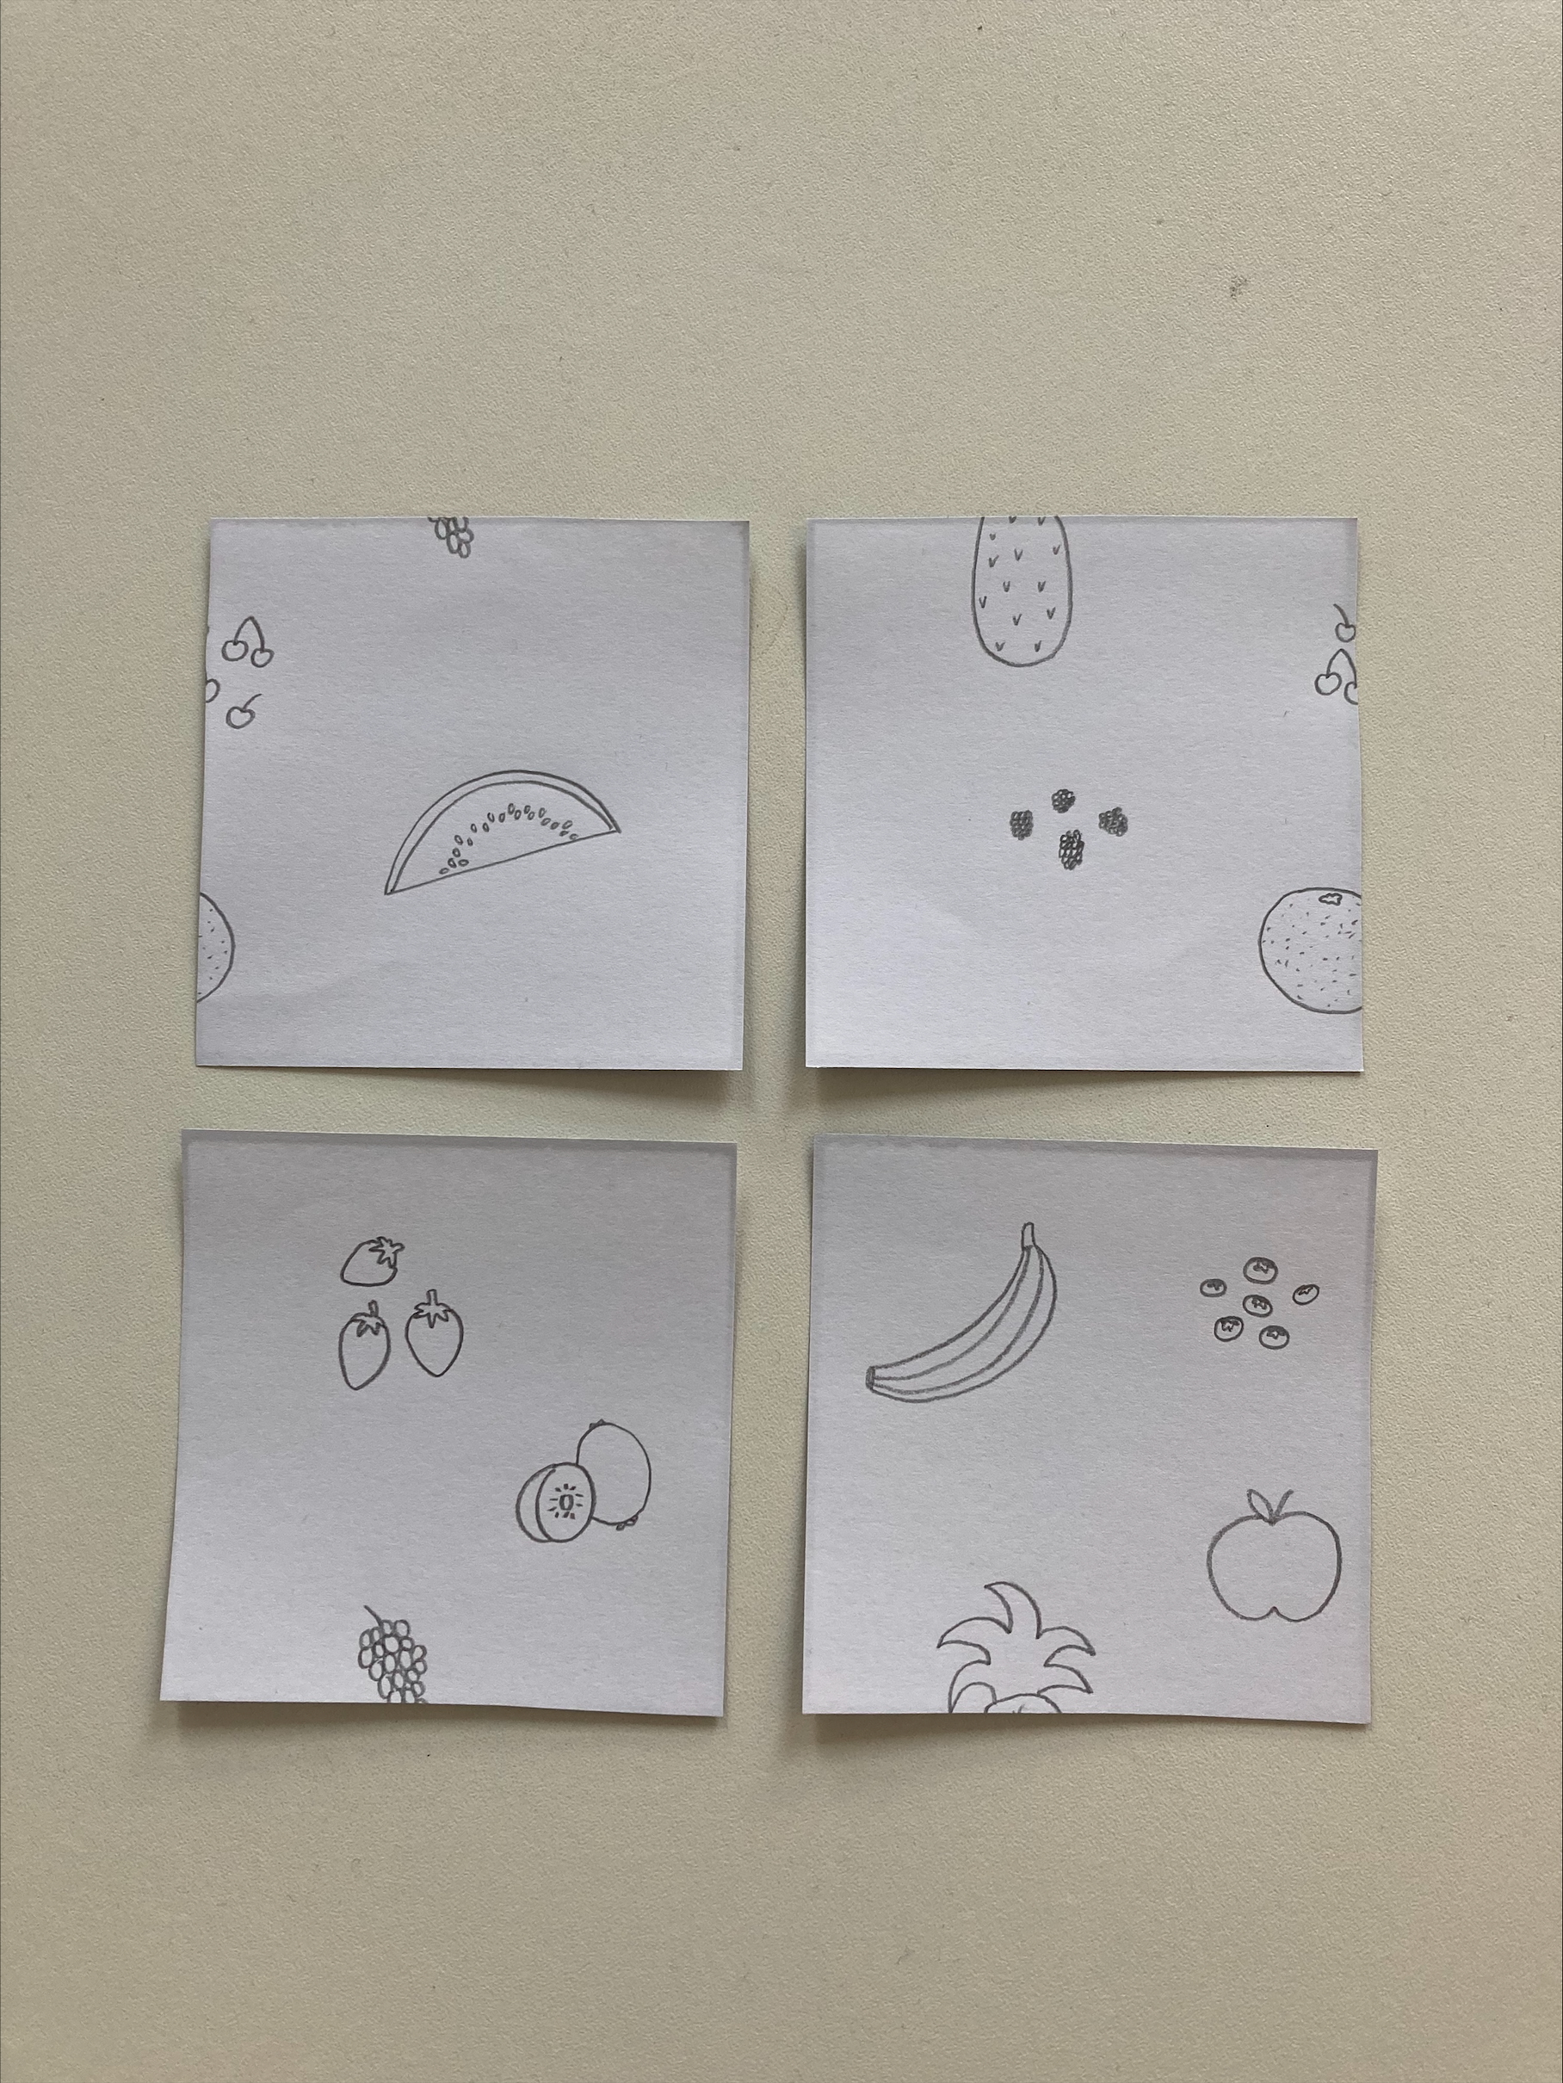
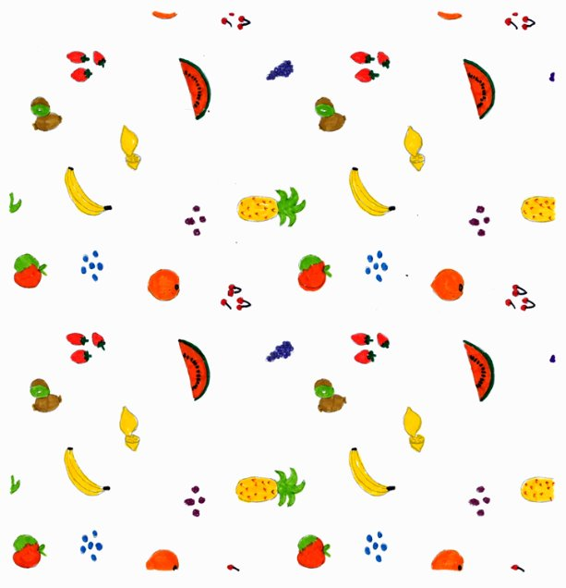
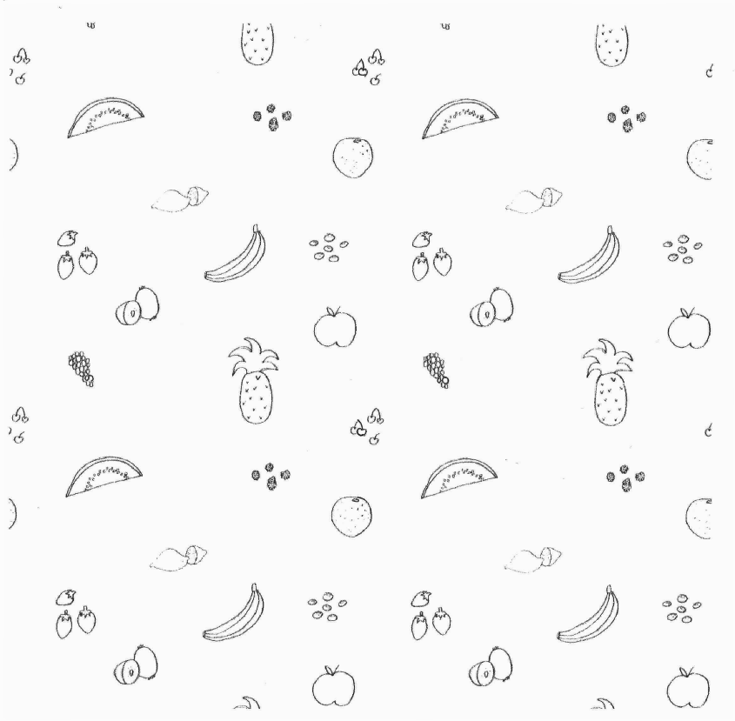
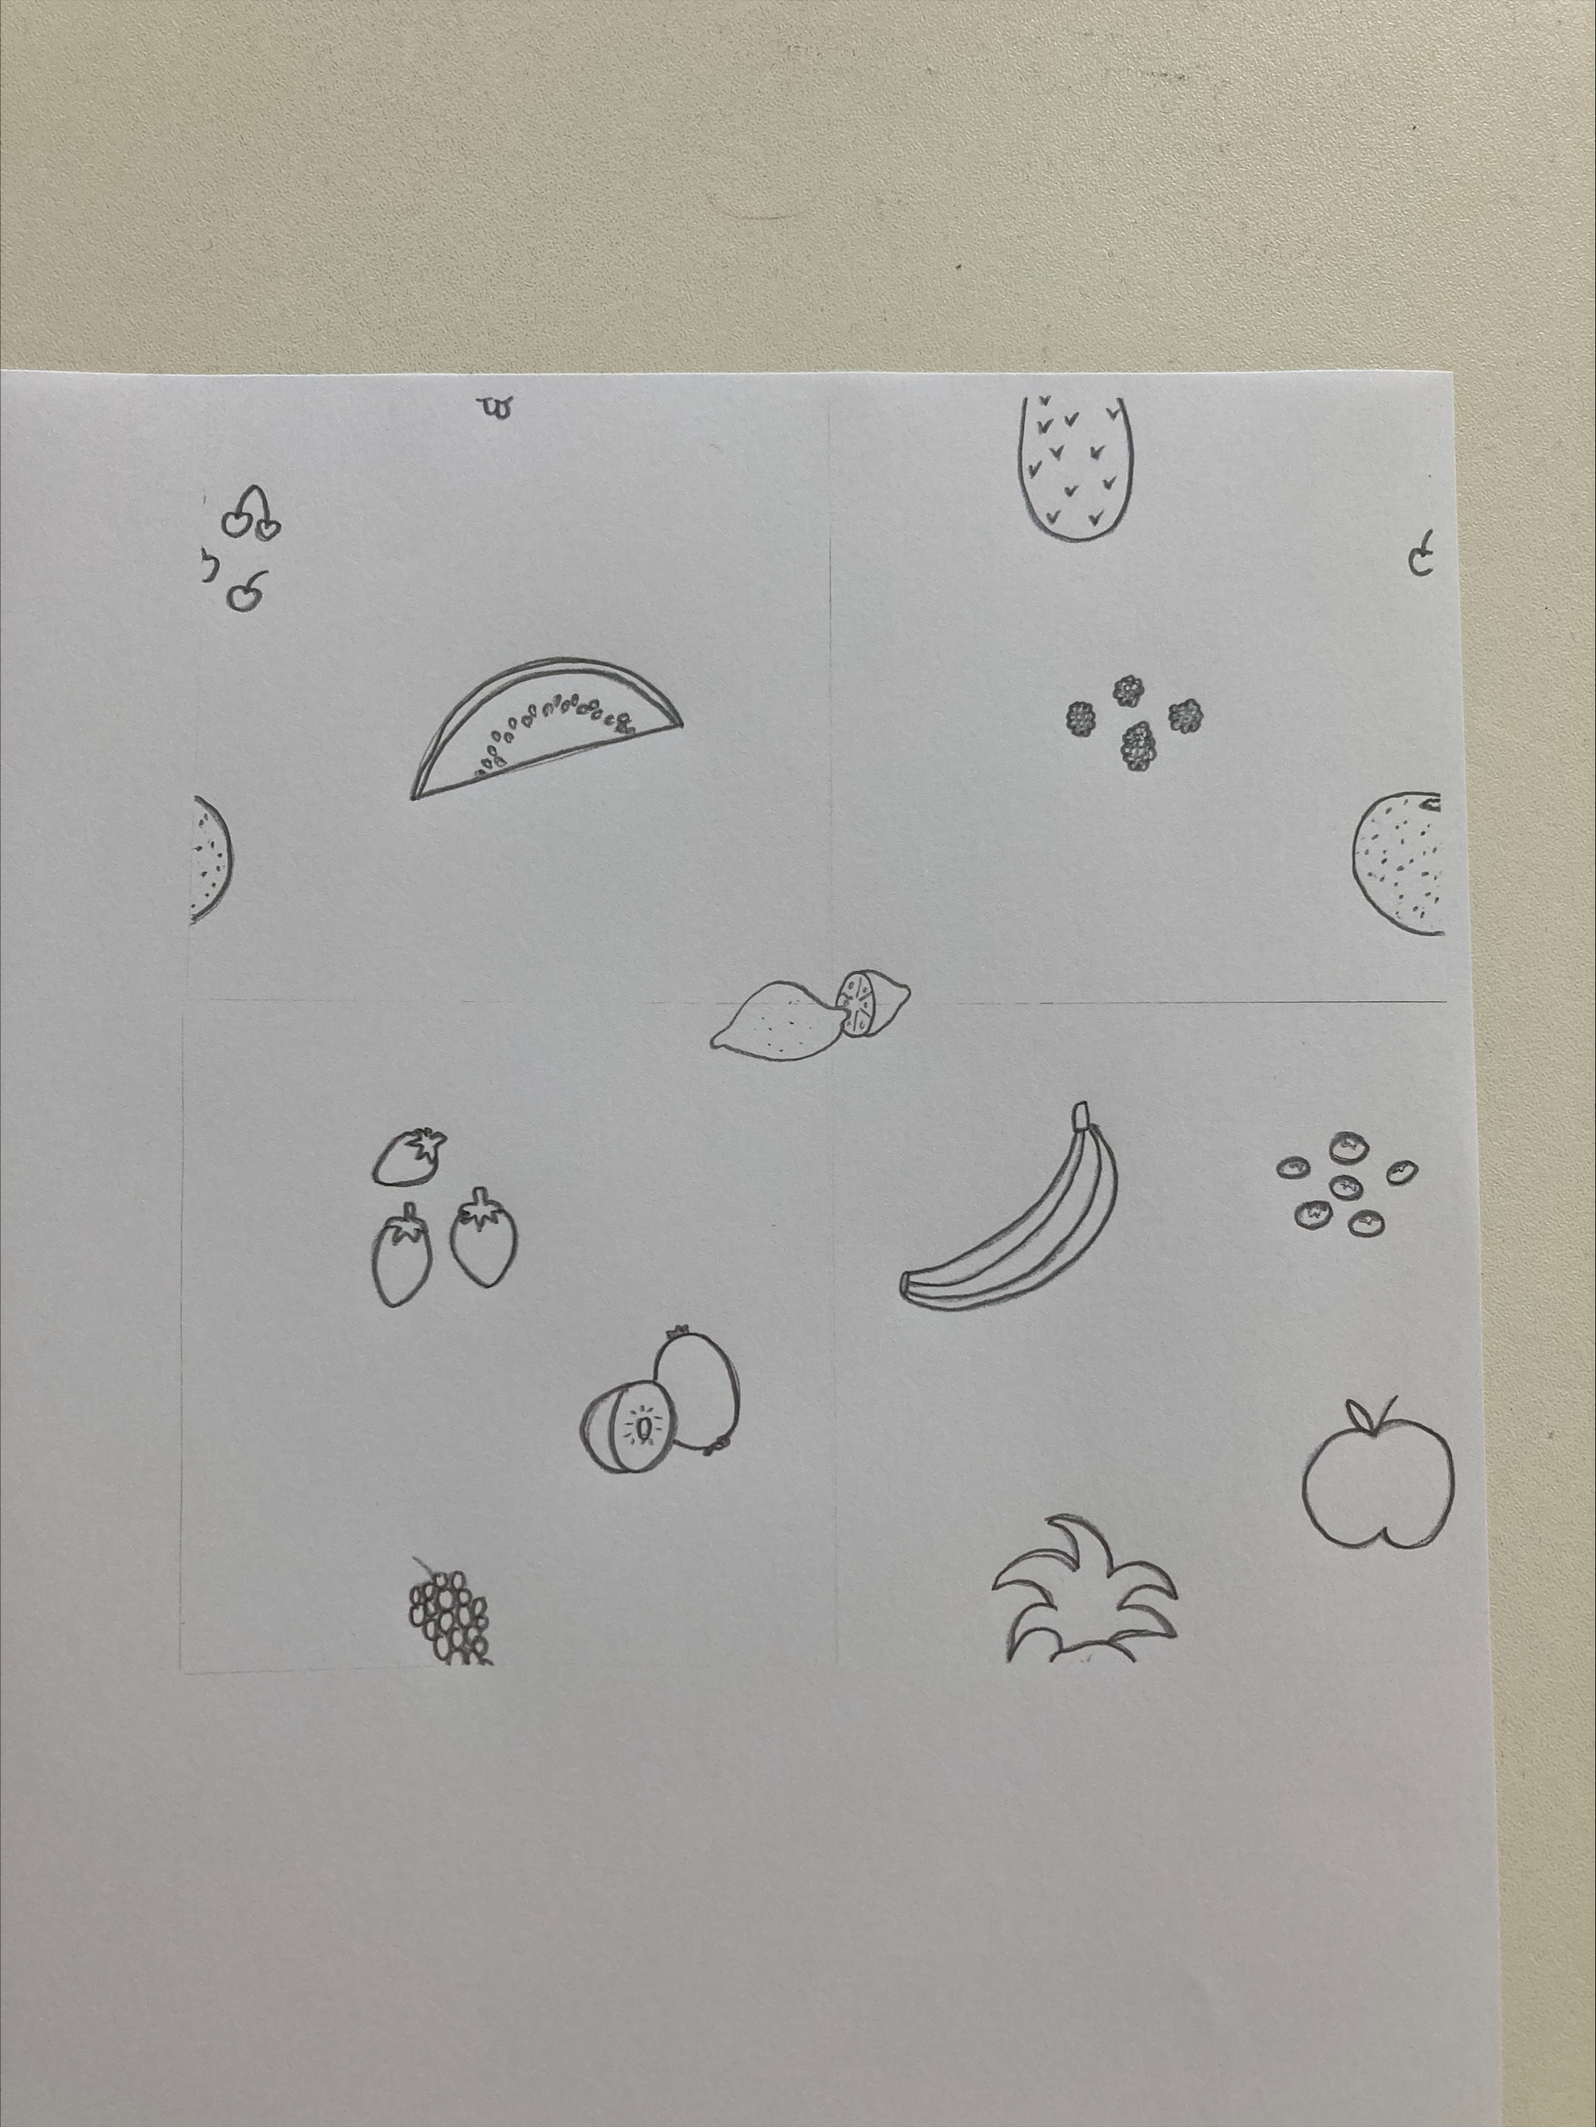
Create a repeating pattern tile
Start with a square piece of paper. | 2. Draw your design. | 3. Cut the paper into quarters, and swap the diagonal pairs.
4. Attach or scan together the pieces, and add a design in the middle. | 5. You now have a tile you can repeat seamlessly! | 6. Add colour to finish it off.
Key Stage 1
^{mylearning.org}

Slide 7
Nets – Maureen Roffey's Doll's House
Maureen Roffey’s doll’s house uses a net to create a 3D doll’s house.
The net of a 3D shape is what it would look like if it was unfolded and laid flat.
Key Stage 1
^{mylearning.org}

Slide 8
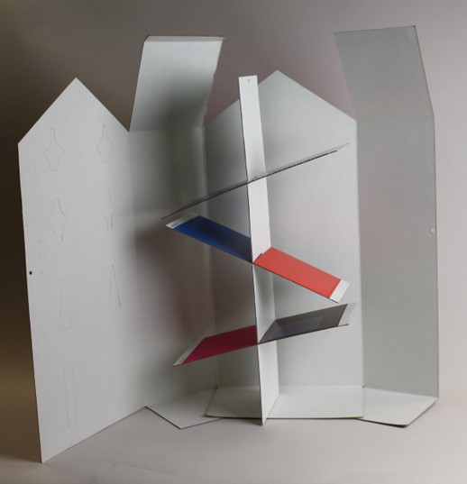
Activity
Maureen Roffey's doll's house net creates a house shape. She then included extra pieces which slotted together to make floors inside.
You are going to create your own miniature house from a net. It will have a house shape, and some floors to stick inside.
First, you will decorate the insides of the house, then cut it out so you can decorate the outside which is on the back.
Key Stage 1
^{mylearning.org}

Slide 9
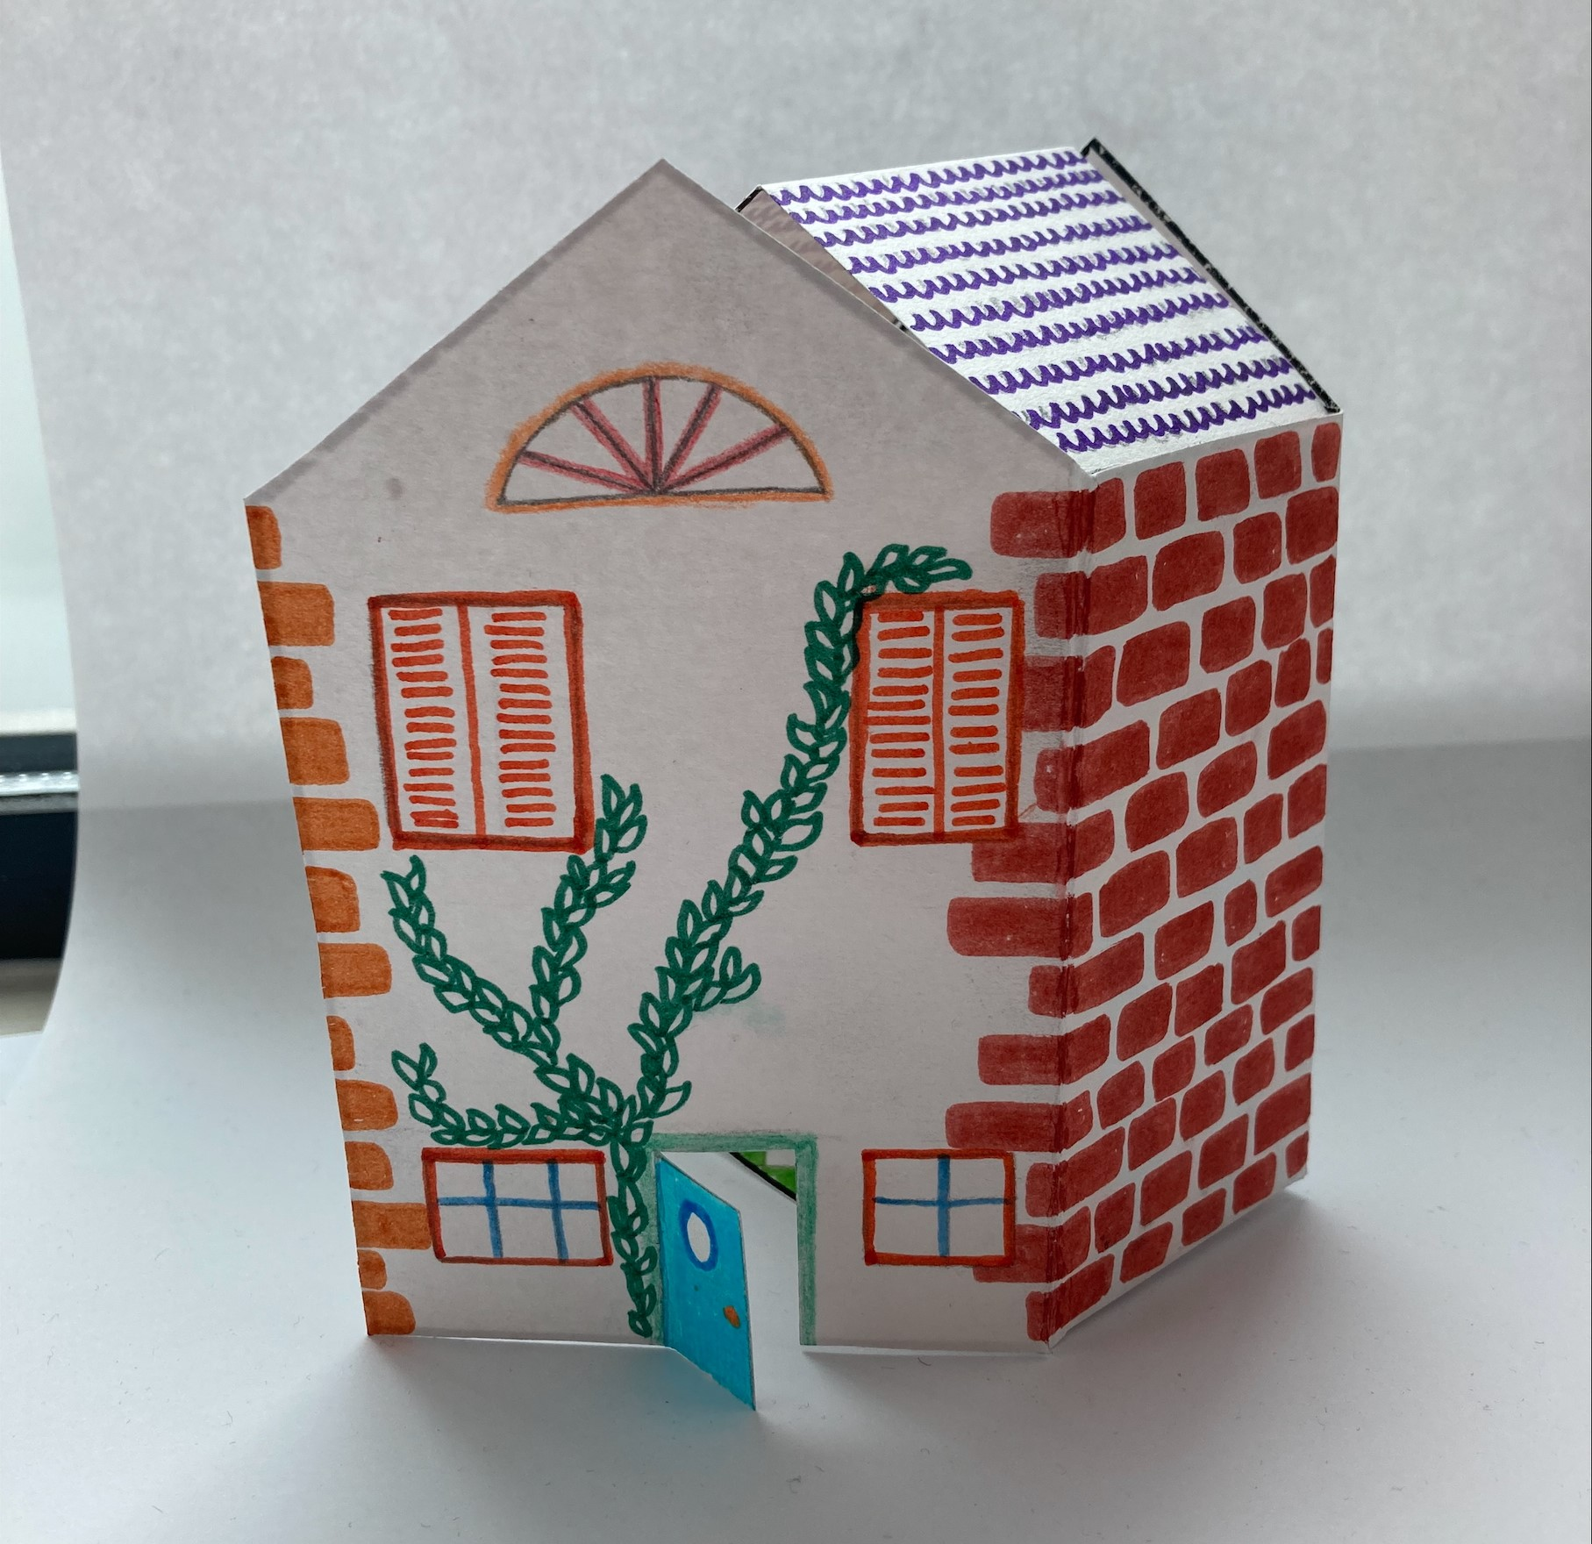
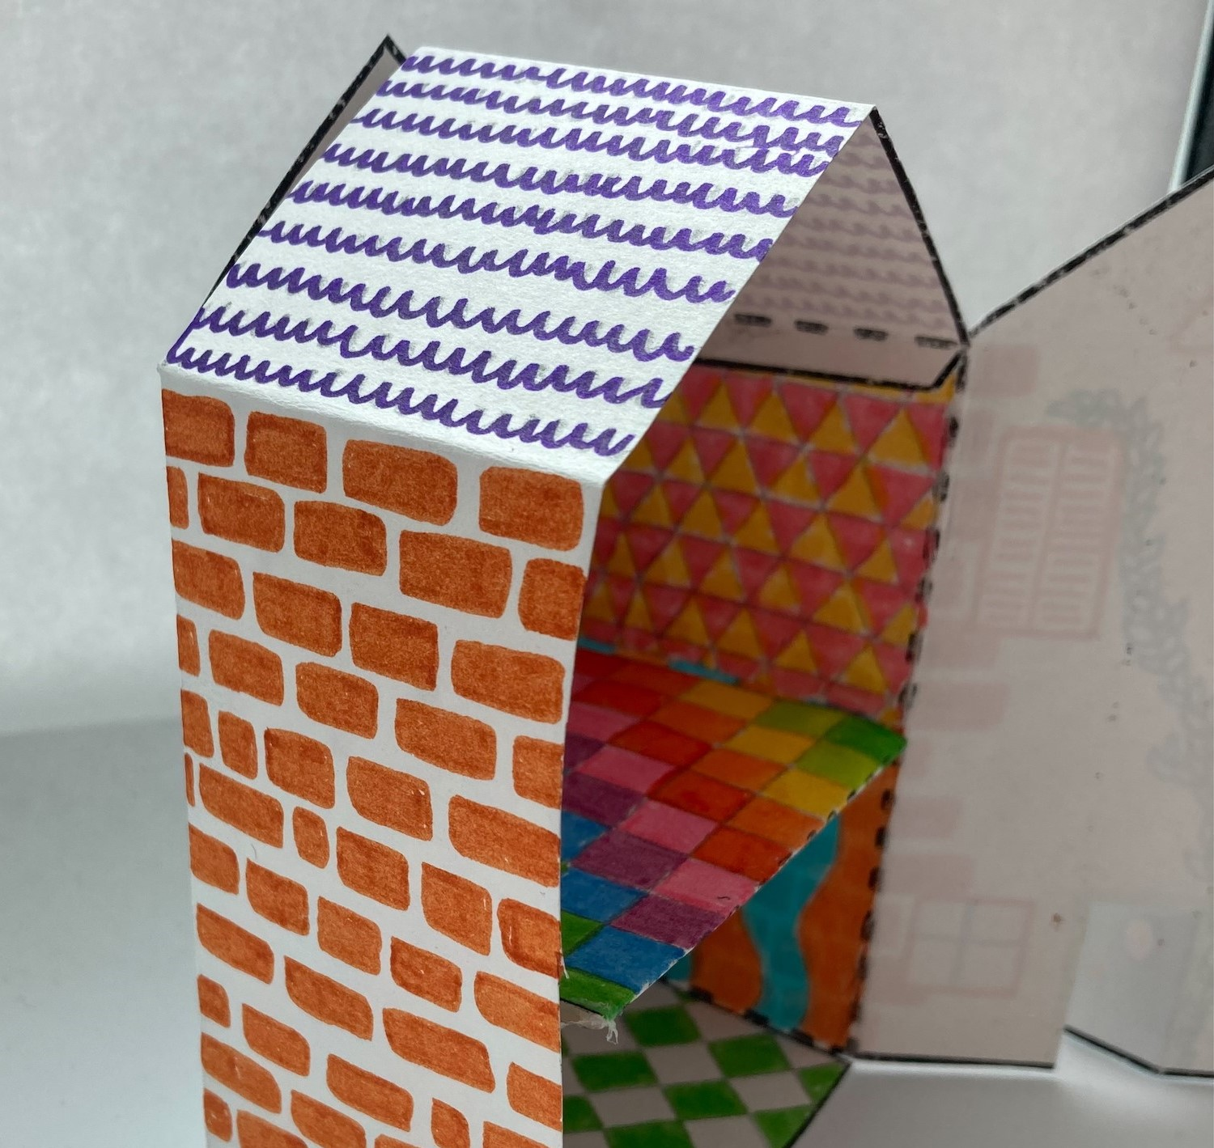
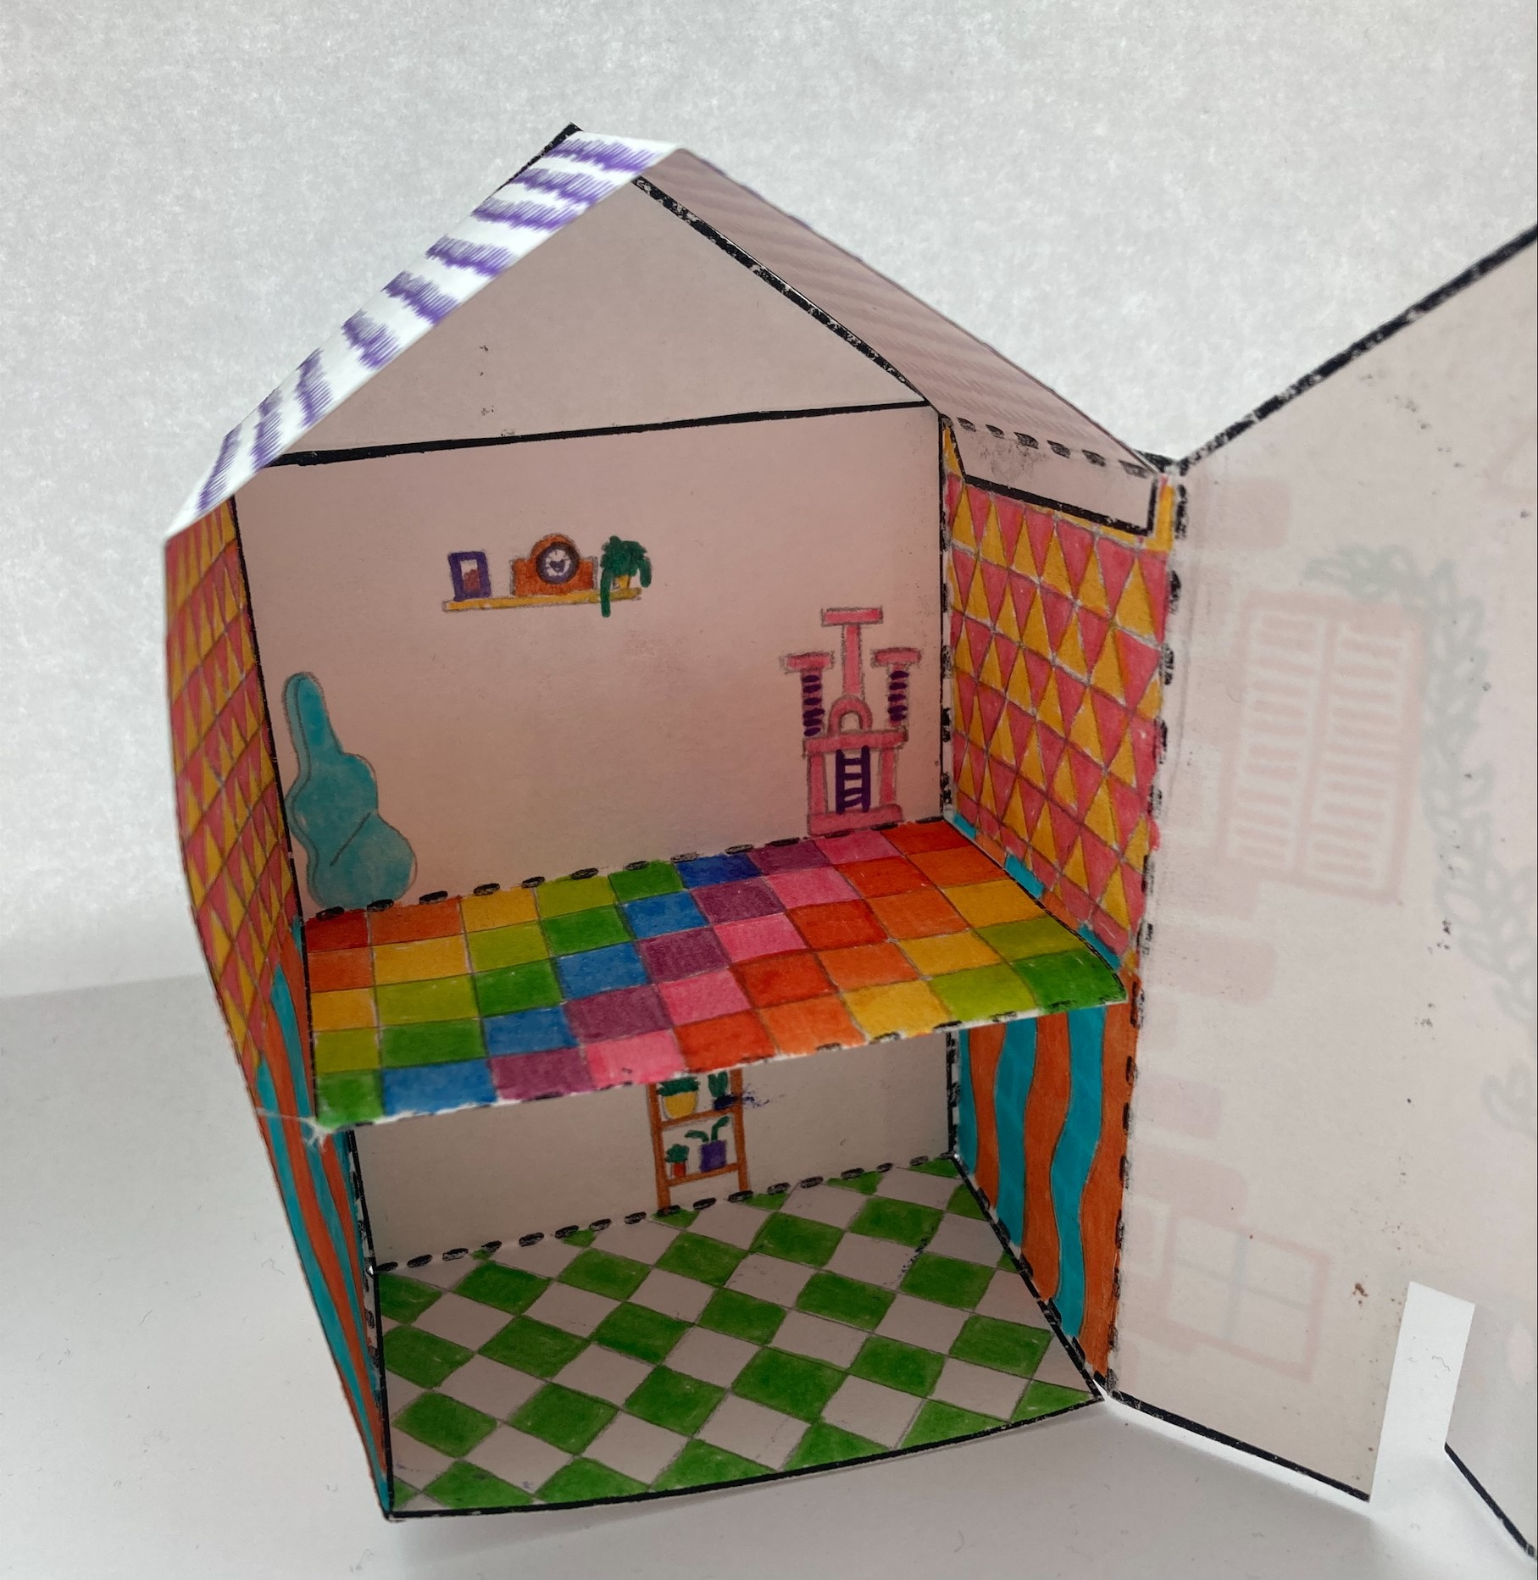
Key Stage 1
^{mylearning.org}
^{mylearning.org}

Slide 10

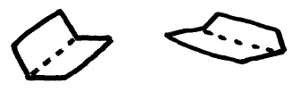

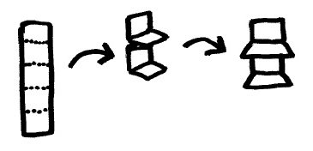
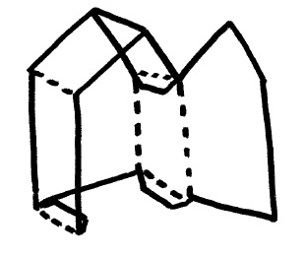
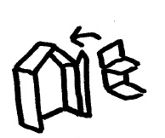
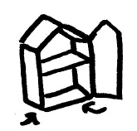
Nets - Instructions
Decorate the inside of your house, following the guide on the next slide. | 2. Cut out the solid lines. | 3. Fold the dotted lines.
4. Open out and decorate the outside of the house. | 5. Create the floors to go inside. | 6. Fold the house fully and glue the roof tab to the opposite inside wall.
7. Glue the walls inside the house to create the floors. | 8. Stick the side wall tabs to the base of the house. | 9. Well done!
Key Stage 1

Slide 11
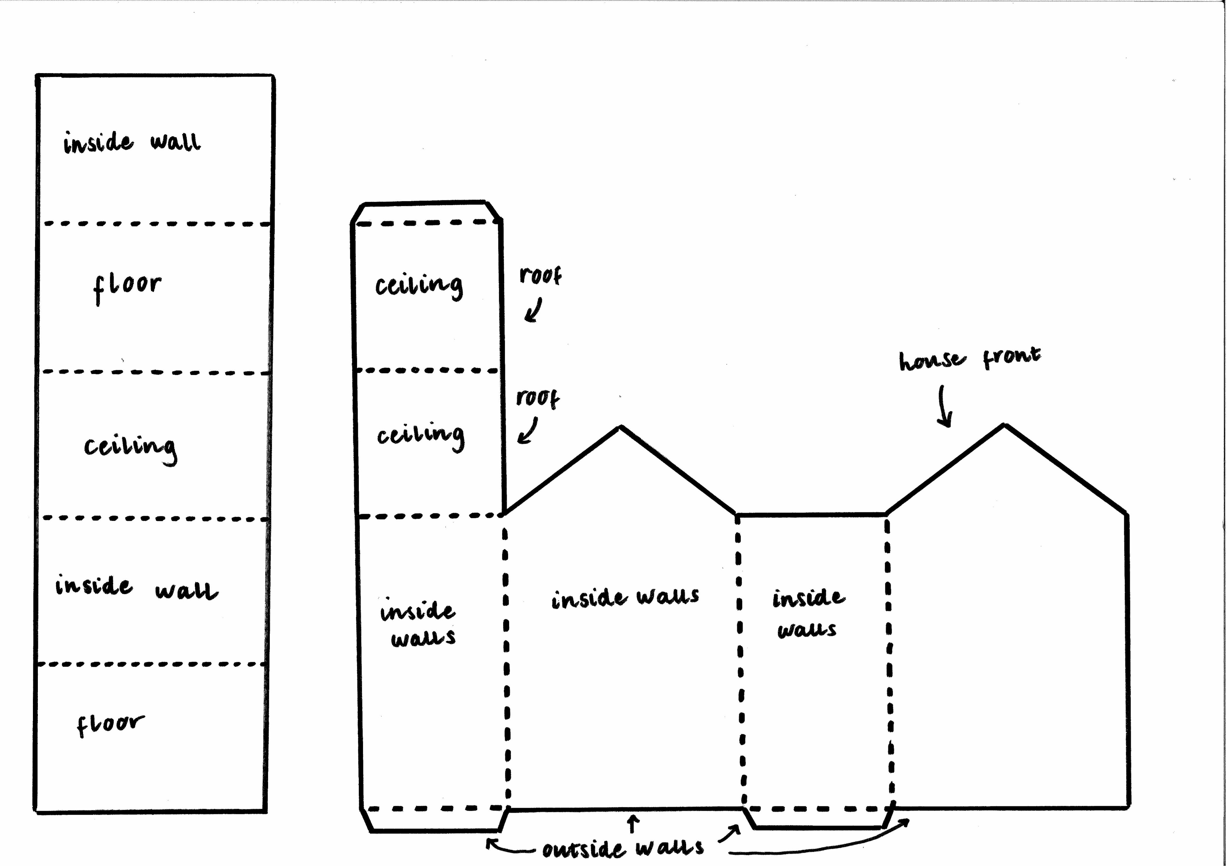
Nets – Design Guide
Arrows indicate what is on the reverse side of the section.
Key Stage 1

