Slide 1

Ancient Greece
Journey to the Underworld
Megan Miller, Hannah Lear and MyLearning
Free learning resources from arts, cultural and heritage organisations
^{mylearning.org}

Slide 2
Journey to the Underworld
To set up this PowerPoint as a touchscreen interactive on a smartboard:
  Go to ’Slide Show’ on the command ribbon
  Choose ‘Set Up Slide Show’
  Select ‘Browse at Kiosk (full screen)’
If you do not have a smartboard, this PowerPoint can be used with a mouse as usual.
^{mylearning.org}

Slide 3
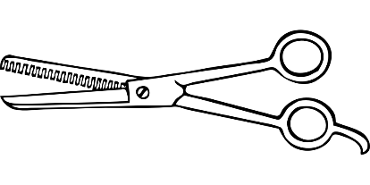
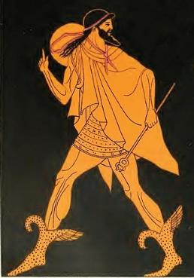
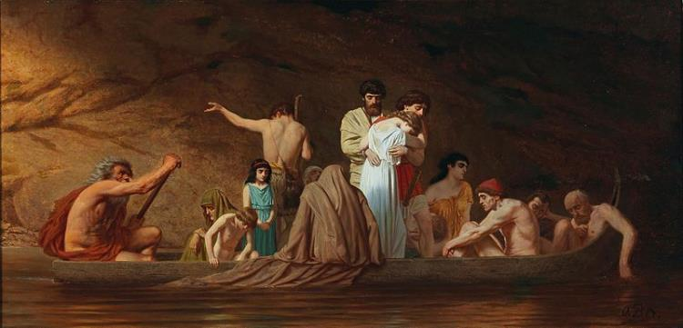
The Journey
The Greeks believed that when you die, Thantos, the God of Death cut a piece of hair from your head.
After this, Hermes, the messenger of the gods, led you to the river Styx.
Image: Francois Lenormant| Public Domain
If your body had been buried, Charon, the ferryman, transported
you across the river Styx.
Image: Otto Brausewetter| Public Domain

Slide 4
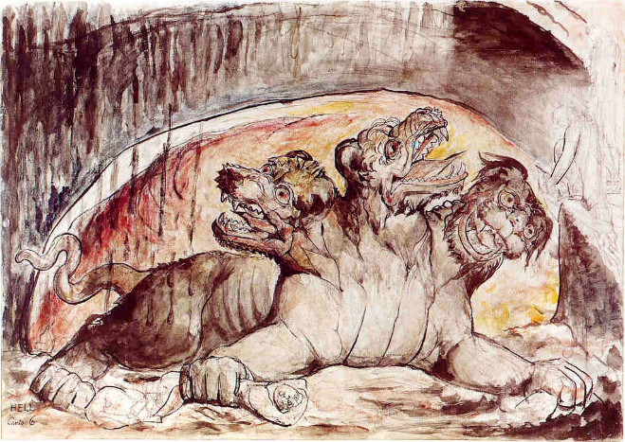
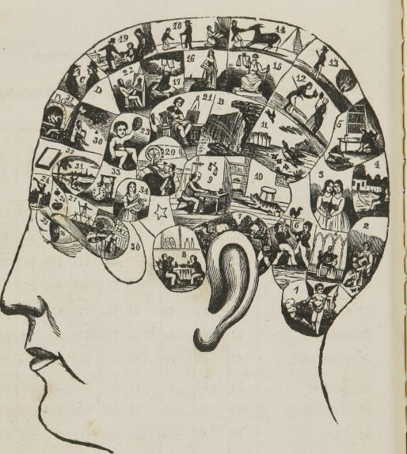
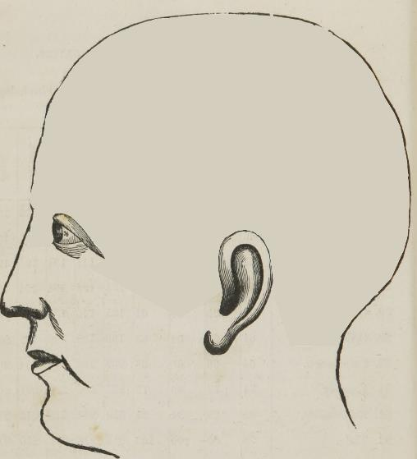
On the river banks sat Cerberus the three-headed dog. He belonged to Hades, the God of the Underworld.
Cerberus guarded the Underworld. His job was to stop people from leaving and returning to the living world.
Image: William Blake | Public Domain
After crossing the river, you would leave the ferry and walk to a place called the ‘Asphodel Fields’. Here you would forget all memories of your former life.

Slide 5
Then, at a fork in the road three judges would decide where to send souls. There were 3 different places:
Elysium is where the good people were allowed to go. This was a comfortable place where the sun was always shining.
Asphodel Fields is where the judges sent people if they couldn’t decide on the soul’s fate.
Tartarus is where the bad people were sent for punishment

Slide 6
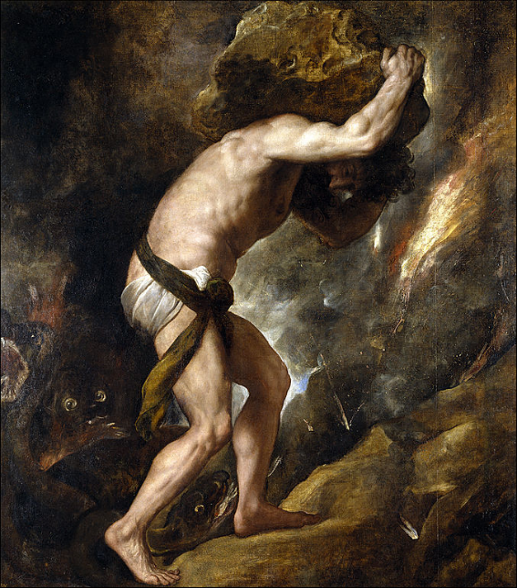
In Tartarus, people who had upset the Gods would receive terrible punishments. Tartarus was a dark place, imagined to be as far below the Earth as the Earth is from the sky.
Greek mythology tells the stories of people who ended up in Tartarus.
For example, Sisyphus, had to push a heavy rock up a hill again and again, only for it to roll back down on him every time.
Image: Titian| Public Domain
Another story tells of hungry Tantalus, who stood near a table covered with delicious food but could never reach it.

Slide 7
Now it’s your turn!
See how much you can remember.
Who was Cerberus?
A
B
C
A God of War
A three-headed
dog
A judge
^{mylearning.org}

Slide 8
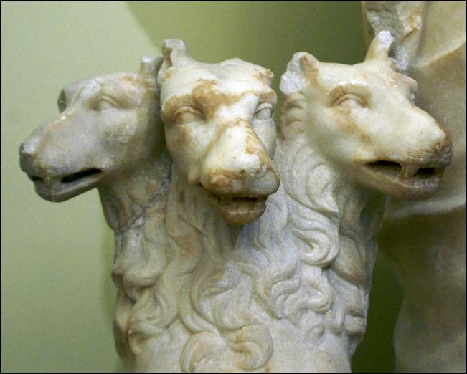
Yes, he is the
three-headed dog!
Cerberus stopped the dead from leaving the Underworld.
Image: Howard Stanbury | Flickr | CC BY-NC-SA 2.0
^{mylearning.org}

Slide 9
That’s not right, try again.
^{mylearning.org}

Slide 10
Now it’s your turn!
See how much you can remember.
What did Thanatos (God of Death)
take when you died?
A
B
C
A finger
Your money
Hair
^{mylearning.org}

Slide 11
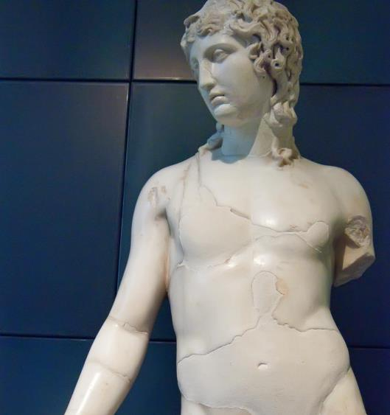
Correct, Thanatos did take
a lock of your hair!
Thanatos was the God of Death.
^{mylearning.org}
Image: Mary Harrsch| Flickr | CC BY-NC-SA 2.0)

Slide 12
Not right this time, try again.
^{mylearning.org}

Slide 13
Now it’s your turn!
See how much you can remember.
What happened after crossing
the river?
A
B
C
You forgot all of
your memories
You were in
the Underworld
You met with the
God of Death
^{mylearning.org}

Slide 14
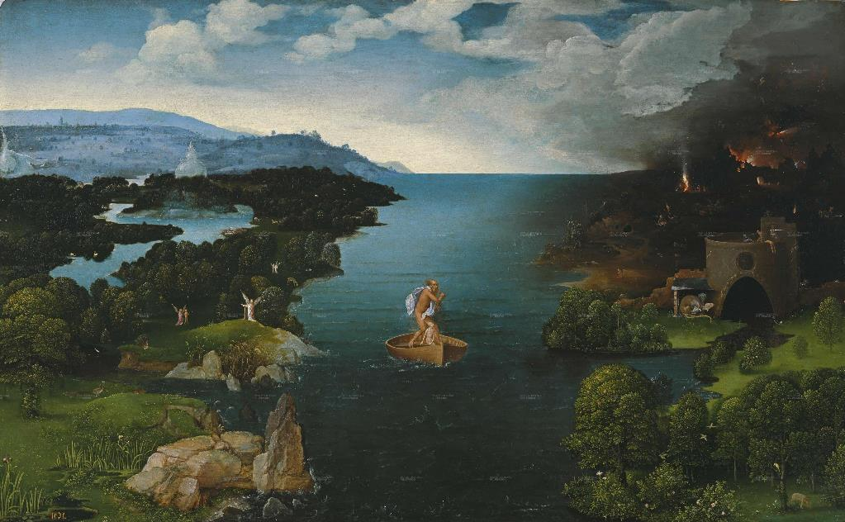
Correct, you forgot all of
your memories!
Image: Amy Goodman| Flickr | CC BY-NC 2.0
^{mylearning.org}

Slide 15
That’s not right, try again.
^{mylearning.org}

Slide 16
Now it’s your turn!
See how much you can remember.
What was Hades the god of?
A
B
C
Death
Underworld
He wasn’t a god
^{mylearning.org}

Slide 17
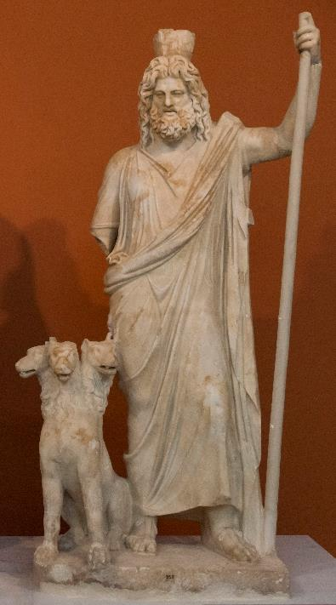
You are right – he was the
God of the Underworld!
^{mylearning.org}
Image: Egisto Sani| Flickr | CC BY-NC-SA 2.0

Slide 18
That’s not right, try again.
^{mylearning.org}

Slide 19
Now it’s your turn!
See how much you can remember.
Who led you to the River Styx?
A
B
C
Cerberus
Hades
Hermes
^{mylearning.org}

Slide 20
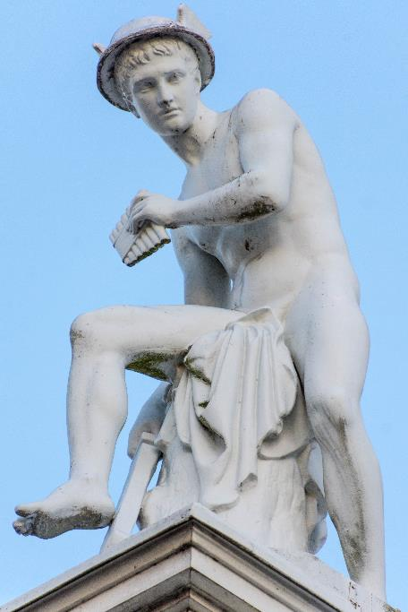
You are right – Hermes led
you to the River Styx!
End
Image: Don Sniegowski | Flickr | CC BY-NC-SA 2.0
^{mylearning.org}

Slide 21
Not this time! Try again.
^{mylearning.org}

Slide 22
Now you have explored the journey to the Underworld…
Ancient Greece
Why not explore a nearby museum’s
Ancient Greek collection?
You’re bound to discover something amazing!
^{mylearning.org}

