Slide 1

The story of one Shabti
© Jael Williams Consultants 2021

Slide 2
This Resource
The uniqueness of this resource is the collaboration between Theatre Company Blah Blah Blah, Leeds Museums and Galleries and Jael Williams Consultants – a combination of creative learning, participatory drama, storytelling, object based learning and critical thinking specialists.
We want to create a set of resources that you can draw from to deliver a number of distinct curriculum areas as well as enabling cross curricular learning and skills development including English Literacy, History, Geography.
The resources will also be a rich source of teaching and learning to support wider social, moral, spiritual, cultural and emotional learning.
The resource will give inspirational ideas for generating an immersive and captivating learning environment within the classroom – taking children to a series of other places, spaces and perspectives.
Notes:
This series of slides accompanies the core resource on My Learning ‘The story of one Shabti’
You can dip in and out of the core resource and this PPt to create your own bespoke lines of enquiry and learning activities for your class
You do not need to be studying Ancient Egypt as the resources cover a number of different subject areas using the Shabti as a ‘way in’ to teaching and learning.

Slide 3
The 6 Sections
Seti I Shabti
Creating an immersive learning environment
Using objects for learning
Using stories for learning
Using drama for learning
Using philosophical enquiry for learning
Using Geography and History for learning

Slide 4
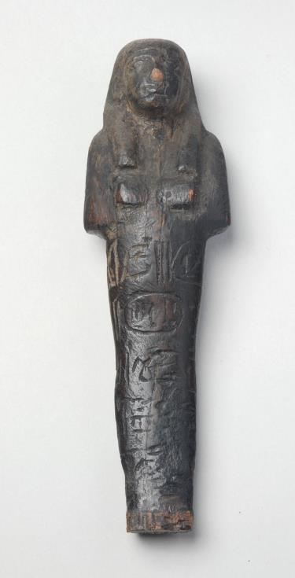
The Object
Shabti from tomb of Set I | Leeds Museums and Galleries

Slide 5
Using stories for learning
Ipi’s Story
Amelia’s Story
The Shabti’s Story
Jess’s Story
Notes:
You can make links to each story film or audio files if you have these files on your own computer. You should also read out loud the four story summaries provided in the core resource.
Just highlight the text in the slide
Right click and click on ‘Link’.
Then click ‘Webpage or File’ and find the film or audio file that corresponds.
This will automatically create the link so you can play it directly from your whiteboard.

Slide 6

Ipi’s Story
Vocabulary used in Ipi’s Story
Craftsman – a skilled worker who makes items that can be used both for decoration and to do a specific job
Carpenter – a person who makes wooden objects and structures
Tomb – a room or space underground for burying the dead
Chisel – a tool used for cutting or carving wood
Mallet – a large hammer
Hoe – a gardening tool with a thin metal blade used for digging
Hieroglyphs – Ancient Egyptian writing that uses pictures instead of words
Workshop – a room where objects are made
Foreman – a person in charge of a group of workers
Apprentice – a person learning a job from someone who is skilled in it, often for little money
Activity ideas
Create a character profile for Ipi, starting with what you have learnt from the audio story. You could think about his strengths, weaknesses and super powers, a bit like a Top Trumps card! What other detail could you add using your imagination, or further research and drama work you have already done?
Imagine a day in the life and or the ‘nose incident’ day for Ipi. Write a diary entry for Ipi thinking about what and who he sees, what he has been doing at home and at work, how he feels and what he wishes he could do most.
Based on Ipi’s review of his handiwork in the audio story, and the role play between Ipi and Khufu from the Using Drama for Learning section, write instructions for a new apprentice on how to carve a shabti figurine.
Using the locations mentioned in the audio story, map the Valley of the Kings considering both the human and physical features e.g. what terrain does Ipi cross to get to Menes’ hut, what would be needed to supply Deir El Medina (the craftsman’s village), how might the materials required to build and decorate Pharaoh Seti’s tomb be transported into the valley?

Slide 7
Shabti’s Story
Vocabulary used in Shabti’s Story
Mass-produced – something made in large quantities
Motto – a short sentence summing up someone’s beliefs
Exhibition – a display of things that are of interest to the public
Faience – a type of glass-like material used to make objects, the word means ‘dazzling’ or ‘shining’
Curator – people who look after collections of objects and artworks at museums, galleries and libraries
Humidity – the amount of water in the air
Magnification – making something look bigger than it really is
Activity ideas
You are now a journalist who will cover the opening of a new exhibition at Leeds City Museum. On prominent display is a small wooden figurine – a shabti – an object that is often overlooked. What is it about this shabti that makes it so unique? As a journalist you are tasked with writing an (online) article about the shabti, that will be accompanied by images and will need an attention grabbing headline. You will have the chance to interview the curator, who is in charge of the exhibition, to find out a little more so you must carefully prepare your questions.
Your teacher will become the Curator. The Curator is very busy and only has a short amount of time to speak with journalists so make sure that every question counts!
Now write an award winning article for the opening of the exhibition.

Slide 8
Jess’s Story
Vocabulary used in Jess’s Story
Cuneiform – a form of ancient writing
Linen – a smooth strong cloth made from the flax plant
Hoax – a trick in which someone tells a lie
Artefact – an object made by humans that can give us information about life in the past
Collections – a group of objects brought together to be seen, studied or kept together
Provenance – the history of something, where it is from and who has owned it
Evidence – facts and information to prove that something is true or false
Geometry – a kind of mathematics that deals with shapes and figures
Plough – a farming machine that prepare the soil for planting seeds
Activity ideas
Write Jess’s reply to Mrs Bletherswick. This can be done either individually or in a group.
When you have drafted your final version read out to the rest of the class.
Create a character profile for Jess, starting with what you have learnt from the film. What other detail could you add using your imagination, further research and drama work you may have been doing?
Discussion ideas
What are your best memories of visiting a museum? What did you do? What did you think? How did you feel?
How do we decide who owns anything that’s been buried for thousands of years anyway? Is it the archaeologist who finds it – or the person who’s paying the archaeologist to dig? Is it the person who owns the land, or the whole country where the dig takes place? Or simply the person who can offer the most money for it?
Genuine or Fake – how can we tell whether a museum object is real or not?

Slide 9
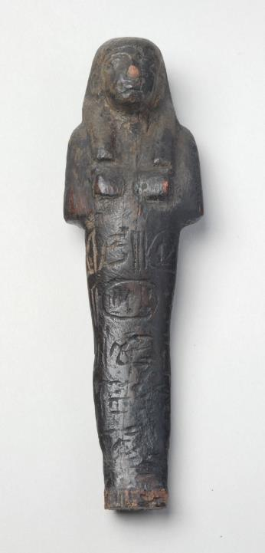
Creating a classroom museum
Disaster has struck!
All museums have been closed and the object have been put into closed storage forever. How will people learn about their past? How will people in the future understand and find out about us? We need a museum – RIGHT NOW!
A Classroom Museum all about you, just your things, what you decide is worthy and valuable enough to go in. So how will we decide and what will our Museum look like?
Find the objects that tell the right stories. Where will you look for and find the right objects? What kind of objects are you looking for? Whose story does it tell? Who will be interested to come and see it? How will it make them feel?
Bring your objects into school and agree as a group which objects will make up your Museum collection. It could be a sweet wrapper or a book or an old sock that your cat chewed up or your dad’s favourite thing – really, it could be anything that is important and tells an important story about your life.
All museum objects have to have a formal Acquisition and Storage record. Use the template to make records for all your objects.
Now you need to decide how to display your objects and where the Classroom Museum will be. You could even have an online museum.
Each object on display should have a label describing what it is and telling its story. Use the instructions to write short and interesting labels for all your objects.
Shabti from tomb of Seti I | Leeds Museums and Galleries

Slide 10
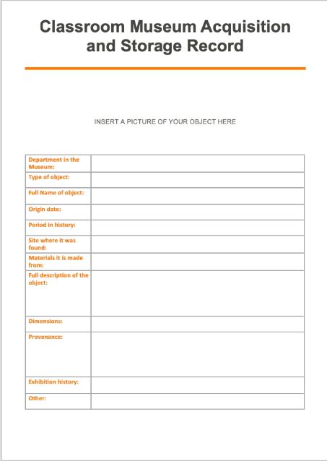
Acquisition and Storage Records
Museums have to have detailed records of each object in their collection.
This record describes the object in detail.
It is also important for museums to know where the object has come from and who it has belonged to – museums call this the object’s provenance.
Why do you think provenance is so important for a museum?
Create your own Acquisition and Storage Record for your Classroom Museum objects.

Slide 11
Philosophy for Children- The process
Introduction and warm up activity
Stimulus
Thinking Time
Question Creation
Sharing Questions
Voting
Dialogue
More Thinking Time
Final Thoughts
Gathering the key themes
Warm up

Slide 12
Philosopher’s Fruit Salad – quick fire questions!
Humour always helps prepare the mind for philosophy!
Nuts
If a tree falls in a forest and nobody is there, does it make a sound?
If a squirrel falls from a tree, should you pick him up?
If a tree falls on a squirrel, is it bad luck?
If a tree falls on you while you are picking up the squirrel, is it a tragedy?
Who’s better?
Are dogs better than cats?
Are dolphins better than sharks?
Are cats better than dolphins?
Are sharks better than dogs?
Are boys better than girls?
Are children better than adults?
Epistemology (study of knowledge)
Would 2+2 still be four if nobody could count?
Is there anything you can know 100% for certain? If you know something, does that mean it is true?
Philosophy of science
Can science tell you if something is true?
Can science tell you if something is false?
Can you prove the sun will rise tomorrow?
Notes:
Philosophers’ Fruit Salad – Traditional and Playful Questions from © Jason Buckley 2009 www.outspark.org.uk
You can argue backwards and forwards about how important knowledge of traditional philosophy is to doing P4C. Whether you think it is or it isn’t, traditional philosophy is still jolly interesting, so the first column of questions are grouped within the headings you might encounter in a philosophy degree.
Humorous questions are also a good way to shake off the rest of the day. I’m sure there’s a deep link somewhere between philosophy and play, so playful questions help prepare the mind for philosophy. You can also use these as quick-fire questions to which people call out instant answers, followed by reasons.
Other deeper questions for older young people:
Ethics
Are some people born evil?
If you are born evil, can you help it?
Can it sometimes be right to kill someone?
Can it sometimes be right to kill a child?
Is abortion as bad as killing a child?
Is killing someone worse than letting them die?
Cosmology
Does everything have a cause? Did time have a beginning?
Is the future longer than the past?
Political philosophy
Is it fair to expect the rich to pay for the rich?
Is it fair to expect the poor to work for the rich? Would the world be fairer if all jobs paid the same?
Nuts
If a tree falls in a forest and nobody is there, does it make a sound?
If a squirrel falls from a tree, should you pick him up?
If a tree falls on a squirrel, is it bad luck?
If a tree falls on you while you are picking up the squirrel, is it a tragedy?
Who’s better?
Are dogs better than cats?
Are dolphins better than sharks? Are cats better than dolphins? Are sharks better than dogs? Are boys better than girls?
Are children better than adults?
Pigs
Can a pig be happy?
Is eating a happy pig worse than making a pig unhappy?
Is it better to an unhappy pig than a happy pig? Is being an unhappy person better than being a happy pig?
If we found out pigs could talk, should we stop eating them?
If a pig asked you to eat it, should you?
Splitting up children who distract one another
Does your first name start with....?
Have you stayed sat down so far?
Do you want to stay where you are sitting?
Philosophy of religion
Are things good because God says they are?
Could God change his mind about what was good? Did God make himself?
Epistemology (study of knowledge)
Would 2+2 still be four if nobody could count?
Is there anything you can know 100% for certain? If you know something, does that mean it is true?
Philosophy of science
Can science tell you if something is true? Can science tell you if something is false? Can you prove the sun will rise tomorrow?

Slide 13
Identifying the themes
gender
relationships
ownership
value
culture
conservation
knowledge and understanding
power and colonialism
perfection
belonging
creativity
ego
exploration and discovery
religion
science
theft
Notes:
Pulling out the key themes:
Ask how did the text/stimulus make you feel?
If you were in this position what would you do?
What bits are most interesting?
What bits confuse you?
What do you think the key themes, tensions, contradictions?
Creating a good enquiry question
Best ones are Would/Could/Should/Are/Why?
Share in pairs then group
Vote on best juiciest ones add them in – challenge the answers and evidence/challenge the question/challenge the assumptions
Dialogue and Discussions – with other children/alone? Time limit for responses
Further research /More thinking time / which side are you on / Is this the only answer?
Final Thoughts - Stand on a line/Matrix of answers – Have you changed your mind, why

Slide 14
Philosophy for Children - Good questions
Specific (stimulus) Questions
Factual comprehension: You can see/hear the answers to these questions: “Who/What/Where/When?” E.g. “What is the name of this object?”
Imaginative/Empathetic: You can use your imagination to answer these questions: “Why/What if?” E.g. “What if all Shabtis could talk?”
Factual clarification: You can research the answers to these questions: E.g. “How did the Shabti end up in Leeds?”
Philosophical: There can be a number of possible answers to these questions, arrived at through discussion: “Why/Should/Could/Would?” E.g. “Should explorers bring objects back from other countries?”
Closed Questions
Open Questions
General (life) Questions

Slide 15
Philosophical Enquiry - Question Bank
Watch the video, Jess’s story. What should Jess do? What should she say to Mrs Bletherswick?
Should museum objects be sent back to their country of origin?
Watch the video ‘Amelia’s story’. Imagine if Reverend Aquila didn’t allow Amelia to present the shabti? Amelia says that Aquila should be more interested in ‘scholarship over showmanship’. What does she mean and why is this important? Why would something that is common be of interest to anyone?
Should we preserve ancient objects and keep them locked away or share them with everyone?
Should people be allowed to sell ancient artefacts?
Which objects are worth keeping in museums?
Should Egyptian objects be exhibited in Leeds Museums?
Should people be allowed to have private collections?
What does stolen mean? Are all archaeological finds in museums stolen?
How do we decide who owns anything that’s been buried for thousands of years? Is it the archaeologist who finds it – or the person who’s paying the archaeologist to dig? Is it the person who owns the land, or the whole country where the dig takes place? Or simply the person who can offer the most money for it?

Slide 16
Philosophical Enquiry - Question Bank
The Shabti is now considered a treasure. Should treasures be in places where everyone can see and touch them?
What about the people who made the shabti. Were they poor? Were they recognised then? Were they important? What is the difference in the value of people’s activities in the past and today?
Could a woman have made the shabti? Should women be treated differently to men?
What might be the equivalent to a shabti now? Why do people believe in an ‘afterlife’?
Ipi worked in workshop making hundreds of Shabtis everyday. This type of production is now called a supply chain. Should children work?
What make you proud? Is being proud good? Should you be proud of where you live?
Is an object still valuable if its damaged?
Does being different matter?
What is art?
Listen to Ipi's story. Old Ipi says that beauty is never about perfection. It’s the imperfections that make something beautiful.’ Do you agree?

Slide 17

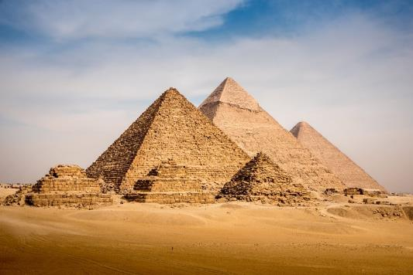
Where is Egypt?
What can we use to find out where Egypt is?
Here’s a clickable map of the world
How far is Egypt from the United Kingdom?
What climate does Egypt have?
What is Egypt famous for?
Pyramids at Giza, Egypt | CC BY-SA 3.0 | Creative Commons
Notes:
It’s important that you start the overall topic with some orientation about Egypt generally and then focus in on Ancient Egypt and the Shabti as a focus. You don’t necessarily need to be studying the Egyptians for this set of resources to be useful – the theme of Ancient Egypt and the Shabti can be used as ways in to other subject areas.

Slide 18
When was Egypt ancient?
Can you put these events in order on a timeline?
World War I
The Victorians
Ancient Egypt
The invention of the electric car
The Tudors
The Neanderthals
The Dinosaurs
First human on the moon

Slide 19
An Egyptian Timeline – research and complete classroom timeline sheet to include the time when Seti I ruled Egypt.
Place three markers on the timeline to show when Seti I, was born, ruled Egypt and died?
Place a marker on the timeline when Giovanni Belzoni discovered Seti’s tomb first discovered.
Place a marker on the timeline when Howard Carter discovered Tutankhamun’s tomb.
Place a marker on the timeline when Amelia presented the shabti to the Leeds Literary and Philosophical Society.
Place a marker on the timeline when you were born.

Slide 20
The Object
Shabti from tomb of Seti I | Leeds Museums and Galleries

Slide 21

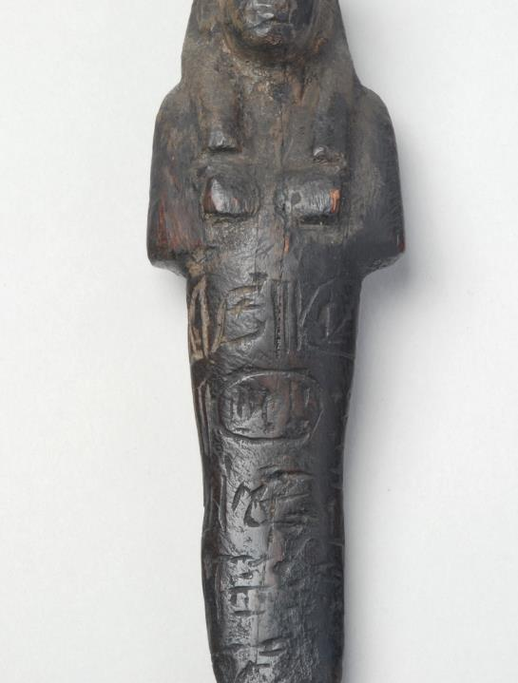
Using objects for learning
Let’s look closer at Seti’s shabti – No, I mean REALLY look!
In groups take 5 minutes for each of these questions. Together write as many answers to these questions as you can:
  I see…?
  I think….?
  I wonder…?
  What if…?
Now share your answers with the rest of the class
Shabti from tomb of Seti I | Leeds Museums and Galleries

Slide 22
Philosopher’s Fruit Salad – quick fire questions!
Humour always helps prepare the mind for philosophy!
Nuts
If a tree falls in a forest and nobody is there, does it make a sound?
If a squirrel falls from a tree, should you pick him up?
If a tree falls on a squirrel, is it bad luck?
If a tree falls on you while you are picking up the squirrel, is it a tragedy?
Who’s better?
Are dogs better than cats?
Are dolphins better than sharks?
Are cats better than dolphins?
Are sharks better than dogs?
Are boys better than girls?
Are children better than adults?
Epistemology (study of knowledge)
Would 2+2 still be four if nobody could count?
Is there anything you can know 100% for certain? If you know something, does that mean it is true?
Philosophy of science
Can science tell you if something is true?
Can science tell you if something is false?
Can you prove the sun will rise tomorrow?
Notes:
Philosophers’ Fruit Salad – Traditional and Playful Questions from © Jason Buckley 2009 www.outspark.org.uk
You can argue backwards and forwards about how important knowledge of traditional philosophy is to doing P4C. Whether you think it is or it isn’t, traditional philosophy is still jolly interesting, so the first column of questions are grouped within the headings you might encounter in a philosophy degree.
Humorous questions are also a good way to shake off the rest of the day. I’m sure there’s a deep link somewhere between philosophy and play, so playful questions help prepare the mind for philosophy. You can also use these as quick-fire questions to which people call out instant answers, followed by reasons.
Other deeper questions for older young people:
Ethics
Are some people born evil?
If you are born evil, can you help it?
Can it sometimes be right to kill someone?
Can it sometimes be right to kill a child?
Is abortion as bad as killing a child?
Is killing someone worse than letting them die?
Cosmology
Does everything have a cause? Did time have a beginning?
Is the future longer than the past?
Political philosophy
Is it fair to expect the rich to pay for the rich?
Is it fair to expect the poor to work for the rich? Would the world be fairer if all jobs paid the same?
Nuts
If a tree falls in a forest and nobody is there, does it make a sound?
If a squirrel falls from a tree, should you pick him up?
If a tree falls on a squirrel, is it bad luck?
If a tree falls on you while you are picking up the squirrel, is it a tragedy?
Who’s better?
Are dogs better than cats?
Are dolphins better than sharks? Are cats better than dolphins? Are sharks better than dogs? Are boys better than girls?
Are children better than adults?
Pigs
Can a pig be happy?
Is eating a happy pig worse than making a pig unhappy?
Is it better to an unhappy pig than a happy pig? Is being an unhappy person better than being a happy pig?
If we found out pigs could talk, should we stop eating them?
If a pig asked you to eat it, should you?
Splitting up children who distract one another
Does your first name start with....?
Have you stayed sat down so far?
Do you want to stay where you are sitting?
Philosophy of religion
Are things good because God says they are?
Could God change his mind about what was good? Did God make himself?
Epistemology (study of knowledge)
Would 2+2 still be four if nobody could count?
Is there anything you can know 100% for certain? If you know something, does that mean it is true?
Philosophy of science
Can science tell you if something is true? Can science tell you if something is false? Can you prove the sun will rise tomorrow?

Slide 23

Using sounds for learning
  Listen to the 5 sound files
  What sounds can you hear? Try to identify every sound
  Finish this sentence ‘We hear…’
  What do the sounds make you think about? Brainstorm all your ideas
  Finish this sentence ‘We think…’
  What do the sounds make you wonder about?
  Finish this sentence ‘We wonder...’
  Draw a picture of what you are imagining now.
Sound 1
Sound 2
Sound 3
Sound 4
Sound 5
All sounds from Freesound.org
Notes:
You can replace the sounds with ones of your choice if you wish
Delete the speaker icon
Click on INSERT and choose Audio
Either choose an audio file from your computer, or record one using your device’s microphone
Repeat with Sound 2, 3, 4, 5 etc.

Slide 24
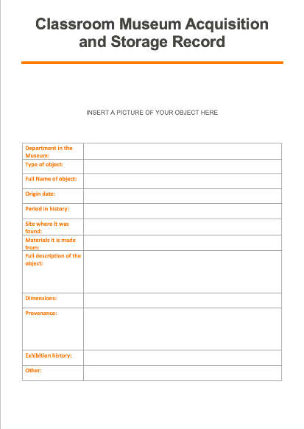
Acquisition and Storage Records
Museums have to have detailed records of each object in their collection.
This record describes the object in detail.
It is also important for museums to know where the object has come from and who it has belonged to – museums call this the object’s provenance.
Why do you think provenance is so important for a museum?
Create your own Acquisition and Storage Record for your Classroom Museum objects.

Slide 25

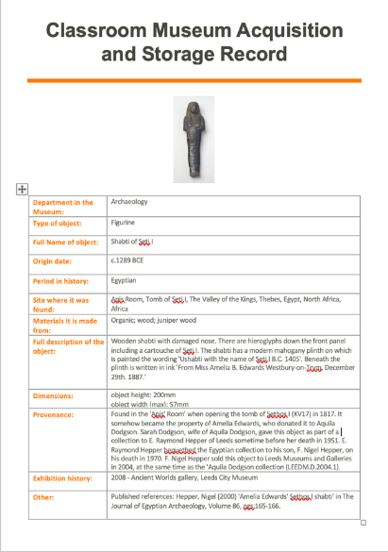

Slide 26
Writing a museum label in 10 steps
Each object in your classroom museum should have a label describing what it is, for museum visitors. Here is a list of things to consider when creating your object labels.
Write for your visitors/audience. Who are they and what would they want to know about the object? Use your label to get people to look more carefully at the object.
Write the most important information first , a title, the name of the object or artist, the date and place the object was created/discovered.
Now write a short paragraph describing or telling the story of the object.
Think about what it is that you want people to know about this object?
Then order the rest of information so that people who want to know more can read on.
Stick to the word count – a normal museum label has 50-60 words!
Admit if there are things that you don’t know about the object – sometimes that can make it more interesting!
Add a bit of the ‘human’ perspective, like notes about, or quotes from the owner of the object. That helps visitors to connect to it more.
Write as you would speak in a conversation.
Plan your label carefully and rewrite it several times to get it right.
Double check your label – would you or your friend be interested to read it?

Slide 27
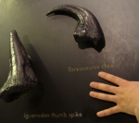
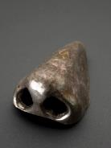
Great museum labels? – think about what is good and bad about these labels.
This Iguanodon thumb spike
was a straight stabbing weapon,
while the sharp curved
Torvosaurus claw was used
to hold and slash. Both show
the long groove that
anchored the outer
horny sheath.
This bird is a famous fortune teller and THIEF!
Every English schoolchild knows that counting Magpies will tell your fortune.
One for sorrow, two for joy, three for a girl
Four for a boy
Five for silver, six for gold,
Seven for a secret never to be told.
Iguanodon and torvosaurus thumb spikes | CC BY-SA 4.0 | Wikimedia Commons
Sword with later hilt
1760-1800: This sword was one of the first artefacts donated to Pilgrim Hall. Tradition said that it belonged to Plymouth’s military leader Captain Myles Standish.
This is not possible. The blade carried the Arabic date of 1149. When the Islamic calendar is translated to the western calendar, the date is actually 1774. When the sword was given to the Hall, the misunderstood date of 1149 was thought to connect to Plymouth’s celebrated soldier Myles Standish with the legendary Crusades.
Longfellow referred to the sword in The Courtship of Miles Standish, as did novelist Jane G. Austen in her novel Standish of Standish.
Materials – Brass and Iron
Magpie| CC BY-SA 3.0 | Wikimedia Commons
THIS AN ARTIFICAL NOSE FROM AROUND
1601-1800.
DID YOU KNOW?
YOU SWALLOW 1 LITRE OF SNOT EVERY DAY.
Artificial_nose,_Europe,_1601-1800_Wellcome | CC BY 4.0

Slide 28








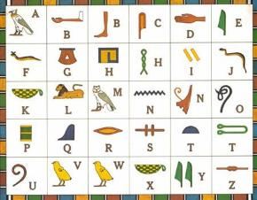
Make your own shabti
You will need:
Air drying or modelling clay
Clay carving tools or a knife and cocktail sticks
Hieroglyph alphabet
A scrap notebook or piece of paper
(Optional) acrylic paint
Make it:
Before you make your clay shabti, plan out the message you want to put on the surface in your notebook. You will need to carve this message into the surface before it dries.
Use the Hieroglyph alphabet translation chart to plan your message.
Now shape your piece of clay into a small shabti shape – maximum 10cm height. Use the image of Seti’s shabti to help you get the right shape.
Whilst the clay is still wet carve your hieroglyph message onto the surface.
Paint your shabti if you want to change its colour.
©Jael Williams
Hieroglyph alphabet | CC BY-SA 4.0 | Wikimedia Commons

Slide 29

Hieroglyph alphabet
Hieroglyph alphabet | CC BY-SA 4.0 | Wikimedia Commons

Slide 30
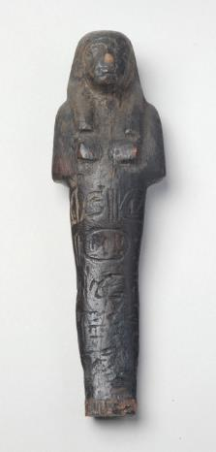
Arty Maths
Draw a picture of the Shabti to scale using the dimensions shown in the Museum Storage Records worksheet.
If you want to be really mathematical about this drawing, try these extension activities:
  Measure the angles on the Shabti and label them on your drawing.
  Use graph paper to create your drawing using your understanding of geometry, shape and scale.
  Calculate the approximate perimeter of the outline of this Shabti.
Research other types of Shabti online and compare the dimensions. Would the the Seti I shabti be large, average or small compared to the ones you have discovered?
Shabti from tomb of Seti I | Leeds Museums and Galleries

Slide 31
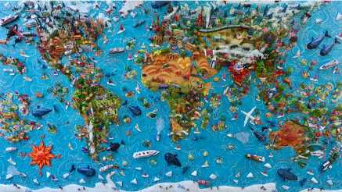
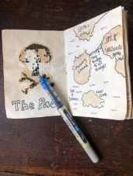
The Shabti’s journey through time…
Activity 1 - Geography: maps, location, climate, landscape, human features
Using a world atlas try and track the journey that the Shabti from Seti I tomb has taken over the years.
Once you have drawn your journey on a printed map have a go at creating a 3D map showing each location in detail. Use modelling materials e.g. paper mâché, cardboard, paper, paint, fabric or whatever other materials you want to create our mini locations in Deir el-Medina, Egypt, Bristol, Leeds.
You could make mini mobiles to hang over your 3D map to show the weather in each location for example clouds with rain in Leeds!
Now add in labels describing the climate, landscape and human features in each location.
Extension activity: To complete your 3D map, create miniature books telling the story of the Shabti at each location.
© SARA DRAKE 2021 Instagram @sara_drake http://www.saradrake.com
©Jael Williams

Slide 32
Using drama for learning – The Big Debate
You are part of an archaeological dig in Egypt. You and the team have just discovered hidden alleyway within a collapsing tomb. You only have minutes to decide which of two objects can be excavated in that time to be conserved for others to see and learn about ancient Egypt.
One object is a small figure shaped with a cat’s head and human body and legs. It is made with materials that are unknown and could lead to new understanding of materials the Egyptians used for their art and craft. An object like this has never been found before.
The other is an exquisitely perfect mummy’s death mask decorated in gold and with mysterious message in painted hieroglyphs. Discovering the identity of the owner of this mask would lead to fresh understandings of ancient Egyptian life and a newly discovered dynasty of Pharaohs.
Break into two groups. One group is debating to keep the beautifully crafted cat/human figure, the other group to keep the priceless death mask.
In your own group brainstorm all of the reasons why you should keep your object. (You may want to do some research yourself to back up your reasons.)
Now brainstorm all the reasons that the other object should be left behind in the collapsing tomb.
As a whole group take turns to present your best arguments for keeping your object. Listen to one another’s main points and take notes.
Take turns to respond to each other in a debate. Your teacher will help you to do this.
At the end of the debate as a small group make your final concluding statement or argument.
Think about whether you have changed your opinions based on what the other group said.
You could try a class vote to see who feels which object should be saved.

Slide 33



Project Funders

