Slide 1
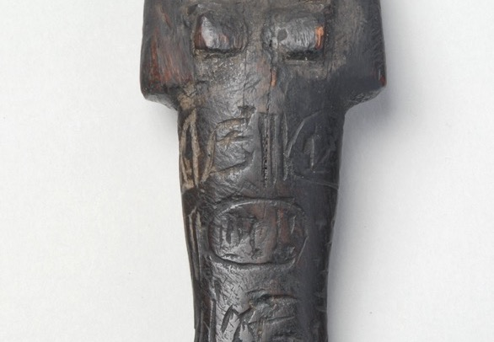
Shabti from tomb of Seti 1| Leeds Museums and Galleries

Slide 2
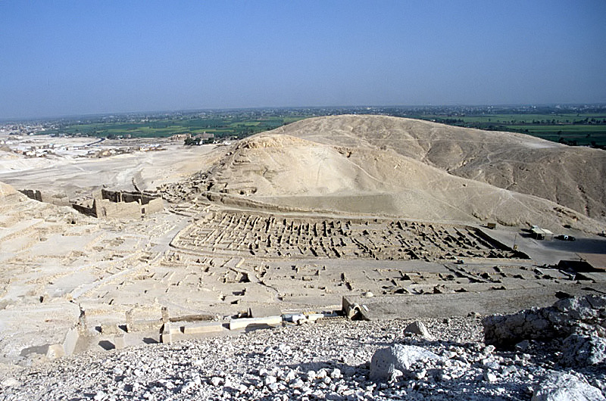
Remains of the workers village at Deir el Medina | CC BY-SA 3.0 | Creative Commons
Notes:
The ruins of the workers village at Deir El Medina

Slide 3
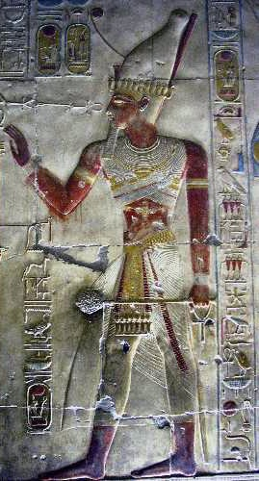
Image of Seti I taken from his temple at Abydos | CC BY-SA 3.0 | Wikimedia Commons
Notes:
Image of Seti I taken from his temple at Abydos

Slide 4
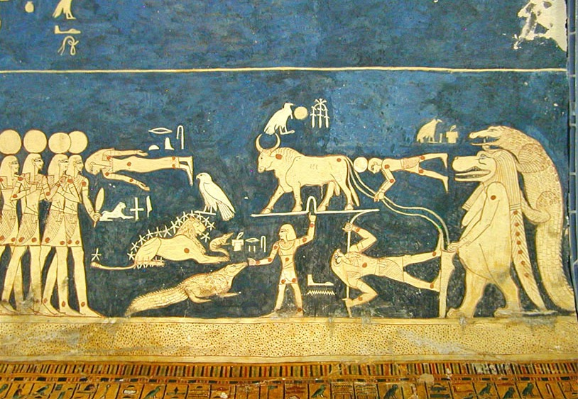
The ornate ceiling of Seti I tomb | CC BY 2.0 | Wikimedia Commons
Notes:
The ornate ceiling of Seti I tomb

Slide 5
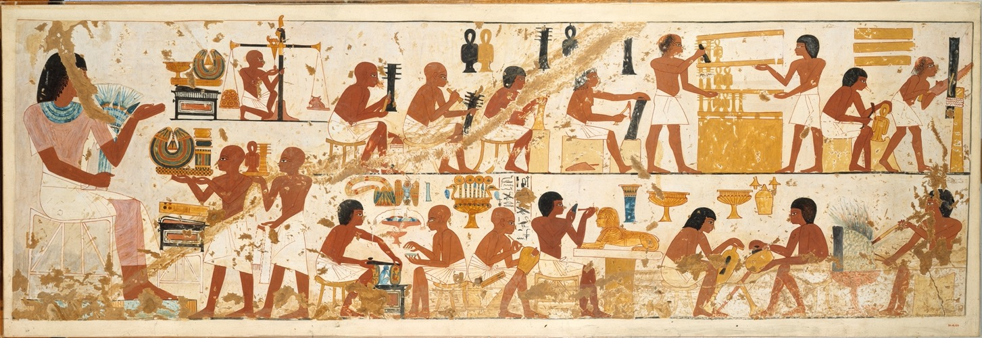
Craftsmen at work on a tomb | CC0 1.0 Universal | Wikimedia Commons
Notes:
Egyptian crafts people working on a tomb

Slide 6
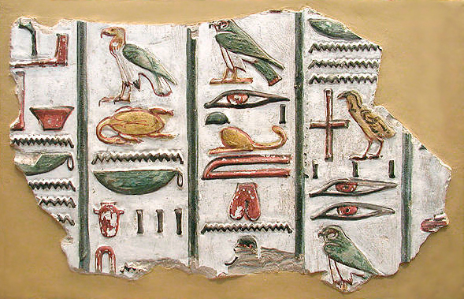
Hieroglyphs from the tomb of Seti I | Jon Bodsworth | Copyrighted free use | Wikimedia Commons
Notes:
Hieroglyphs from the tomb of Seti I

Slide 7
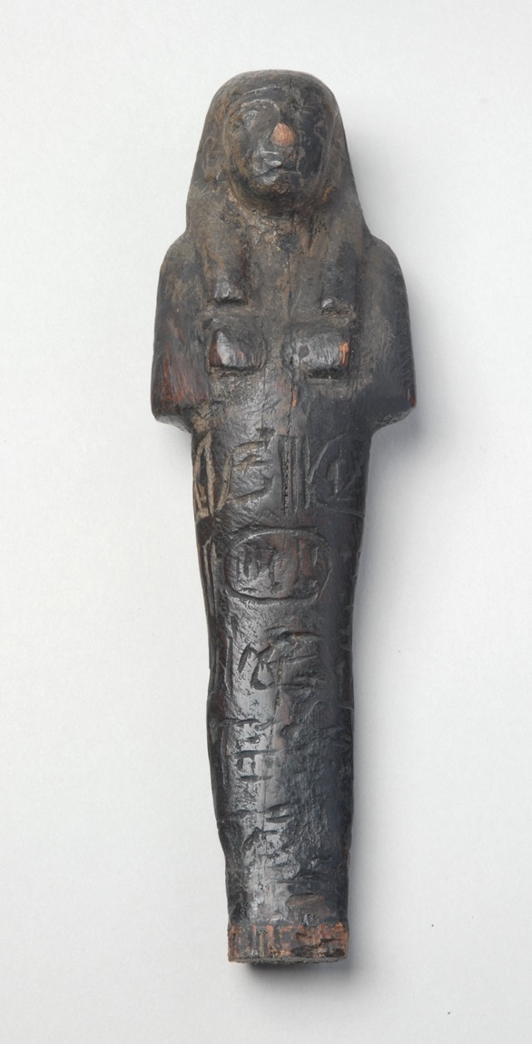
Shabti from tomb of Seti I | Leeds Museums and Galleries

