Slide 1

Teachers Notes: Exploring Two Temporary Exhibitions
This powerpoint is designed to help students think about the decisions that have been made when designing and displaying an exhibition. It uses two temporary exhibitions from Leeds City Museum as case studies: ‘Beavers to Weavers’ and ‘Fast X Slow’.
Photographs of the exhibition are provided alongside questions to prompt closer looking and critical thinking skills.
Explanations and ideas are provided in the ‘Notes’ section under the slides as needed.
This powerpoint can be used to help students think about how to display and interpret their objects in the ‘Make a Museum’ activity. The last slide provides some question prompts to help them organize their thoughts.

Slide 2

Beavers to Weavers
“The wonderful world of animal makers”
(This exhibition was designed using environmentally sustainable materials)
Temporary exhibition at City Museum, Leeds

Slide 3
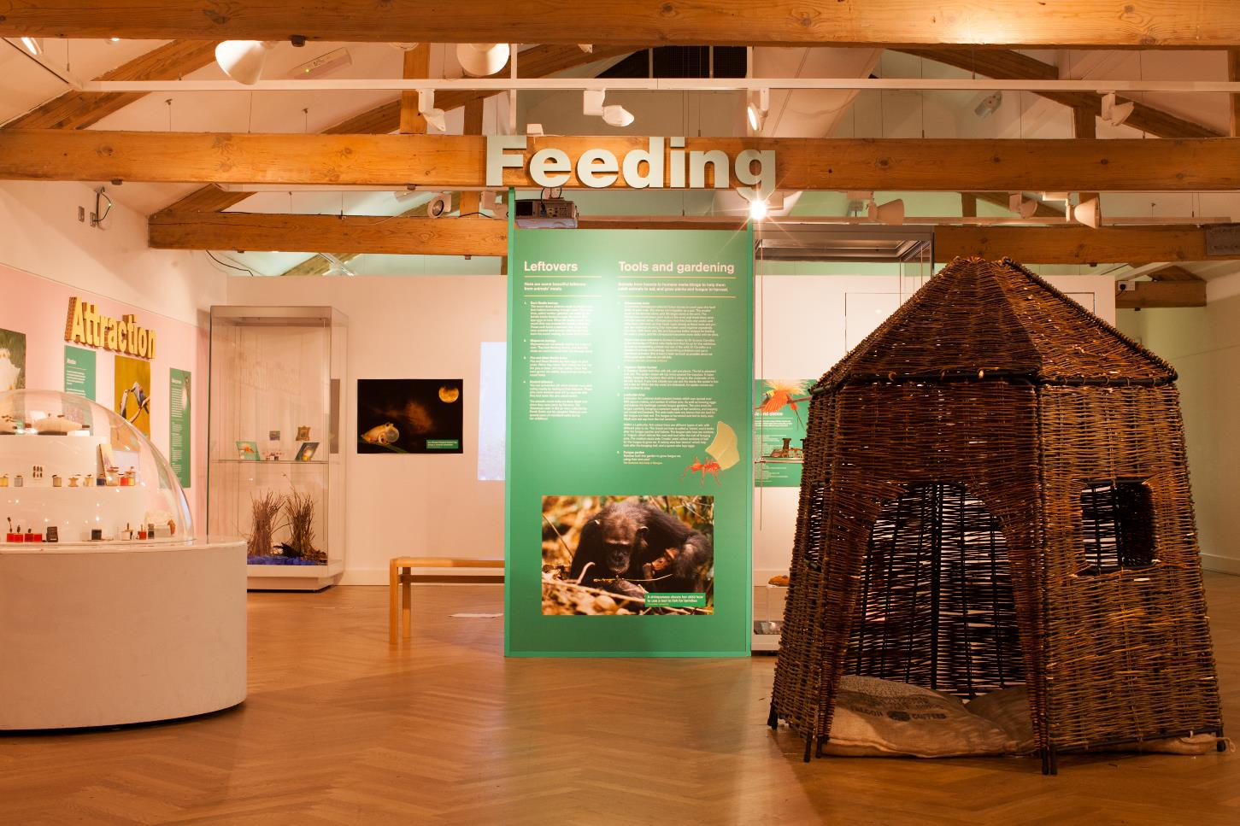
Layout
What different ways have been used to:
Display objects
Display information?

Slide 4
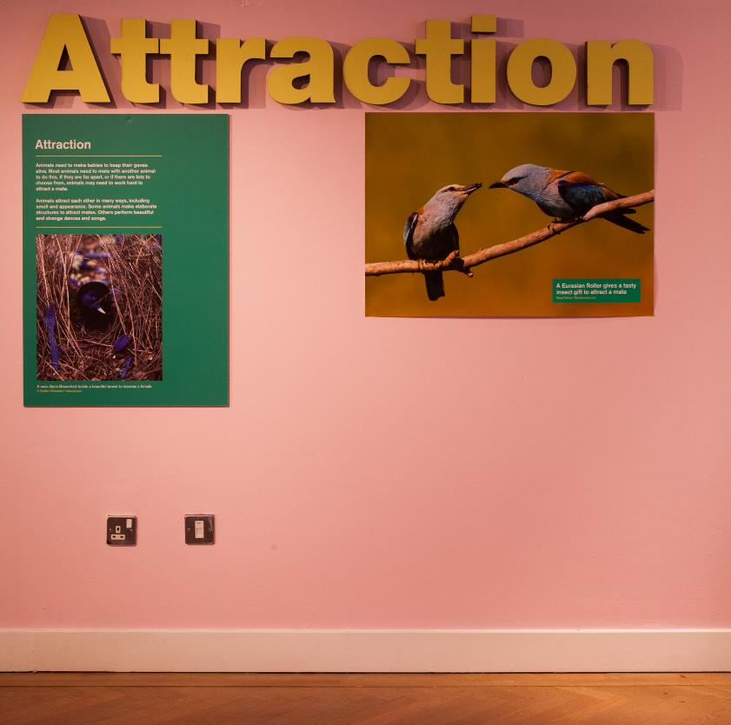
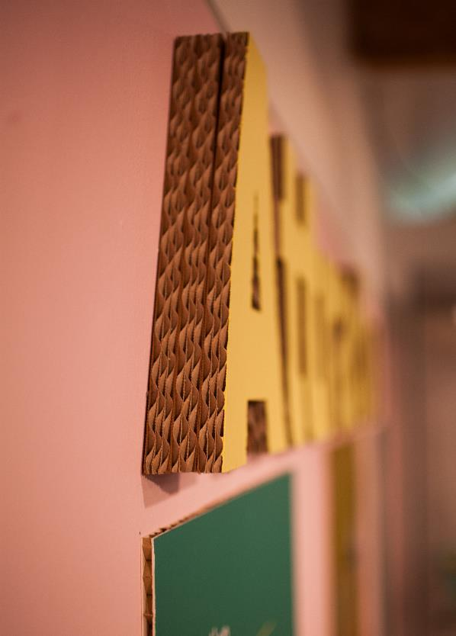
Choice of materials
What materials have been used for the title and images?
Why might this material have been chosen?
Notes:
Corrugated cardboard was used as a sustainable material, reducing waste.

Slide 5
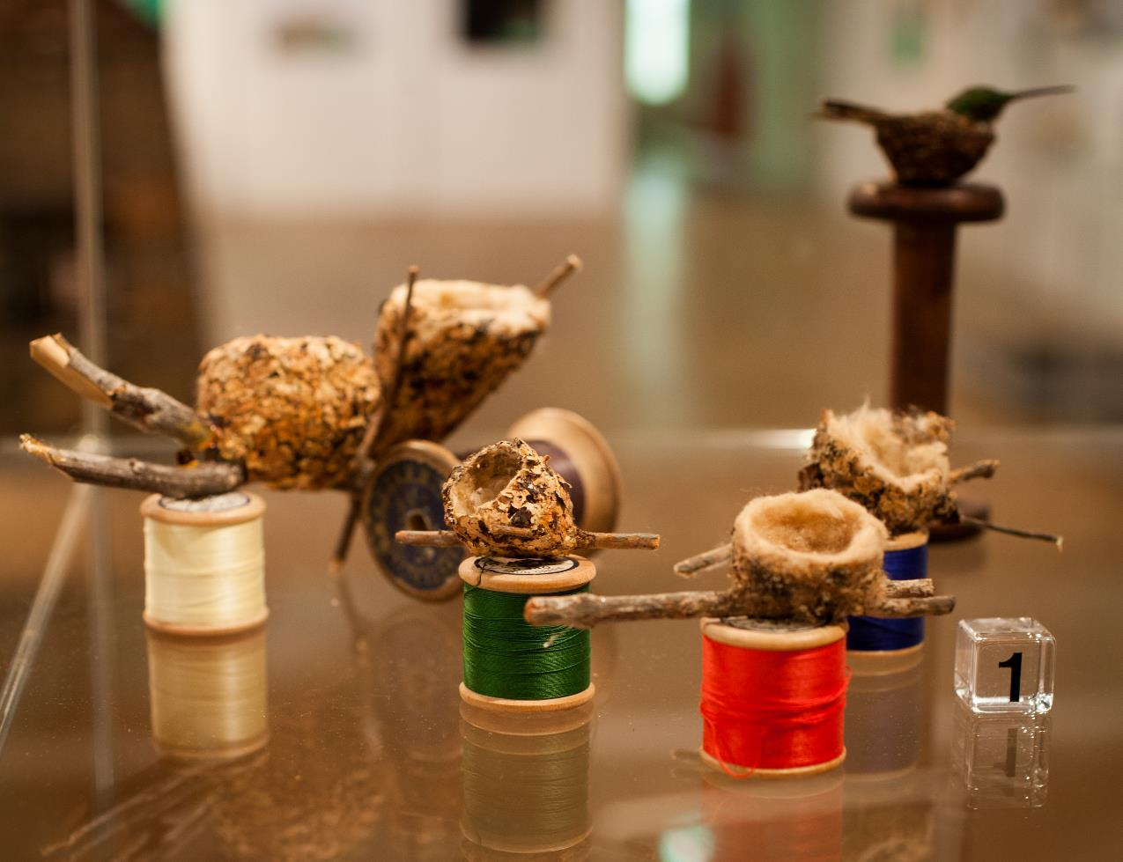
Object mounting 1
The curator has chosen to mount these hummingbird nests on cotton reels.
Why do you think she chose to do this?
Notes:
Helps to show the size of the nest – puts it in context with everyday objects.
Many nests are made by weaving materials together, like thread can be woven.
The cotton reels are second-hand, made of wood and therefore have a low environmental impact.

Slide 6
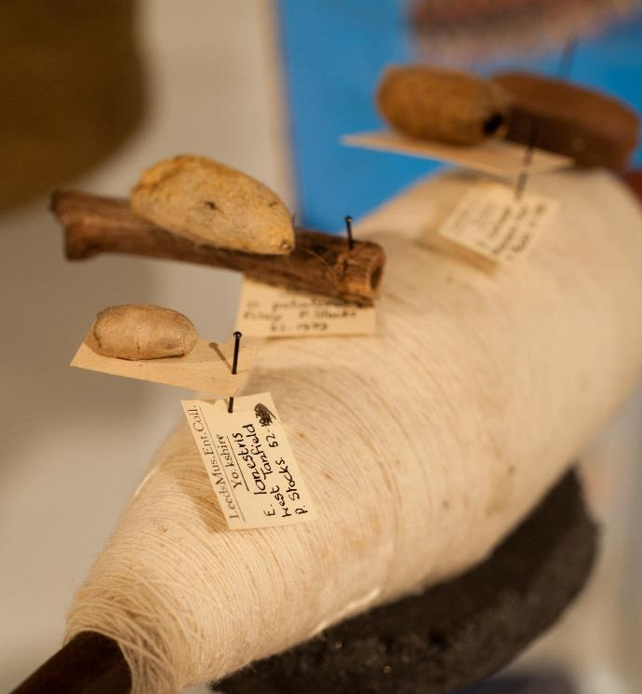
Object mounting 2
What do you think these silk worm cocoons have been displayed on?
Why do you think this display choice was made?
Notes:
The cocoons are on a spool of silk, which would have been made from the cocoons of other silk worms.
It shows what the cocoons are made from. Also, the shape of the spool of silk is very similar to that of the cocoons!

Slide 7
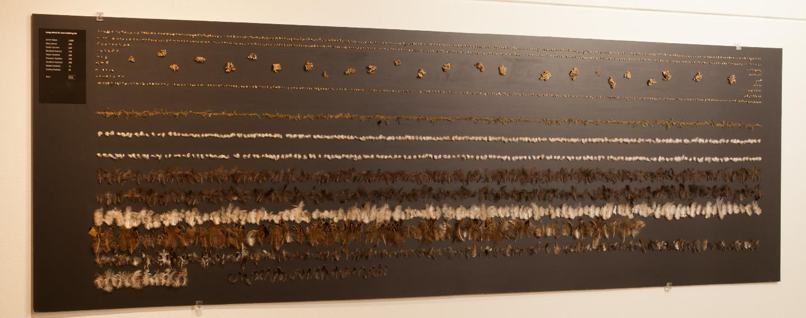
Inspiring curiosity and wonder
What do you think this display is showing?
When you get up close, you can see this display is a collection of bits of leaf, lichen, feathers and more…. What do you think it is?
This is a birds nest that has been carefully taken apart to reveal every single piece that the bird used to create the nest. How does this display make you feel?

Slide 8
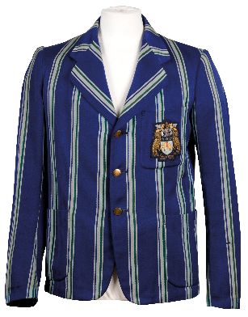
Fast X Slow
“Shopping for Clothes in Leeds 1720 – 2020”
Temporary exhibition at City Museum, Leeds

Slide 9
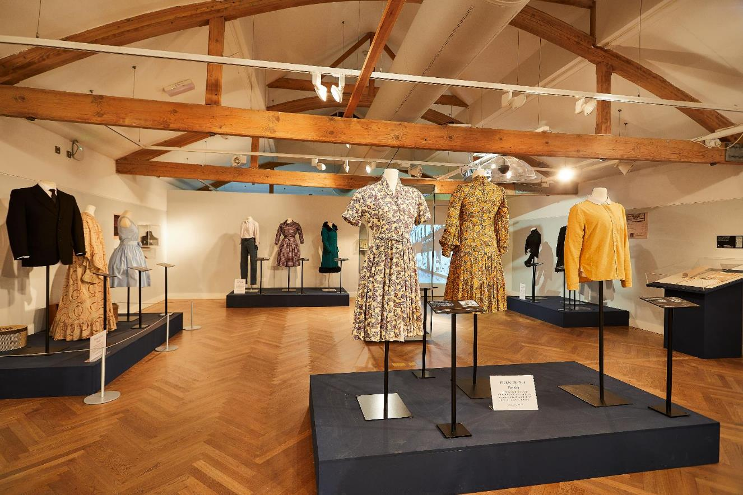
Object display
How has the curator used space in this part of the exhibition?
Notes:
There is lots of space around each collection of items. This helps the visitor to concentrate on the few objects more easily. Each object can make more of an impact this way too. From a practical point of view, it is easy for visitors to move around the exhibition as there is lots of space. Wheelchair users can easily navigate the exhibition, and there is plenty of space to allow for turning their chair around.

Slide 10
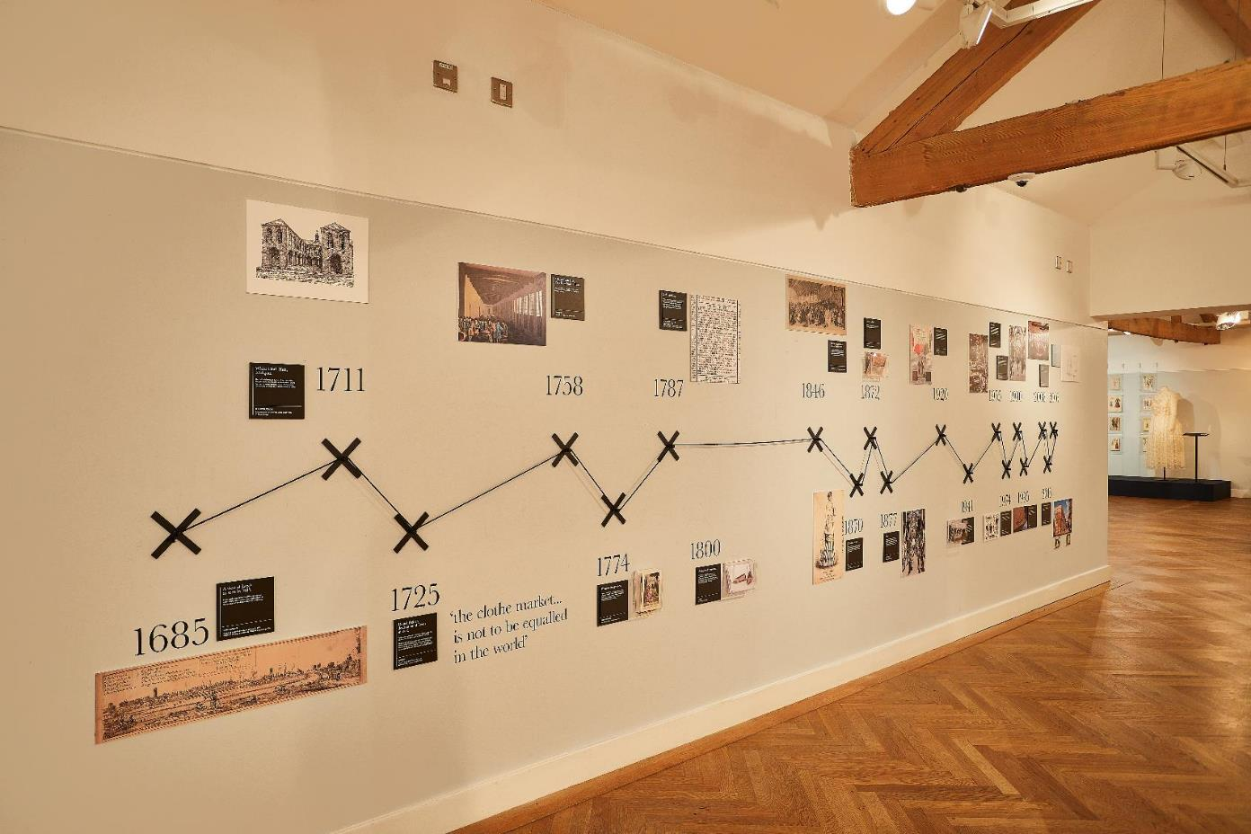
Graphic devices
The theme of this exhibition is about making and selling clothes.
How have the designers used visual clues to link the display shown here to the theme?
Notes:
The use of X as a graphic element, and lines between the Xs are reminiscent of sewing and thread.

Slide 11
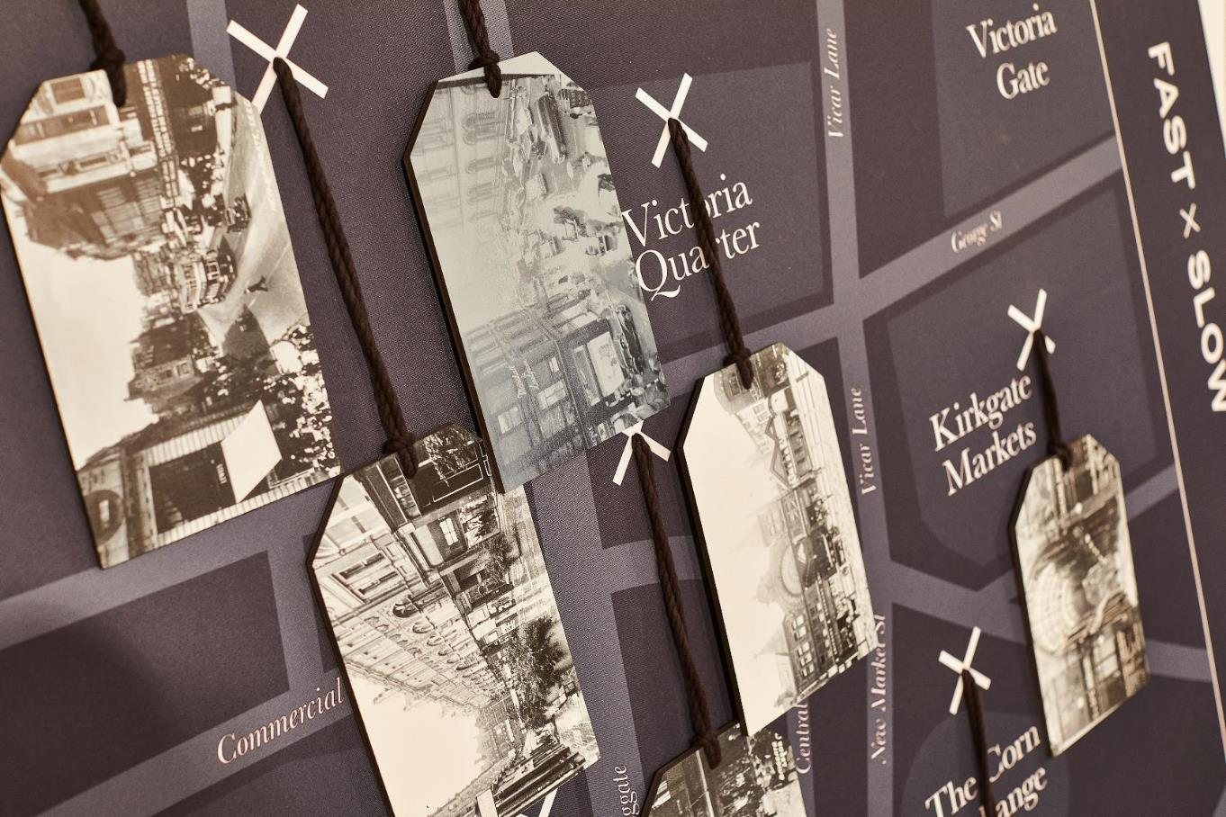
Interactive display
How have the designers aimed to make this display interesting for the visitor to explore the information?
Notes:
Archive photographs are linked to the location on the map. The ‘X’ graphic device is used here again, helping to tie different elements of the exhibition together. Visitors can pick up the tag and turn it over to read the information on the other side, making it a tactile experience.

Slide 12
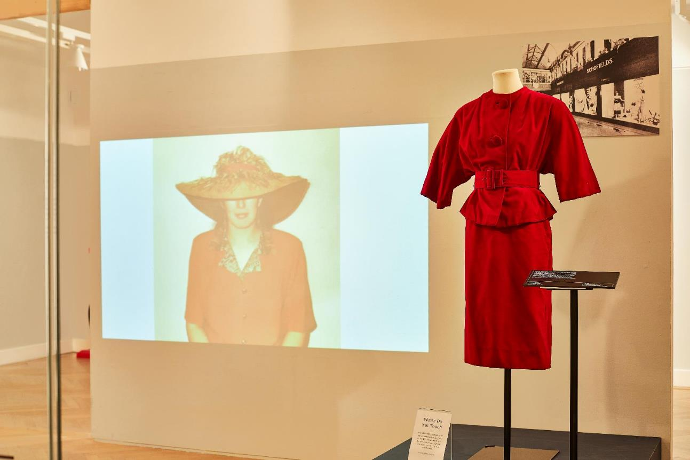
Using different media
The curator has shown three different types of display in one small area.
What factors might you need to think about if using video in an exhibition space?
Notes:
Light levels – can the visitors see the film effectively? Is there too much light given off which might damage exhibition objects nearby?
If there is audio – how is this brought into the gallery – where are the speakers / headphones situated so that visitors can here, but also to keep them safe from tampering?
If using speakers – consider how the audio will affect the exhibition – visitors not watching the film will be able to hear the audio. Will this be distracting, or will it encourage them to come and view the film?
If using headphones – how many pairs to provide? How to ensure they are kept safe? What alternatives are there to headphones (note, there are many, more robust options for audio than providing headphones – such as listening posts).
How does all the media in the one place work together to deliver a message?

Slide 13
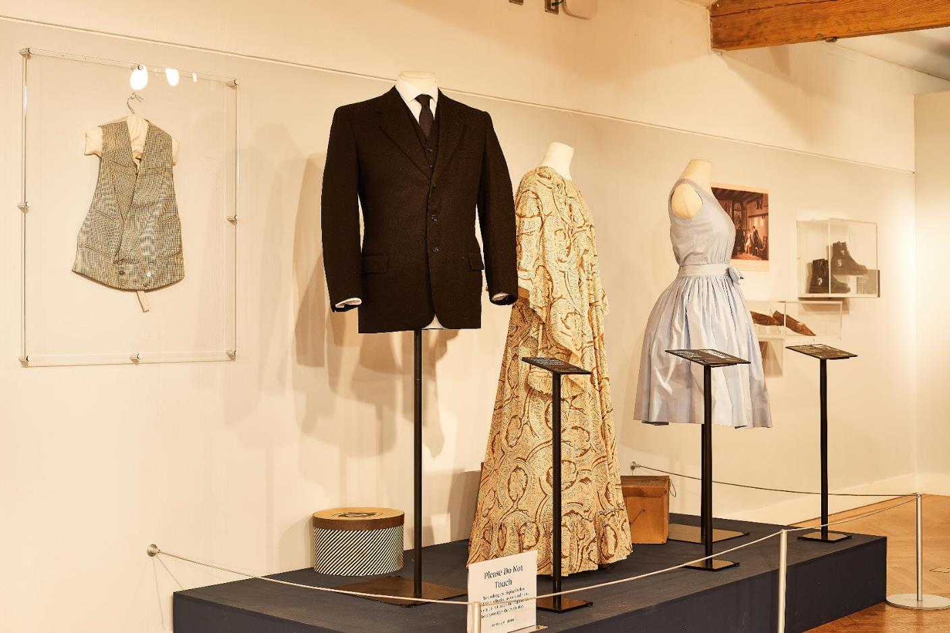
Display options
How has the curator used the space to exhibit different objects?
How many different mounting techniques have been used to display the objects?
Notes:
Objects are displayed on mannekins, on the wall, in 3D cases (the boots) and on the floor.
Each object is carefully mounted to keep it safe and secure, whilst also allowing a visitor to get the best view of it.

Slide 14
Make a Museum Activity: Questions to help you plan
How will you display each object so that:
  Visitors get the best view of it
  The object doesn’t get damaged
  It is interesting to look at
How will visitors move around your exhibition easily? Think about:
  Space for people to walk and wheelchair uses to move and turn around.
  Do you need or want a one-way system, or will visitors be free to explore the exhibition in any order?
  Are there particular objects that you think will be especially popular? If so, how will you make sure that everyone will be able to see this object and that it won’t cause a bottleneck in the exhibition?
What different kinds of media will you use to help display and interpret your objects?
  How will you make sure that audio or video improves the visitor experience, rather than spoiling it (though, for example, sound leakage)
  What interesting ways will you create to interpret the objects and tell their stories?

