Slide 1
Ancient Egypt
Canopic Jar Interactive
Free learning resources from arts, cultural and heritage organisations
^{mylearning.org}

Slide 2
Canopic Jar Interactive
To set up this Powerpoint as a touchscreen interactive on a smartboard:
  Go to ’Slide Show’ on the command ribbon
  Choose ‘Set Up Slide Show’
  Select ‘Browse at Kiosk (full screen)’
If you do not have a smartboard, this Powerpoint can be used with a mouse as usual.
Free learning resources from arts, cultural and heritage organisations
^{mylearning.org}

Slide 3
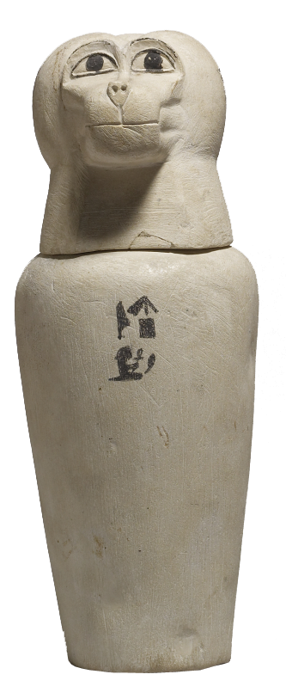
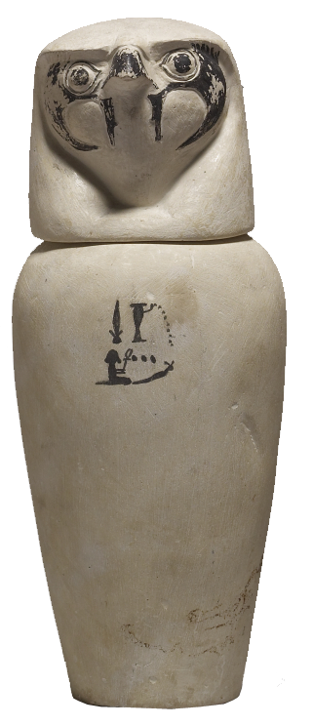
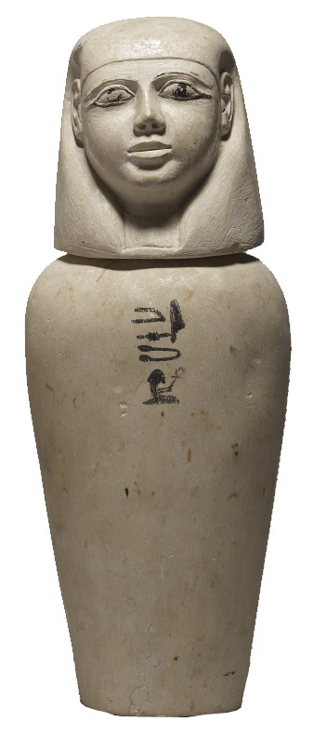
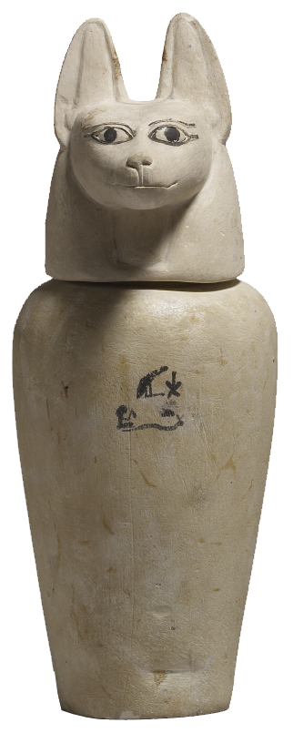
Life after Death in Ancient Egypt
In Ancient Egypt people believed in life after death. They needed to keep their bodies and use them in this ‘afterlife’.
This is why they preserved their bodies as mummies.
Part of the mummification process was to remove the body’s organs and place them in special containers called canopic jars.
Each organ had a different God to protect it, shown by
the different heads of the jars.
Image: Ramy Alaa |Flickr | CC BY ND NC 2.0

Slide 4

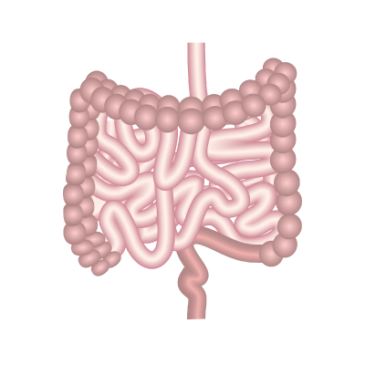
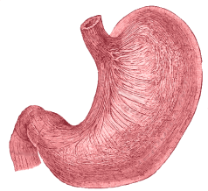
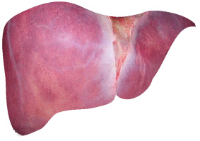
Which Ancient Egyptian God protected which organ?
?
?
?
?
Hapy
Duamatef
Imsety
Qebehsenuf
Image: Walters Art Museum | CC BY-SA 3.0

Slide 5
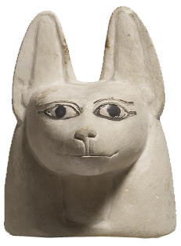
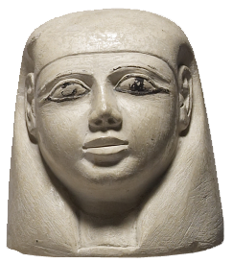
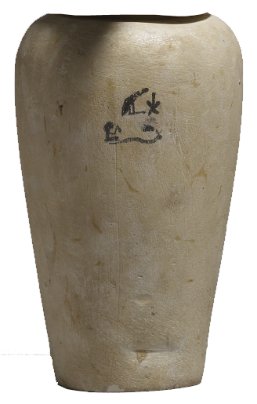
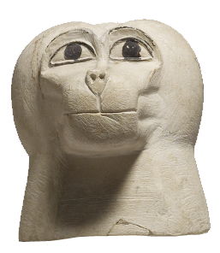
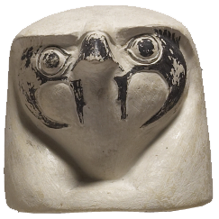
Which Ancient Egyptian God protected the stomach?
Duamatef
Imsety
Hapy
Qebehsenuf

Slide 6
Did Hapy protect the stomach?
No, Hapy did not protect the stomach.
Try again.
No, Hapy did not protect the stomach.
Try again.
^{mylearning.org}

Slide 7
Did Imsety protect the stomach?
No, Imsety did not protect the stomach.
Try again.
^{mylearning.org}

Slide 8
Did Qebehsenuf protect the stomach?
No, Qebehsenuf did not protect the stomach.
Try again.
^{mylearning.org}

Slide 9
Did Duamatef protect the stomach?
Yes, well done. Duamatef protected the stomach.
^{mylearning.org}

Slide 10
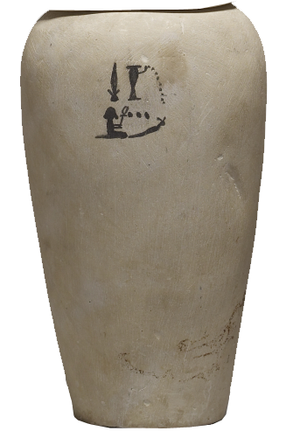
Which Ancient Egyptian God protected the intestines?
Duamatef
Imsety
Hapy
Qebehsenuf

Slide 11
Did Hapy protect the intestines?
No, Hapy did not protect the intestines.
Try again.
No, Hapy did not protect the stomach.
Try again.
^{mylearning.org}

Slide 12
Did Duamatef protect the intestines?
No, Duamatef did not protect the intestines.
Try again.
^{mylearning.org}

Slide 13
Did Imsety protect the intestines?
No, Imsety did not protect the intestines.
Try again.
^{mylearning.org}

Slide 14
Did Qebehsenuf protect the intestines?
Yes, well done. Qebehsenuf protected the intestines.

Slide 15
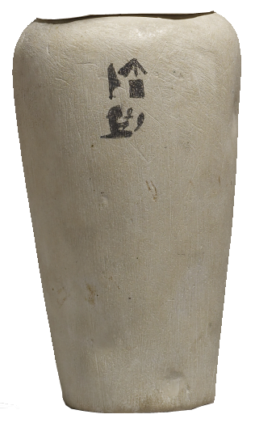
Which Ancient Egyptian God protected the lungs?
Duamatef
Imsety
Hapy
Qebehsenuf

Slide 16
Did Duamatef protect the lungs?
No, Duamatef did not protect the lungs.
Try again.
^{mylearning.org}

Slide 17
Did Imsety protect the lungs?
No, Imsety did not protect the lungs.
Try again.
^{mylearning.org}

Slide 18
Did Qebehsenuf protect the lungs?
No, Qebehsenuf did not protect the lungs.
Try again.
^{mylearning.org}

Slide 19
Did Hapy protect the lungs?
Yes, well done. Hapy protected the lungs.

Slide 20
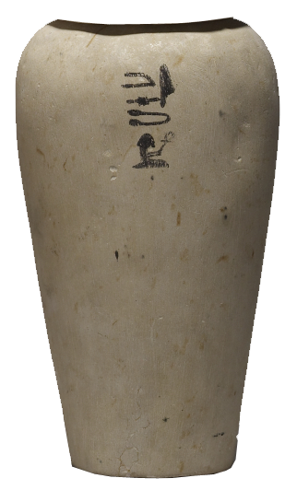
Which Ancient Egyptian God protected the liver?
Duamatef
Imsety
Hapy
Qebehsenuf

Slide 21
Did Qebehsenuf protect the liver?
No, Qebehsenuf did not protect the liver.
Try again.
^{mylearning.org}

Slide 22
Did Duamatef protect the liver?
No, Duamatef did not protect the liver.
Try again.
^{mylearning.org}

Slide 23
Did Hapy protect the liver?
No, Hapy did not protect the liver.
Try again.
No, Hapy did not protect the stomach.
Try again.
^{mylearning.org}

Slide 24
Did Imsety protect the liver?
Yes, well done. Imsety protected the liver.

Slide 25
Now each Ancient Egyptian God is protecting the correct organ.
Hapy
Duamatef
Imsety
Qebehsenuf
What happens next?
Image: Walters Art Museum | CC BY-SA 3.0

Slide 26
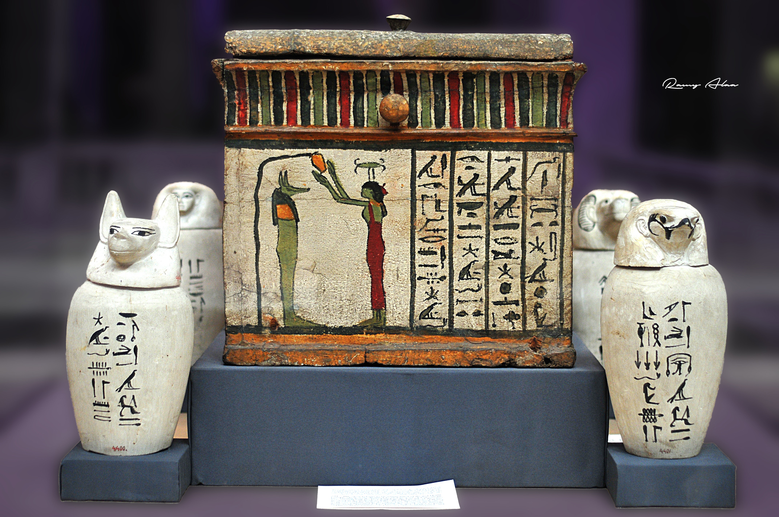
The canopic jars with the organs inside were then placed in a special chest, and put in the tomb with the mummy.
^{mylearning.org}
Image: Ramy Alaa |Flickr | CC BY ND NC 2.0

Slide 27
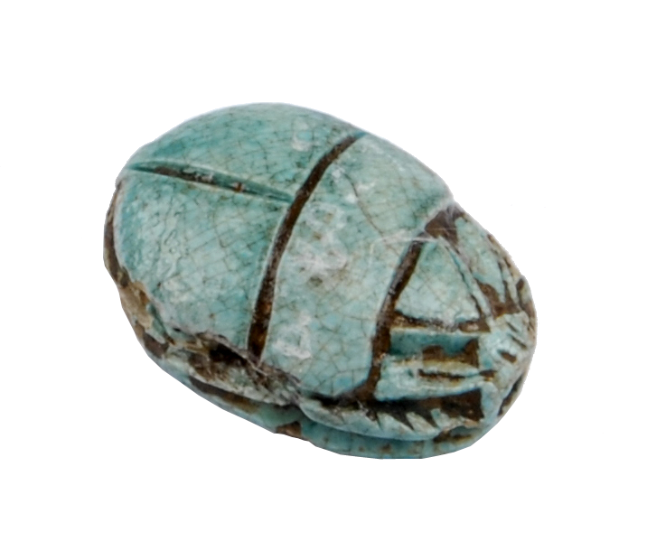
Ancient Egypt
Why not explore a nearby museum’s
Ancient Egypt collection?
You’re bound to discover something amazing!
^{mylearning.org}

