Slide 1
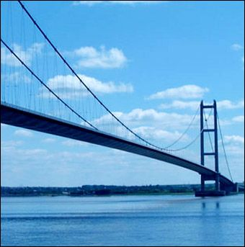
THE HUMBER BRIDGE
INFORMATION PACK

Slide 2
WHAT TO KNOW ABOUT THE BRIDGE?
The Humber estuary has five important rivers following into it - The Trent, Ouse, Don, Aire and Derwent and makes up one-fifth of the country's river water. The Humber has been used for trade since the Bronze Age (1500 B.C.) and even crossed using plank boats, recently discovered in Ferriby which are the oldest discoveries in Europe!
The Humber has always provided a barrier between the North and the South, especially when it came to trade which is important for an areas growth. Ferries were introduced by 1315 but this was slow. The Industrial Revolution and the importance of the railways meant a faster crossing was needed. Talks about a crossing were taking place from 1860 but it was not until May 1971 that a bridge was given the green light with work beginning in on 27th July 1972.
As cities expanded due to the Industrial Revolution so also did traffic and people movement. Hull's port was becoming involved in world wide trade and its traffic expansion grew by 130% between 1862-1882. Ferry crossing where slowing down the speed of transporting goods to the south of the country meaning Hull could be losing out on possible trade.
The Humber had provided a defence to the area throughout history, mainly during the Anglo-Saxon period amongst the warring tribes. Now however the river was working against those on its north banks.

Slide 3
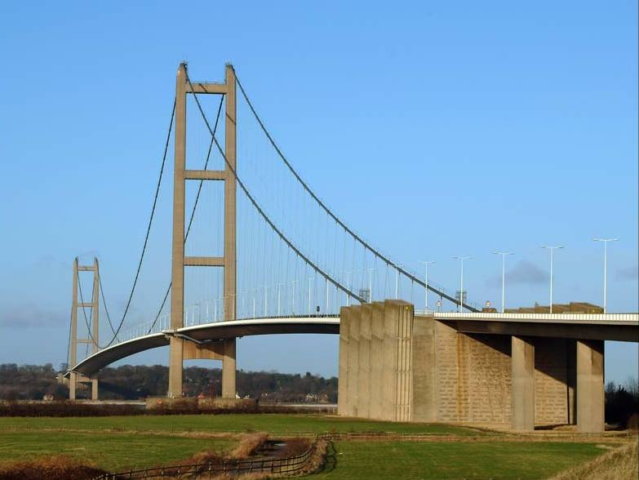
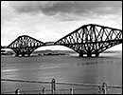
DESIGN
WHY THIS....
AND NOT THIS

Slide 4
DESIGN FACTS
The reasons why a suspension bridge was chosen over other designs were due to two key reasons. First the Humber River has a shifting bed and is deep enough and wide enough to afford passage to ships, but what is always changing. A suspension bridge with no support piers within the river would not obstruct the estuary. Secondly, because of the local landscape a construction of a tunnel under the bridge would have been far more costly.
Many different ideas were put forward however over the years, mainly before the knowledge of the Humber had been gained.
The Humber Bridge when first constructed was the largest single span suspended roadway in the world! It spans some 1,410 meters, that’s 13 and a half lengths of Wembley Stadium!
The bridge sits 30 meters above the river to allow shipping to safely pass under.
The two towers that support the Bridge are 510 ft high, just over half the size of the Eiffel Tower. The roadway is made up of 124 sections all weighing 140 tons, roughly the weight of a Blue Whale. The cables that suspend the bridge are 14,948 parallel galvanized drawn wires of 5mm in diameter spun together to make one steel wire cable of 62m in diameter.

Slide 5
BRIDGE OF CHOICE
The Arch Bridge;
Has great natural strength. Thousands of years ago, Romans built arches out of stone. Today, most arch bridges are made of steel or concrete, and they can span up to 800 feet.
No cables or extra supports are needed and shift the weight from on top to down in its foundations. An arch bridge has a semicircular design with abutments on each end. An arch is known as a compression structure.
Romans used these bridges to carry water to towns.
The Beam Bridge;
This is the most simple bridge design.
Made up of a horizontal beam, which is supported at each end by pillars. The weight of the beam pushes straight down on the piers. The farther apart its piers, the weaker the beam becomes. This is why beam bridges rarely span more than 250 feet. Can be made for larger distances but more beams have to be placed together meaning more pillars.
Very often seen in parks and for pedestrian crossings.

Slide 6
The Cantilevered Bridge;
A cantilever bridge is used for crossing large distances with heavy loads.
A cantilever is supported only on one end. In a typical cantilever bridge, two cantilever arms are joined in the centre by a light suspended span.
The Suspension Bridge;
Can span 2,000 to 7,000 feet -- a lot farther than any other type of bridge!
Supported by two pillars at each end, the bridge is held up and weight supported using tension in cables. Can support large numbers of cars, lorries, pedestrians and even trains!
Ideal also for allowing movement pass under below due to lack of pillars.

Slide 7
THE TASK
Now you know a little bit about bridge design it’s time to put it to the test. In four groups you will each be given a task in which you will have to design and make your own bridge. Good Luck....

Slide 8
Your task, should you choose to accept....
Using the material and equipment provided, design and build your own bridge to span a 75 cm gap.
The bridge once completed most hold at least the weight of three texts books upon testing.
In your groups discuss and plan a bridge design from the previous list that you think could achieve holding the weight.
Other design instructions include:
A smooth ramp for a car to drive onto the bridge.
Must have enough room for two cars to pass each other.
To achieve the task all instructions must be followed.
Good Luck

Slide 9
MATERIALS AND EQUIPTMENT....
SCISSORS
RULER
CARDBOARD
STRING
STRAWS
TUBE
PAPER
PENCIL
TO TEST THE BRIDGE
3 X TEXT BOOKS
TOY CAR

Slide 10
Your Designs
Please include measurements.

Slide 11
Your Designs
Please include measurements.

Slide 12
Your Designs
Please include measurements.

Slide 13
RESULTS
How did your bridge design go? Is there anything you could have done better?
Write a short paragraph stating;
Why you choose the bridge you did?
Did it work? If it didn't do you know why?
What have you learnt?

