Slide 1



Amazing Accrington:
Industry and Art
Supporting Resources for Teachers (Images)
The use of images is restricted to educational purposes
Resources created by www.theheritageconnection.co.uk

Slide 2
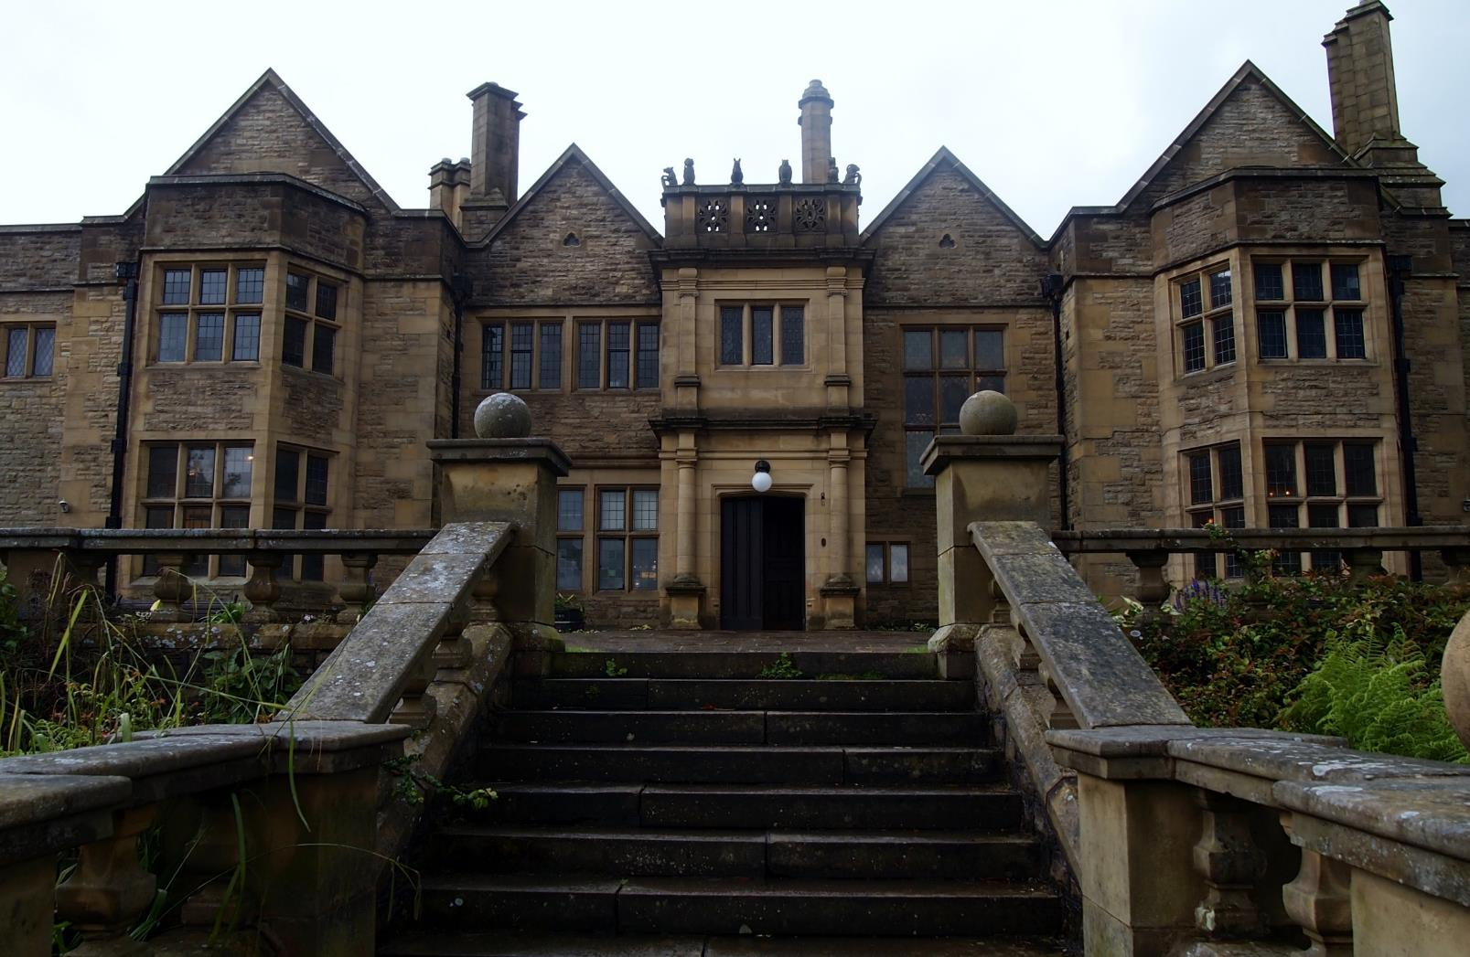
Exterior of Haworth Art Gallery 2017
© The Heritage Connection | Trizia Wells
Notes:
Ref. HAG01
Haworth Art Gallery, formerly Hollins Hill, designed by Yorkshire architect Walter Brierley and built for William Haworth, Accrington textile manufacturer, and his sister Anne. William died in 1913 and Anne managed the house alone until her death in 1920. William and Anne had been great collectors of paintings and artefacts and wanted to bequeath the house to Accrington as an art gallery. The house was re-opened as the Haworth Art Gallery in 1921.
HAG03,04 and 05 are other examples of Brierley’s work. HAG05 was built in 1926 for Noel Terry, of Terry’s chocolates and was Brierley’s last design.

Slide 3
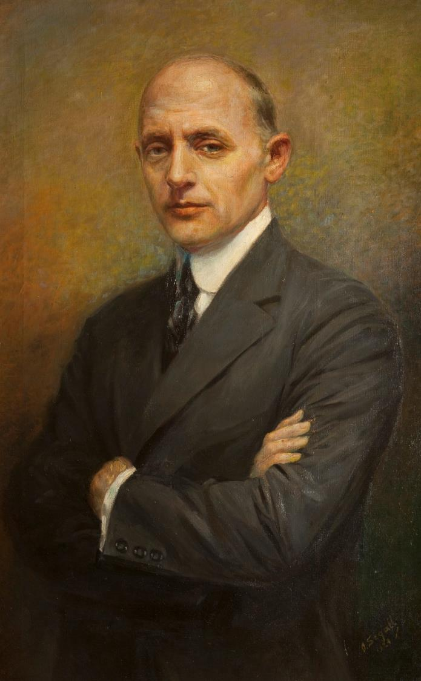
Joseph Briggs, 1924
Haworth Art Gallery,
by permission
Notes:
Ref. HAG06
Joseph Briggs was born in the shadow of the town’s viaduct, at no. 3 Milnshaw Lane, where the roundabout is now. After an apprenticeship at Steiner’s Calico Printing works, he went to America in search of adventure. After a couple of years, he joined Tiffany Glass and Decorating company, and rose to become head of the mosaic department and personal assistant to the head of the company, Louis Comfort Tiffany. Joseph stayed with Tiffany Glass until the company closed in 1932. Although Tiffany Glass was now unfashionable, Joseph recognized its fine workmanship and saved many pieces from destruction by sending them back to Accrington. However it was to be 30 years before their beauty and value was recognized and they were unpacked and put on display. The pieces Joseph rescued now form the largest public collection of Tiffany Glass in Europe.

Slide 4
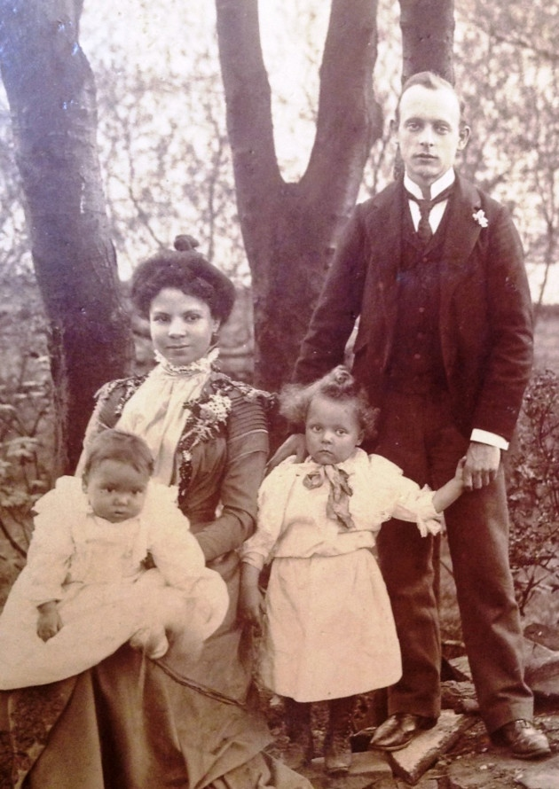
Joseph Briggs and family, around 1901
Lancashire Life 2015
Notes:
Joseph aged 28 years with wife Elizabeth, children Joseph and Viola on a visit to Accrington

Slide 5
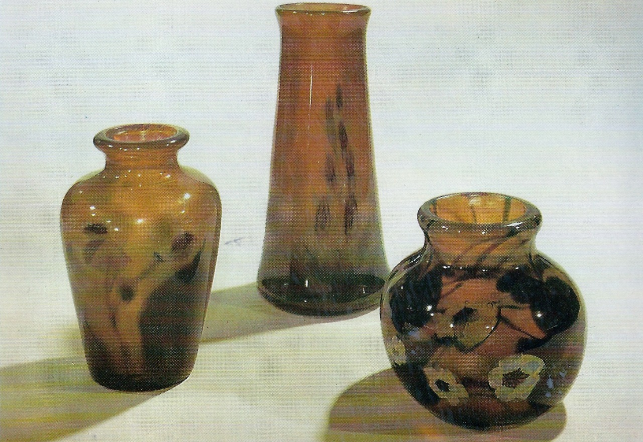
Millefiore glassware
© Haworth Art Gallery | By permission
Notes:
Ref. HAG07 Millefiore paperweight and vase collection
These items can be seen along with many others at the Haworth Art Gallery.

Slide 6
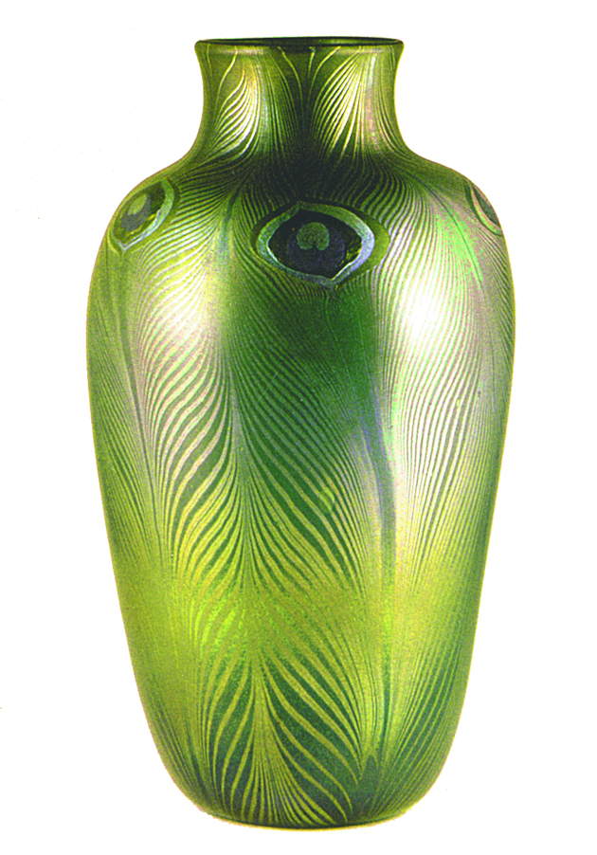
Peacock vase
Haworth Art Gallery,
by permission
Notes:
Ref. HAG08 Peacock vase – peacocks were one of Tiffany’s favourite motifs.
This item can be seen along with many others at the Haworth Art Gallery.

Slide 7
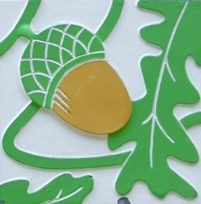
Accrington acorn
Hyndburn Borough Council
Notes:
Ref. HAG09
Acorns are the symbol of Accrington. There are lots of acorn symbols in and around the town.

Slide 8
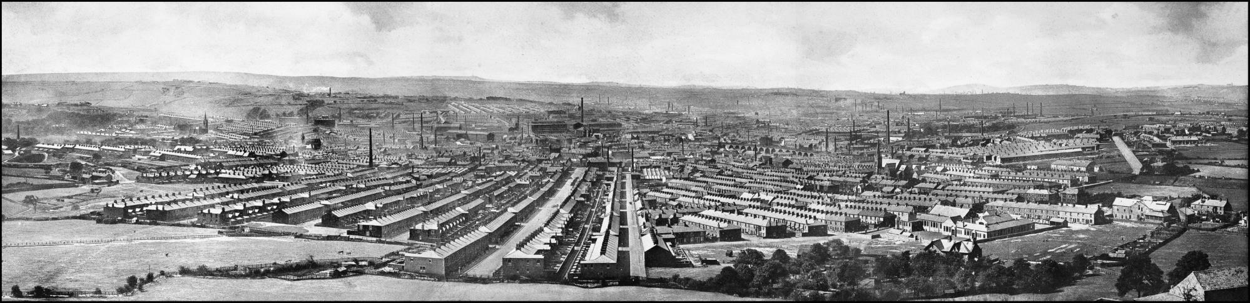
Accrington Panorama
Accrington Local Studies Library
Notes:
Ref. HAG10
This photograph can be seen by request in the local history section of Accrington library. It was taken from the Coppice. In the foreground can be seen The Avenue leading down to the centre of the town and the railway arches on the right.

Slide 9
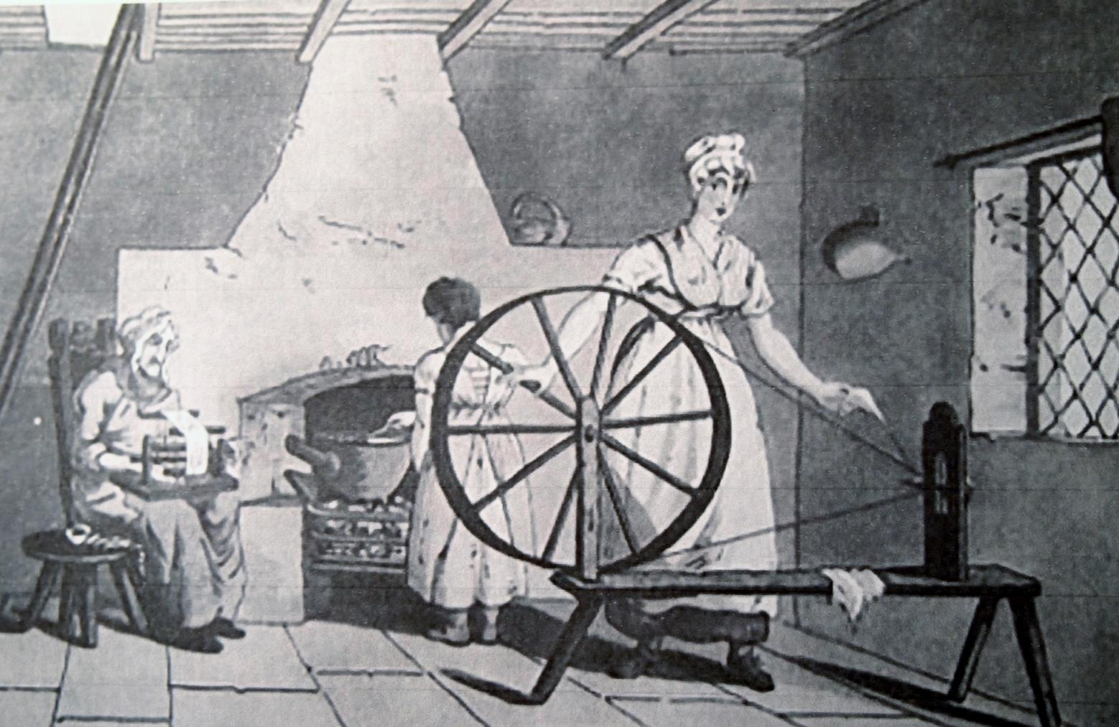
Weaving was a cottage industry
Creative Commons via wikipedia
Notes:
Ref. HAG14b
Before the mills were built, weaving was done at home and the whole family helped.

Slide 10
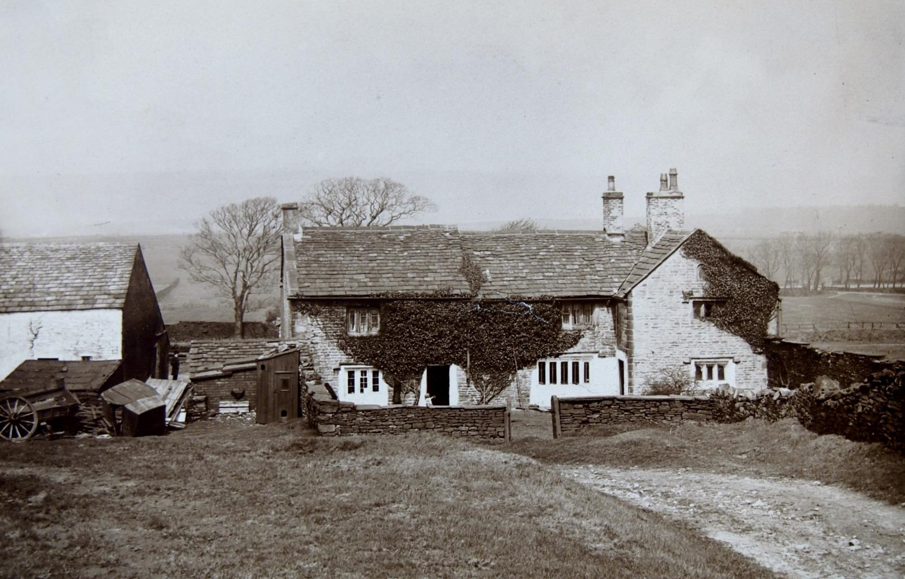
Peel Fold Farm, home of
Parsley Peel
Accrington Local Studies Library
Notes:
Ref. HAG15
Robert Peel supplemented his farming income with weaving. He invented ways to print patterns onto the finished cloth. His first design was a parsley leaf and this gave him his nickname of “Parsley Peel.” He opened a calico printing factory and became very wealthy.

Slide 11
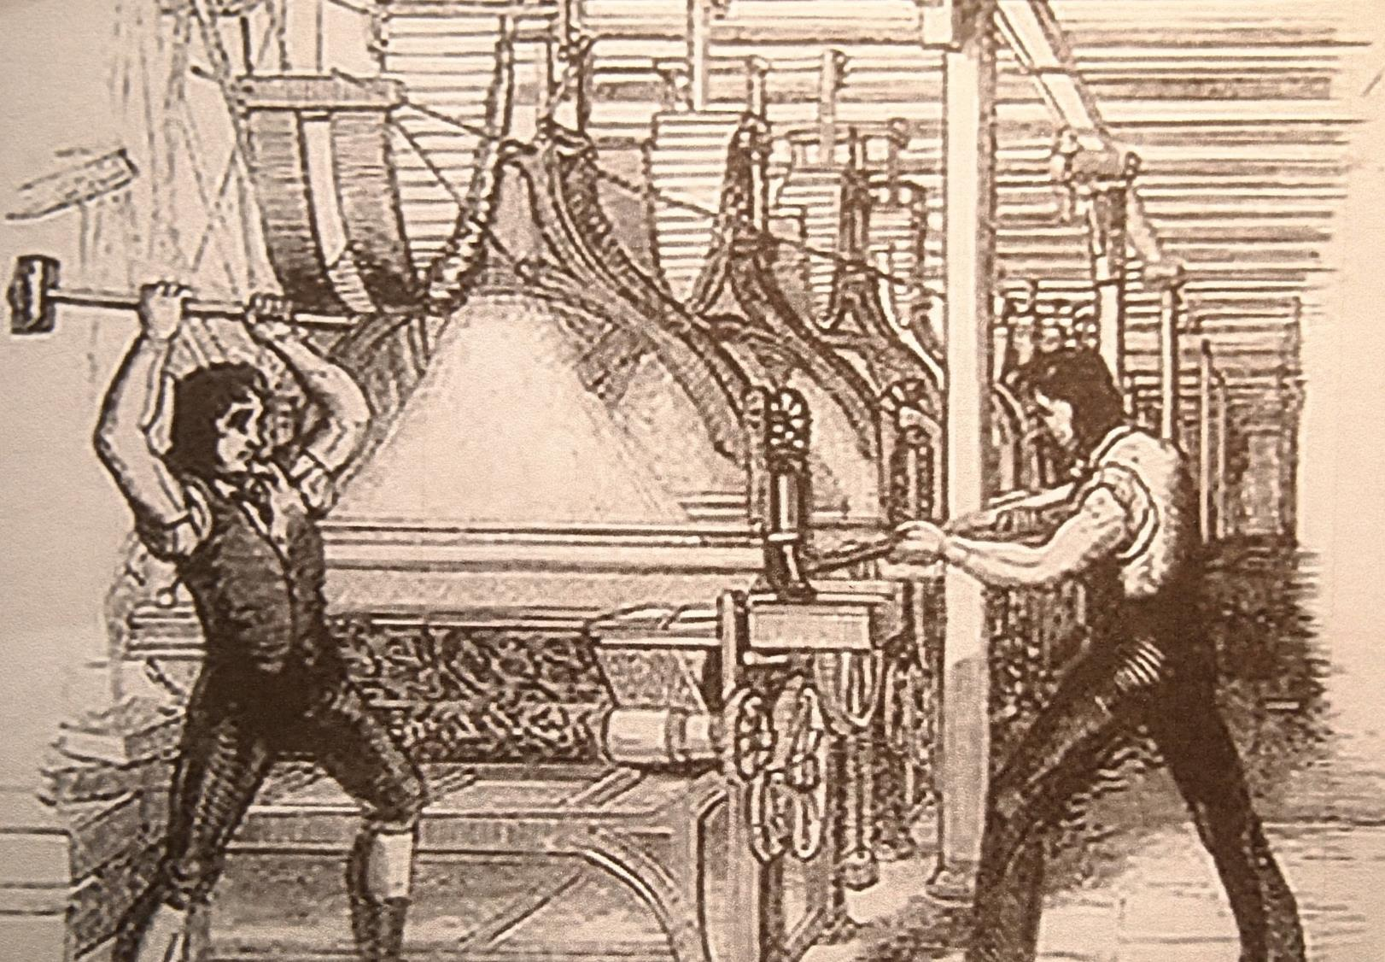
Protests against new machinery
Creative Commons via wikipedia
Notes:
Ref. HAG18b
The spinning jenny and other inventions meant more cloth could be produced more quickly. But the machines would not fit into the cottages and people had to go to work in mills and factories. They had to work when they were told, and for a set wage. They had less time to themselves. Many people did not like this change in their way of life and smashed up the new machines. Robert Peel closed his factory and moved to another town where carried on printing cloth and became even more wealthy.

Slide 12
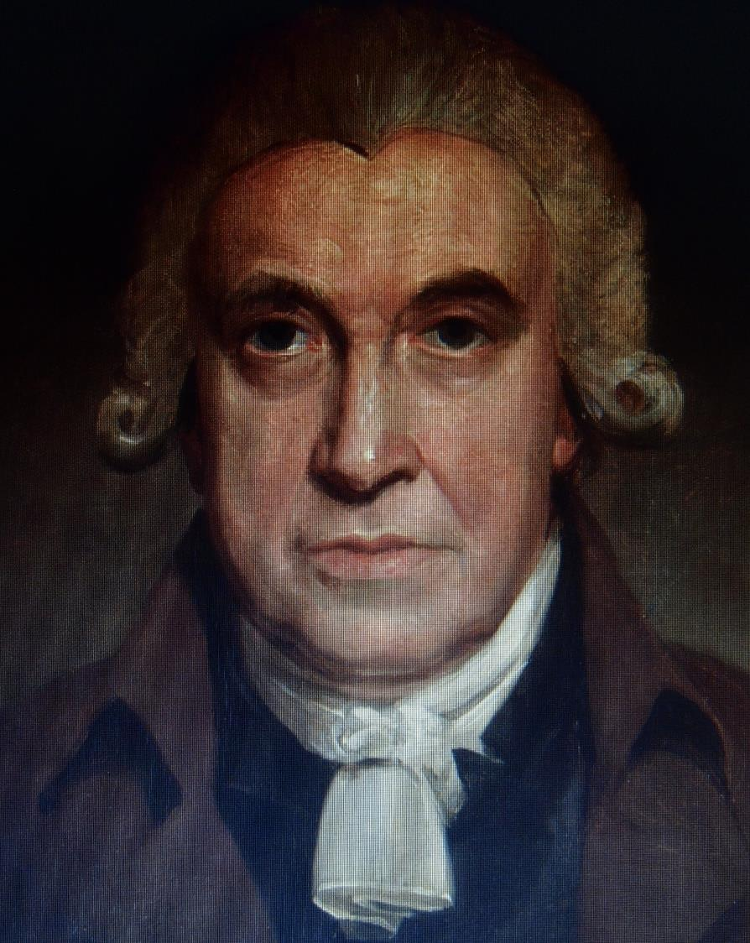
James Hargreaves, inventor of the spinning jenny
Tracy Leeming | Oswaldtwistle Mills
Notes:
Ref. HAG19
James Hargreaves worked for Robert Peel and invented a loom with multiple spindles. Legend says it was named after his daughter, Jenny.

Slide 13
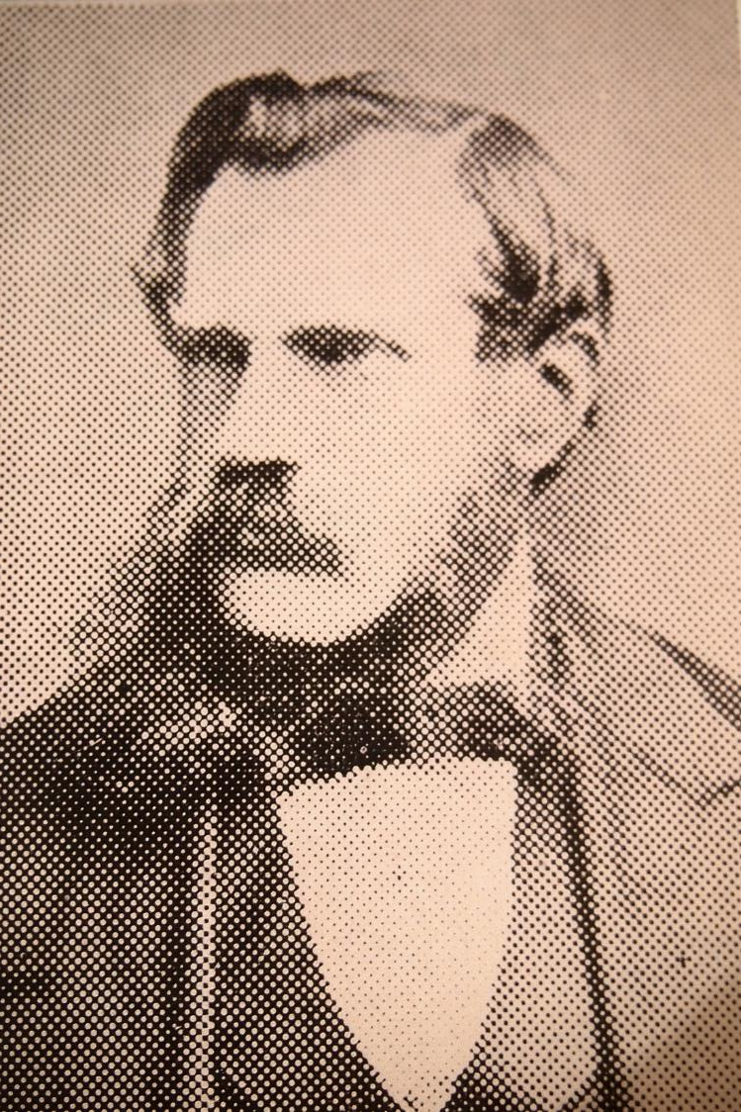
Frederick Gatty, inventor of Turkey Red and Khaki dyes
Accrington Local Studies Library
Notes:
Ref. HAG21
Frederick Gatty was invited to come and live and work in Accrington by a man called Frederick Steiner who worked in the dye department of Accrington’s biggest factory, Broad Oak Print Works. Frederick Gatty was an expert in dyeing and printing cloth. He invented ways of fixing two dyes – khaki and a deep red which became known as Gatty red or Turkey red. Both Fredericks had streets named after them in Accrington.

Slide 14
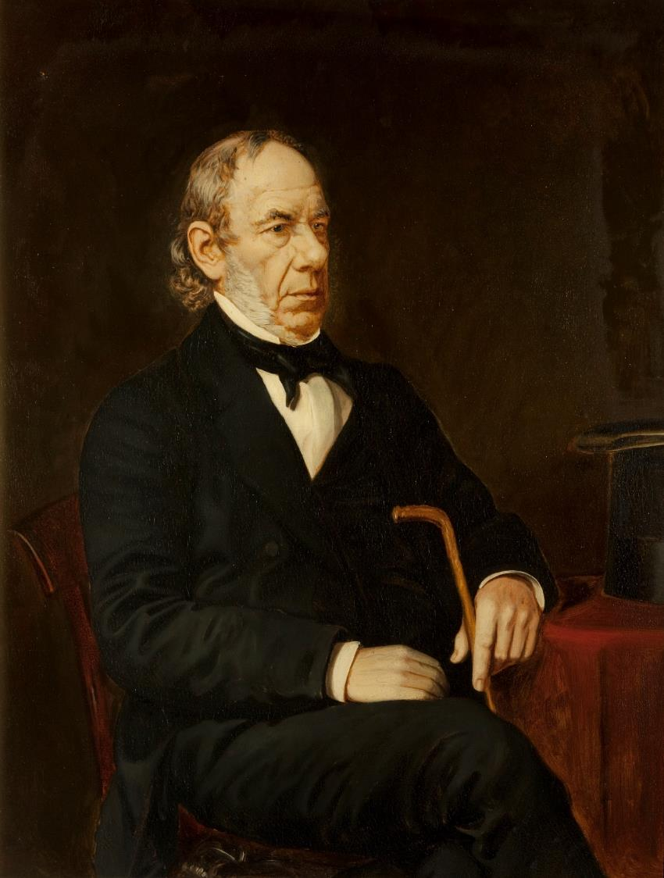
John Mercer, inventor of mercerised cotton
Haworth Art Gallery,
by permission
Notes:
Ref. HAG22
John Mercer invented dyes for fabric including indigo and shades of organs. His most important invention was mercerised cotton, which is stronger and easier to dye.

Slide 15
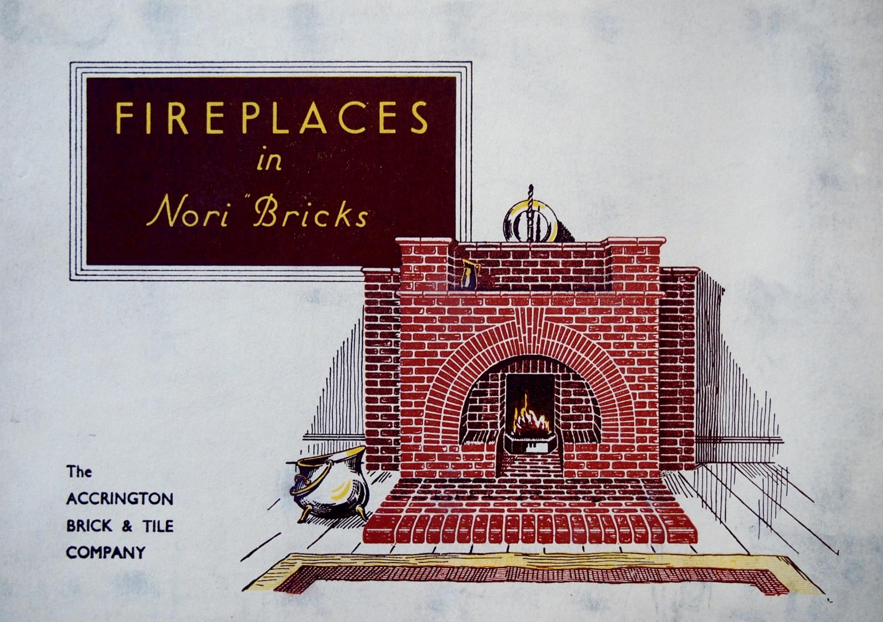
Accrington
Nori Bricks
Accrington Local Studies Library
Notes:
Ref. HAG23a
Accrington NORI bricks. NORI is IRON spelt backwards. The clay which these bricks are made from contain a high quantity of iron ore. Accrington is one of only two places in the UK where this clay can be found. This clay makes the bricks very hard wearing. Accrington NORI bricks were used in the Empire State Building and Blackpool Tower.

Slide 16
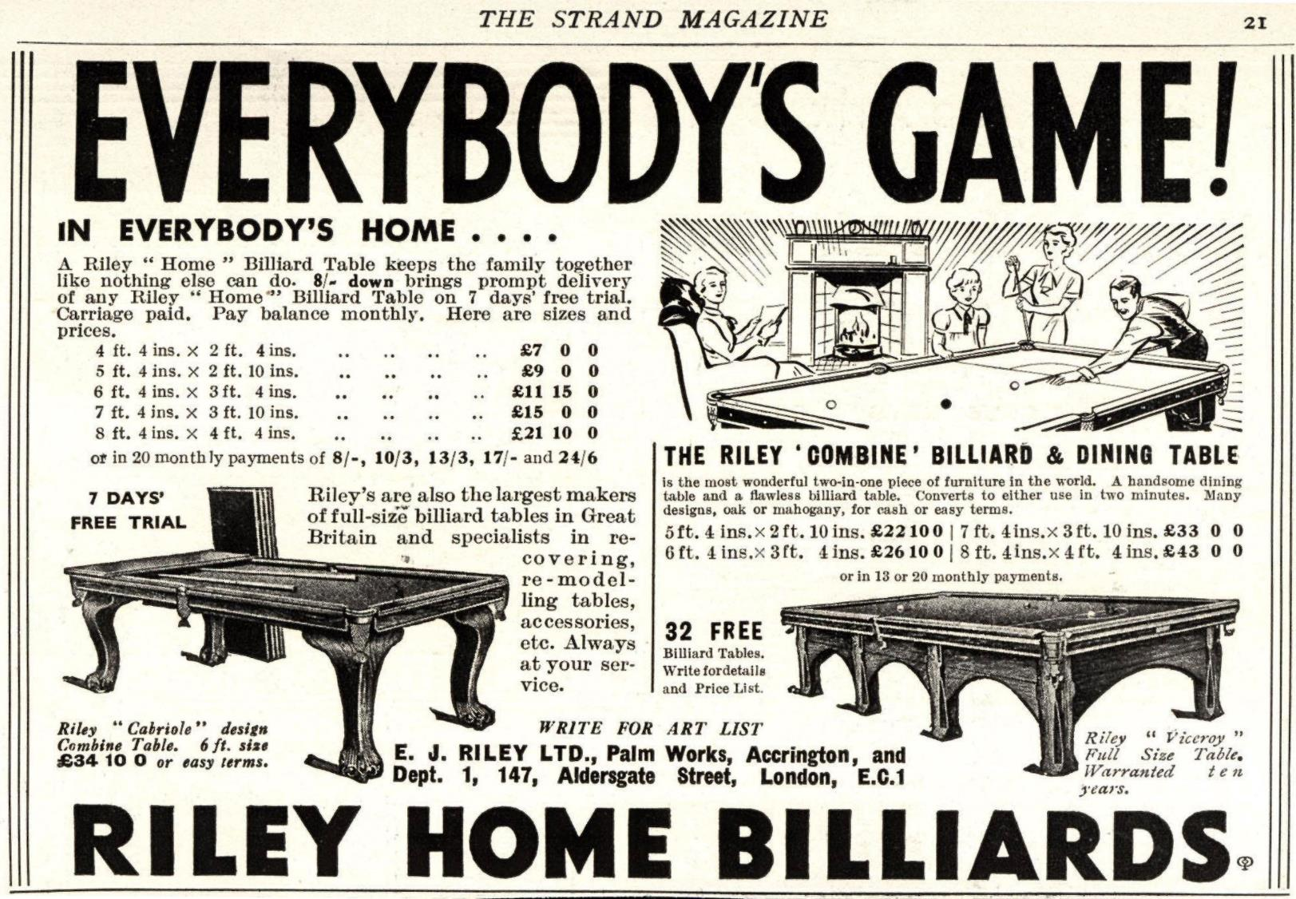
Riley Sports Equipment
www.advertising
archives.co.uk
Notes:
Ref. HAG24
E.J. Riley had two failed sports shops before he decided to manufacture sports equipment. At one time Rileys were the biggest manufacturer of cricket bats in the world. They made golf equipment and bowling balls but are best known for their billiard and snooker tables. They also ran billiards halls.

Slide 17
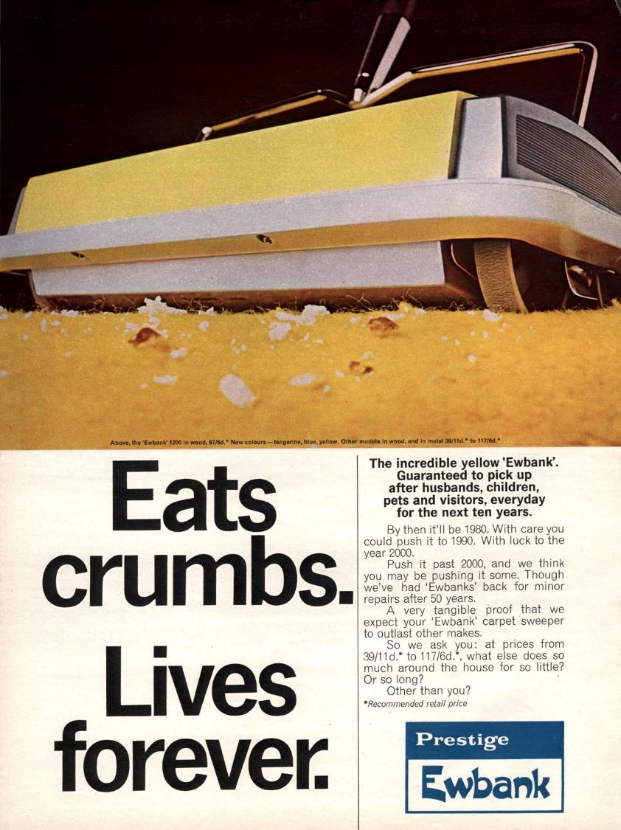
Ewbank Carpet Sweeper
www.advertising
archives.co.uk
Notes:
Ref. HAG26
The first Ewbank carpet sweeper went on sale in 1889. It was so successful that this household chore became known as “ewbanking.” Ewbank is still making carpet sweepers, vacuums and cleaning products, although not in Accrington.

Slide 18
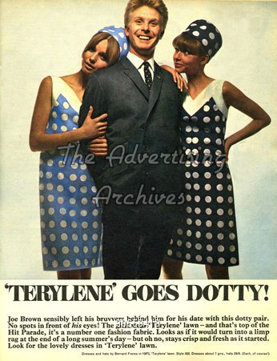
Terylene
www.advertising
archives.co.uk
Notes:
Ref. HAG27
John Rex Whinfield was born in Accrington. He was living in Hollins Lane and working as a textile chemist when he invented Terylene in 1941 with colleague James Tennant Dixon. It was the world’s first synthetic fibre. Because of the war, it was kept secret and not used commercially until 1948, when it was used in net curtains.

