Slide 1



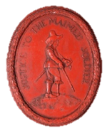
Royal Rescue
Spies!

Slide 2
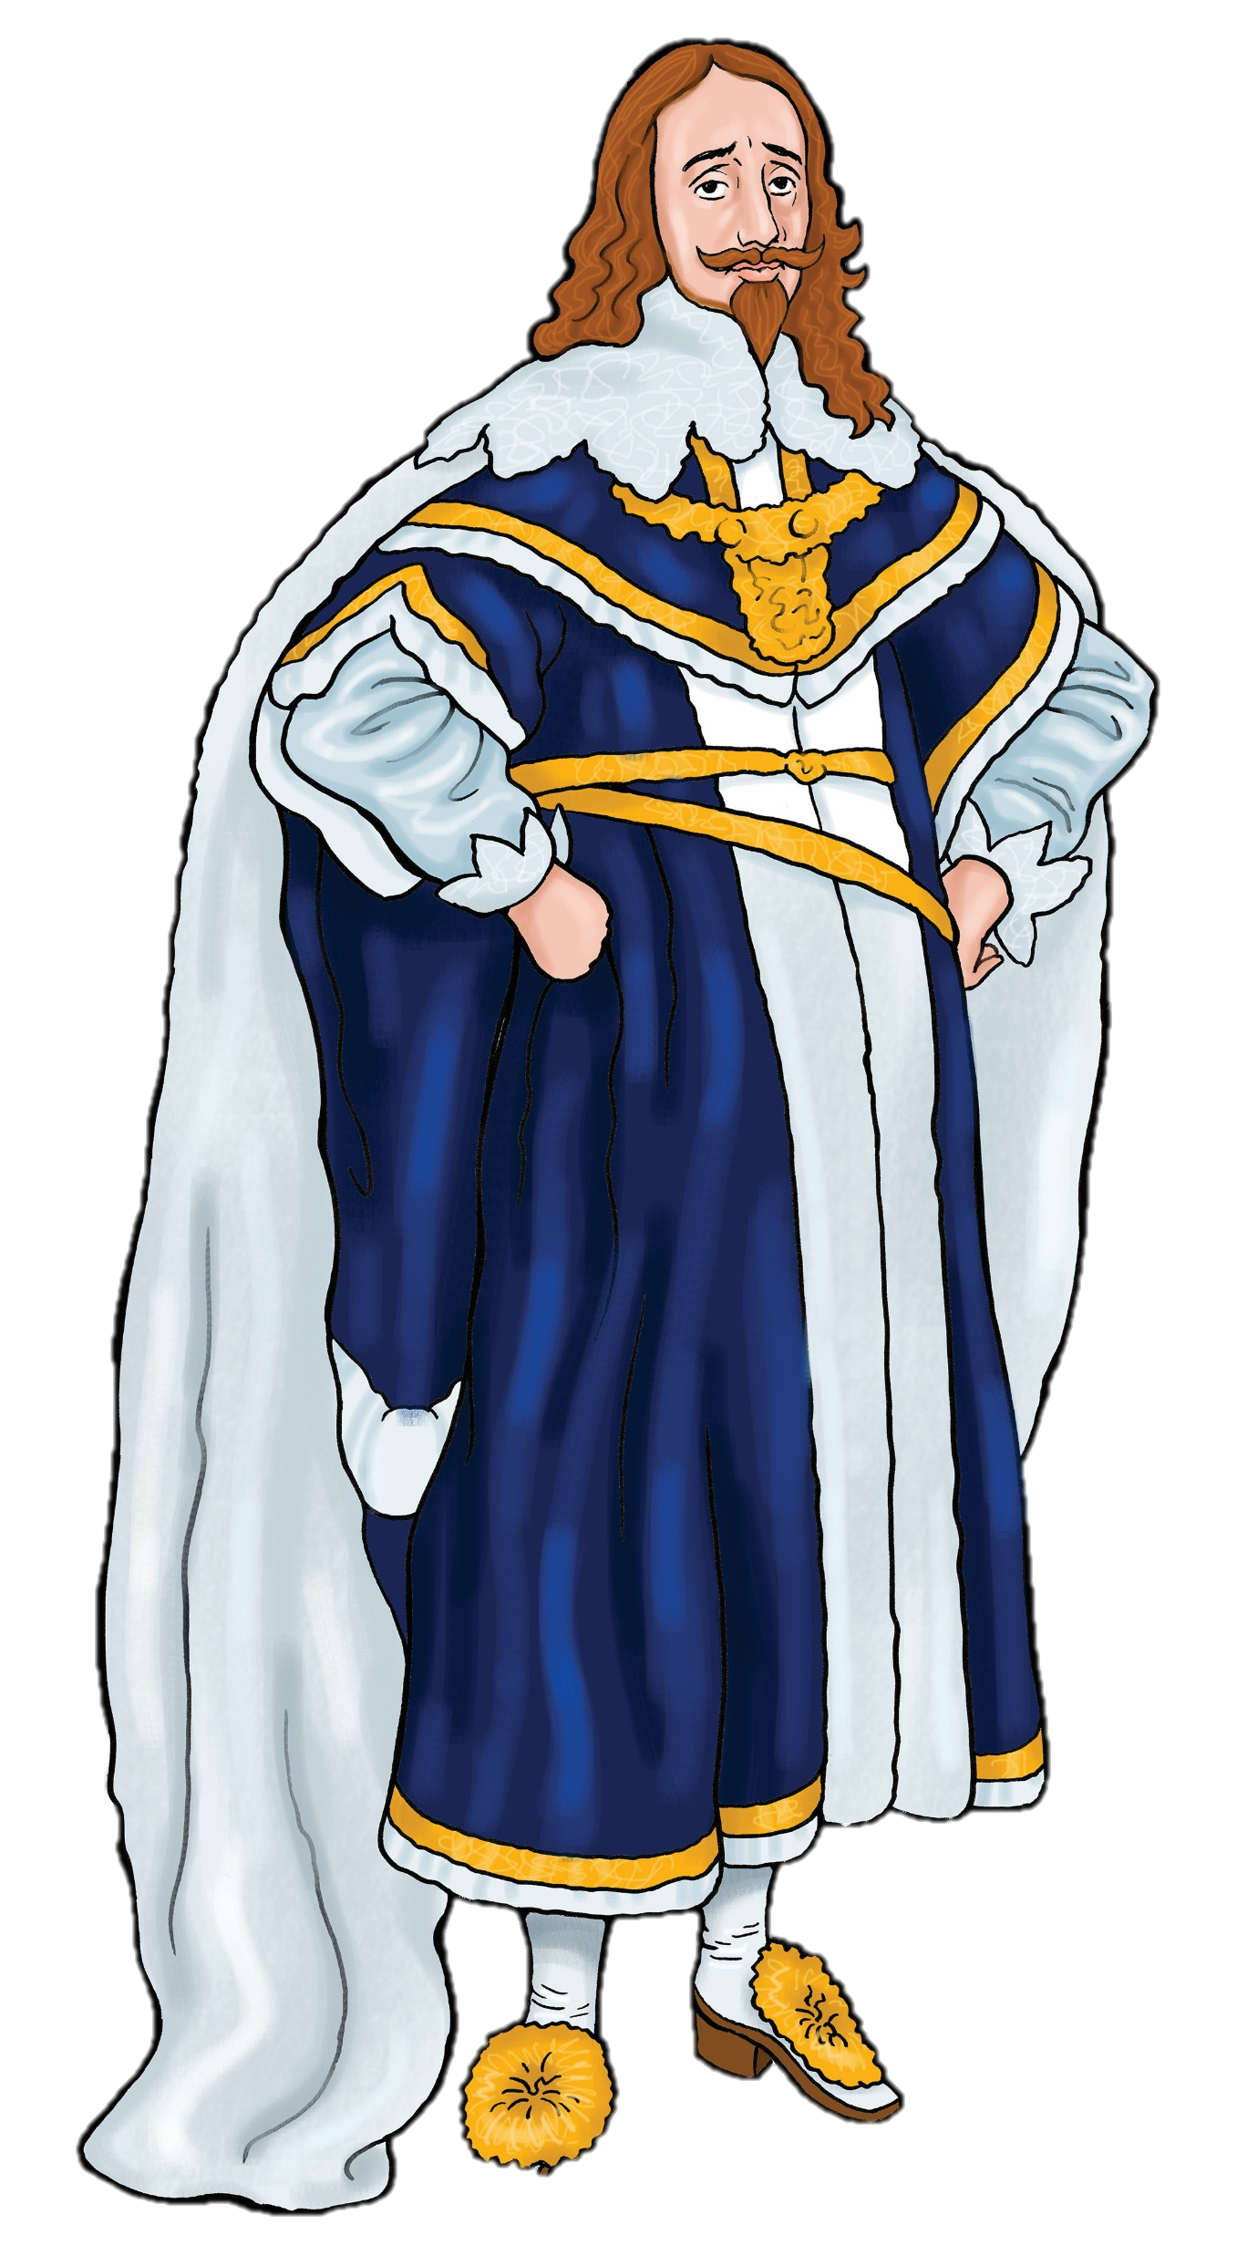
Defeat!
The King has lost the First Civil War.
He surrendered to the Scots at Southwell in Nottinghamshire.
He hoped that the Scots would help him, but…
…they sold him to Parliament.

Slide 3
Escape!
The King escaped from his prison at Hampton Court Palace and ran to Southampton.
He hoped that the governor of the Isle of Wight, Colonel Robert Hammond, would help him.
But Hammond has imprisoned the King at Carisbrooke Castle on the Isle of Wight.

Slide 4
Spies!
Now the King needs your help.
He needs spies to help him plan an escape.

Slide 5

What does a spy have to do?
Recruit a network of informers
Find out enemy secrets
Smuggle money
Deliver
secret messages
Travel around secretly
Think
Pair
Share

Slide 6
During the British Civil Wars, both sides used spies to
Find out enemy secrets
Send secret messages
Smuggle money
Spies were a very important part of the effort to win the war.

Slide 7
Now spies are plotting to help the King escape from prison and find safety abroad.
You are part of the King’s spy ring.
Can you come up with an escape plan?
You will need to find the best spies to help you…

Slide 8
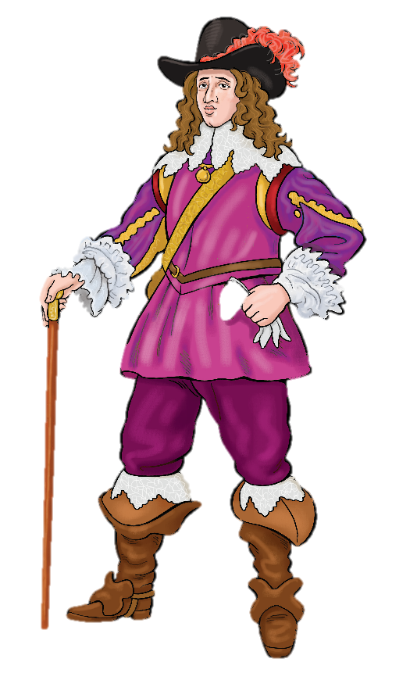
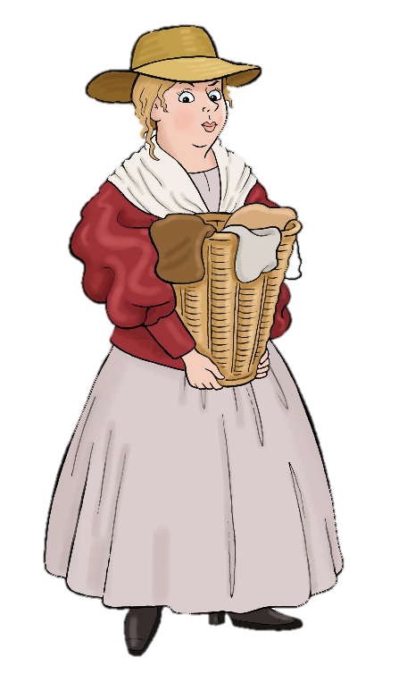
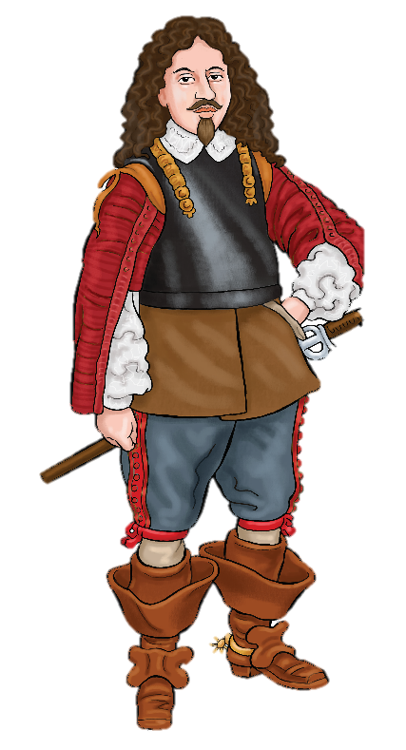
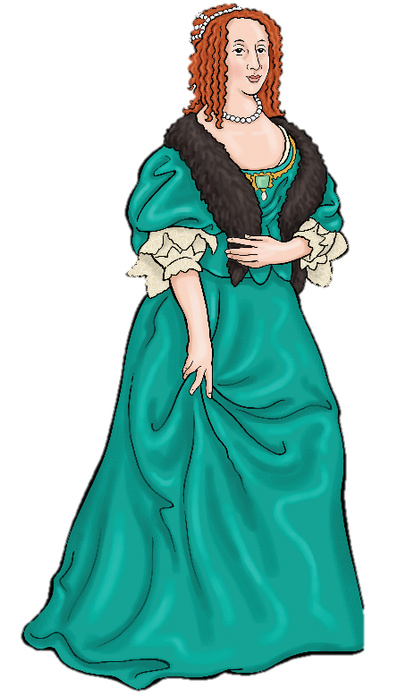
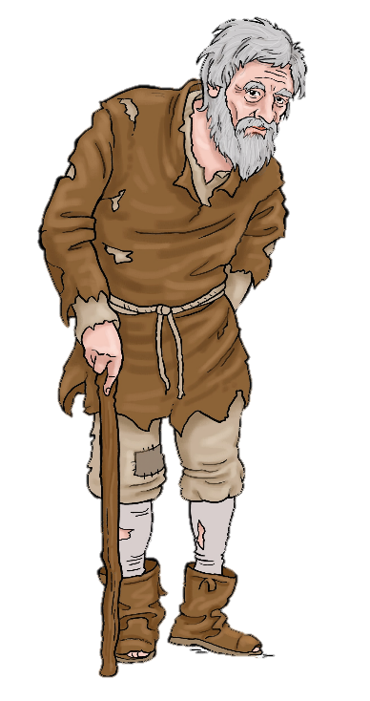
Who would make the best spy?
Read the spy files, fill in the spy selection sheet and make your choice

Slide 9
Click on the person you would like to recruit as a spy.
Find out if your mission will be a success

Slide 10
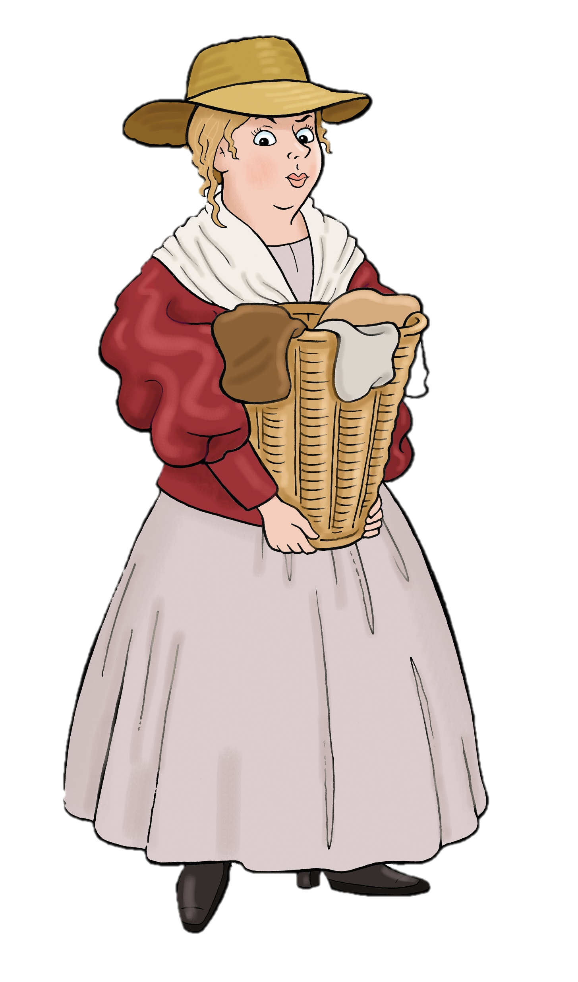
Women made the best spies! Why do you think this was?
Most people thought women were less important than men so they paid less attention to them . This made women invisible.
Most people thought women could not think clearly and had no ideas of their own. So..
..if a woman was caught and found to be a spy she was usually released not killed.
Some women did jobs like nursing or washing clothes. This meant they travelled widely and had hiding places for money or letters.
Think
Pair
Share

Slide 11
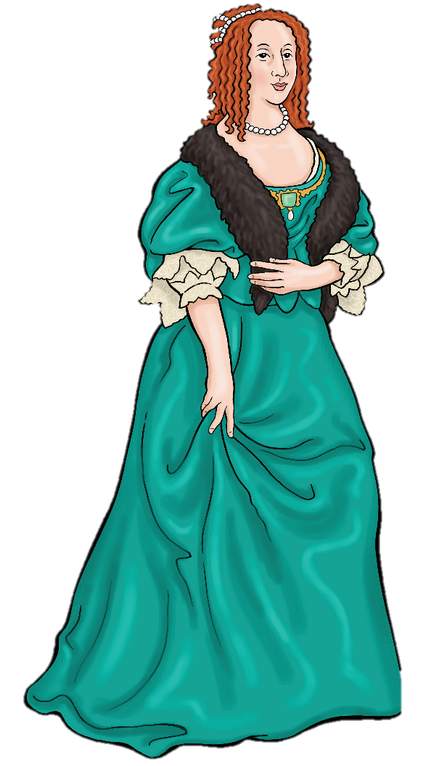
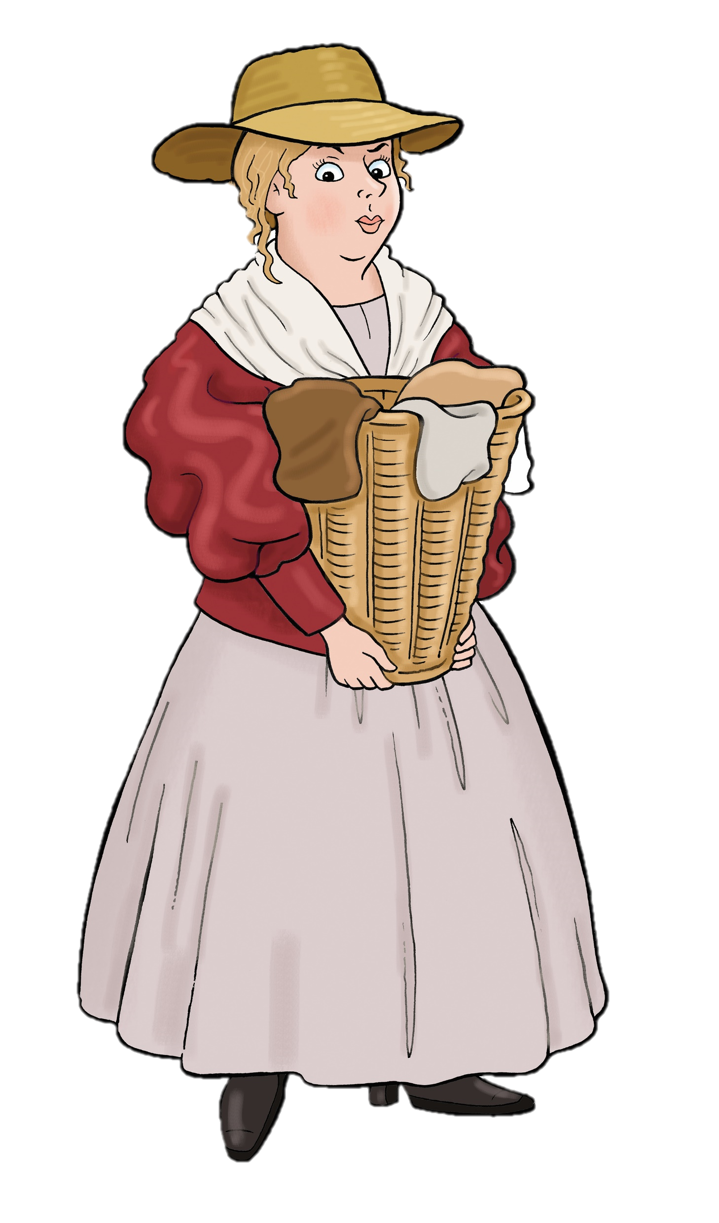
Royal Rescue!
Your spy ring
Jane Whorewood, also known as Agent 409, is an experienced spy.
Elizabeth Wheeler, laundress, is happy to work with her to help.

Slide 12
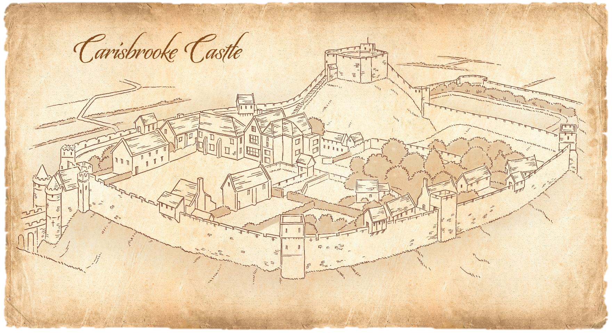
The King is in Prison here, on the Isle of Wight

Slide 13
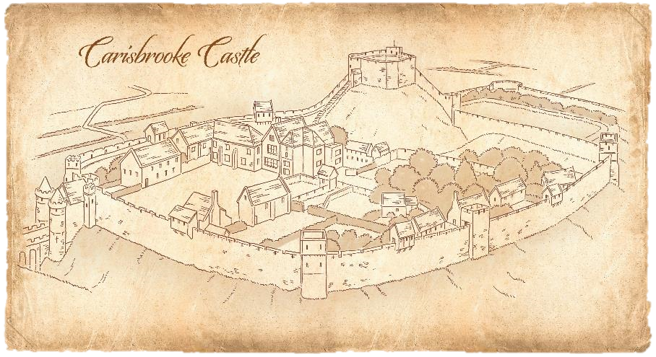
Use your plan of the King’s prison and the information below to plan his escape!
Some of his ‘Grooms of the Bedchamber’ are loyal to the king.
There are bars on the windows
of the king’s chambers
There are guards
by the king’s chamber and the castle walls
A bowling green has been built to entertain him
A woman brings him clean clothes every day
He is allowed to see a few friends
Looking for ideas? Read the spy stories on the next slide….

Slide 14
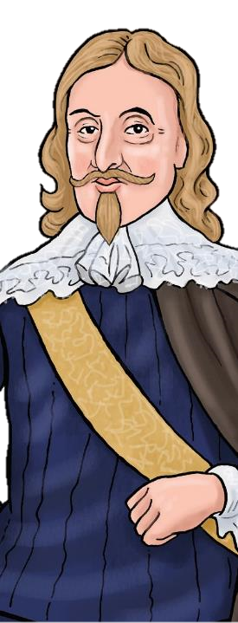
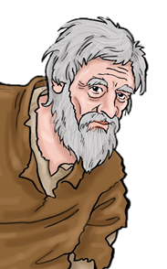

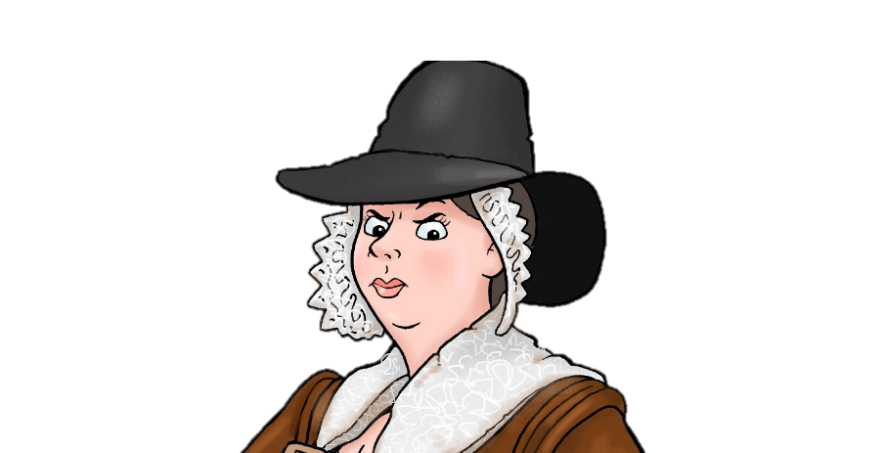
I swallowed a hollowed out slug bullet containing a message from the King. I sneaked past the Roundhead soldiers who were besieging Newark. When I got inside the town, I drank some medicine that made me poo the message out!
We went to attack a fort in Nottingham disguised as women. We hid our weapons under our skirts! Our secret plan was overheard by a Parliamentarian spy. We were caught and we had to jump in the river to escape!
I hid gold in barrels of runny, sticky, smelly soap and smuggled it to the king
I soaked eggs in vinegar to make the shells soft. Then I pushed messages inside and let them harden again.
Strange Spy Stories
Which of these stories do you think is true?

Slide 15
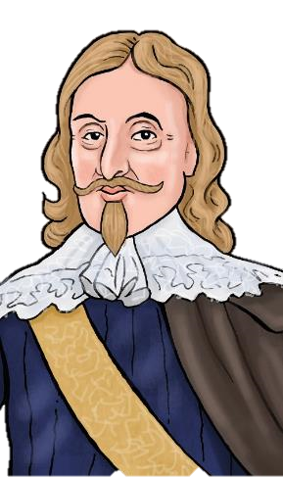
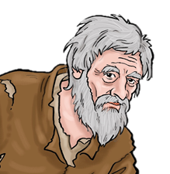
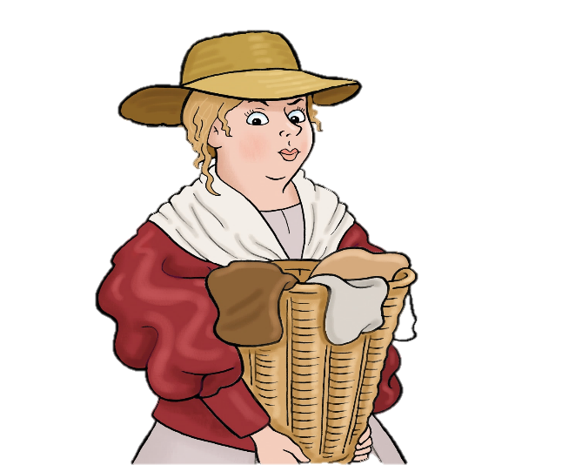

I swallowed a slug bullet in which there was a message from the King. I sneaked past the Roundhead soldiers who were besieging Newark. When I got inside the town, I drank some medicine that made me poo the message out!
We went to attack a fort in Nottingham disguised as women. We hid our weapons under our skirts. Our secret plan was overheard by a Parliamentarian spy. We were caught and we had to jump in the river to escape!
All True!
I hid gold in barrels of soap
I soaked eggs in vinegar to make the shells soft. Then I pushed a message inside and let them harden again.
Can you think of an even better plan and rescue the King?

Slide 16

Operation Royal Rescue!
It is time to act!
Jane Whorewood has sent a coded message to explain the escape plan.
Decode the message and find out the plan.
Do you think this plan will work?
7 25 81 67 75 25 the 16 25 25 65 1 2 25 89 5
3 57 9 65 2 25 81 75 55 6 the 98 9 21 4 25 98
3 57 9 65 2 4 25 98 21 the 16 25 67 5
59 5 16 89 1 21 75 98 9 57 57 75 8 16 25 98
150 25 89 5 41 the 98 1 57 57
16 5 1 4 14 25 21 the 25 75 8 5 16 59 9 4 5
Agent 409

Slide 17

Do you think this plan will work?
What might go wrong?
Go up to the room above. Climb out of the window. Climb down the rope. A servant will throw the King over the wall. A horse is ready on the other side
Jane Whorewood
Think
Pair
Share

Slide 18
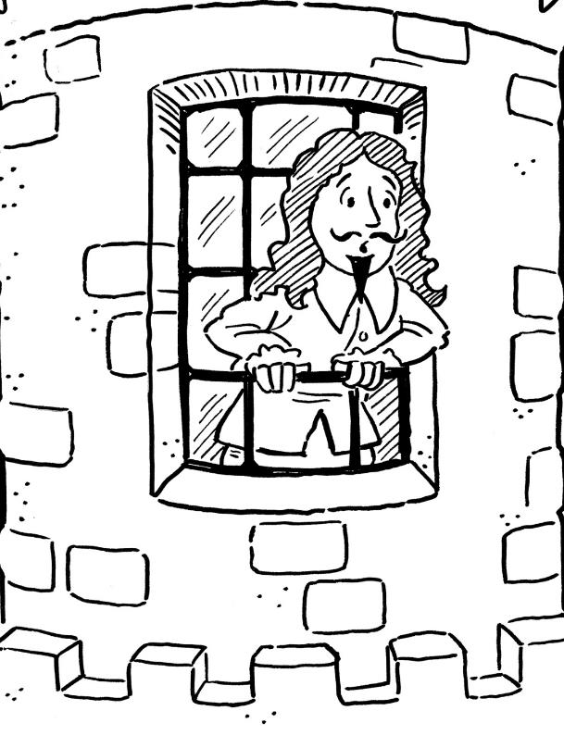
Stuck!
The King attempted to squeeze out of the window.
He became stuck between the bars.
The escape attempt failed!

Slide 19
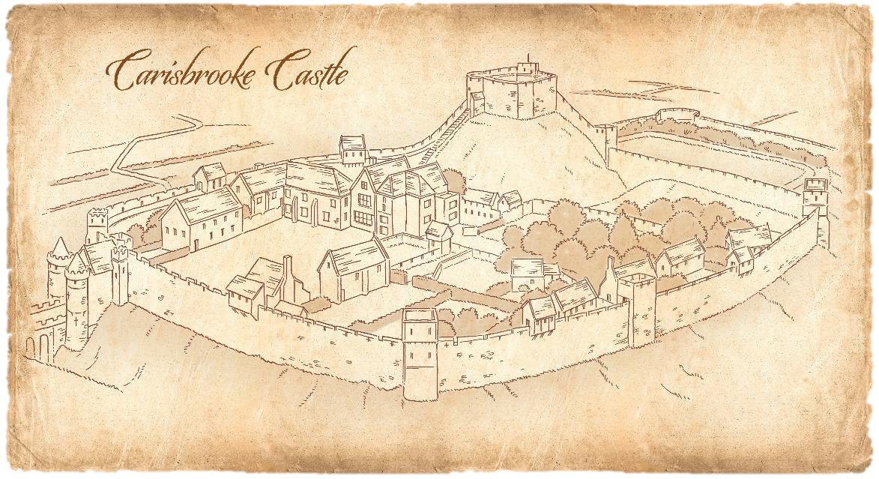
Try Again!
The King has been moved to a new chamber by the castle wall
Can you come up with a second escape plan?
What will you add to make sure it works this time?

Slide 20

Try Again!
16 9 2 5 7 81 1 16 4 59 75 25 59 75 1 14
9 57 5 21 75 98 9 57 57 59 5 21 4 1 3 9 4
25 65 5 57 75 98 4 21 4 25 98 2 1 16 59
65 81 21 25 59 1 98 2 1 16 59
98 8 5 21 59 25 6 75 16 81 21
8 16 25 8 1 7 8 2 25 98 57 9 21 7
16 5 5 21 35 98 1 9 77 9 21 7 75 25
16 9 4 5 75 25 72 Agent 409
Agent 409 has sent a second plan.
Use your copy of this letter to decode the plan.

Slide 21
Try Again!
Bribe the guards to stay silent.
We will send acid to melt the window bars.
The King must saw the bars when soft
Run through bowling green
Horse waiting to ride to ship
Here is the second plan.
Do you think it will work?
What problems might there be this time?

Slide 22
Failed again!
The King was caught in the act of escaping.
The plan failed.
Can you guess how it was discovered?

Slide 23
Failed again!
I consulted William Lilley, an astrologer, to find out if the plan would be lucky. He supplied the acid and the saw. He also told Parliament what we were planning!
The guards we bribed to stay silent when they saw the King trying to escape betrayed us!

Slide 24
Many women, like Jane Whorewood, worked as spies during the British Civil Wars.
Their identities were so secret that very little of their important work was recognised until now.

Slide 25
Challenge
How many things can you remember about spying during the British Civil Wars?
Write down as many facts as you can in 10 minutes!

Slide 26
Elizabeth Wheeler
This capable woman manages a team of laundresses and so she can get close to the king. No one will mind her moving around because travelling is part of her job and think of all the places she can hide important secret things!
Choose another spy

Slide 27

Nathaniel Drudge
This poor old man might make a good courier. No one would notice him sneaking into a well guarded location. But he wont be able to help you make valuable contacts and organise your plan
Choose another spy

Slide 28
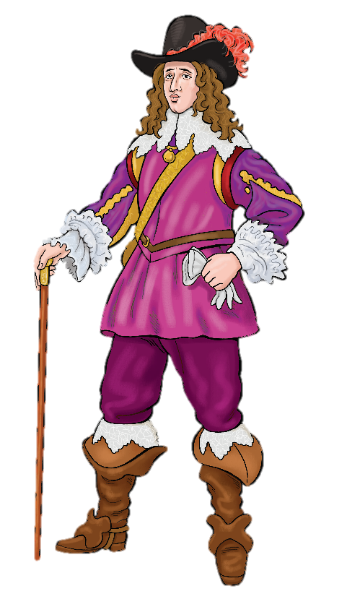
Ramshackle Huntinghorn
This rich man would certainly be able to raise money and organise an escape. But a man like this attracts a lot of attention. And do you really think he could keep a secret?
Choose another spy

Slide 29
Choose another spy
Humphrey Atkins
This soldier is a trusted Parliamentarian. It is very brave of you to try and recruit him as a royalist spy. The Roundheads certainly trust him and they might let him near the king. But a man like this will always be noticed..

Slide 30

Jane Whorewood
This well born lady is an excellent choice. She is loyal, educated and female. That means she is almost invisible. No one thinks a woman would be thinking up a clever plan and she can travel without attracting suspicion. She is good friends with the King and lots of other rich people so she can organise key parts of the plan and find the money to pay for transport.
Choose another spy

