Slide 1
Leeds Boxing Day Floods 2015 A Christmas to remember!

Slide 2
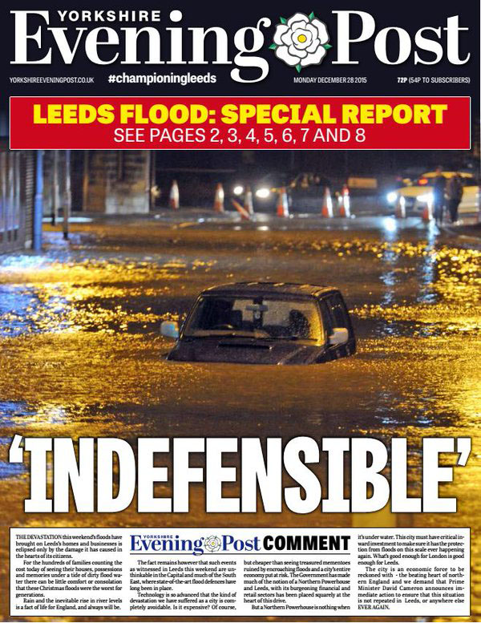
What happened?
Floods happen for lots of
different reasons.
How many reasons can you list?

Slide 3
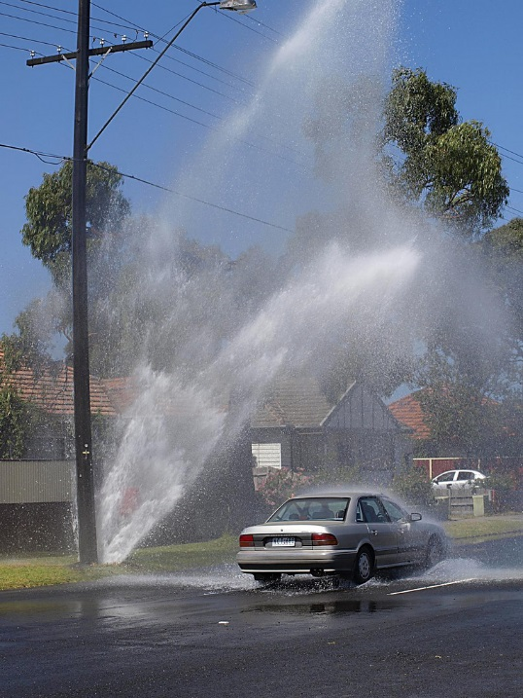
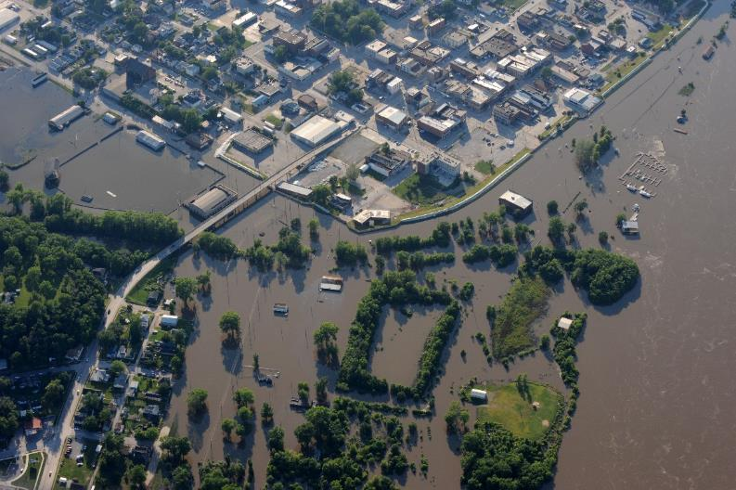
Some of the reasons places flood:
Heavy rainfall
Heavy snowfall then melts quickly
Rivers burst their banks
Storms at sea
Blocked drains
Burst pipes
Blocked ditches
Image: © Starr 61 | Flikr | CC BY-SA 2.0
Image: © Public Domain| Wikimedia Commons

Slide 4
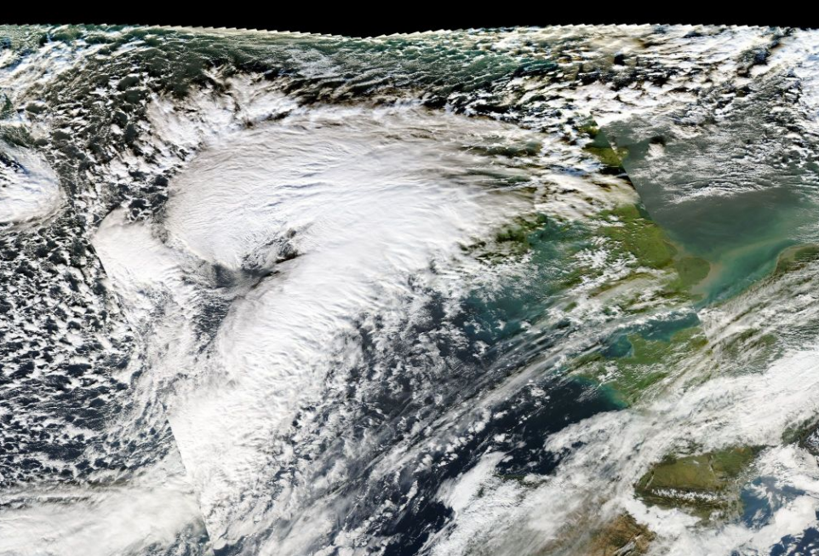
Leeds boxing Day floods 2015 Timeline of events
In the days just before Christmas . . .
Storm Eva is battering Cumbria
(west coast of England) with winds
of 80 miles an hour and very heavy
Rain
Cumbria has lots of flooding
and this starts to affect other
places around it
Image: © Public Domain| Wikimedia Commons

Slide 5
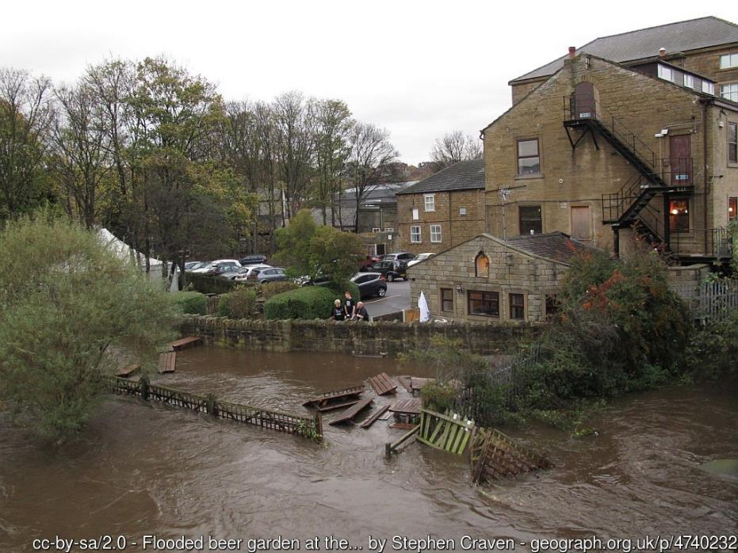
Christmas Day 2015
River Aire (normally has a height of 0.9m)
Is at a record high of 2.95m at Crown Point
In Armley the river rises to 4.61m during
the night
The Environment Agency issues a red
warning – its highest alert which means
“significant impacts to infrastructure and
risk to life in the area”
Kirkstall Road shops under water

Slide 6
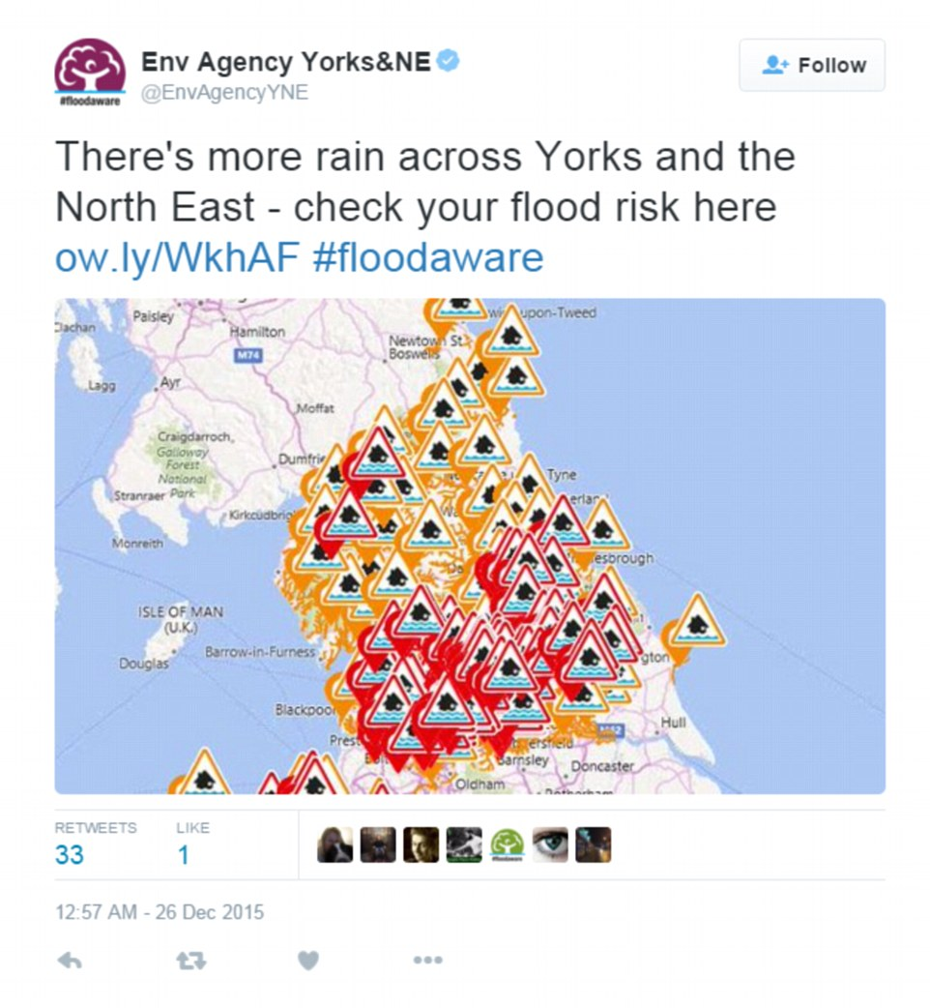

Slide 7
Boxing Day 2015
River Aire bursts its banks, 1000 homes are flooded and 400 businesses are underwater in the city centre, Kirkstall and Otley
By 10.30pm 15000 people have no power & the trainline in Kirkstall is under 1.2m of water
The fire brigade carry out 40 rescues and answer 700 emergency calls
100 soldiers are sent to help the fire brigade
Worst hit areas are Kirkstall, Stourton & city centre along River Aire
Emergency Response chiefs say it’s the worst case of flooding for at least 70 years

Slide 8
Image: Stephen Craven | Geograph | CC BY-SA 2.0

Slide 9
Image: Stephen Craven | Geograph | CC BY-SA 2.0

Slide 10
Image: Stephen Craven | Geograph | CC By-SA 2.0
Image: Rich Tea | Geograph | CC BY-SA 2.0

Slide 11
Films of the floods
Lots of people posted photos & videos of the floods online.
Three people have kindly let us use their footage to give you a better idea of what it was like.
Omed Alikhanizaadeh filmed between 12-3am on Boxing Day
https://www.youtube.com/watch?v=AzI_gVn4T3k
Laurie Cooper-Murray filmed around Clarence Dock & Royal Armouries
https://www.youtube.com/watch?v=6fk6Q9SKQDg
George Brooks filmed driving down Kirkstall Road
https://www.youtube.com/watch?v=xKRCHfJXsis&feature=em-comments

Slide 12
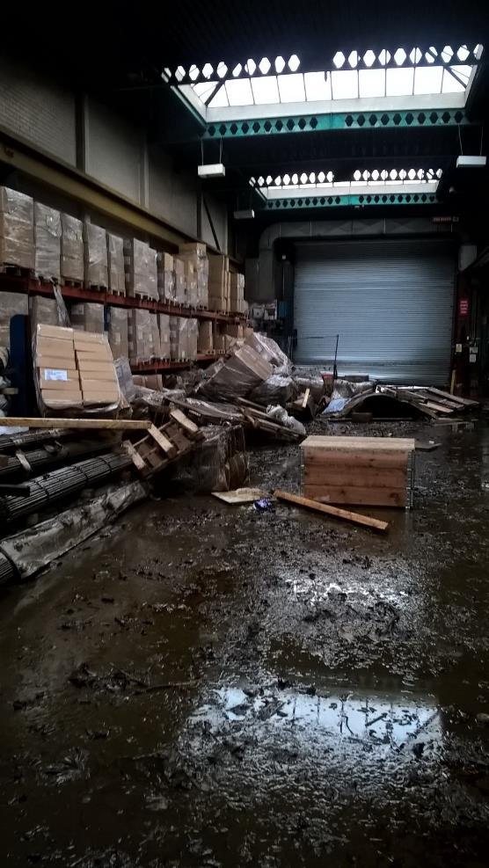
Monday
Monday – the rain has stopped and the water starts to subside (go back to normal levels)
The floods battered 3,355 properties in Leeds, 672 of which were businesses
People start calling for better flood defences for Leeds so that this never happens again
Flood damage in a warehouse in Leeds, 2015

Slide 13
The aftermath
Leeds City council said the direct cost to the city was an estimated £36.8m & the cost to the wider city region was more than £500m
Judith Blake (Leader of Leeds City Council) said:
“The Christmas floods of 2015 caused devastation to communities and businesses in Leeds and across the region, but the response both immediately and in terms of the recovery which followed showed off the very best of our community spirit and a real teamwork approach by all agencies to help people get back on their feet.”

Slide 14
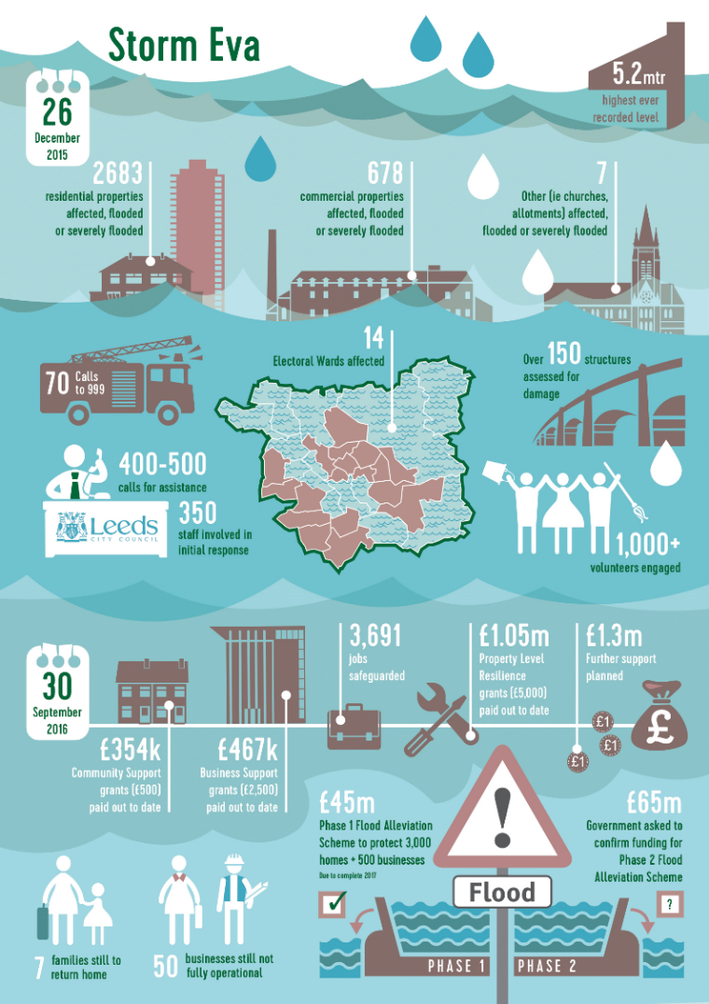
Image: © Leeds City Council

Slide 15
What is being done to protect Leeds?
The Leeds Flood Alleviation Scheme (FAS) is led by Leeds City Council with the Environment Agency
Phase One is to increase the protection against flooding from the River Aire and Hol Beck for residents and businesses in the city centre, Woodlesford and Holbeck
Part of the scheme includes building moveable weirs at Crown Point and Knostrop, a UK-first!
The Government has promised £35million to help protection in Leeds
The Environment Agency has done a study on different options to reduce flood risk to the city centre and Kirkstall Road as part of phase two

Slide 16
Leeds City Council video explaining the impact of the floods and the new flood alleviation scheme

Slide 17
Phase two
Look at Kirkstall and areas beyond the city boundary to help stop the river overflowing in Leeds
Extra measures to protect the South Bank area of the city centre.
These are going to be a mix of ideas for “Natural Flood Management” e.g. planting trees and building a new 700m flood defence at Stourton.
The leader of the council said:
“We are delighted to open phase one of the Leeds Flood Alleviation Scheme . . . which puts Leeds at the forefront of flood prevention measures using state-of-the-art technology”.

Slide 18
Extra useful videos from Leeds City Council about the Flood Alleviation Scheme (FAS)
Flythrough of Leeds FAS
https://www.youtube.com/watch?v=CqOFqCNAukA
Leeds FAS phase one in numbers
https://www.youtube.com/watch?v=TyxGKsyVGJU
Chair of Environment Agency at the opening of phase one of FAS
https://www.youtube.com/watch?v=7y0HbSbdvPg
Extra info on Leeds FAS
https://www.leeds.gov.uk/parking-roads-and-travel/flood-alleviation-scheme

