Slide 1

What am I? Activity
Note: This Powerpoint is set so it can be printed on A4 paper, and used with a projector.
This activity can be done individually, or in small groups
Print out enough copies of slides 2 - 9
Cut each sheet in half along the dotted lines and then mix them up
Provide each pupil / group with a set of mixed up cards
Pupils read the description and match it to the correct object.

Slide 2
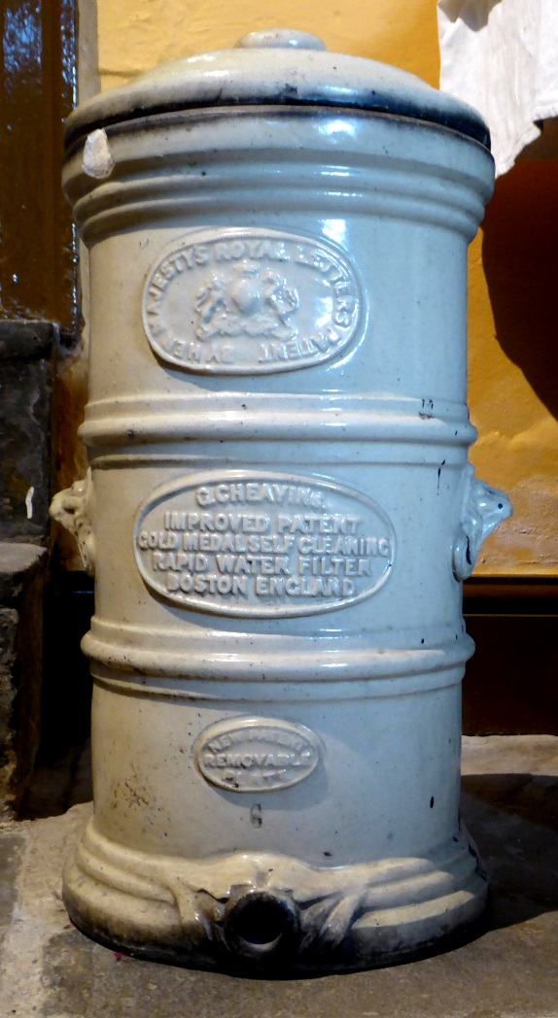
What am I?
Water Filter
Water is put inside me
I am made of ceramic (fired clay)
I am very heavy
I help keep the family healthy
You will find me in the kitchen
Image: © Colne Valley Museum

Slide 3
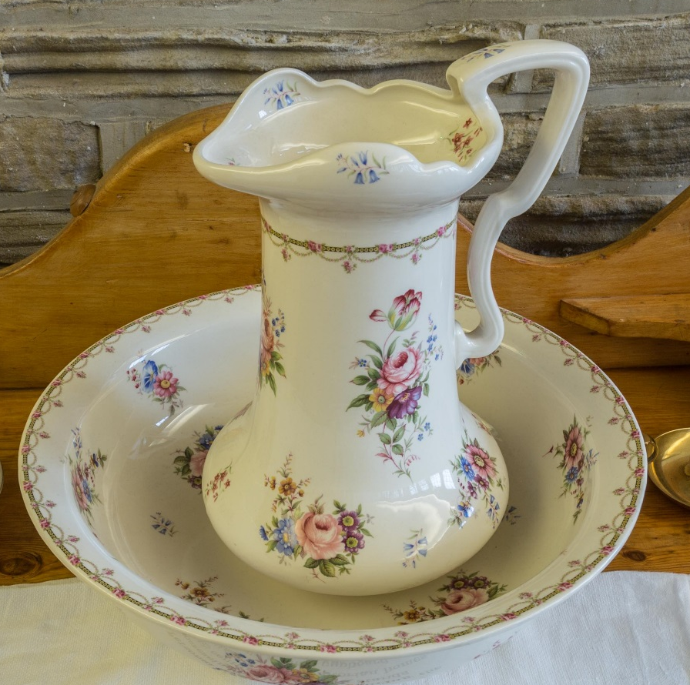
What am I?
Jug and Basin
Water is put inside me
I am made of ceramic (fired clay)
I help keep the family clean
You will find me in the bedroom
Image: © Colne Valley Museum

Slide 4
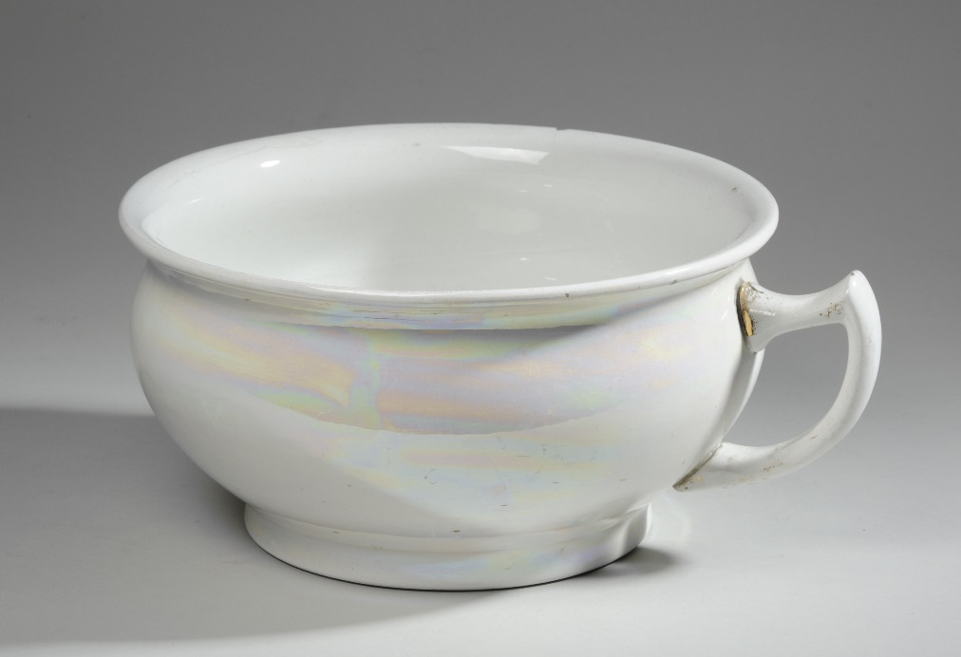
What am I?
Chamber Pot
Liquid is put inside me
I am made of ceramic (fired clay)
If the family uses me, they don’t need to go outside in the night.
Some unlucky person has to empty me in the morning
Image: © Leeds Museums and Galleries

Slide 5
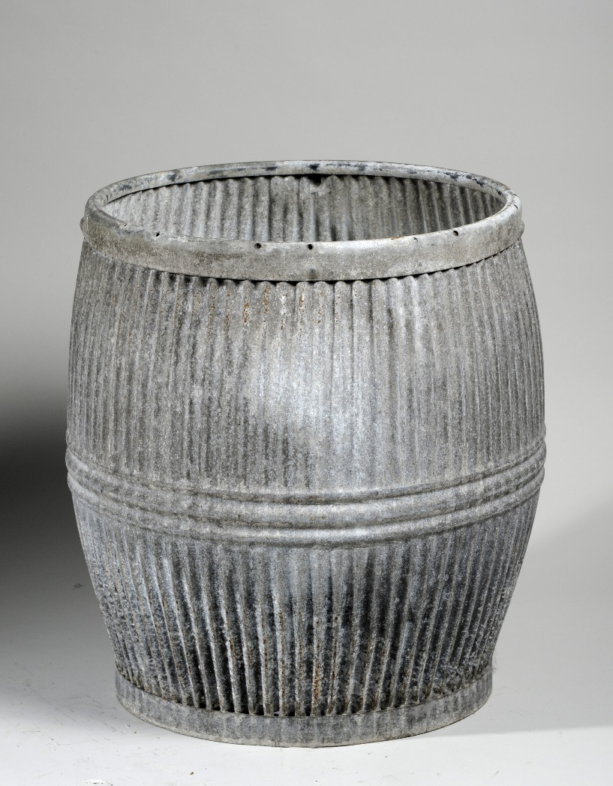
What am I?
Wash Tub
Liquid is put inside me
I am made of metal
I get a lot of use one day of every week
I am used by the women of the house
Image: © Leeds Museums and Galleries

Slide 6
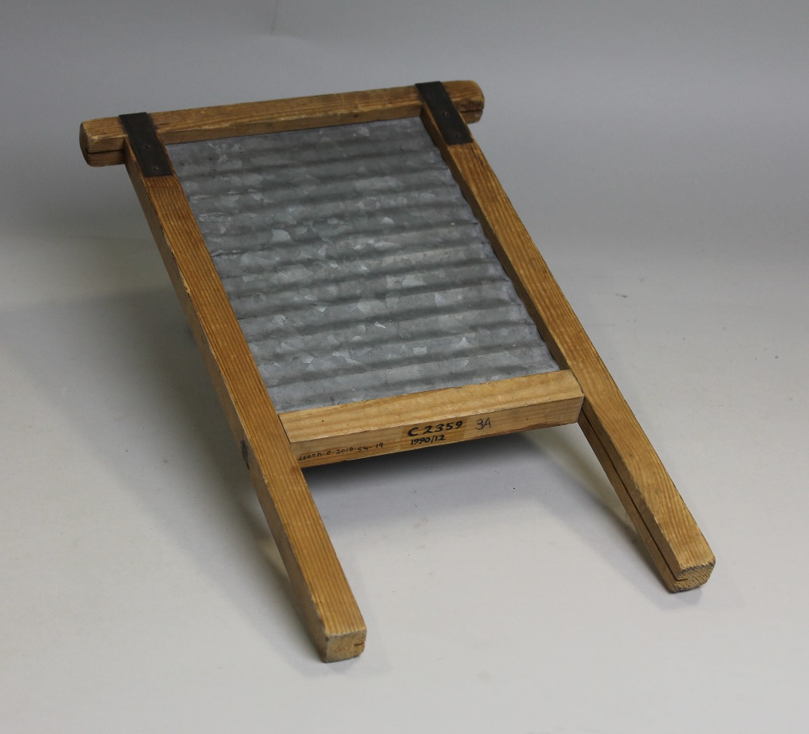
What am I?
Washboard
I get a lot of use one day of every week
I am used by the women of the house
I am made of two different materials
Image: © Leeds Museums and Galleries

Slide 7
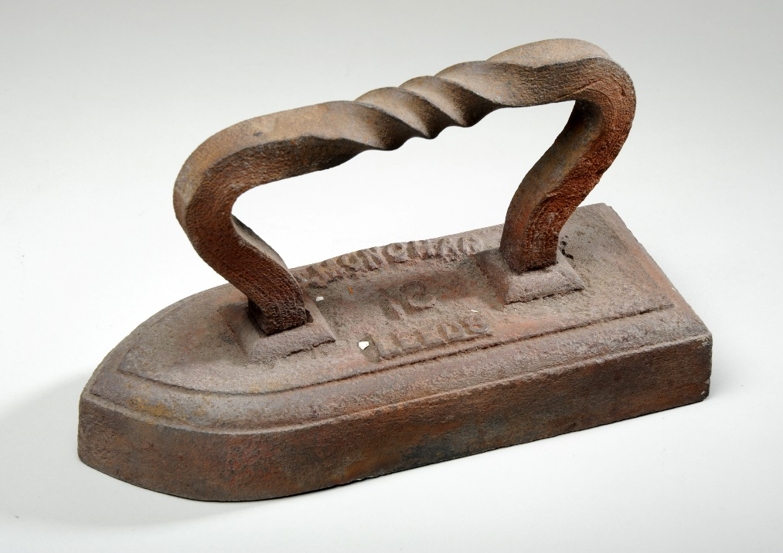
What am I?
Flat Iron
I am made of metal
I get a lot of use one day of every week
I am used by the women of the house
I am put in the fire to heat up
Image: © Leeds Museums and Galleries

Slide 8
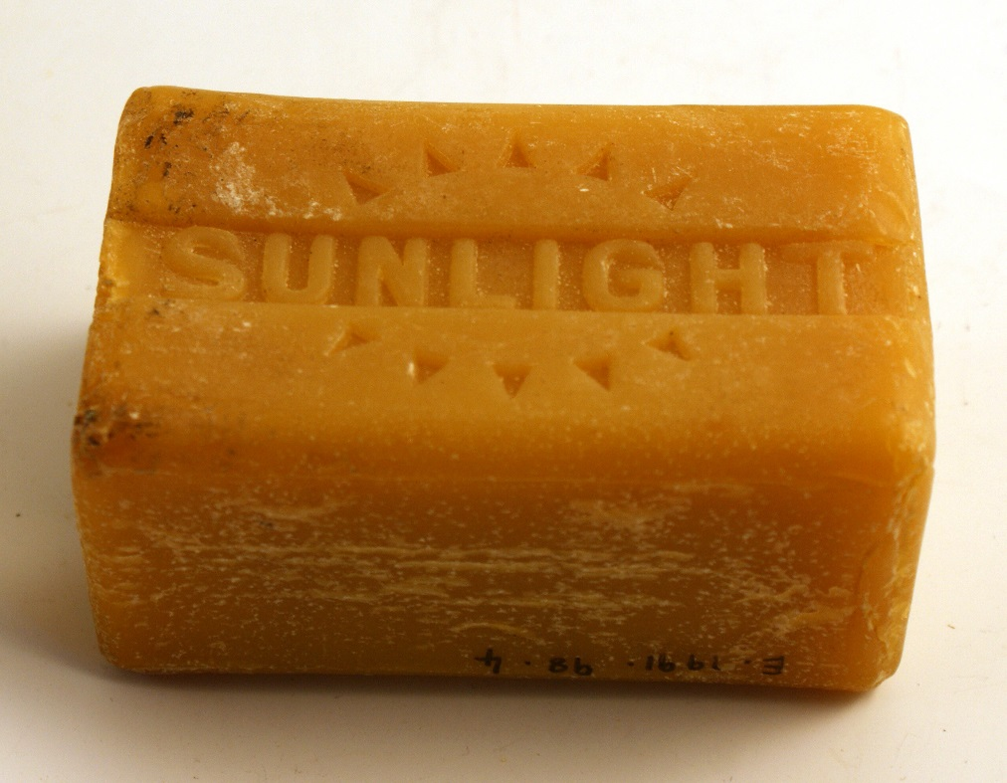
What am I?
Carbolic Soap
I get a lot of use one day of every week
I am used by the women of the house
I am put into liquid
I help the family keep clean
Image: © Leeds Museums and Galleries

Slide 9
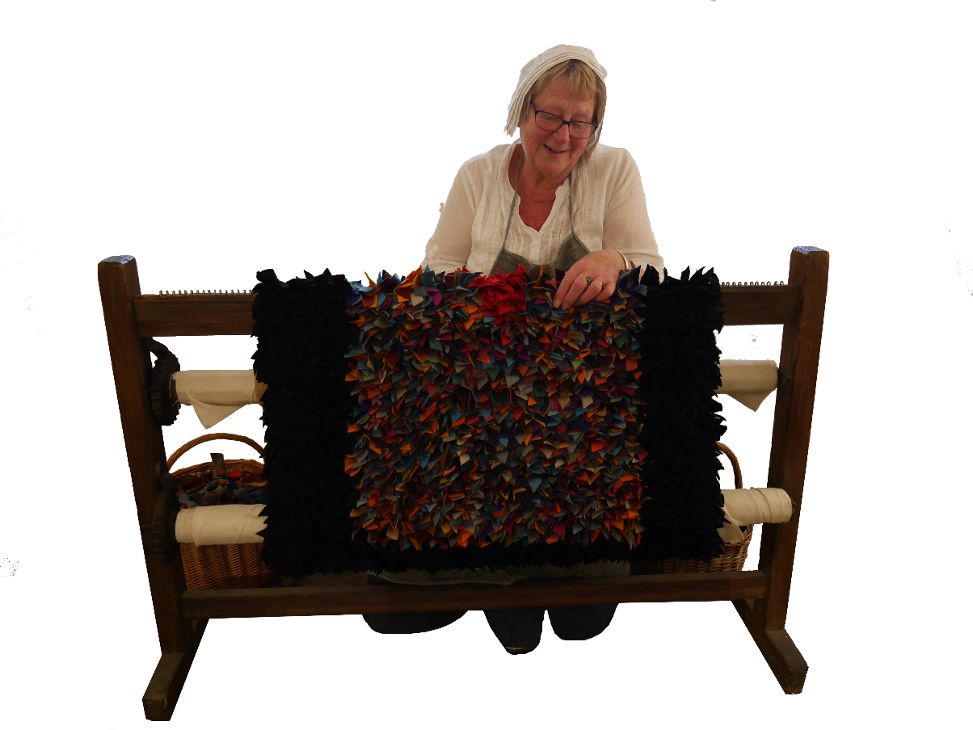
What am I?
Rag Rug
I help keep the family warm
Every member of the family helped to make me
I am made of fabric
Image: © Colne Valley Museum

