Slide 1
Victorian Transport
in Preston
Free learning resources from arts, cultural and heritage organisations
^{mylearning.org}

Slide 2
These resources look at the developments in transportation in the Victorian age and early twentieth century, and the impact this had on society.
The activity suggestions use contemporary photographs to encourage historical enquiry, thinking skills and group collaboration.
Many of the activities have cross curricular links.
This resource was created by the Harris Museum.
©Harris Museum
Free learning resources from arts, cultural and heritage organisations
^{mylearning.org}

Slide 3
Teacher Notes
Preston dock:
Preston dock was opened in 1892 by the queen’s second eldest son, Prince Albert, and was therefore know as the Albert Edward Dock.
When it was built, it was the largest single dock in the country and carried cargoes such as:
Timber, wheat, wood pulp, bananas, china clay, cattle, coal and cotton.
Boats from the dock also took day trippers and holiday makers to Blackpool, the Isle of Man and North Wales.
To build the dock, workmen dug a new channel into the River Ribble and lined it with stones. They diverted the river down this new route and turned the old river bed into the dock.
The first ship to use the dock belonged to Booth’s grocers.
The dock experienced many financial and practical difficulties over its lifetime and ceased to be a working dock in 1981.
^{mylearning.org}

Slide 4
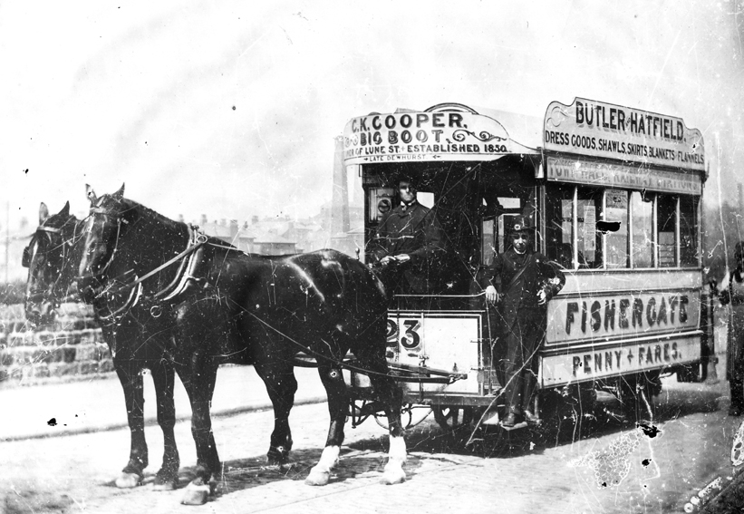
Teacher Notes: Trams
Compared to horse drawn buses, trams offered a more competitive form of transport. They allowed greater loads to be pulled due to the reduced friction of running along steel tracks set into the road, but required no extra horses to pull them along. This meant more people could travel – and the fare was cheaper. Horse drawn trams were also faster than horse buses.
Horse drawn trams were introduced into Preston in 1897, with electric trams arriving in 1904.
^{mylearning.org}

Slide 5
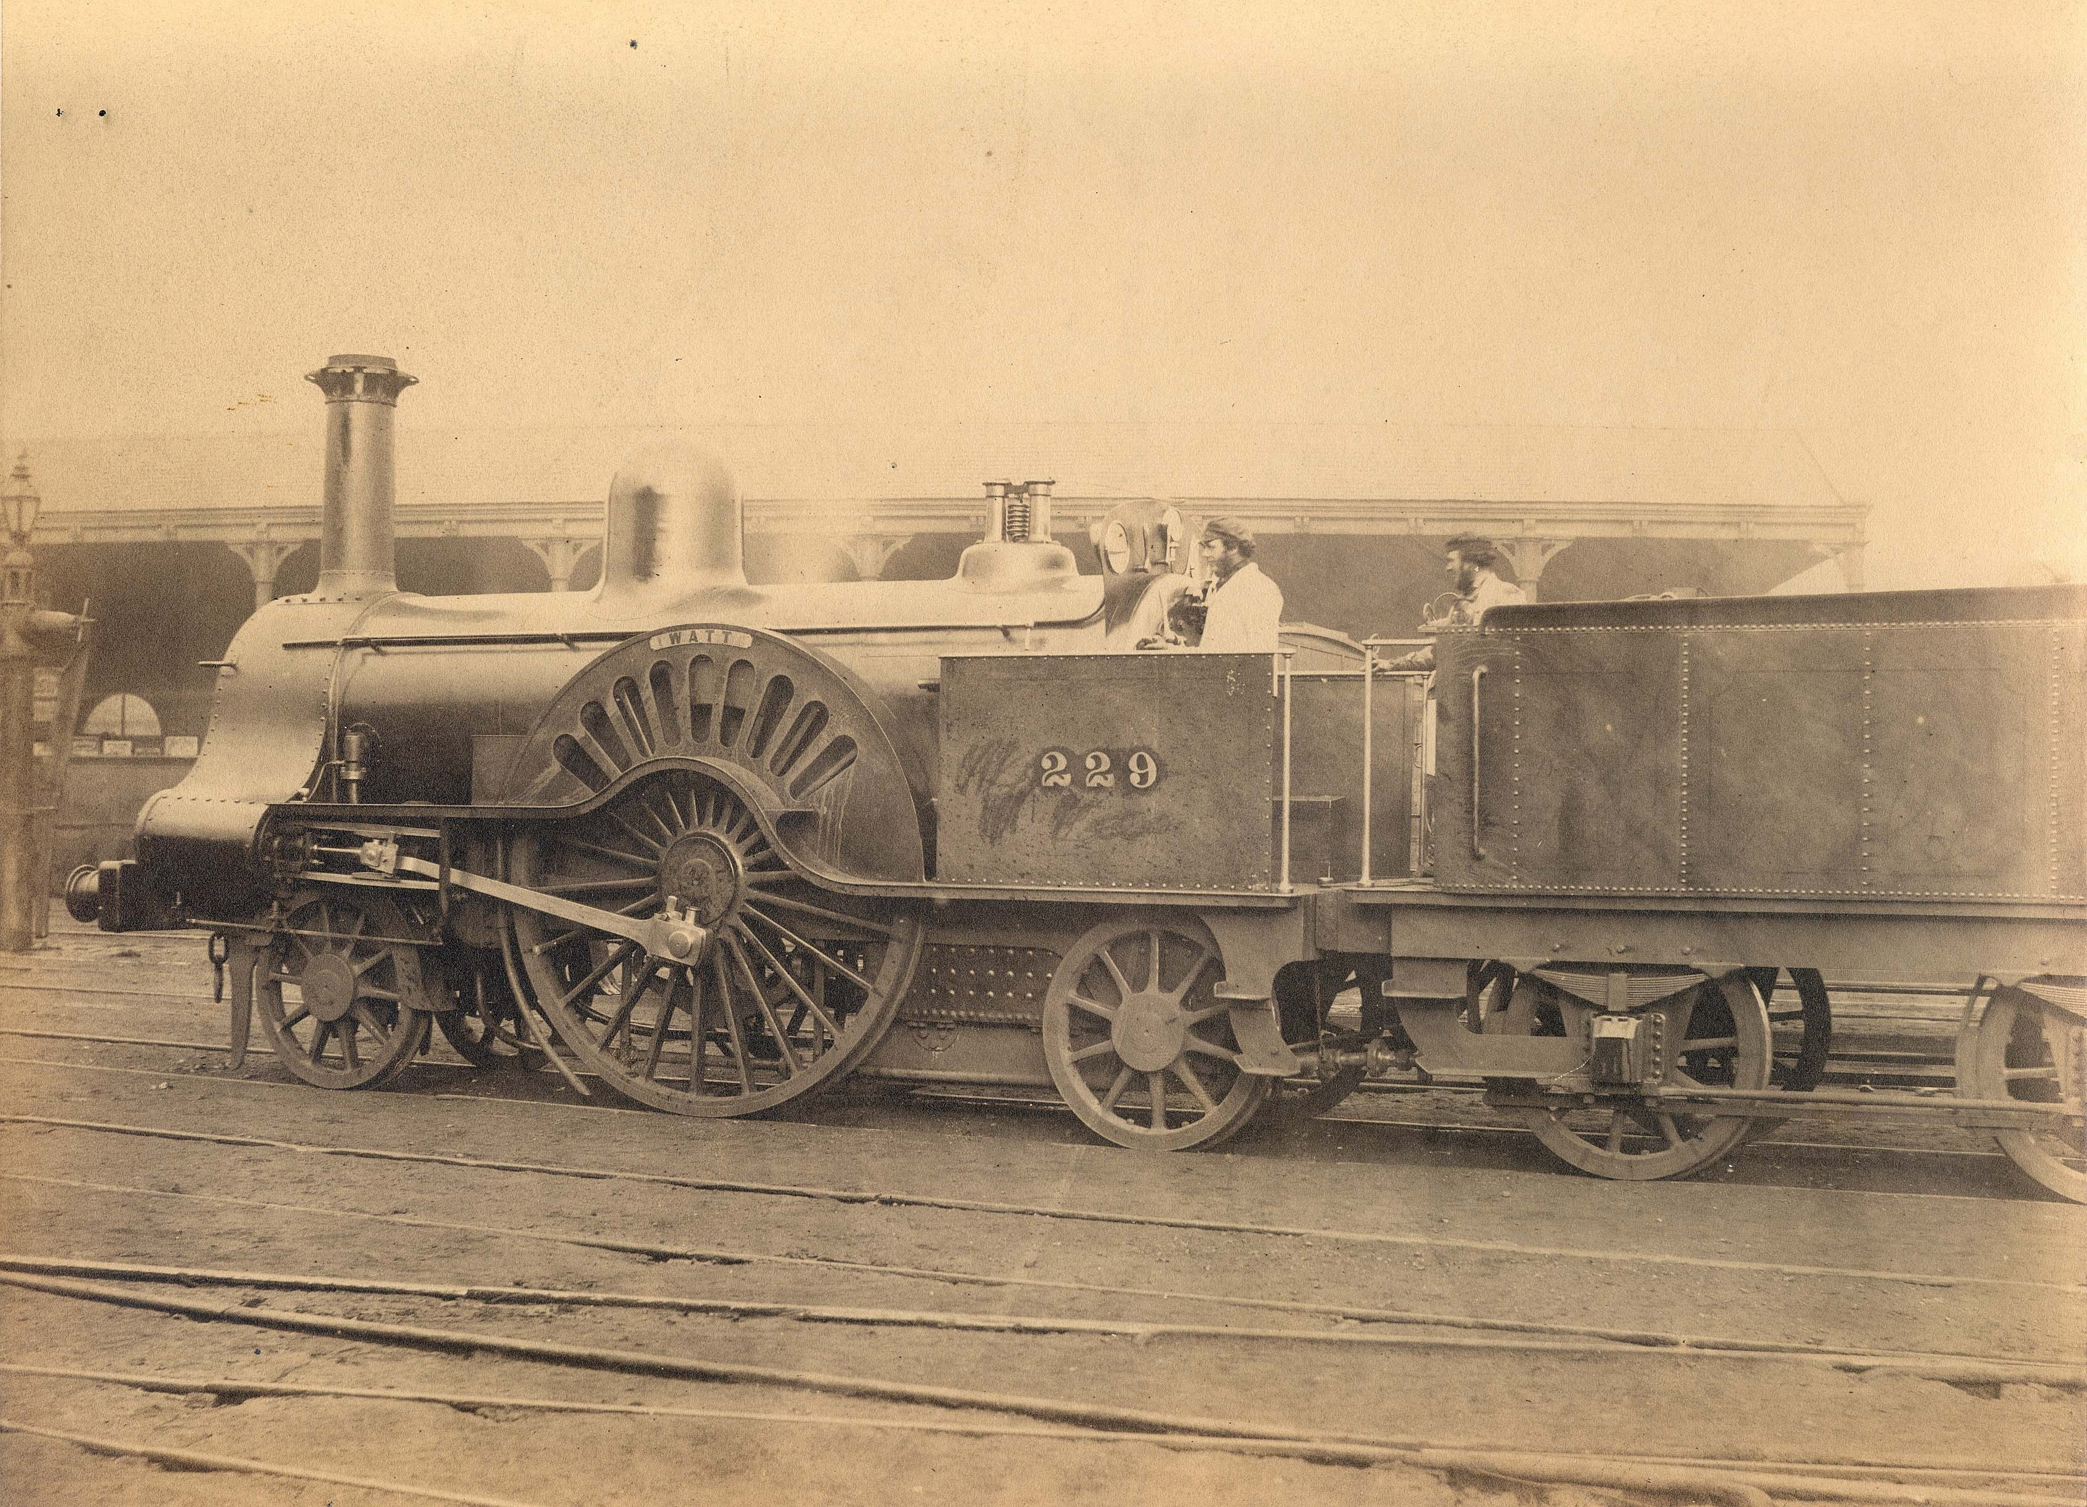
Teacher Notes: Trains
Rail travel was the most popular form of transport for both goods and people throughout the Victorian era and well into the twentieth century.
The building of the railways made the transportation of goods possible across larger distances and at faster speeds than ever before (some trains reached speeds of 30mph!) The opportunities to carry people, as well as produce was soon realised, and the affordable fares from the towns to the countryside and seaside soon became popular.
The first passenger steam railway is credited to the Stockton and Darlington railway which opened in 1825, however, the first truly successful public steam railway was the Liverpool to Manchester line which opened in 1830.
The first railway line in Preston opened in 1838 and went to Wigan. By the 1840s trains went to the cities of Liverpool, Manchester, London and Glasgow, and local towns including Blackpool. The main station opened in 1880.
By 1854 every town of a reasonable size in England had a railway.
^{mylearning.org}

Slide 6
Suggested activities
Key Vocabulary:
Horse and cart
Tram
Barge
Ask the children to brainstorm all the different modes of transport they can think of and make a class list.
Go through the list and mark all the modes of transport they think were available in Victorian times. It does not matter at this stage if their assumptions are correct or misguided.
Ask the children how we could find out what type of transport the Victorians had - what sources could we use?
Give out documents 1-9 (photos on slides 12 - 20) to pairs or individuals.
What am I?
Play the What Am I? game (Resource 1, slide 9) as a way of introducing the transport pictures, and encouraging the children to look closely and think about them.
Discuss It:
How many modes of transport from the documents are on the list you made earlier? Did you correctly identify them as Victorian?
Are there any modes of transport we still use today?
How do the Victorian examples compare to modern versions? What are the similarities and differences?
What forms of transport didn’t you see in the pictures? What reasons are there for this?
Why are some modes of transport not used anymore? Why do you think this is? What has replaced them?
Do you think the people using the transport are rich or poor? How can you tell and why do you think this is?
^{mylearning.org}

Slide 7
Suggested activities:
Use and Impact of Victorian Transport
Go back to your list of transport and discuss what the different modes are used for.
Do they transport people or produce, or both?
Can they travel long distances or are they better for short journeys?
Do you think the Victorians had the same or similar uses for transport?
Display documents 1-9 around the room.
Individually or in pairs, think about what the mode of transport in each document is being used for.
Write this on a post-it note and stick it to the document.
Compare and discuss everyone’s thoughts. As a class come to a common agreement about what the transport is being used for.
Find out about transport before the onset of industrialisation using books or the internet.
How did people and produce get around?
How far did they travel?
How long did it take to get there?
Establish that because of the growth in inventions in the Victorian era that led to the development of a vast new range of transportation, people and produce could travel around the country with a speed and efficiency never before known.
These new forms of transport, especially the railways, had a huge impact on Victorian society.
^{mylearning.org}

Slide 8
Suggested activities:
Use and Impact of Victorian Transport
Discuss It:
Cut up the statement cards (resource 2, slide 11) and put them in a hat or box. As a class, pull out one at a time and discuss it (maybe choose just three or four to focus on). Encourage the children to imagine themselves in the situation, thinking about what they know about what life was like before the growth of industrialised transportation, and the impact the trains, trams and boats would have had on their lives.
How do they think people felt about these changes?
Take it Further:
After discussing the statements write a letter to a Victorian newspaper explaining why you like or dislike the new modes of transport.
The transport in documents 1-9 are being used to transport produce to and from warehouses and shops, importing limestone into the dock, home removals, emergencies, personal transportation, public transport around the town…
Impact on people and society – good and bad
Power
Links to Science and DT
Look at the documents – can you see how they are being powered?
Talk about the invention of steam power by burning coal and the combustion engine in the late nineteenth century that led to the invention of the car.
^{mylearning.org}

Slide 9
Resource 1: What am I?
Read out the following statements and ask the children to hold up the picture showing the mode of transport they think it is describing.
Horse and cart – corn merchants (document 1)
I am pulled by two horses
I have wheels
I am loaded from the side of the building
I transport corn What am I?
Barge (document 2)
I carry goods in and out of Preston Dock
I travel on water What am I?
Locomotive (document 3)
I have wheels
I travel on tracks
I am powered by coal
I produce steam
I can transport goods or people around the country What am I?
Removal cart (document 4)
I am pulled by two horses
I have wheels
I travel along the road
Two men work on me
I am used to move people’s furniture and belongings What am I?
^{mylearning.org}

Slide 10
Resource 1: What am I? cont.
Read out the following statements and ask the children to hold up the picture showing the mode of transport they think it is describing.
Horse drawn tram (document 5)
I am pulled by two horses
I travel along tracks in the road
I have wheels
One man drives me and another collects the fares
I transport passengers around Preston
I have advertisements around my roof What am I?
Fire engine (document 6)
I have six wheels
My back wheels are larger than my front wheels
I have a ladder and lamp attached
I am used in an emergency What am I?
Horse and cart (document 7)
I am pulled by a horse
I have two large wheels
I travel along the road
I carry people or bring goods to the shops What am I?
Car (document 8)
I have wheels
I have no roof
I am powered by an engine
I have a steering wheel, horn and lamp
Wealthy people drove me to wherever they wanted to go. What am I?
Electric tram (document 9)
I travel along tracks on the road
I have two levels
I am powered by electricity
One man drives me and another collects the fares
I transport people around Preston What am I?
^{mylearning.org}

Slide 11
Resource 2: Statement cards
Cut up the statement cards (resource 2) and put them in a hat or box. As a class, pull out one at a time and discuss it (maybe choose just three or four to focus on). Encourage the children to imagine themselves in the situation, thinking about what they know about what life was like before the growth of industrialised transportation, and the impact the trains, trams and boats would have had on their lives.
How do they think people felt about these changes?
People could go on day trips to the country or seaside for the first time.
The coal used to power trains and boats causes a lot of pollution.
Public transport was affordable for the first time.
Produce could be transported across the country much quicker than ever before.
The building of the railways created work for thousands of people.
People had never travelled so quickly before.
People from the towns and cities could travel to the countryside, and people from the countryside could travel to the towns much more quickly and cheaply than ever before.
The laying of railway tracks and the building of railway stations, canals and docks changed what places looked like.
^{mylearning.org}

Slide 12
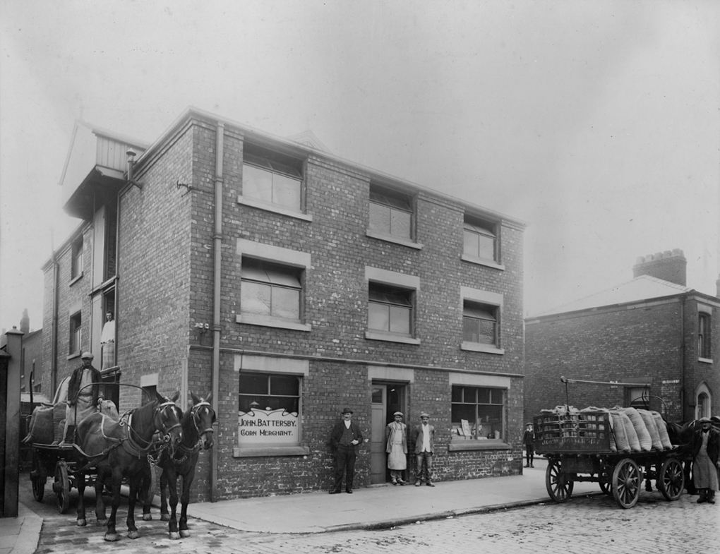
Document 1
Horse and carts belonging to John Battersby -corn merchant.

Slide 13
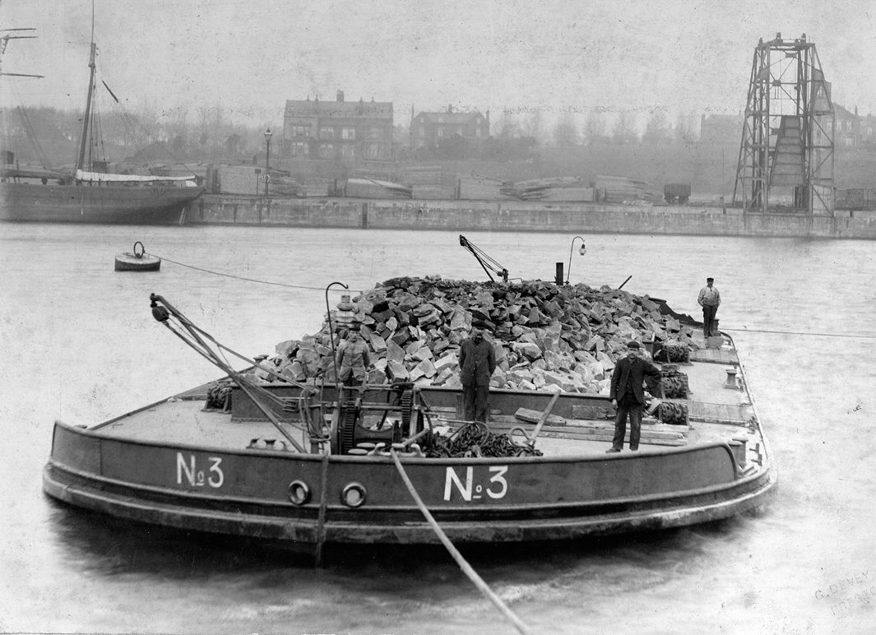
Document 2
Barge No.3 on Preston Dock importing limestone to be used for building.

Slide 14
Document 3
Locomotive at Preston Station

Slide 15
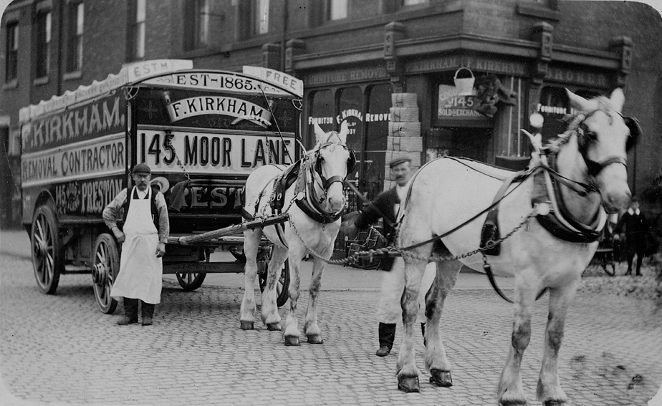
Document 4
Horse drawn removal cart

Slide 16
Document 5
Horse drawn tram

Slide 17
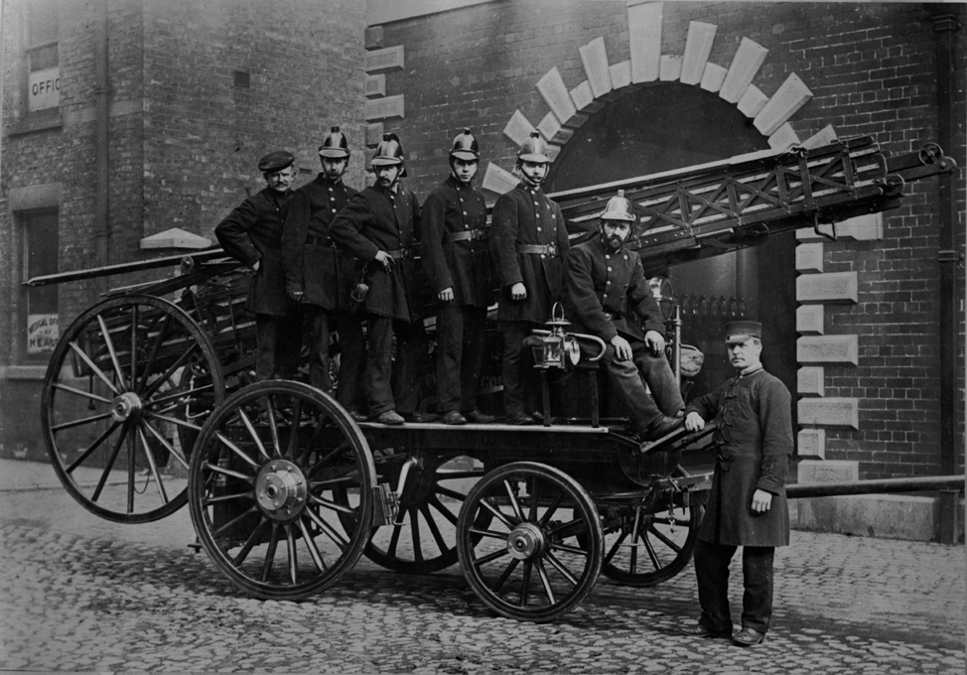
Document 6
Fire Engine

Slide 18
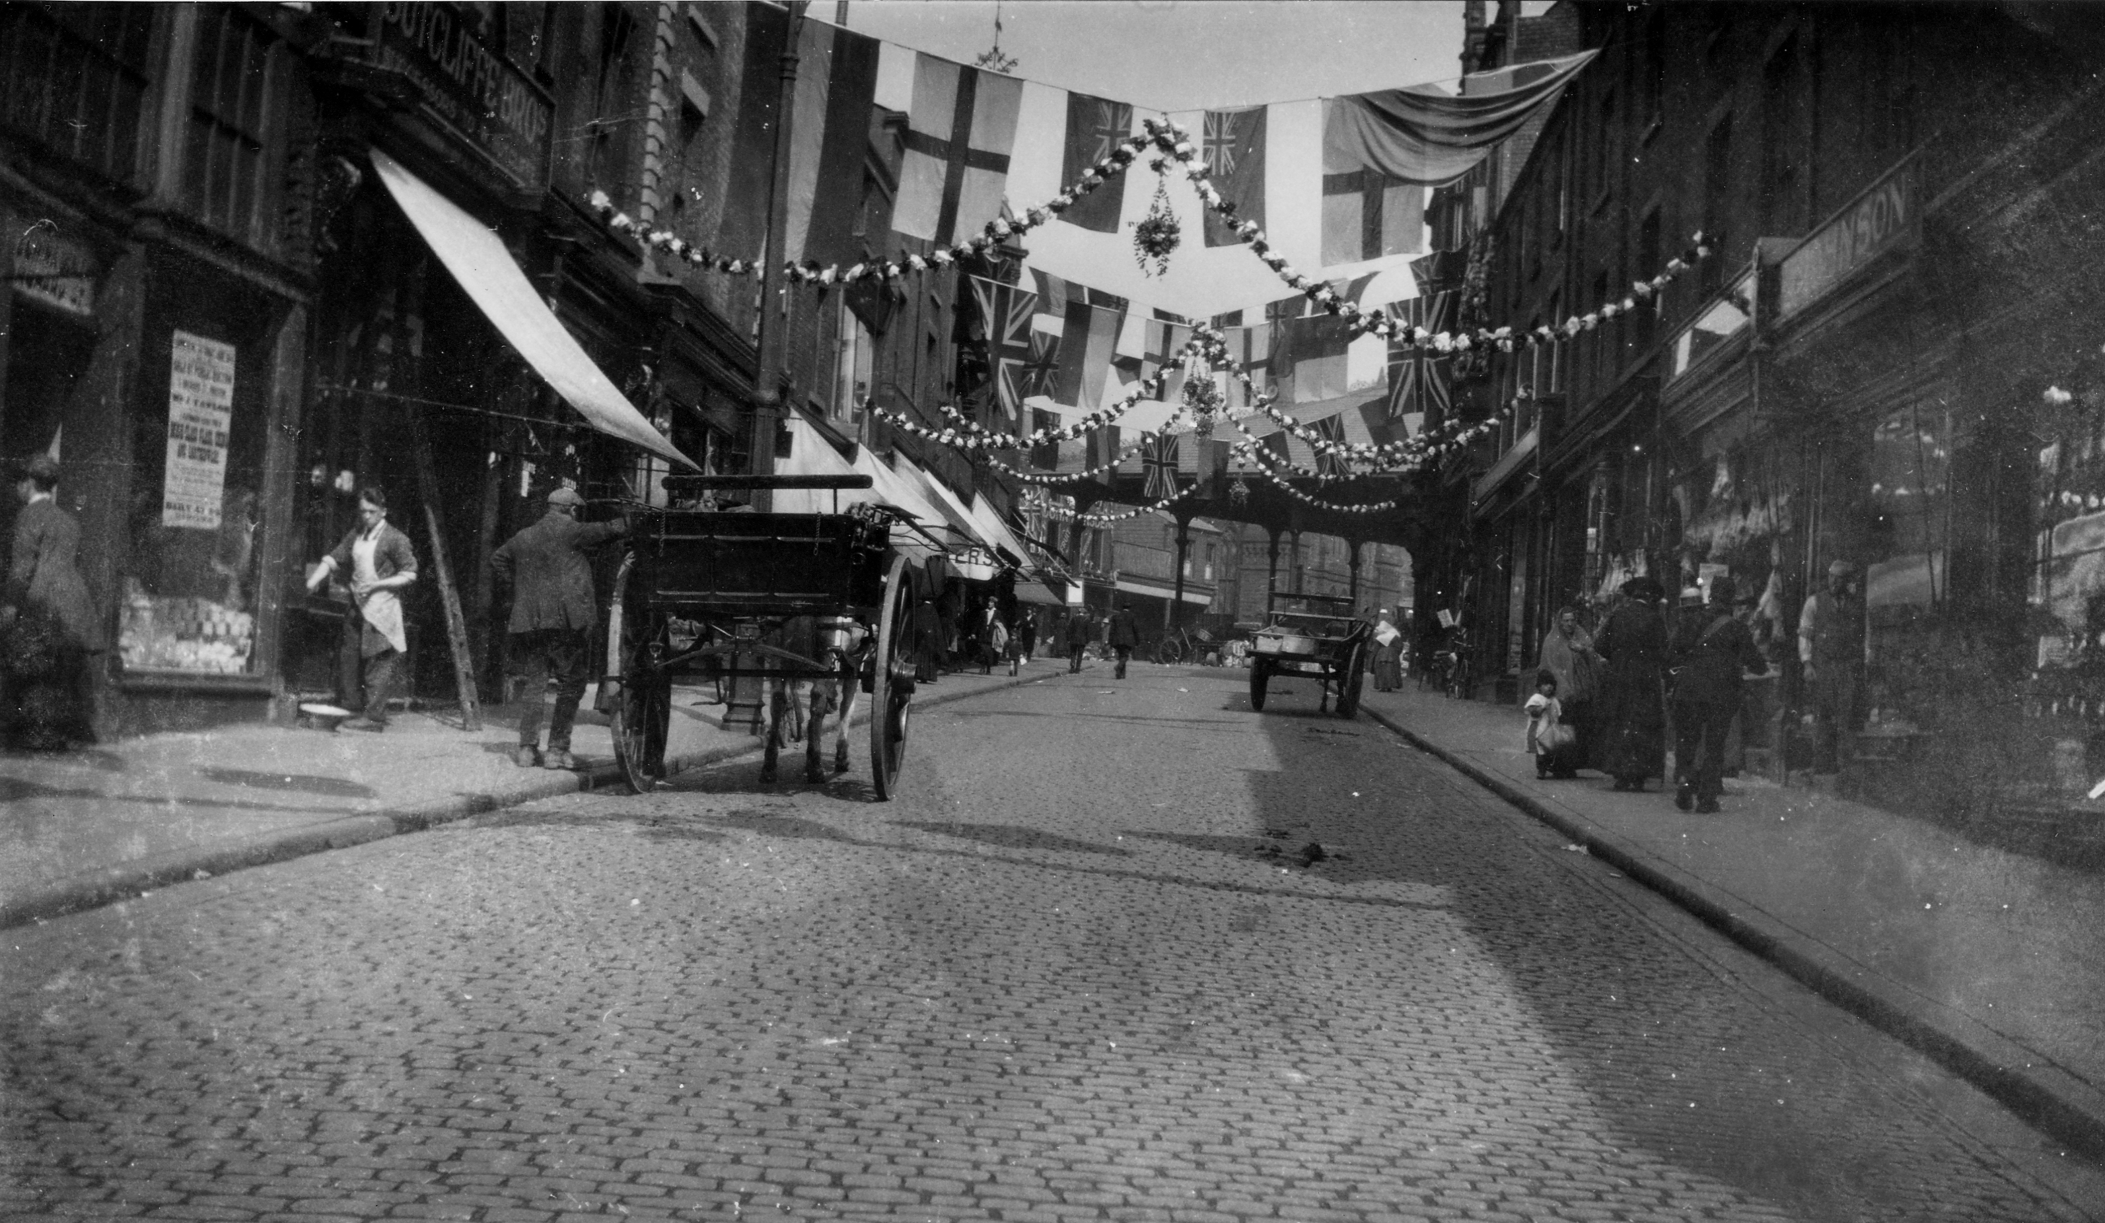
Document 7
Horse drawn carts on Orchard Street, Preston

Slide 19
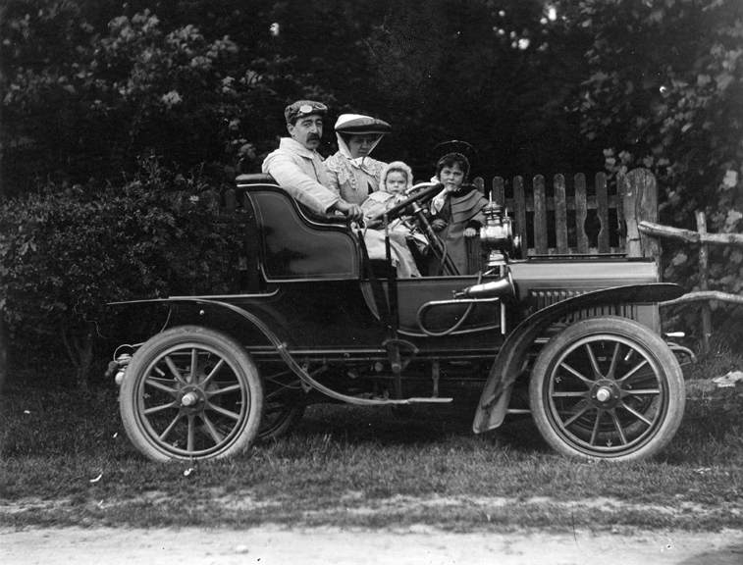
Document 8
Early motor car

Slide 20
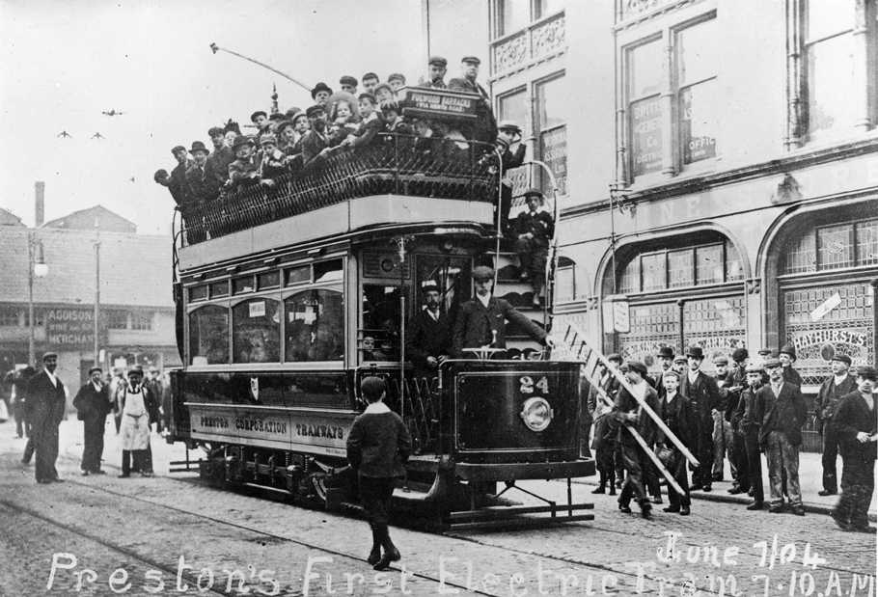
Document 9
Electric tram

Slide 21
If you enjoy learning about the Victorian era, why not come along to the Harris Museum & Art Gallery for a facilitated Victorians workshop to find out more?
www.harrismuseum.org.uk
This resource was created by the Harris Museum.
©Harris Museum
Free learning resources from arts, cultural and heritage organisations
^{mylearning.org}

