Slide 1
Thwaite Through Time: Additional Images
All images ©Leeds Museums and Galleries
CC BY-SA 2.0

Slide 2
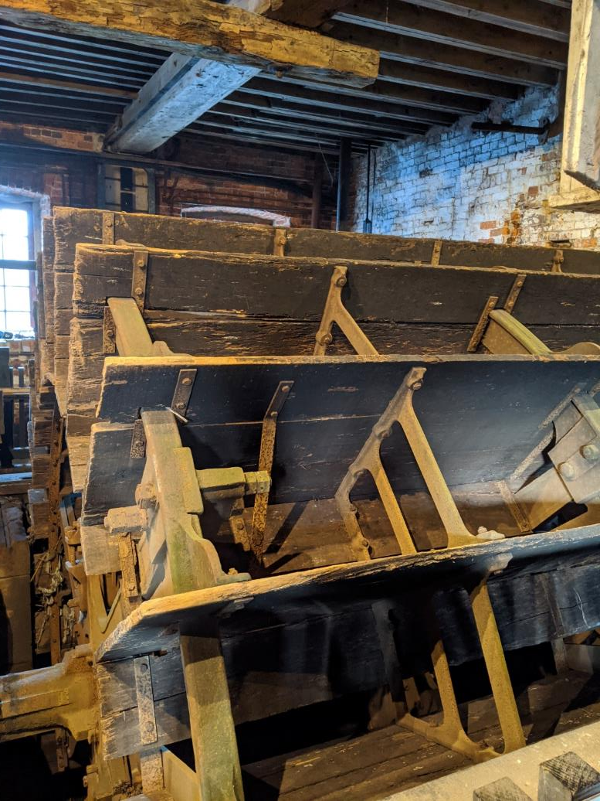
The large water wheel inside the mill

Slide 3
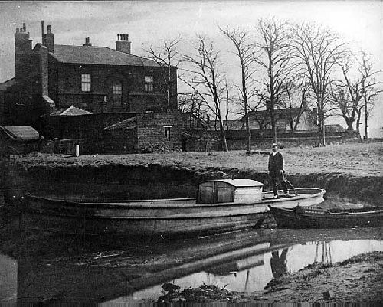
William Horn (mill owner at the time) on a barge in the mill pond, c. 1900

Slide 4
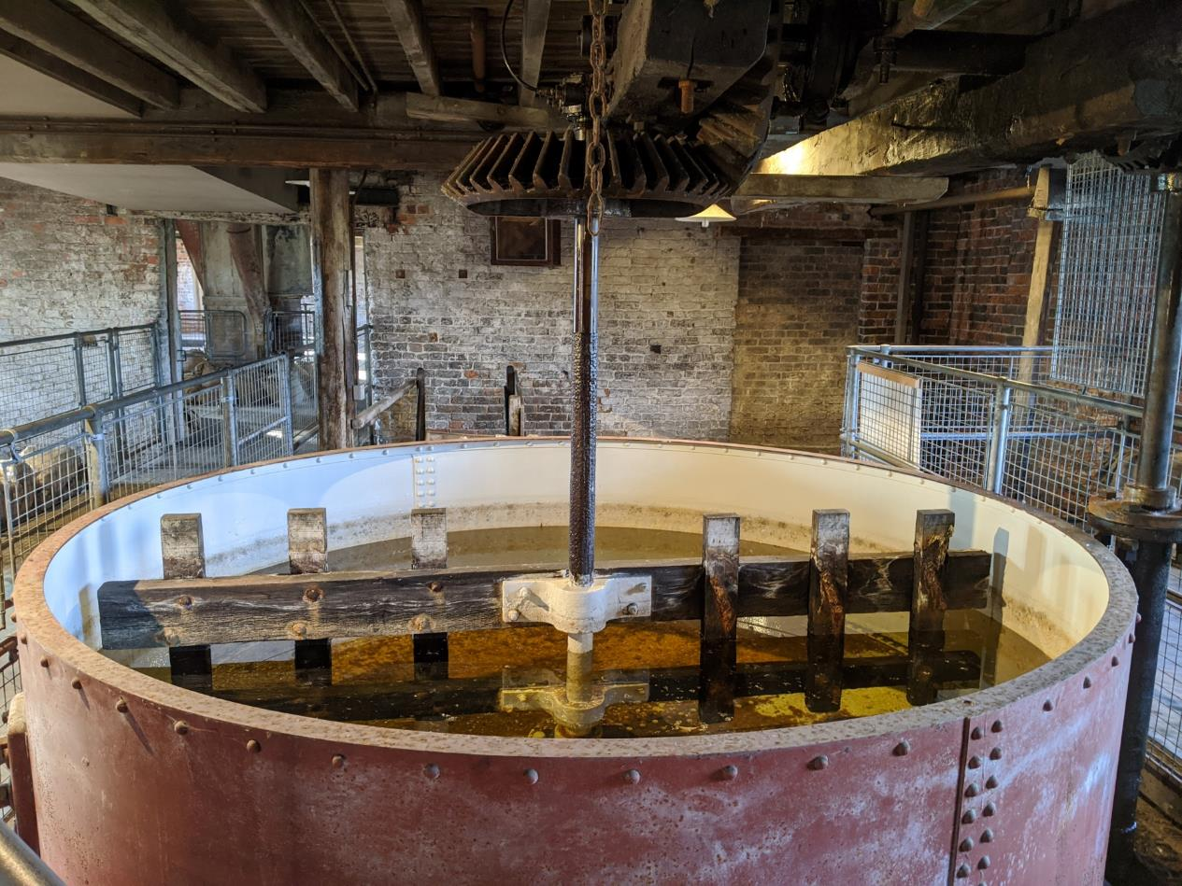
The Wash Tub in the mill, where ground flint or china stone was stirred with water to remove impurities.

Slide 5
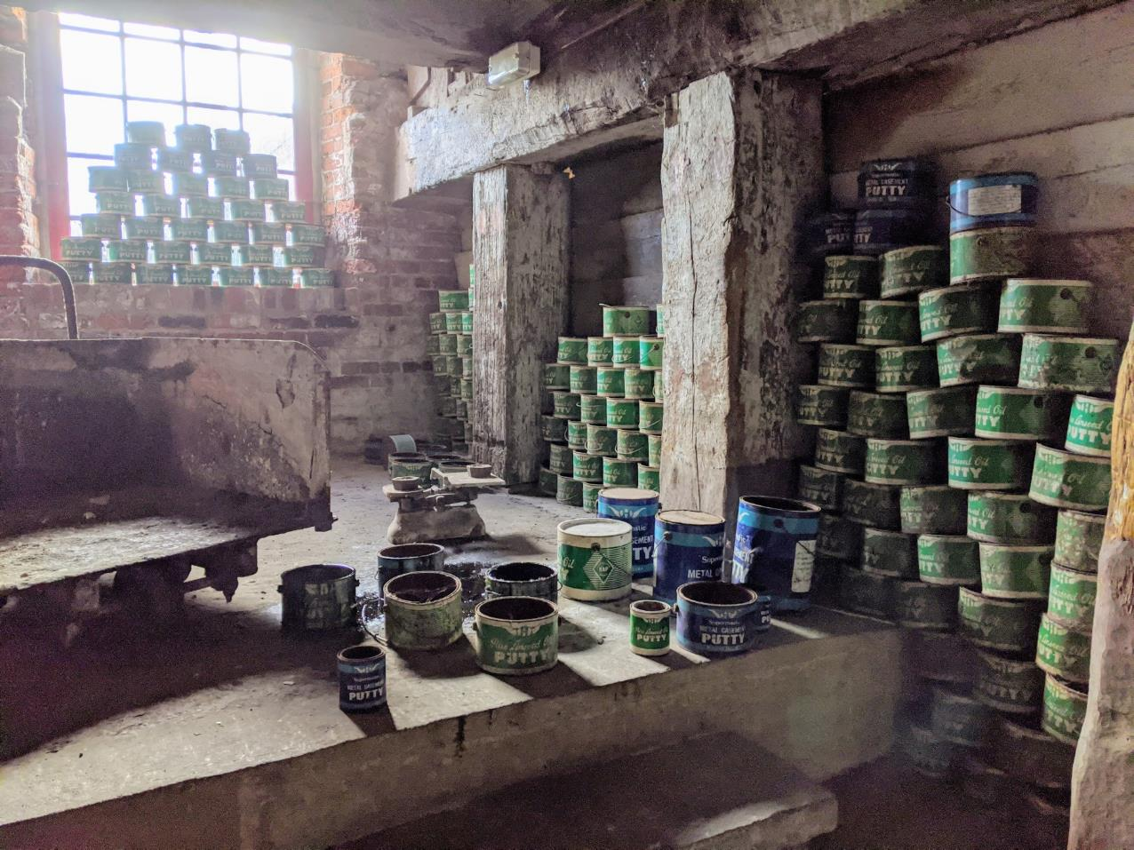
The Putty Packing Room in the mill

Slide 6
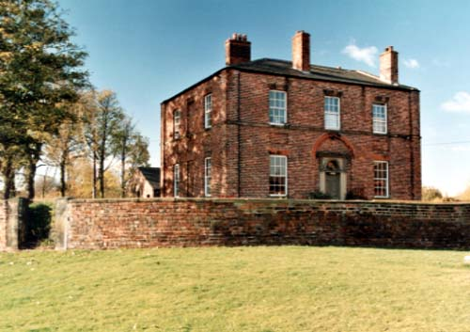
Thwaite House in 1999

Slide 7
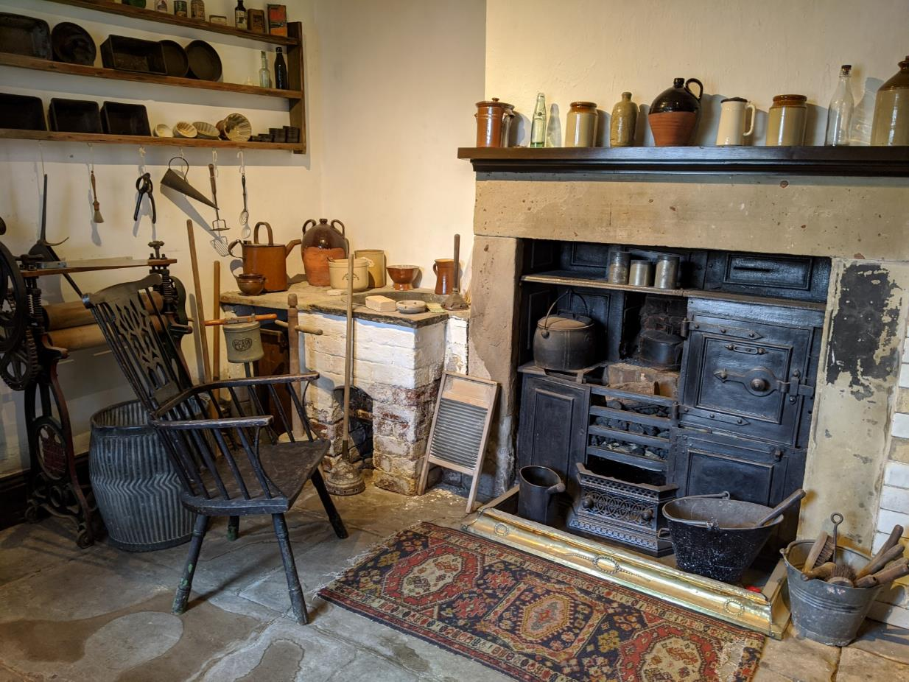
The Victorian Scullery in Thwaite House – part of the current museum

Slide 8
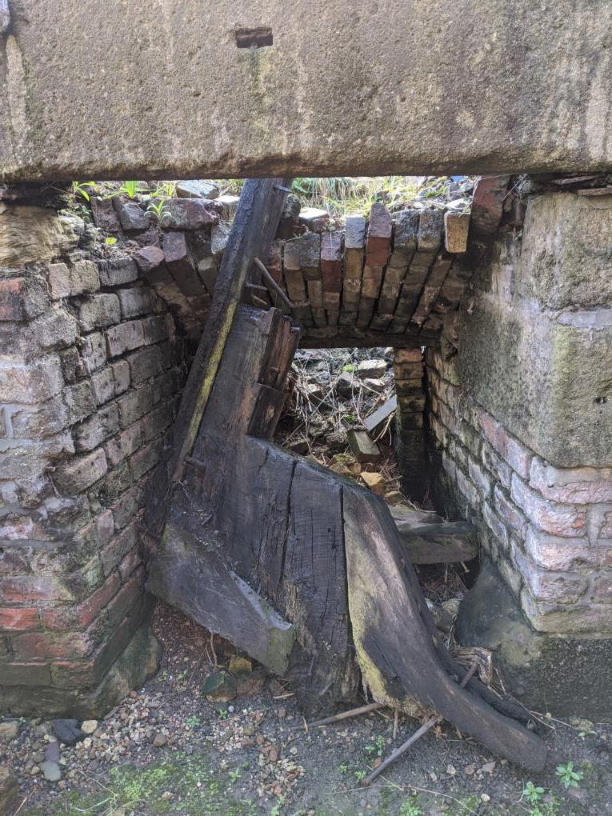
Old barge wood in the calcining kilns

Slide 9
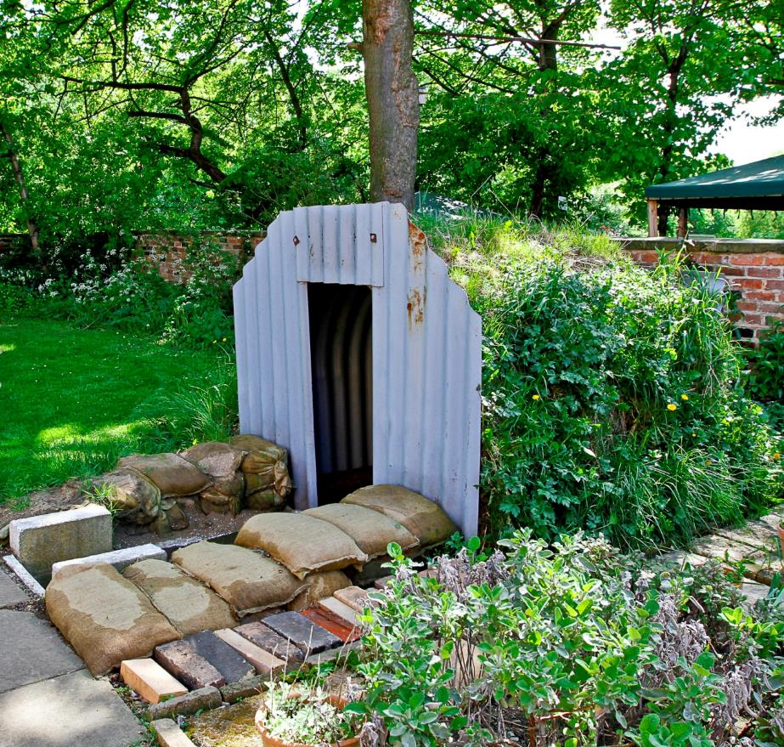
Visitors today can imagine the experience of an air raid by stepping inside a replica Anderson Shelter in the garden

Slide 10
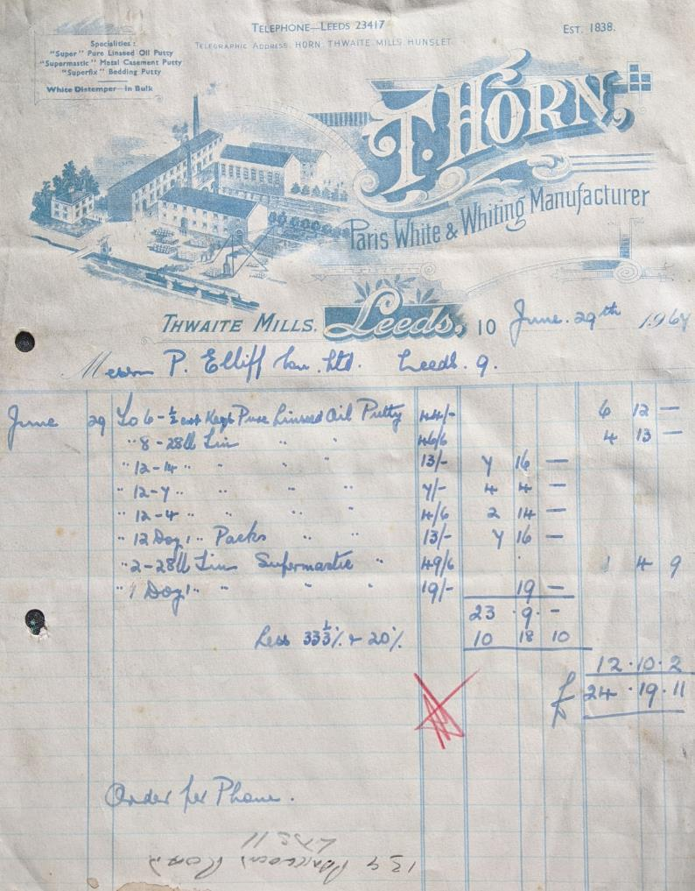
An invoice from the Horns for a list of different types and amounts of putty, dated 1967

Slide 11
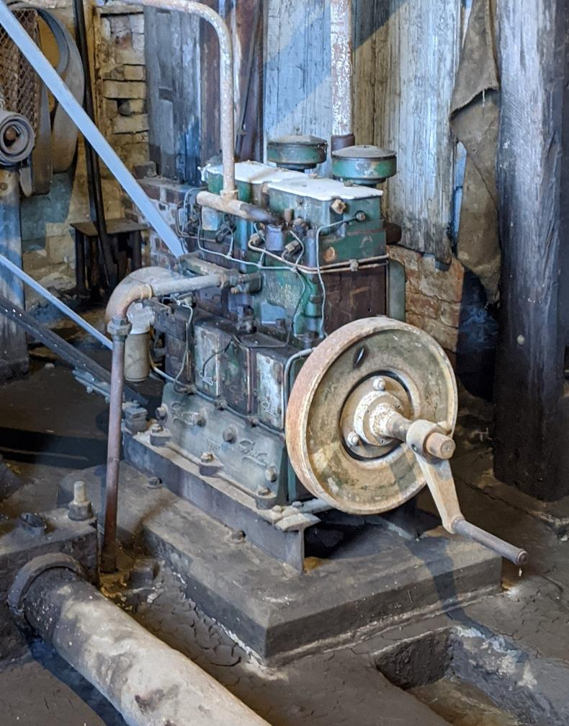
The Petter Engine which enabled the Horns to complete remaining putty orders after the flood of 1975

