Slide 1

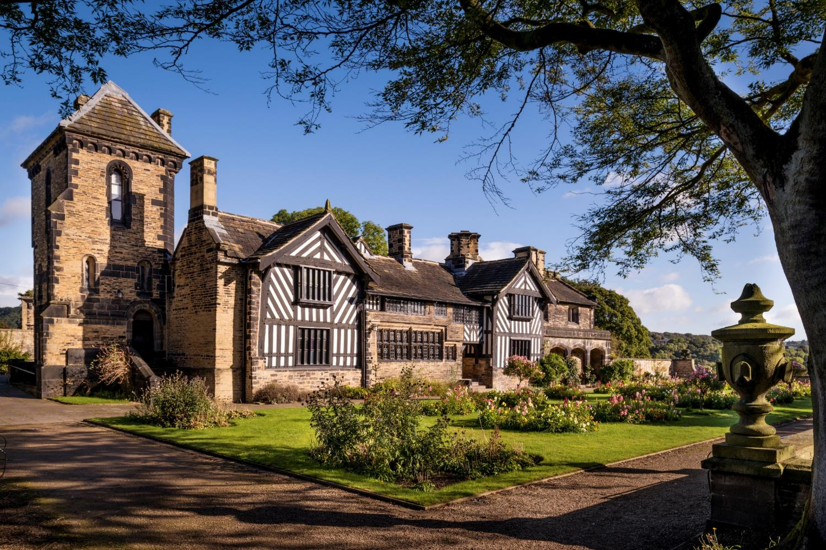
Shibden Hall Timeline

Slide 2
Shibden Hall Timeline
This presentation follows the development of Shibden Hall from its known existence in 1420 to its present day ownership by Calderdale Council.

Slide 3
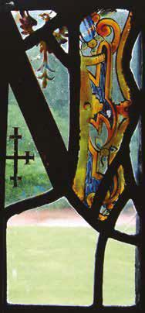
Shibden’s Early years
The first person to be recorded at living at ‘Schepdene’, valley of the sheep, Shibden Hall was William Otes, around 1420/21.
He was a cloth merchant making his wealth from his valley of the sheep.
Shibden Hall is situated halfway down a hill and in the 15th century the land would have consisted mainly of woodland rather than fields.
Otes coat of arms.

Slide 4
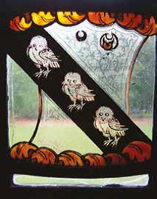
Otes to the Saviles
William Otes had a son, William who he himself had a daughter, Joan from his first marriage and a son Gilbert from his second.
William II had left Shibden Hall in his will to Joan but his son Gilbert contested this unsuccessfully.
Joan in the meantime had married a Robert Savile and finally moved into Shibden in 1504 when the court ruled in her favour. They made many changes to the hall such as extending the housebody by 3 ft and installing a new chimney.
Savile coat of arms.

Slide 5
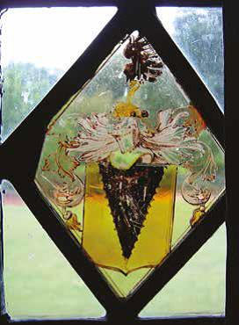
Saviles to Waterhouses
The Savile’s daughter Sybil married a Robert Waterhouse and inherited the hall in 1522.
They collected taxes due to the priory of Lewes as they owned Halifax.
They had eleven children.
His grandson, also named Robert inherited Shibden Hall in 1583. He was a solicitor by trade and helped his brothers with many legal matters over the years.
He had 9 children and 5 grew into adulthood. Shibden was passed on to his son Edward, who unfortunately did not carry on his fathers wishes to look after the family and he himself ended up in financial difficulties, which meant Shibden Hall needing to be sold.
Waterhouse coat of arms.

Slide 6
The Lister Family – 17th Century
In the 17th Century Shibden Hall became the home of the Lister Family and was to remain part of the family for over 400 years.
When Shibden Hall was sold off by the Waterhouses it was actually purchased by Jane Crowther on behalf of her nephew John Hemingway in 1612. Unfortunately both Jane Crowther and John’s father died in 1615.
His uncle, Samuel Lister, a cloth merchant, had become a tenant at Shibden Hall and with John underage, he was guardian to him and his four sisters, Sibil, Edith, Phoebe and Martha. Not long after, John and later his sister Edith died, leaving the other sisters as heirs.
Samuel and his wife Susan had five children of their own and he planned to marry his nieces to his sons who would bring the ownership of Shibden Hall to the name Lister.
Samuel Lister 1673-1702, artist unknown.

Slide 7
The Lister Family – 17th Century
Thomas the eldest son lived until he was nearly 80 at Shibden Hall. He saw the upheaval of the Civil War, causing the family to have to bury documents in the garden and flee to Manchester . On their return the following year they dug them back up. He left the fully furnished house to his son Samuel who was to marry Hester Oates and they had 7 children.
His eldest surviving son (also named Samuel) inherited the house, his portrait is shown to the left. 6 years later sadly he died and with no children or nieces and nephews, Shibden passed to his second cousin James Lister.
Samuel Lister 1673-1702, artist unknown.

Slide 8
The Lister Family – 18th Century
James Lister moved in to Shibden with his wife Mary in 1709.
As well as inheriting Shibden Hall he also inherited his father’s apothecary practice with over 600 clients.
They had twelve children. Two died in infancy.
The eldest son John became a Reverend, then headmaster and when he finally retired he concentrated on work at Shibden such as starting coal and brick making businesses. He also had water mains installed and developed Lister’s Road.
Reverend John Lister, by Richard Lynes
1/2

Slide 9
The Lister Family – 18th Century
John’s brothers Thomas and William moved to America to look at trade they could send back to England. They ended up marrying and staying there.
When Reverend John Lister died in a hunting incident, Shibden Hall passed on to several brothers, first James Lister then Samuel Lister and finally Jeremy Lister. Their other brother Japhet inherited Northgate House and lived there with his family.
They also had 3 sisters Martha, Mary and Phoebe who all married.
James Lister
Samuel Lister
2/2

Slide 10
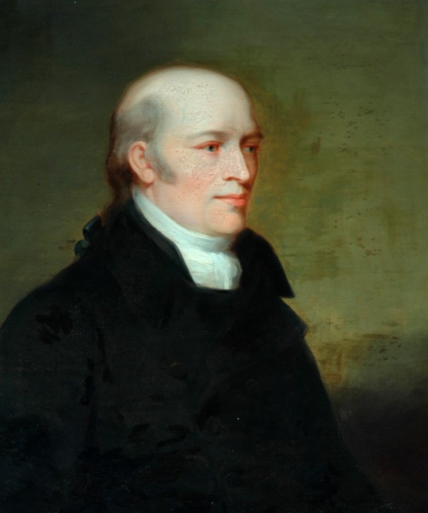
The Lister Family -18th Century
In 1764 Jeremy Lister inherited Shibden Hall and moved in with his wife Anne and his children. They had four sons and four daughters. Jeremy’s children were to inherit the hall, although the descendants of his older brother Thomas would find themselves inheriting Shibden Hall a century later in 1855.
Their second eldest son James lived to inherit Shibden Hall after his father’s death in 1788 and his sister Anne lived there with him.
Their brother Joseph lived at Northgate House after marrying their cousin Elizabeth.
James Lister, by Joshua Horner.
1/2

Slide 11
The Lister Family -18th Century
Their other brother Jeremy was in the 10th Regiment of Foot. He saw active service in the American War of Independence. He took a musket ball in the elbow and returned to England to become the recruiting officer at Gainsborough. He married his wife Rebecca and had four sons and 2 daughters.
When James died in 1826, Jeremy, his sister Anne and his niece Anne inherited a share in the house. His niece had lived at Shibden Hall since 1815.
2/2
Anne Lister, by Thomas Binns

Slide 12
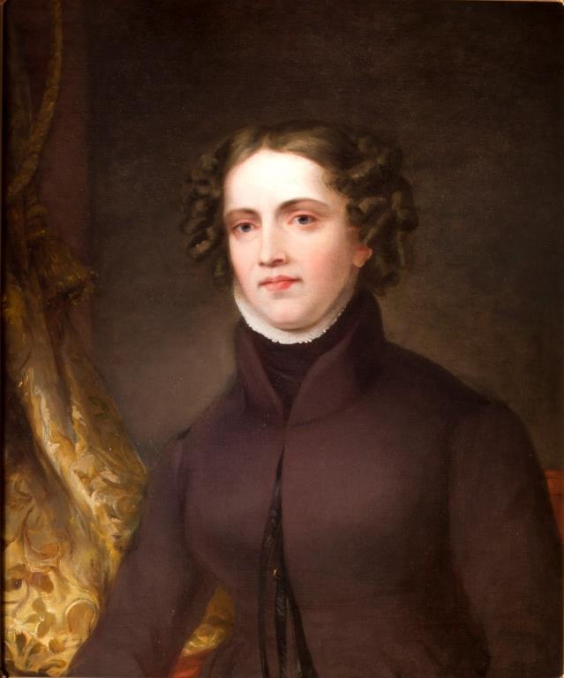
Anne Lister
Anne Lister was the eldest surviving child of Jeremy and Rebecca. Although they lived in Market Weighton, Anne was actually born at Shibden Hall on 3rd April 1791.
Two of her brothers died in infancy, a third at fourteen and the forth, Samuel died at twenty while serving for the army in Ireland. Anne also had a younger sister called Marian.
Anne moved in with her Uncle James and Aunt Anne in 1815. In 1826 when her uncle died, she received a third of the estate along with her aunt and father. It seems from accounts that Anne had already taken over the running of the estate.
By 1832 her father and sister Marian had moved into Shibden.
In 1836 Her father and aunt both died leaving Anne the whole estate and Marian was to receive all their fathers possessions.
Portrait of Anne Lister by Joshua Horner 1812-1881.

Slide 13
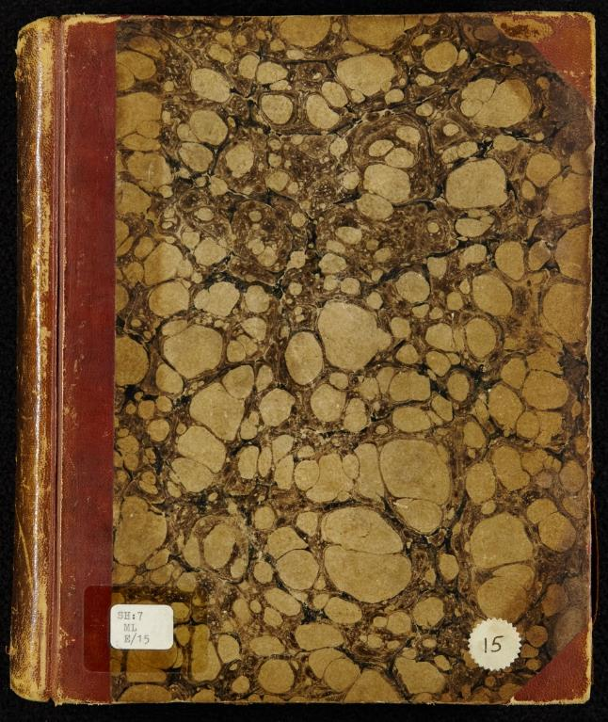
Anne Lister’s Diaries
Anne recorded her life in great detail from 1806 to 1840. These diaries along with hundreds of letters, account books and papers reveal a fascinating woman and life in the early 19th century.
Her legacy has revealed her to be a remarkable scholar, traveller, businesswoman and property owner. Her diaries also reveal that she was a lesbian and defied the norms of the time in her relationships, how she dressed and how she conducted herself, hence the nickname Gentleman Jack.
She had a relationship with a neighbouring landowner, Ann Walker, who moved into Shibden in1834. The couple had a marriage ceremony in York and in their eyes were husband and wife.
Anne Lister died in Georgia whilst travelling with Ann Walker in 1840.
Anne Lister Diary from 1832

Slide 14
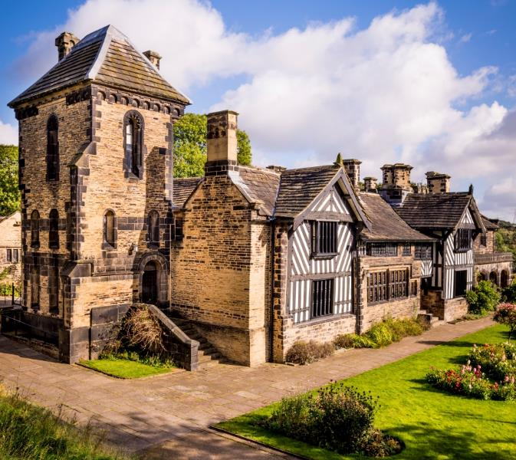
Anne’s changes to Shibden Hall
Earlier Lister’s had made changes to the hall such as the barn on the north side of the house and the rendering and sash windows on the south front of the house.
At the beginning of the 19th Century there was a trend for Medieval and Jacobean styles. She got her inspiration from cathedrals, castles and ruined abbeys. John Harper, an architect was to be employed to make changes to the estate to make Anne’s mark.
Anne’s Gothic Tower at Shibden Hall.
1/2

Slide 15
Anne’s changes to Shibden Hall
Plans had to be reworked together as Anne’s ideas went beyond her means. Finally it was decided that the rendering was stripped off and half the timbering restored on the south front and new timber bay windows replaced the sash ones. On the west side a three storey Gothic Tower would provide a library and modern water closets. On the east side Anne created new kitchens and servants quarters. She then looked at recreating the Housebody. She cleared the upper rooms prior to taking out the floor and opening the Housebody to the rafters and a new fireplace was put in. Part of the buttery built by Robert Waterhouse was taken in for the staircase with the gallery above.
Anne’s Gothic Tower.
2/2

Slide 16
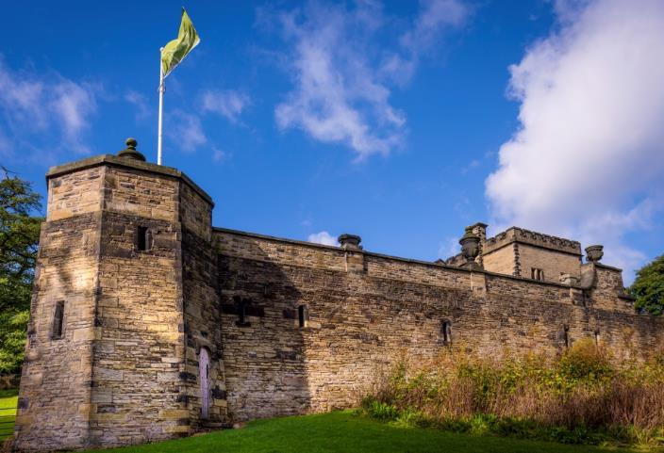
Anne’s changes to Shibden Hall
Anne also had her family motto engraved, Justus Propositi Tenax (Just and true of purpose) and she created tunnels and cellars under the house to ensure she would not be disturbed by servants.
Shibden’s picturesque landscape was created for Anne Lister, who set aside 90 acres of grounds in 1836. Previously this area was used for both farming and coal extraction.
The terrace was raised to give Shibden a higher position and on the west there were a series of terraces for an orchard of apple, pear and quince.
Garden turret with door leading from the gardeners’ tunnel.
1/2

Slide 17
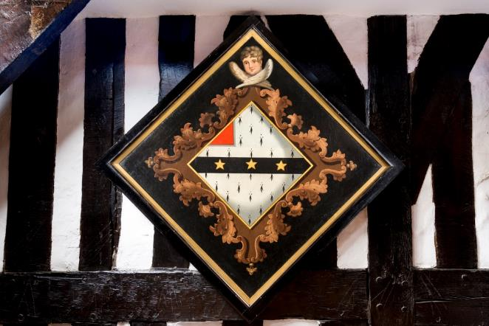
Anne’s changes to Shibden Hall
At the bottom of the track, the lake was part of Anne Lister’s grand plan. It was dammed with a decorative barrier of sandstone and Anne was most pleased when she realised she could use the water power to run machinery in the wire works at Mytholm.
She had a driveway built towards the main road with a gatehouse supporting a Gothic arch at the end of it.
When Anne left for Russia in 1839 work was continuing on the Gothic towers windows but sadly Anne died before the work was completed.
Anne Lister’s funeral hatchment.
2/2

Slide 18
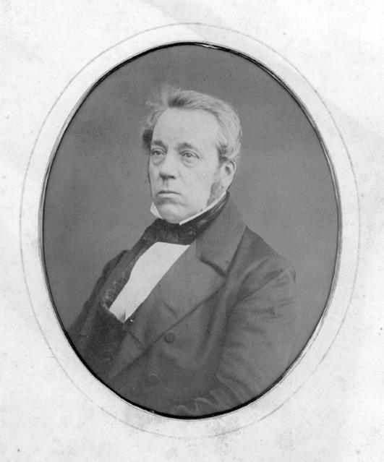
Dr John Lister and Louisa Grant
Ann Walker was to inherit Shibden Hall under the terms of the will. It is believed that Ann was removed from Shibden and taken to an asylum in York and her brother-in-law moved in. Ann never returned to Shibden and she died at her own property of Cliffe Hill in 1854.
On her death the property reverted to Lister family ownership and was inherited by John Lister, the great-grandson of Anne’s great uncle, Thomas Lister of Virginia. He was a doctor and had a practice on the Isle of Wight and when they inherited, the family travelled between their 2 homes. In 1855 he and his wife Louisa Anne Grant, 2 sons, John and Charles and a daughter Anne moved into Shibden.
Dr John Lister 1802-1867
1/2

Slide 19
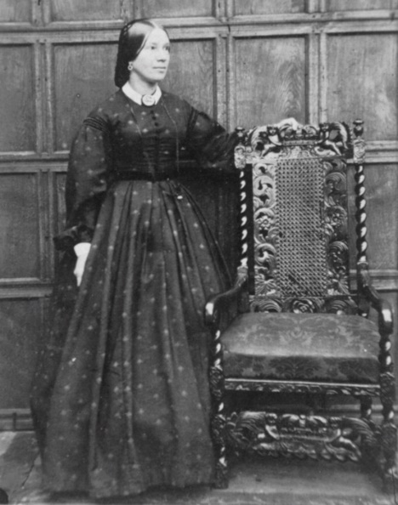
Dr John Lister and Louisa Grant
Anne Lister’s building work had been completed by then but the Hall and Estate needed much maintenance. The coal mines and the farm were profitable but improvements were to be made.
Dr John Lister extended the dining room and retimbered the exterior of the gables. He built the back porch with its Gothic motif and installed several fireplaces with carved tulips. He also built an ornamental pond and a lean-to conservatory and kept a peacock.
His eldest son John inherited the hall in 1867.
Louisa Anne Grant, 1815-1892
2/2

Slide 20
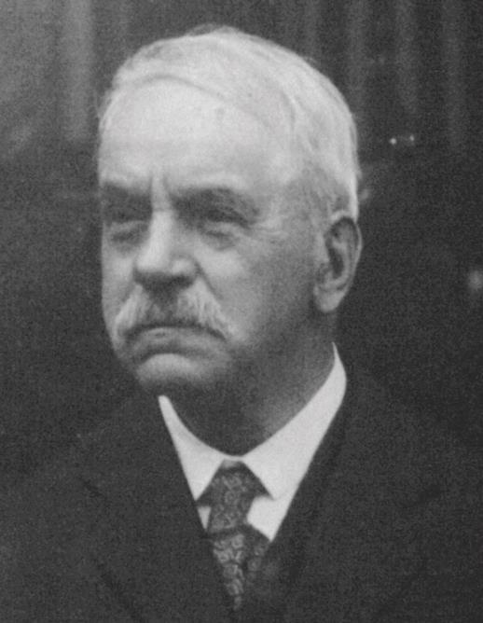
John Lister and Anne Lister
When John inherited Shibden Hall from his father it seemed a less formal setting with the housebody cluttered with bric-a-brac, including two organs, a telescope and a lionskin hearth rug.
He was very proud of his inheritance, showing people around Shibden Hall and sharing its history. He published edited sections of his ancestor Anne Lister’s diaries in the Halifax Guardian and published his research about Shibden and the town in the Halifax Antiquarian Society’s journal.
John and his friend, Arthur Burrell managed to decipher Anne’s code, and could read her diaries. Arthur said he should burn all 26 volumes but John decided to keep them.
He had a reputation for always kind to the poor. For example, he had arranged soup kitchens to be set up when the Pellon Silk Mill workers came out on strike.
John stood as a Liberal councillor in Yorkshire and was a founder member of the Independent labour Party.
John Lister 1847-1933
1/2

Slide 21
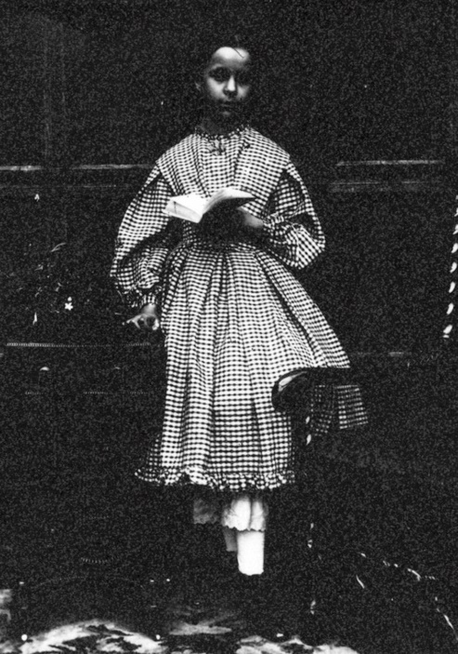
John Lister and Anne Lister
John’s sister Anne took over the management of the house when her mother died, supported by a small and loyal staff headed by the cook, Mrs Kitchener.
However in 1923, the bank called in the mortgages. With John aged 76 this was a cruel blow. He had invested a lot of his money into charitable works and maintaining their home.
His friend, councillor Arthur McCrea came to the rescue and purchased the estate including the 90 acres of parkland to present to the people of East Halifax as a public park which was opened by the Prince of Wales in 1926.
Arthur allowed John and Anne to live there until they died, Anne in 1929 and John in 1933. Shibden Hall was then handed over to the Halifax Corporation.
Anne Lister 1852-1929
2/2

Slide 22
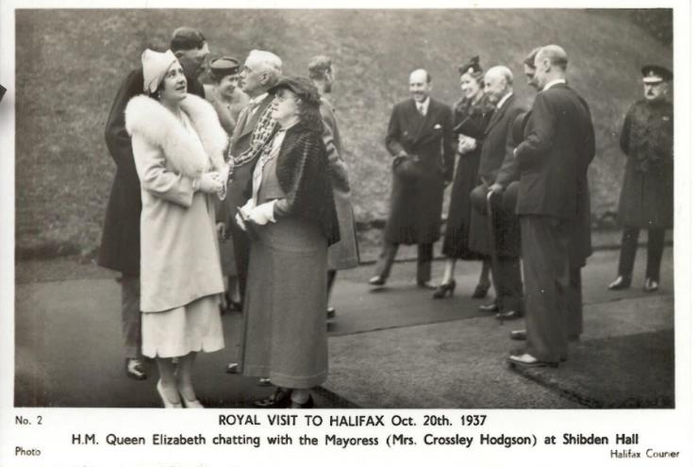
Shibden Hall Museum
Shibden Park became known as ‘The Happy Valley of Halifax’. It included a café, miniature railway and boating lake which are still present today.
The Halifax Corporation decided to open the Hall as a museum on the 4 June 1934. So many objects and documents to be looked through from many lives that passed through the hall.
In October 1937 King George VI and Queen Elizabeth visited Shibden Before heading to the Town Hall.
1/2

Slide 23
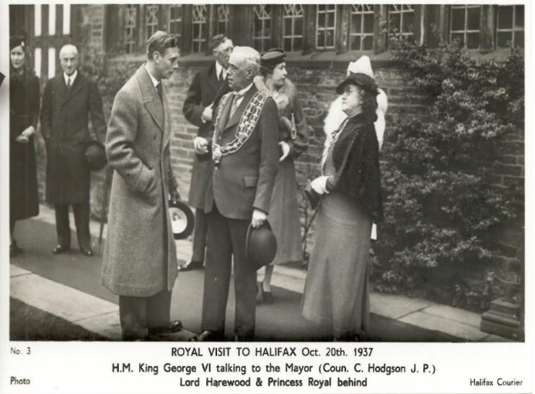
Shibden Hall Museum
Also in 1937, the late John Lister’s friend, Arthur explained the crypt to an early researcher, a librarian Muriel Green. It is said that about a sixth of her diaries are in code and over many years different researchers began to decipher the diaries. In 2011 the diaries were added to the UNESCO online archive of historic UK documents.
The Folk Museum was opened in 1953 and over subsequent years important restoration work has been carried out on Shibden Hall and the Park, ensuring that they can be enjoyed by future generations.
2/2

