Slide 1
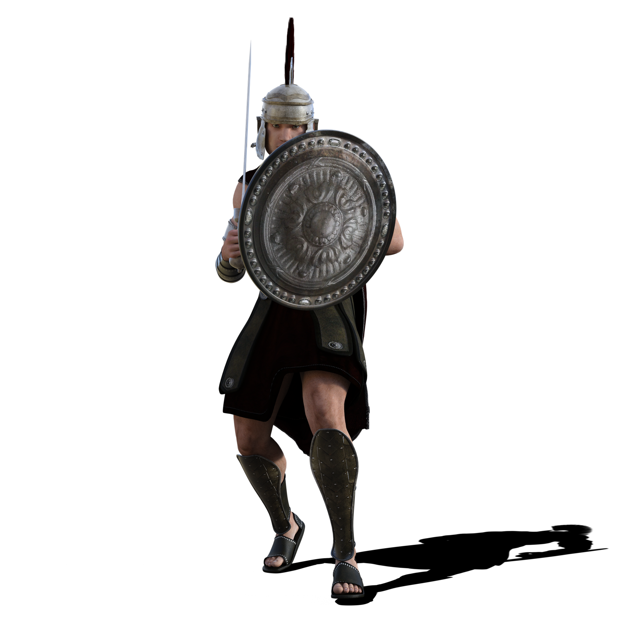
Debate Activity:
To Resist or to Collaborate?

Slide 2

Setting the scene:
It is 45 CE and the Romans have invaded.
They are a powerful fighting force of 40, 000 men, highly trained and disciplined.
Your tribe must choose whether to resist or collaborate.
Activity:
Split the class into two groups, or into multiple smaller groups for a mini debate.
  If in smaller groups, each group could represent one of the Celtic tribes and at the end of the activity you could reveal what the tribe in fact chose to do. See box at bottom of slide.
Each group must develop arguments for either collaborating with the invading Romans, or resisting them.
Get each group to write down ideas thinking about the different potential impacts of their given reaction.
  This could be done under headings such as: social, economic and political impacts.
Use the following slides to help support groups in forming their arguments.
Once both groups have both developed a range of arguments, swap the lists over so that each group has a chance to think of counter-arguments.
Stage a debate
Celtic tribes:
Iceni (Bouddicca’s tribe) (collaborated, then resisted)
Cattavellauni (collaborated)
Coritani (collaborated)
Dobuuni (collaborated)
Brigantes (Cartimandua's tribe)(collaborated)
Ordovices (resisted)
Durotriges (resisted)
Parisis (resisted).

Slide 3
Arguments for Collaboration
The superior strength of the Roman army meant that defeat was likely.
Tribe leaders can keep their kingdoms and some degree of power and are likely to become wealthier.
Tribes were often at war with one another. By collaborating, you would have the opportunity to gain advantage over neighboring tribes.
The Romans brought stable government and the opportunity for a more peaceful, stable life, neither at war with the Romans or neighboring tribes.
The Romans brought with them trade, literacy, a good water supply, towns, roads, education, medicine.

Slide 4
Arguments for Resistance
Collaboration would result in being forced to pay taxes and provide soldiers and slaves to the Romans.
The tribe would be forced to live by Roman laws.
To protect their lands against a foreign force that came to exploit British land and peoples by extracting precious metals, slaves and resources for the Roman Empire.
The Celts were treated as second class citizens by the Romans.
The Romans threatened the tribes’ independence and cultures
By collaborating with the Romans, the tribe would be supporting them, aiding their invasion and exploitation.

