Slide 1
Prehistory Jigsaw Activity
Piece together an object and use observational, thinking and reasoning skills to explore how it might have been made and used.
Free learning resources from arts, cultural and heritage organisations
^{mylearning.org}

Slide 2
Activity instructions
These slides have been designed to be printable on A4 paper and to work on a projector.
You will need:
Scissors
Glue
A copy of the worksheet on slide 4 for each pupil or small group
One of the object photos from slide 5 or 6 per pupil or small group, cut into pieces like a jigsaw.
Activity overview:
Give each pupil cut up pieces of one object from slides 5 and 6 which they must reconstruct like a jigsaw (introducing the idea of archaeologists piecing bits of artefacts together).
Once complete, this is stuck in the middle of the worksheet (slide 4) and pupils answer the questions. There may be no right or wrong answer to some of the questions, providing an opportunity to discuss the limitations of our knowledge of prehistory, and how archaeologists use observation and lots of research to make educated guesses about what objects in the past were used for and how.
The remaining slides provide information on each object and can be used as a class presentation, or printed out for students to check their understanding and learn more about their object.
Curriculum Links:
Changes in Britain from the stone Age to the Iron Age
  To be able to identify trends over time
  Late Neolithic hunter gatherers and early farmers.
  Bronze age technology
  To understand that technologies can cross time periods (for example, a stone axe is not necessarily Neolithic, it may have been made and used in the Bronze age)
^{mylearning.org}

Slide 3
Activity instructions
Variation.
Having cut up the photos of the objects like a jigsaw, give each pupil in a small group one jigsaw piece. Each pupil in a group needs a piece from a different object.
All the remaining jigsaw pieces can be scattered in the centre of the table.
Pupils must use observational skills, communication and cooperation with other group members to find the remaining pieces of their object before reconstructing it. This can be likened to archaeologists uncovering a collection of broken items that have got mixed together through time and need to be sorted before reconstructing.
^{mylearning.org}

Slide 4
1
2
What is your object?
____________________________________________________________________________________
Look carefully at your object and describe it in detail.
___________________________________________________________________________________________________________________________________________________________________________________________________________________________________________________________________________________________________________________________
What it is made of?
What colours is it?
What shape is it?
Are there any patterns or markings on it?
Any other things that you notice about your object.
5
What kind of person do you think would have used your object?
Why do you think this?
3
When do you think your object was made?
Circle all the answers that could be correct :
Stone Age
Bronze Age
Iron Age
Explain your answer:
____________________________________________________________________________
______________________________________________________________________________________________________________________________
___________________________________________________________________________________________________________________________________________________
4
What do you think your object was used for?
__________________________________________________________________________________________

Slide 5
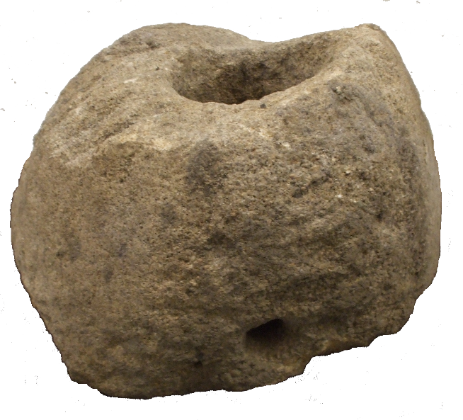
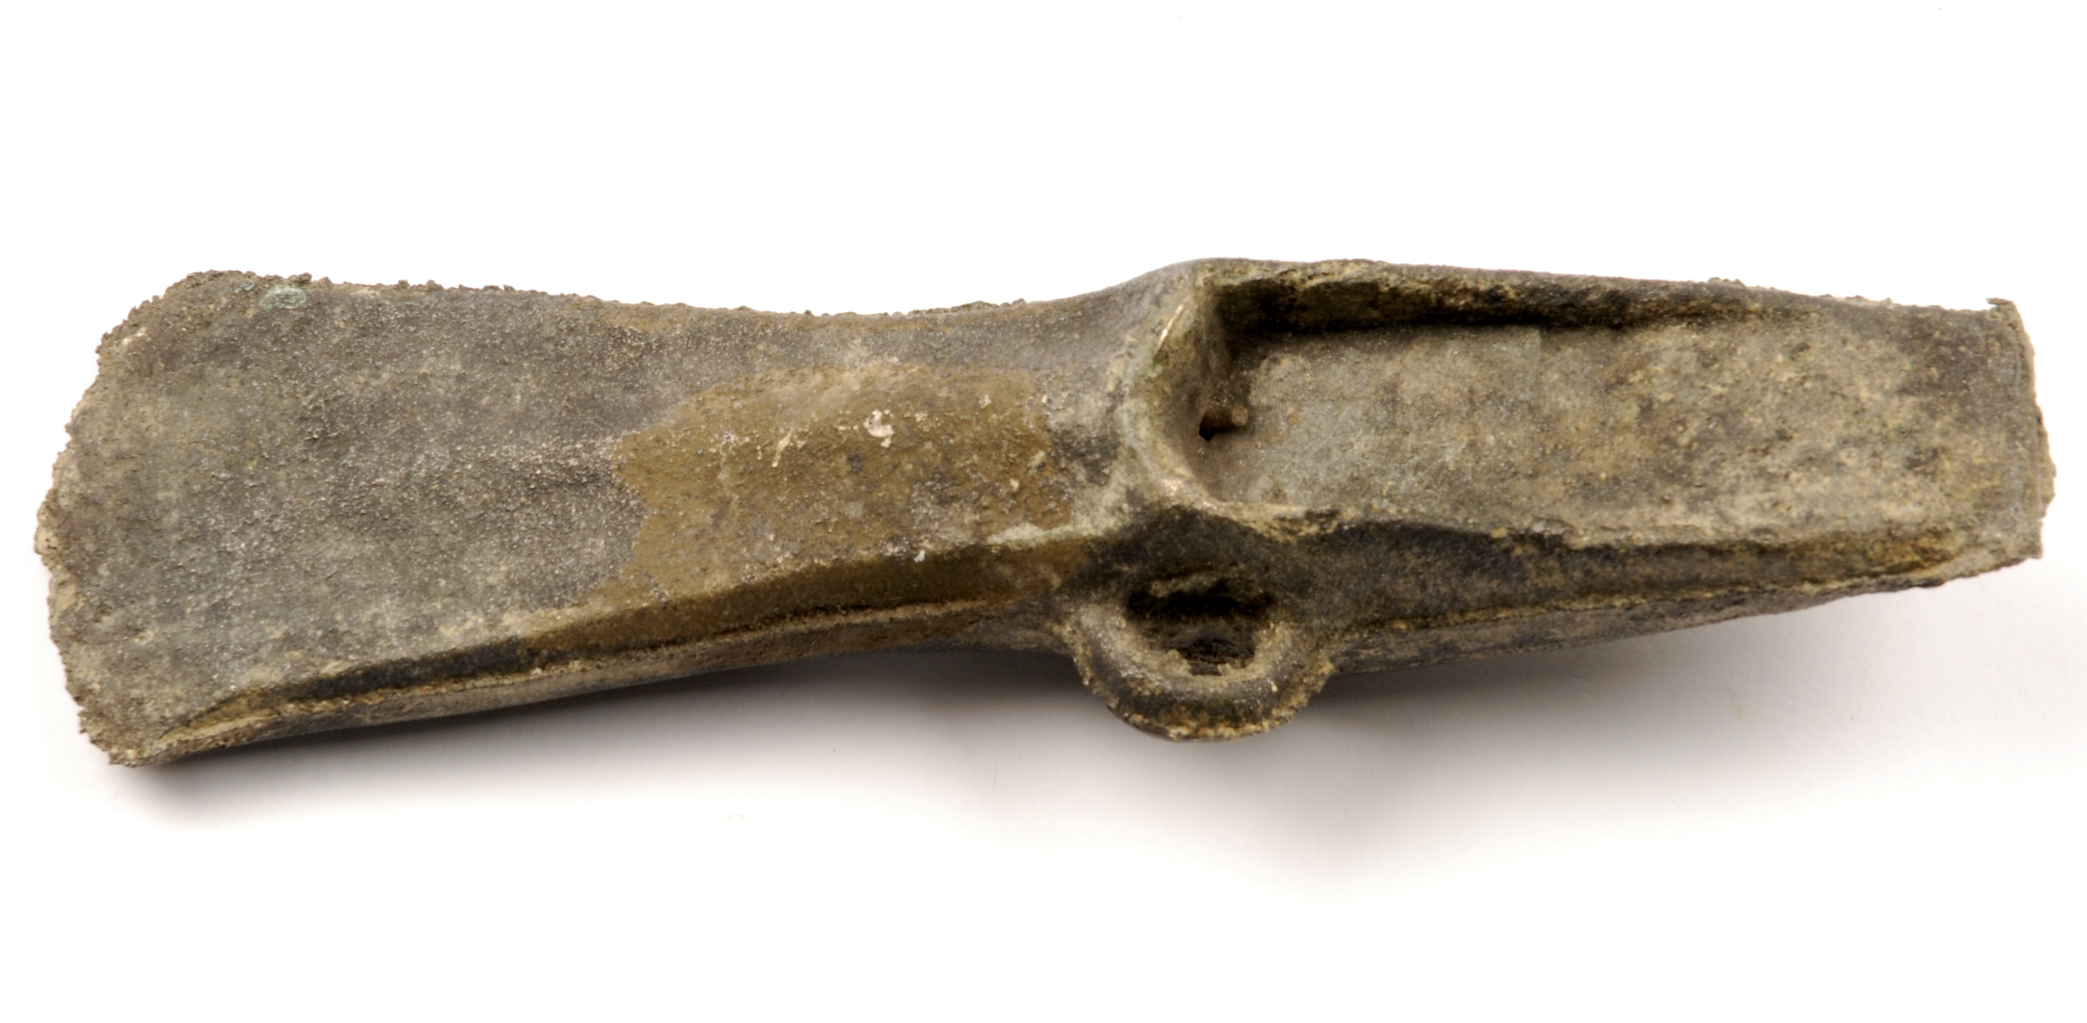
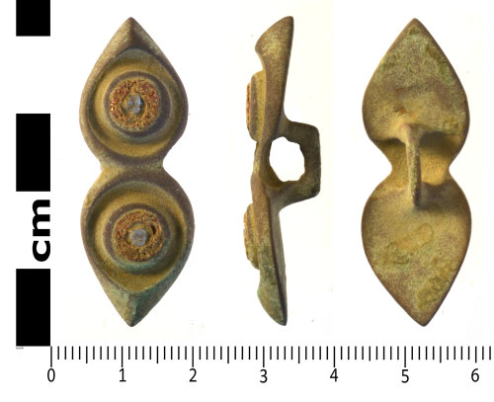
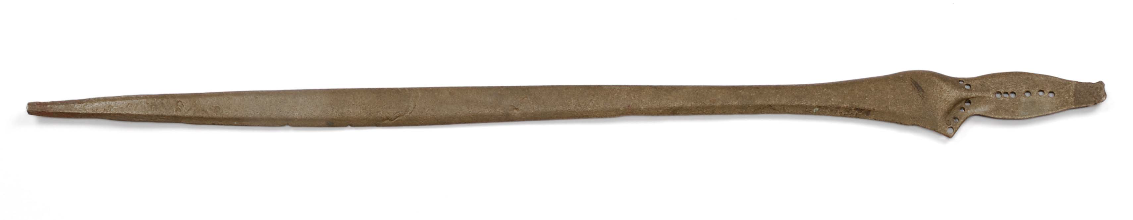
165 mm
275 mm
764 mm

Slide 6
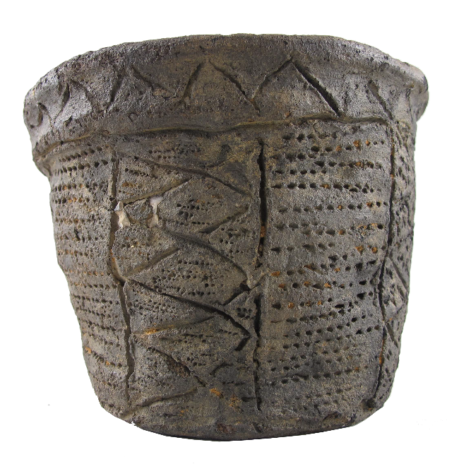
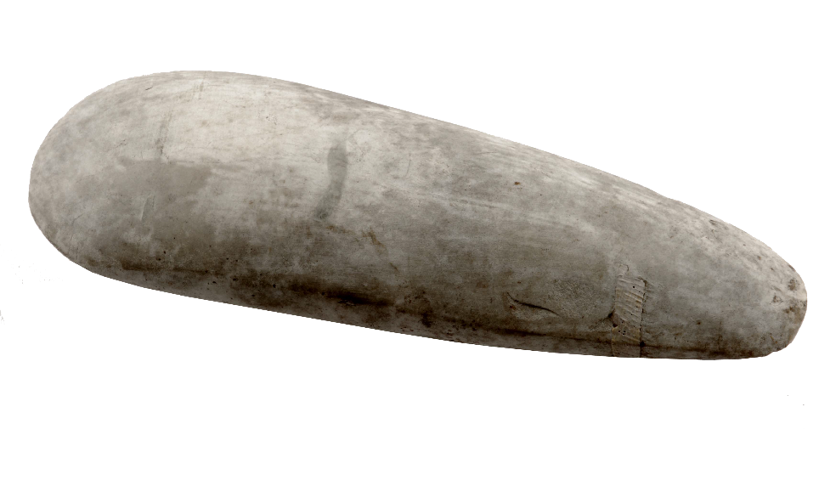
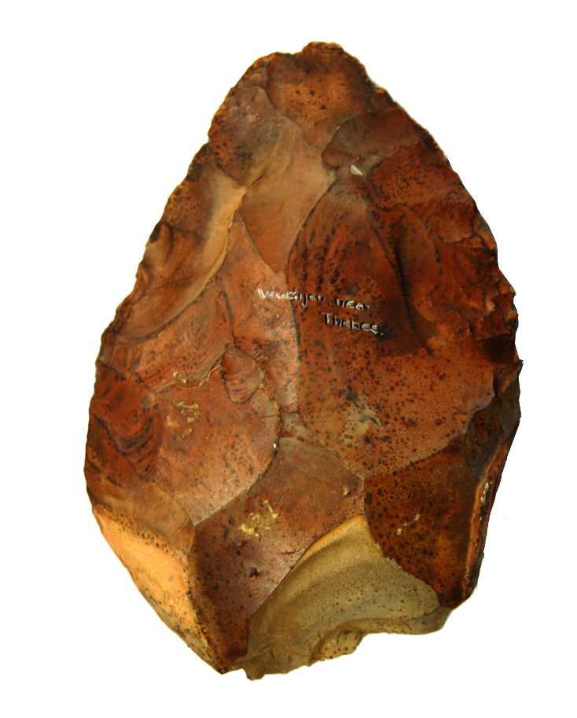
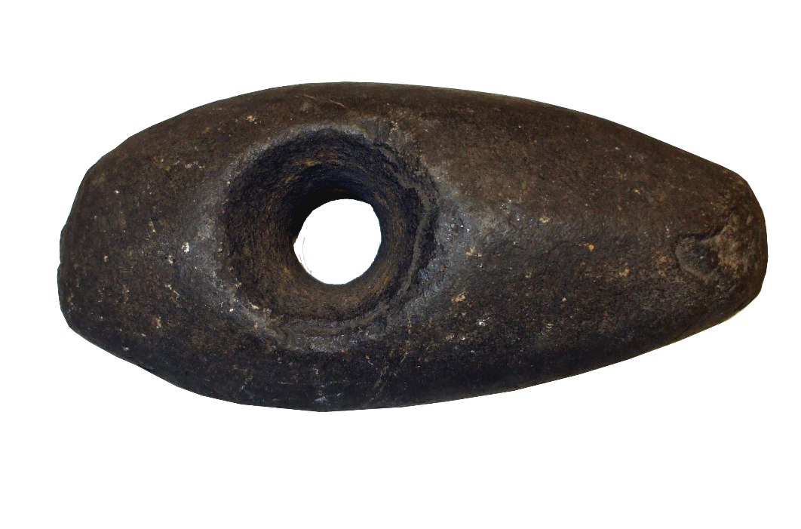
217 mm
135 mm
185 mm
130 mm

Slide 7
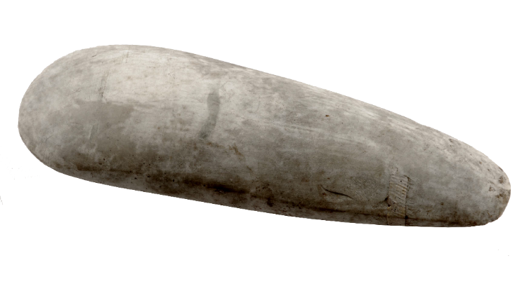
Stone Age axe head
This stone axe head was found in a garden in Leeds.
It was made over 4,000 years ago.
The axe has been polished smooth, probably using sand and grit.
Can you imagine the person who made this axe head:
  What did they look like?
  What did they wear?
  How did they spend their days?
  What did they use the axe for?
217 mm
Image: © Leeds Museums and Galleries.
^{mylearning.org}

Slide 8

Stone Age hand axe
This hand axe is made from flint. It is a hard rock that can be knapped to create a very sharp edge.
The owner of this hand axe would have used it in two ways:
  to cut materials such as straw and animal skin
  to scrape things clean, such as animal skins.
Think about the tools you use in the classroom, for example scissors, pencils etc.
  Imagine if you had to make all these tools yourself. How would your life be different?
130 mm
Image: © Leeds Museums and Galleries.
^{mylearning.org}

Slide 9
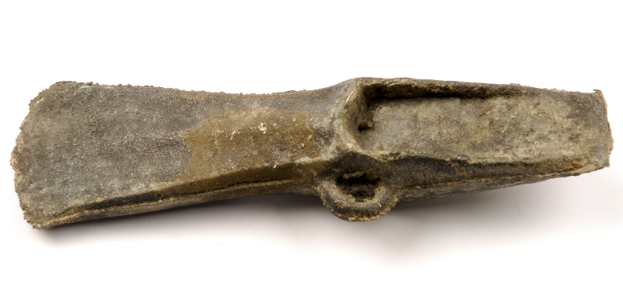
Bronze Age palstave axe head
This axe head would have been made in a mould by a highly skilled craftsperson.
  What kind of place in society would a craftsperson who made axe heads hold?
The axe head would have been attached to a wooden handle using thin rope or leather. The loop would have been used to help keep it secure.
This axe could have been used for chopping small trees and branches, as well as for fighting.
165 mm
Image: © Leeds Museums and Galleries.

Slide 10
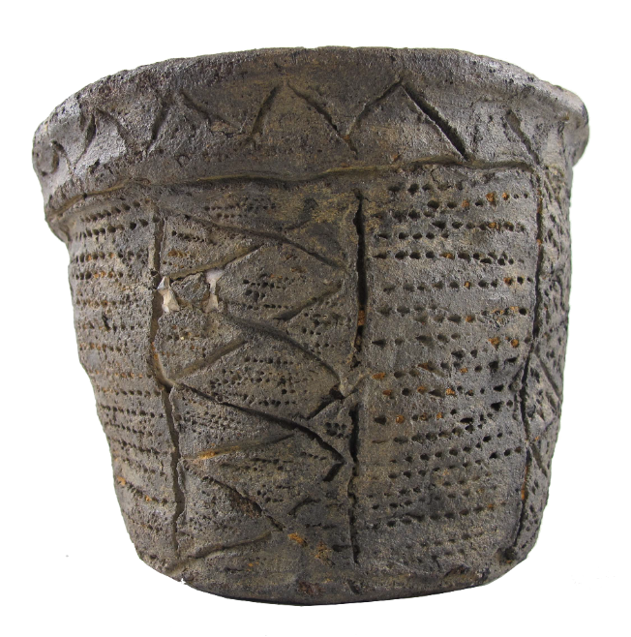
Bronze Age pot
This pot was made from coils of clay over 3,000 years ago and fired in a special oven called a kiln.
  They are still made in exactly the same way today!
We are very lucky that the pot has not been broken during all that time buried in the earth.
Look how carefully the person who made this pot has decorated it.
  What does the decoration tell you about the person who made it and the culture they came from?
135 mm
Image: © Leeds Museums and Galleries.
^{mylearning.org}

Slide 11
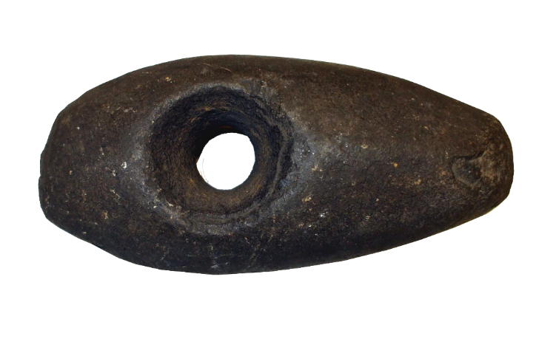
Bronze Age axe
Although this axe is made from stone, it was made in the bronze age.
It is made from basalt, a fine grained volcanic rock.
Look at the different shapes of the ends of the axe. Both have been used.
  What kind of work do you think each end was used for?
185 mm
Image: © Leeds Museums and Galleries.
^{mylearning.org}

Slide 12
Iron Age pendant
This beautiful brooch was made by a skilled craftsperson over 1,800 years ago!
It is made of a mixture of copper and another metal, and enamel.
It was found in Aberford, near Leeds, in the UK.
What do you think the story behind this brooch is?
  Who made it?
  Who bought it?
  How did it get lost?
Image: © Leeds Museums and Galleries.
^{mylearning.org}

Slide 13
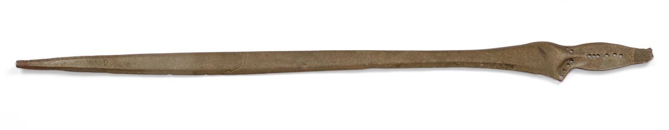
Iron Age Bronze Sword
764 mm
The handle, or pommel of this sword is missing, but you can still see the holes where it would have been attached.
This sword was found near Temple Newsam in Leeds, UK.
The sword would probably have belonged to someone quite rich, or a soldier who fought for a wealthy landowner.
What kind of training do you think a person would need before they could go into battle with a sword like this?
Image: © Leeds Museums and Galleries.
^{mylearning.org}

Slide 14
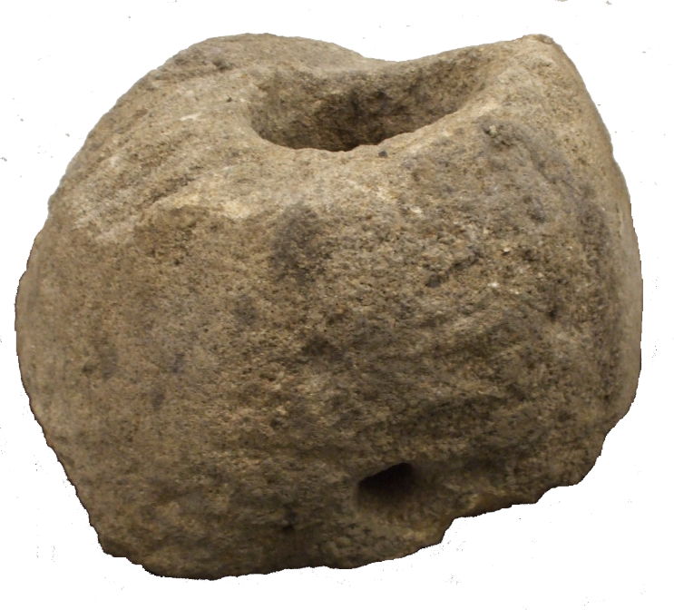
Late Iron Age quern stone
Quern stones were used to grind grains into flour.
The stone pictured would be placed on top of another, flat stone.
The grain would be poured through the hole in the centre of this stone.
A wooden handle would have slotted into the hole in the side and be used to help turn the stone. As it turned the grain would be crushed between the two stones and ground into flour.
Can you imagine how strong you would need to be to turn this stone over and over again?
275 mm
Image: © Leeds Museums and Galleries.
^{mylearning.org}

