Slide 1
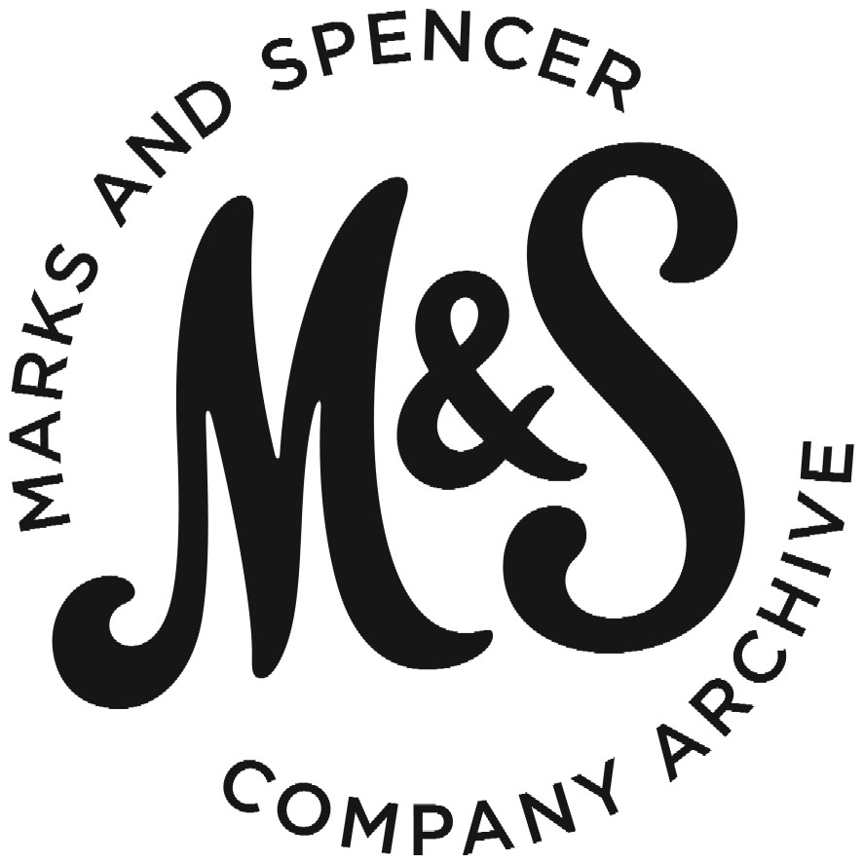
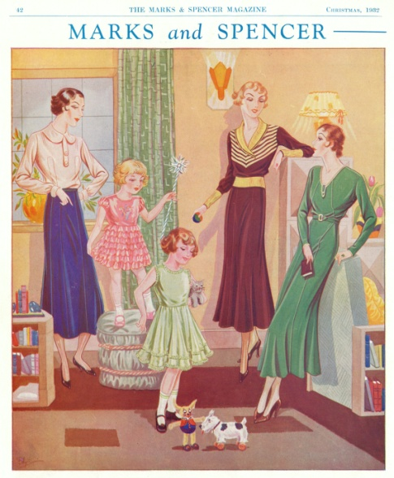

M&S WOMENSWEAR TIMELINE
1930s
M&S started selling ready-to-wear clothes in the 1930s. Our first ranges included smart outfits and overalls for busy housewives, along with glamorous dressing gowns, party frocks and knitted swimming suits. Before this women had been able to buy stockings, handkerchiefs and hats at M&S, but this was the first time they could buy whole outfits.
Advert from ‘The Marks and Spencer Magazine’
Christmas 1932

Slide 2
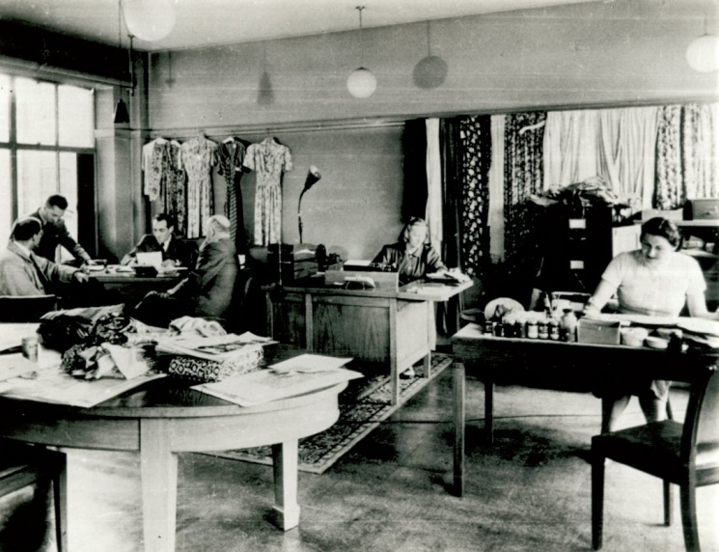
M&S WOMENSWEAR TIMELINE
1936
To keep up to date with fashion trends, a central design department was set up at M&S Head Office in London. We employed Parisian designers to advise on the latest fashions.
Textile Design Department Head Office 1930s

Slide 3
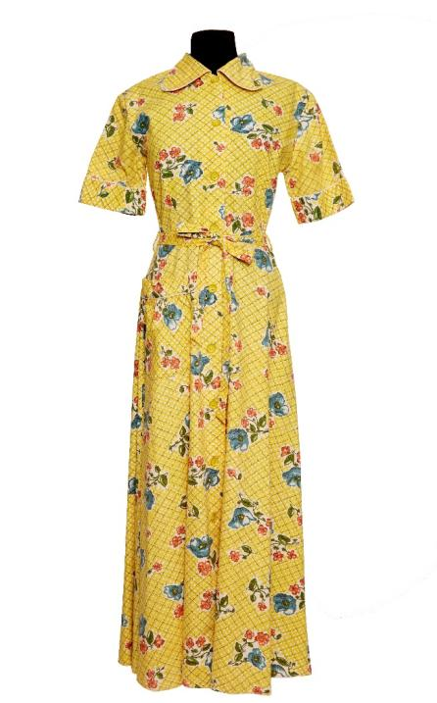
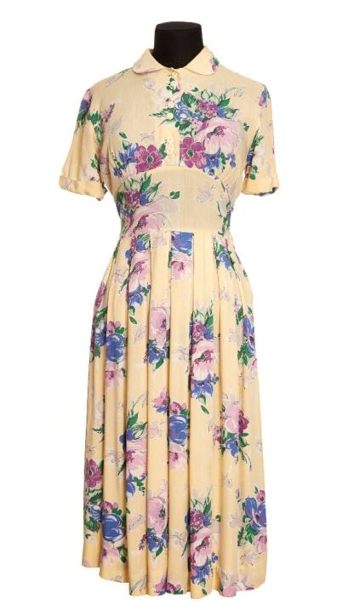
M&S WOMENSWEAR TIMELINE
1941-1945
During the Second World War food and clothing were rationed. To make sure that fabric wasn’t wasted, our technologists helped the government to develop Utility Clothing standards. The standards were a set of rules that limited how much fabric, thread and how many buttons could be used to make items of clothing. Even though we had to work to these rules, M&S Utility Clothing was comfortable and stylish too.
Utility Clothing 1940s

Slide 4
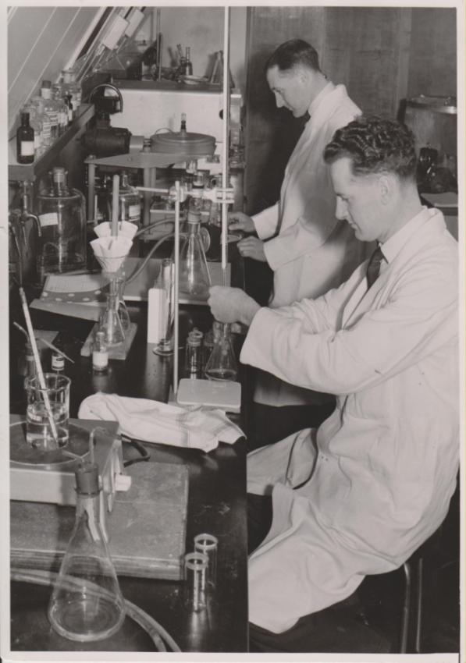
M&S WOMENSWEAR TIMELINE
1946
After the war we put a lot of effort into inventing new fabrics so that clothes would be less expensive to make. This meant that M&S could sell high quality fashion at a price most people could afford. A new textile laboratory opened to experiment with nylons, plastics and other synthetic materials, resulting in man-made fabrics that were easy-wash, non-iron and fade-resistant.
M&S Technology Laboratory c1950

Slide 5
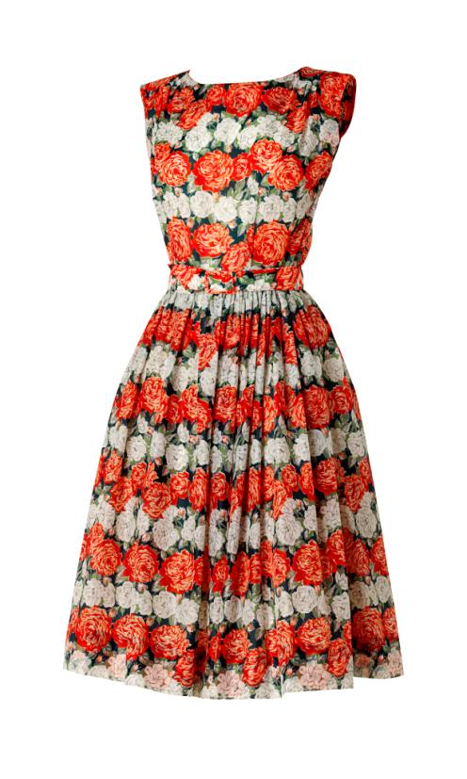
M&S WOMENSWEAR TIMELINE
1947
The famous French designer, Christian Dior, showed his first collection in Paris this year. The dresses used lots of fabric (which hadn’t been allowed during the war) with full pleated skirts and nipped-in waists. This became the style of the 1950s known as the ‘New Look’.
At M&S we used our new easy-care man-made fabrics to make ‘New Look’ dresses, which meant ordinary people could buy high fashion clothing.
Nylon dress with belt c1955

Slide 6
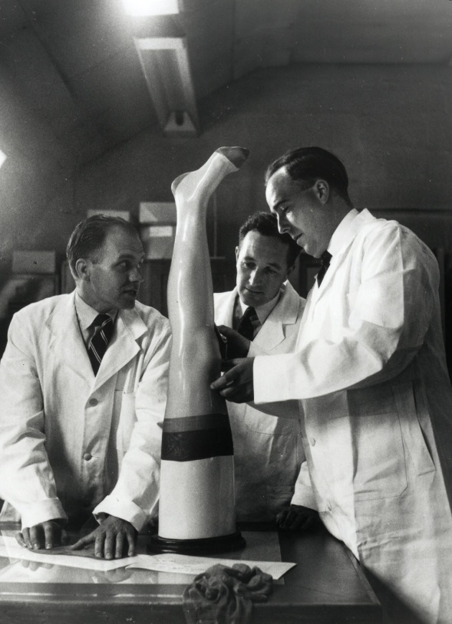
M&S WOMENSWEAR TIMELINE
1957
Our textile technologists ran the first size survey: 'A Scientific Approach to Stocking Sizes'. They wanted to find out how to make M&S stockings fit better for more women, so 600 women had their legs measured and a range of 'super-fit tailored' nylons was produced.
M&S Product testing 1957

Slide 7
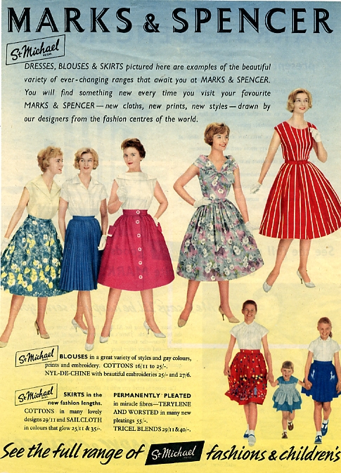
M&S WOMENSWEAR TIMELINE
1958
This was our first colour magazine advert. Over four pages we showed our latest ranges of the ‘New Look’ dress.
As fashions changed and skirts became shorter, we reduced all our skirt lengths by an inch.
‘Woman’ magazine May 1958

Slide 8
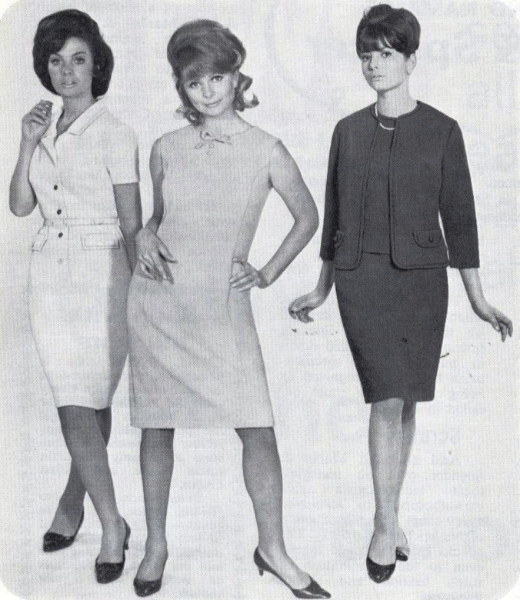
M&S WOMENSWEAR TIMELINE
1960s
In the 1960s more women were going out to work, rather than staying at home. To give our customers what they needed we produced stylish yet comfortable clothes to wear at the office.
St Michael News 1965

Slide 9
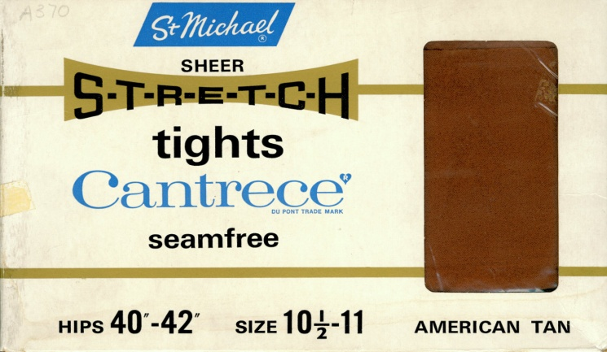
M&S WOMENSWEAR TIMELINE
1962
Fashions were changing fast. In the early 1960s skirts kept getting shorter, and traditional stockings were no longer practical. M&S realised that tights were becoming very popular and we began selling them in 1962.
Sheer stretch tights in American Tan 1960s

Slide 10
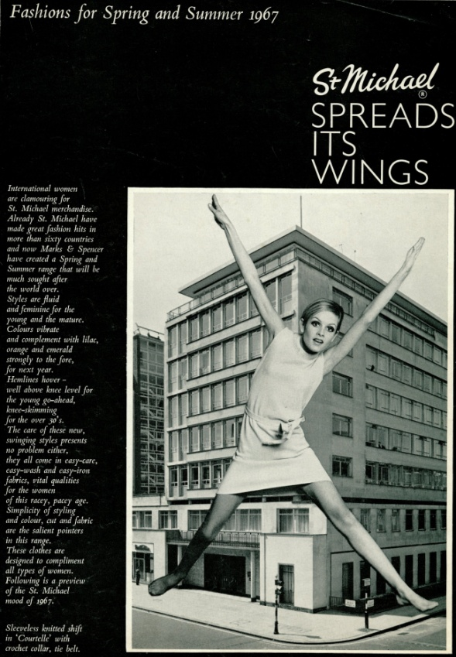
M&S WOMENSWEAR TIMELINE
1967
Twiggy makes her first appearance modelling for M&S. Twiggy’s real name is Lesley Lawson, she got her nickname because she was so slim. She was 18 when she started modelling for M&S – in this article she’s wearing a dress with a hemline ‘well above the knee for the young go-ahead’.
M&S fashion supplement 1967

Slide 11
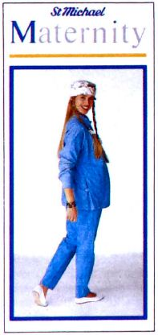
M&S WOMENSWEAR TIMELINE
1987
We started selling our first Maternity Range for pregnant women. The range included smart clothes for work, casual clothing and nightwear.
St Michael News Jan 1987

Slide 12
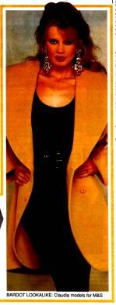
M&S WOMENSWEAR TIMELINE
1990
The first model of superstar status – Claudia Schiffer – appears in our magazine adverts. Claudia was one of the ‘supermodels’ of the 1990s, and we went on to work with her fellow supermodels Linda Evangelista and Yasmin Le Bon.
St Michael News July 1990

Slide 13
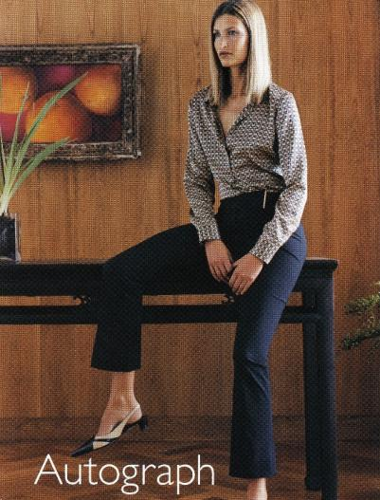
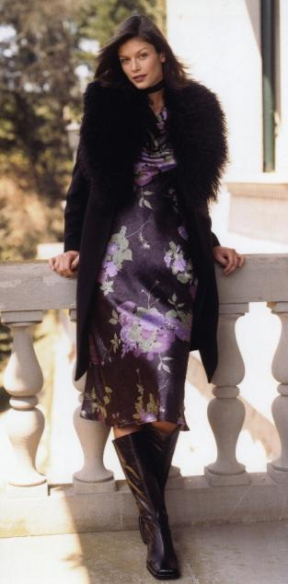
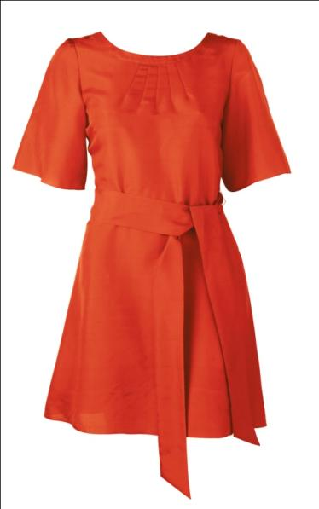
M&S WOMENSWEAR TIMELINE
2000s
In 2000 we stopped using the St Michael label, and introduced new labels for our clothing.
One of the first new labels was the Autograph range, designed to be fashionable and elegant. In 2001 we launched Per Una, inspired by Italian design. Three years later in 2004 Limited Collection arrived, aimed at younger customers who wanted the latest trends.
Autograph advertisement 2001
Red kimono dress Limited Range Spring 2007
Per Una 2001

Slide 14
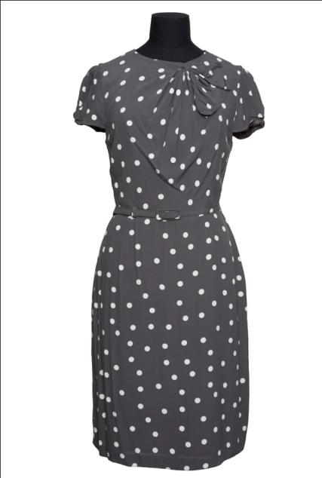
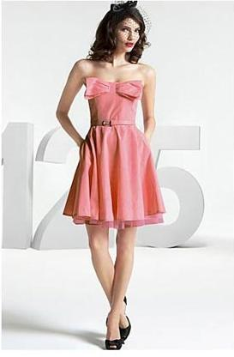
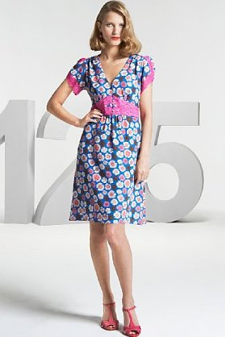
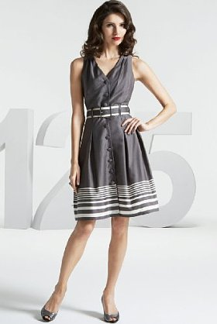
M&S WOMENSWEAR TIMELINE
2009
We celebrated our 125th anniversary this year. To celebrate our designers created a range of dresses inspired by fashion from the archive. One of the dresses, a 1940s style grey spotted dress, became famous when Samantha Cameron (David Cameron’s wife) was photographed wearing it to the Conservative Party Conference.
125 Collection dresses 2009
Polka dot dress, 125 Collection 2009

Slide 15

M&S WOMENSWEAR TIMELINE
2012
After modelling for us for 45 years, Twiggy designed her own collection for M&S. This silver sequin jacket sold out within two hours of going on sale!
Twiggy wearing the sequin jacket 2012

Slide 16
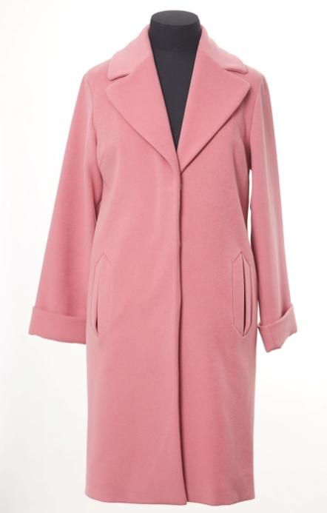

M&S WOMENSWEAR TIMELINE
2013/14
Our Autumn/Winter 2013 collection was the first to be directed by our new style director Belinda Earl. This pink coat, called the Oversize Duster Coat, was incredibly popular and became a sell-out hit. Before the coat was in the shops, our Marble Arch store had a list of 100 customers on their waiting list.
We also launched a new collection of clothing that uses our history to inspire the present. It’s called Best of British, and all the clothes in the range are made in the UK using the best quality fabrics, like Scottish cashmere and Yorkshire woollen cloths.
Best of British advertisement 2014
Oversize Duster Coat 2013

Slide 17
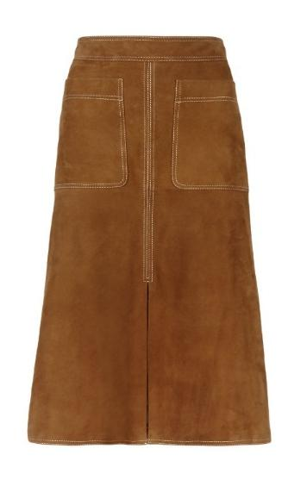
M&S WOMENSWEAR TIMELINE
2015
This suede skirt hit the headlines when it was worn by celebrities Alexa Chung and Olivia Palermo. The skirt’s 1970s design was inspired by items in the M&S Company Archive collection.
Autograph Suede Skirt 2015

