Slide 1


Picture Gallery Interactive
Identify the main features of this magnificent room.
Discover how an owner was influenced by the wider world.
Enjoy activities that help pupils compare and contrast trends over time and allows them to make connections.

Slide 2


Instructions to turn Power Point into a touchscreen Interactive / use with a mouse.
Go to ’Slide Show’ on the command ribbon.
Choose ‘Set Up Slide Show’.
Select ‘Browse at Kiosk (full screen)’.
Click on each TN shape symbol to explore the content. The content can be accessed in any order.
Further information or more details can be accessed by clicking on the or coloured symbols.
Go to ‘From Beginning’ to start.
Press ‘escape’ on the keyboard to exit the programme.

Slide 3
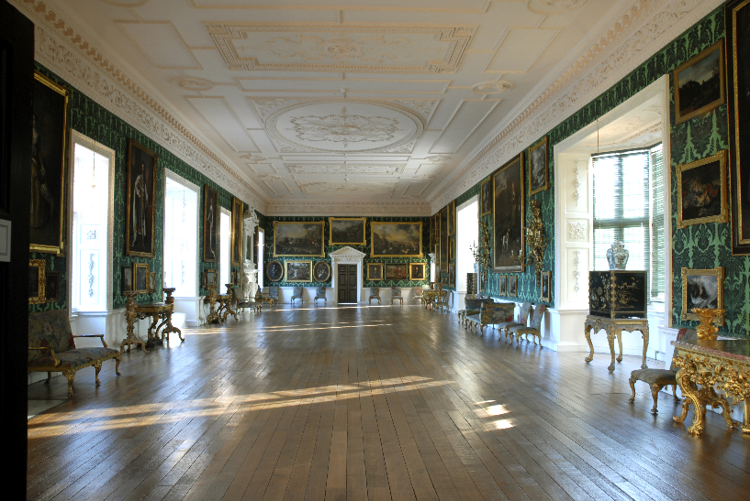
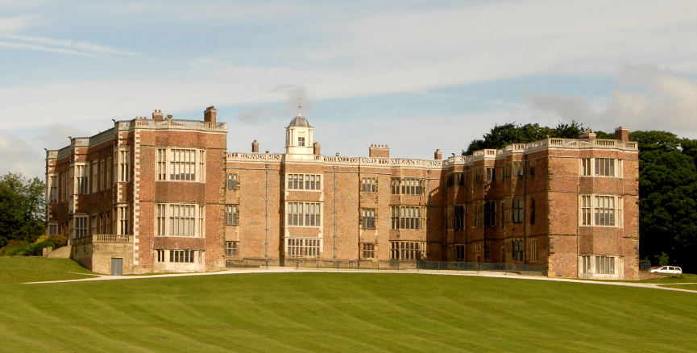


Temple Newsam Picture Gallery
Temple Newsam House is a magnificent home built 500 years ago. It has had many important owners, such as King Henry VIII, Queen Elizabeth I and Lord Darnley, who was born in the house and went on to marry Mary Queen of Scots. In 1622 the Ingram family bought the house and rebuilt many parts of the house. In 1922 the estate was sold to Leeds City Council.
In 1996 the picture gallery was restored to its appearance in 1746

Slide 4

Henry Ingram 7th Viscount
The Picture Gallery at Temple Newsam today is decorated with the same wallpaper, furniture and objects that Henry Ingram chose in 1736.
In his portrait you can see Henry holding a plan of the Picture Gallery ceiling with Temple Newsam house in the background.

Slide 5
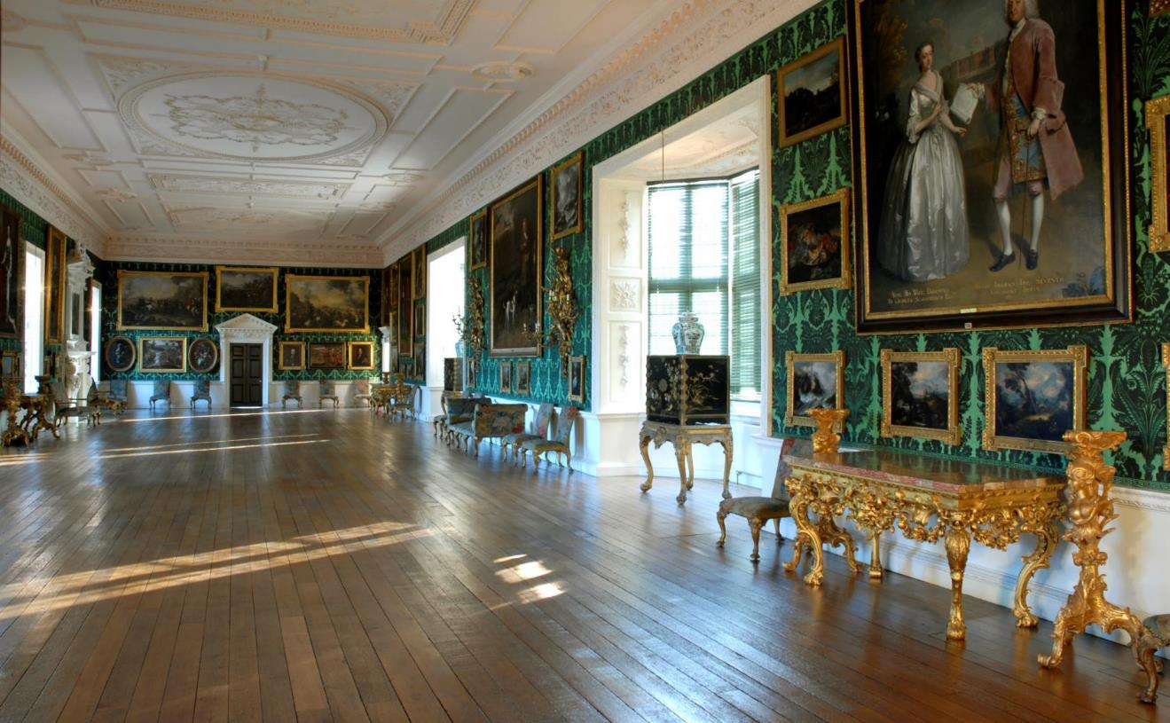

The Picture Gallery
Follow up Activities
?
?
Primary
?
?
?
The gallery at Temple Newsam is a good example of the fashion in the 1730’s. They liked to show myths from Ancient Greece and Rome. This was to show they were well travelled and educated.

Slide 6
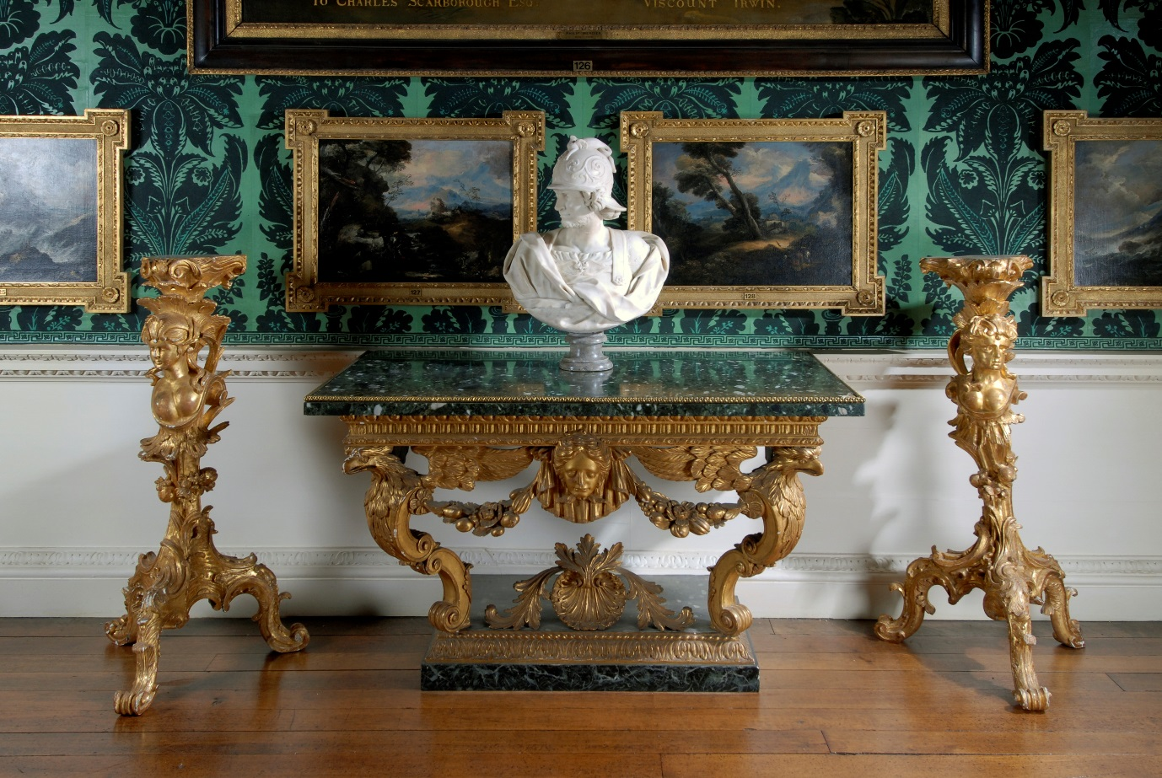


Table and Torcheres
?

Slide 7
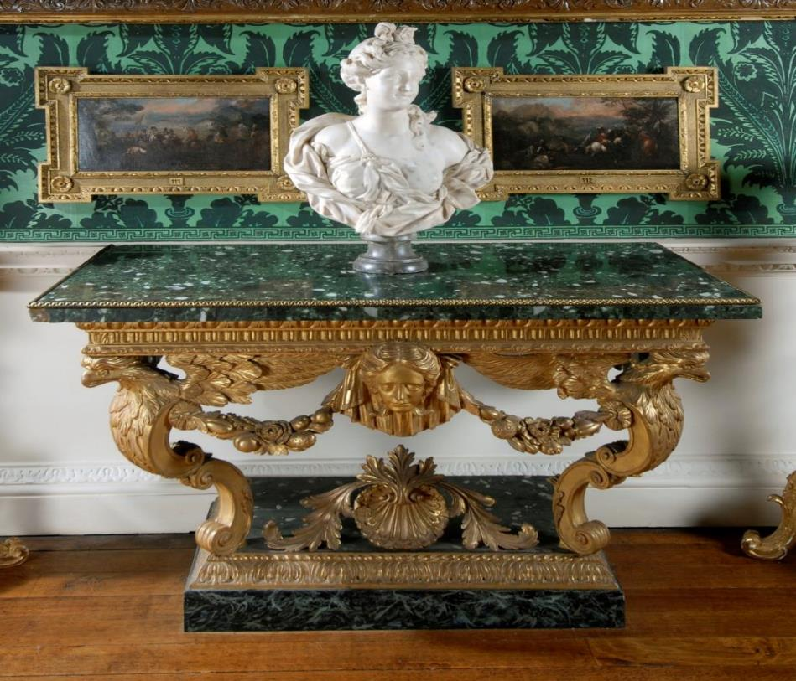
PAN
?
This table originally had the image of Pan. He was half beast and half man. He liked to chase the goddesses.

Slide 8
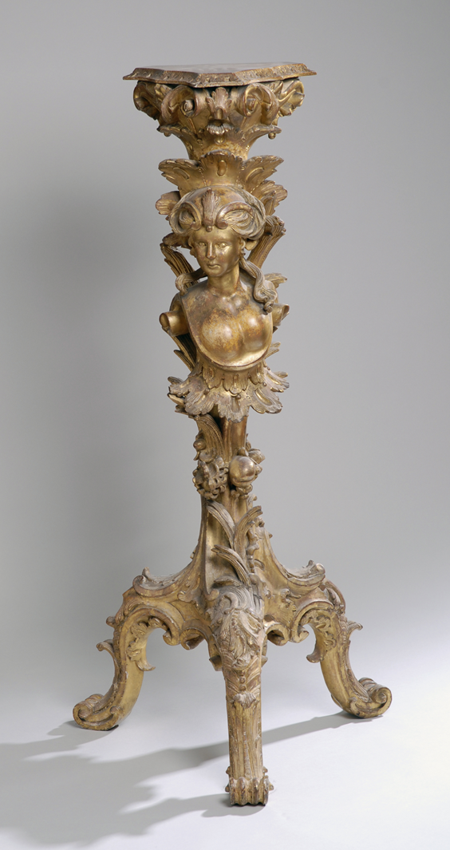
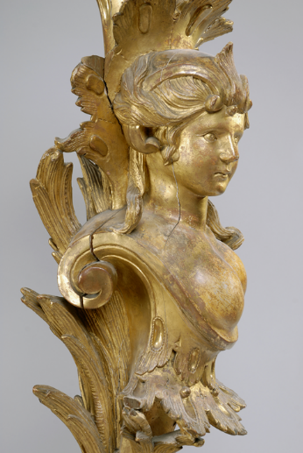
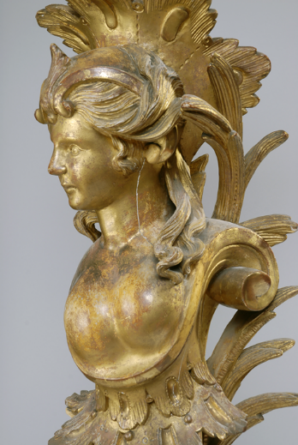
Syrinx
?
The torcheres around the room would have had candles placed on them. This one has Syrinx, a spirit of nature carved onto it. She is being changed into a bull-rush.

Slide 9
Greek Mythology at Temple Newsam House
In ancient Greece, stories about gods and goddesses and heroes and monsters were an important part of everyday life. They explained everything from religious rituals to the weather, and they gave meaning to the world people saw around them.
The story of Pan and Syrinx
?

Slide 10

Pan and Syrinx
The satyr Pan chased the nymph Syrinx. She ran until she reached a river and begged her sisters of the stream to help her. Just as Pan was about to catch and kiss her, Syrinx changed into water reeds. When Pan found that he was holding nothing but marsh reeds, he sighed in sadness. This made the wind blow through the reeds. He loved the sound and believed it to be the cry of his beloved Syrinx. He decided to make a set of pipes out of the reeds so that he could have her with him always.
Nymphs were female spirits of the natural world. They were minor goddesses of the forests, rivers, springs, meadows, mountains and seas. They looked after nature and were usually described as beautiful, young, and graceful women.
Satyrs were half-man, half beast spirits that lived in the forests and hills. They were fun, wild and free creatures who often chased after nymphs because of their beauty.

Slide 11
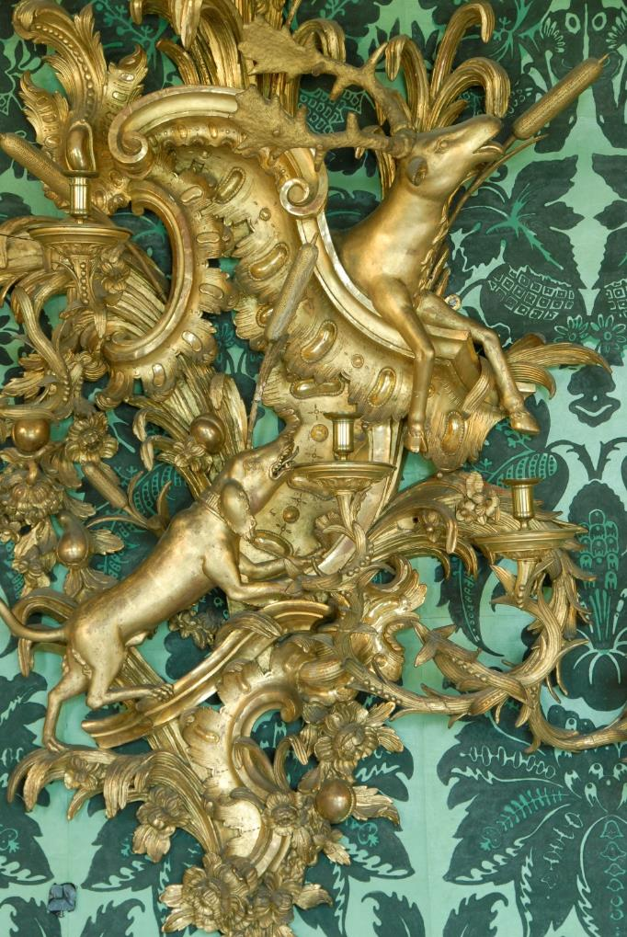
Acteon and Diana
?
Another Greek myth is seen in the Girandoles which are large wall lights.
When the candles were lit it would make the image look as if it was moving.

Slide 12
Greek Mythology at Temple Newsam House
In ancient Greece, stories about gods and goddesses and heroes and monsters were an important part of everyday life. They explained everything from religious rituals to the weather, and they gave meaning to the world people saw around them.
Acteon and Diana
?

Slide 13
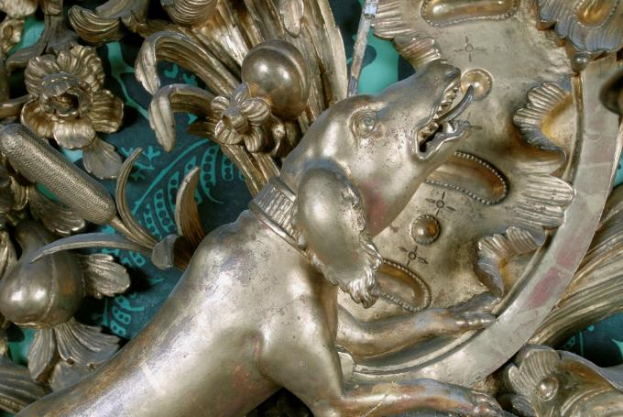
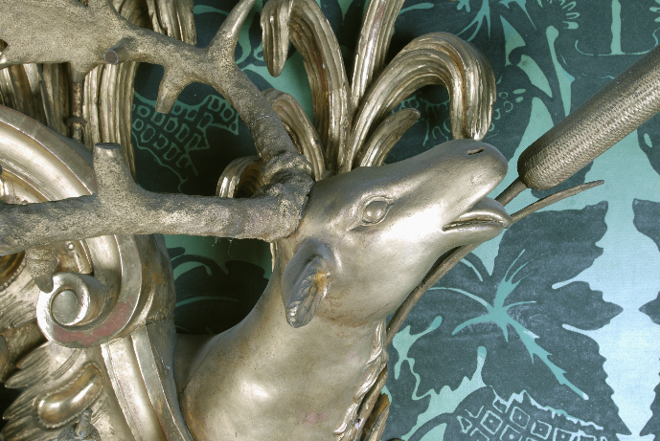
Acteon and Diana
The hunter Actaeon was in the woods with his dogs. They heard laughter coming from a stream nearby. Actaeon crept forward to discover the goddess Diana bathing and splashing with her servants. She was so cross that Actaeon had been watching her that she changed him into a stag. His own dogs turned on him and hunted him down.

Slide 14
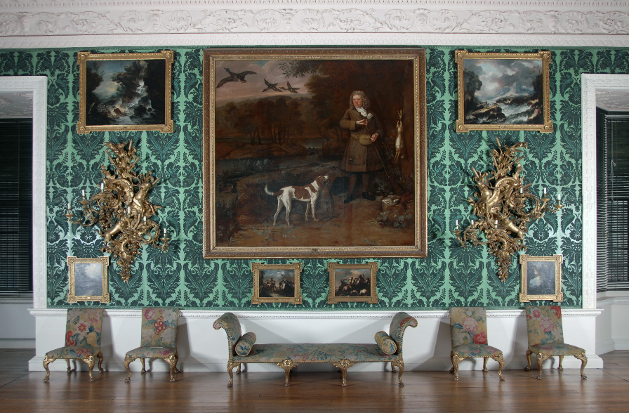
Bring the outside In
In 1736 Henry Ingram decided to change the design of the old Gallery and decorate it with fashions of that time.
He wanted to bring ‘the outside in’ so family and friends could take walks and exercise inside the house when the weather was wet.
The gallery has green wallpaper to look like trees and grass.
A green or flowered carpet would run down the middle of the gallery or around the edges. This gave the idea of walking in a park.
The furniture and plasterwork have floral designs to let you imagine flower beds and leaves.
?

Slide 15
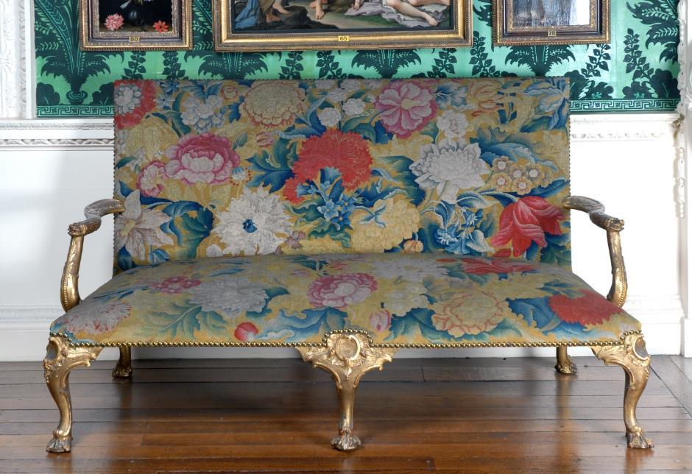
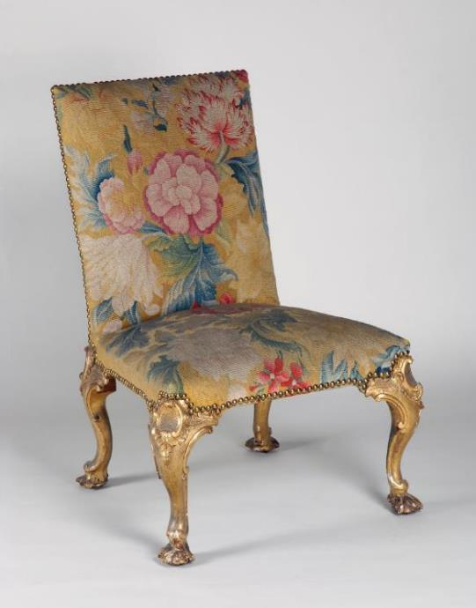
The green flock wall paper gives the idea of green trees or grass.
The Georgians liked the seating around the edge of the room. It was also fashionable to have tables placed between two windows.
The floral design was meant to represent a flowering garden bed.

Slide 16
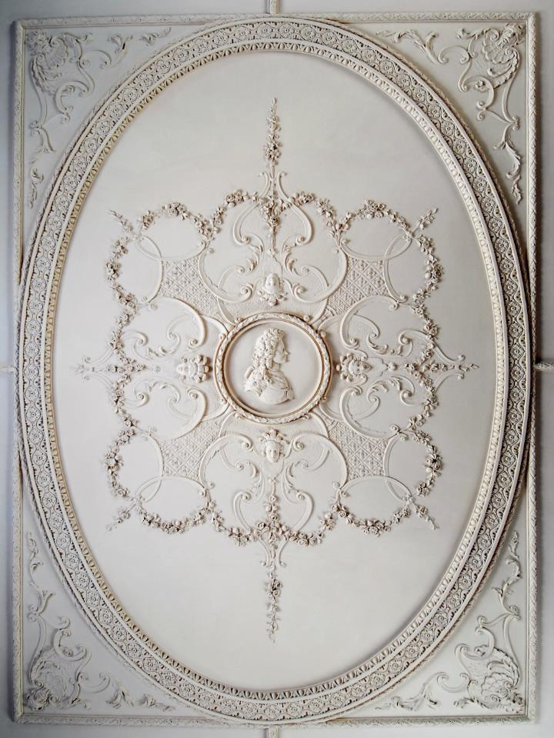
Picture Gallery Ceiling
Henry Ingram wanted to show how much he liked the King who was ruling at that time. He asked his designer to put an image of King George I in the centre of the ceiling.

Slide 17
Follow Up Activities
During the 1800’s the fashion for interior designs often included the idea of ‘bringing the outside in’ and stories from Greek myths and legends.
Research Greek stories and design a piece of furniture that includes these ideas. You could use clay, paper mache or recycled materials!
Look at wall paper designs from that time. Use the patterns as inspiration to create your ‘outside in’ wallpaper. Draw, colour, collage or even print your creations.
Use a shoe box. Can you recreate Henry Ingram’s Picture Gallery?
If you were the new owner of Temple Newsam House what changes would you make in the Picture Gallery? Draw the Gallery with the wallpaper, furniture and objects that you would choose to show off today’s fashions and your taste. How is your design different to Henry’s?
Henry put a picture of the king on the ceiling. Who do you admire? How would you include an image of this person and where would it be displayed?

