Slide 1


Slide 2
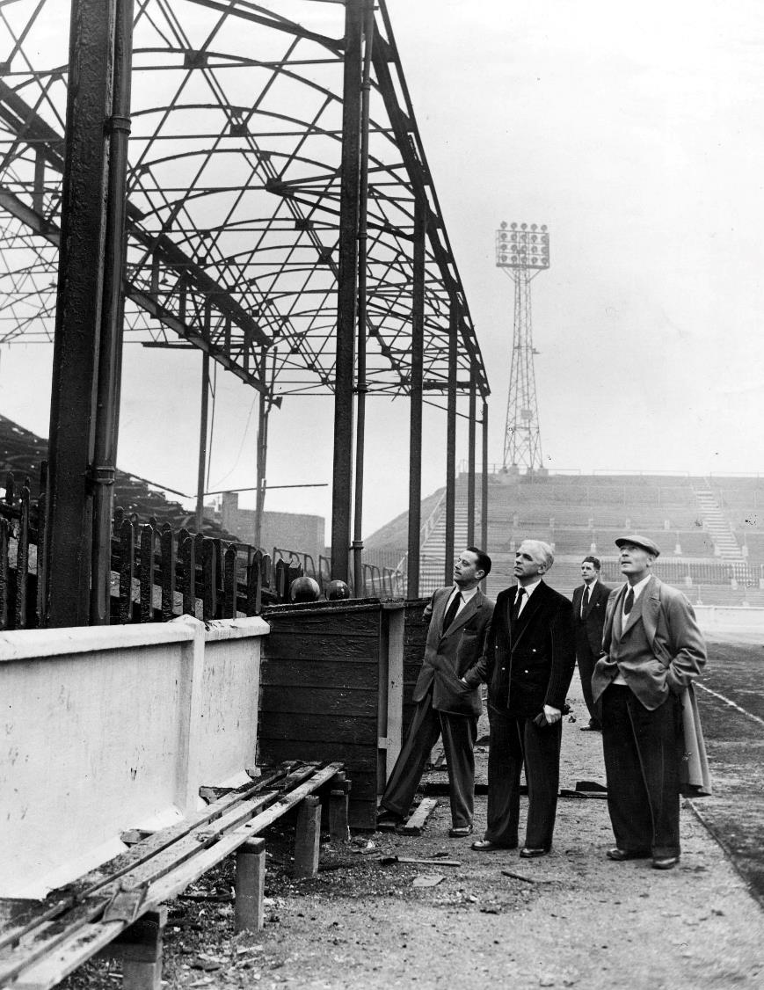
Leeds United manager Raich Carter (centre) inspecting the burned ruins of the West Stand of Elland Road after fire ripped through in 1956.
Image © Varley Picture Agency

Slide 3
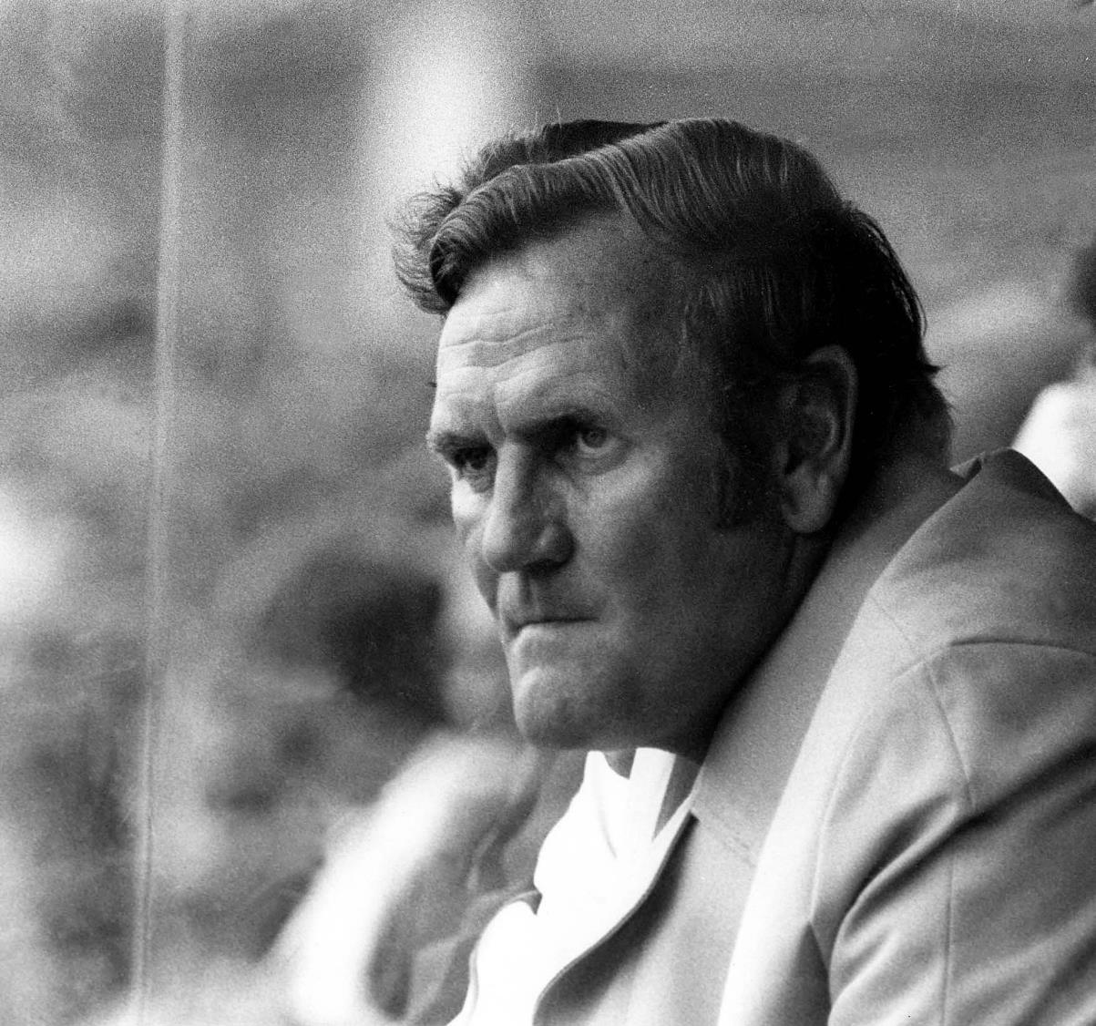
Don Revie
Leeds United Manager 1961 - 1974
Image © Leeds United Football Club

Slide 4
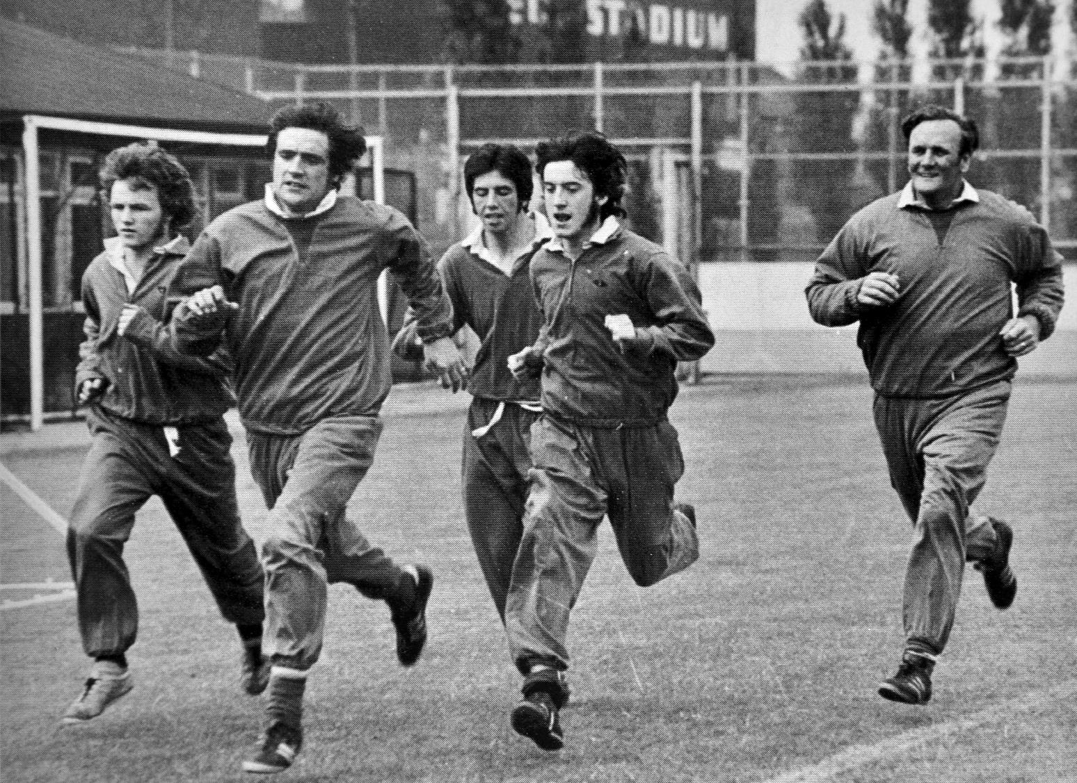
Players training under the management of Don Revie
Image © Varley Picture Agency

Slide 5
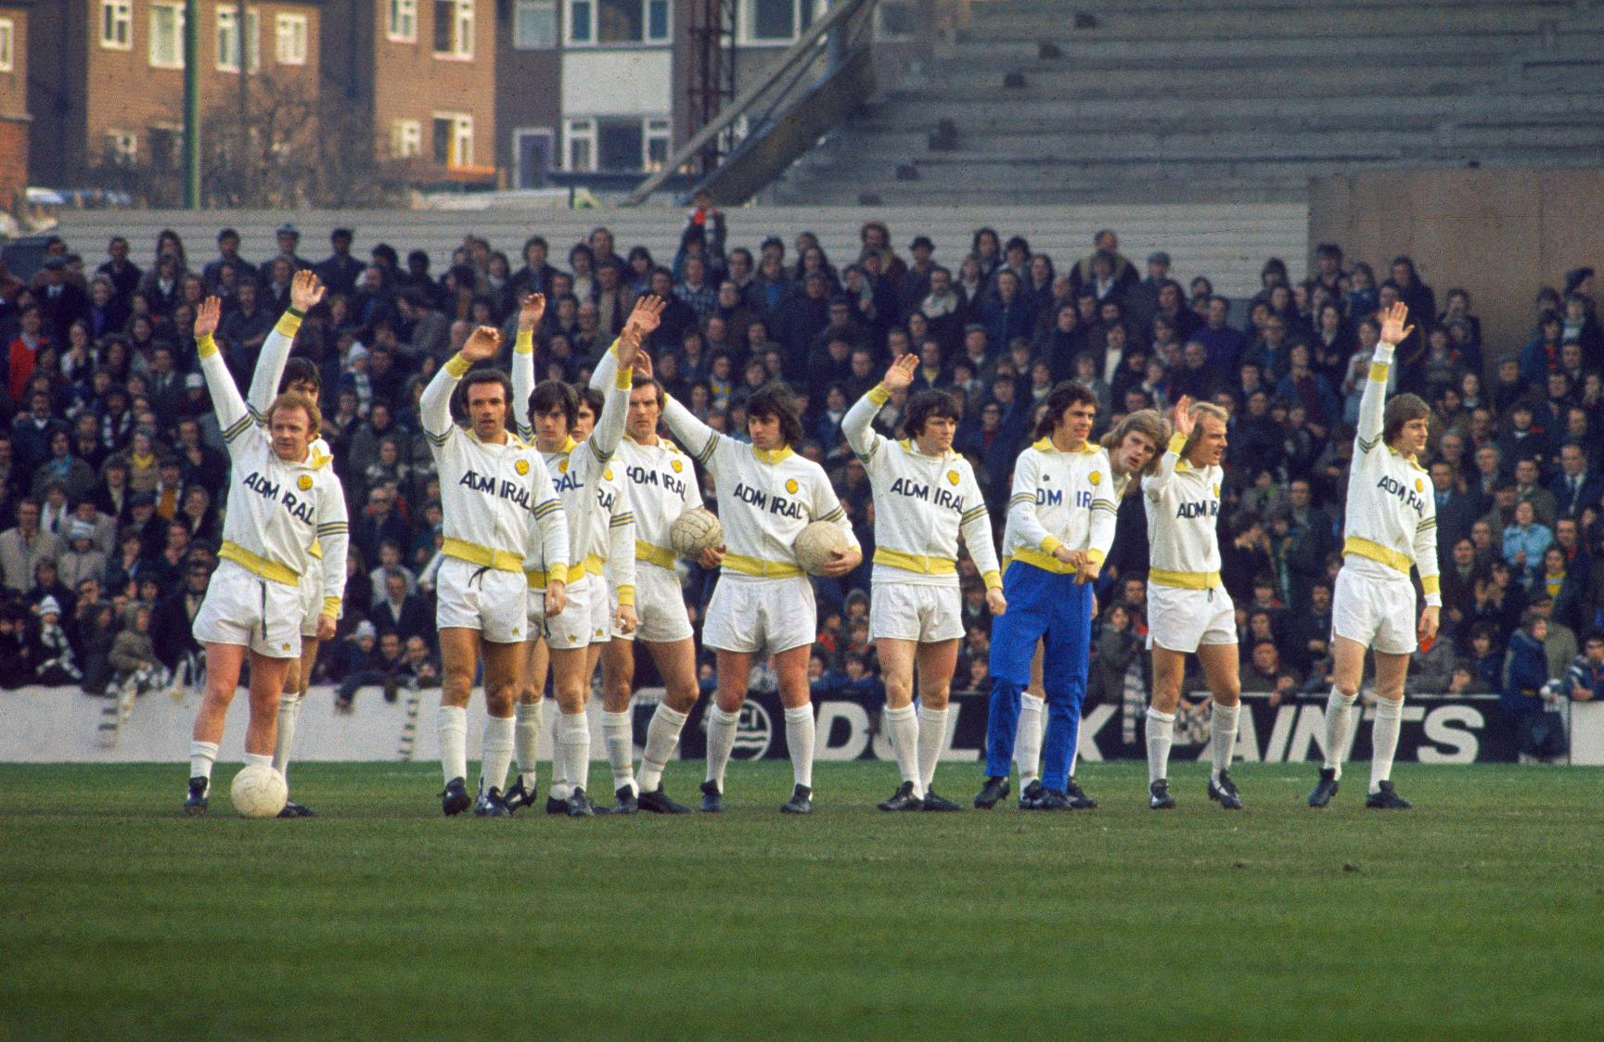
Players doing the ‘Leeds Wave’ introduced by Don Revie
Image © Varley Picture Agency

Slide 6
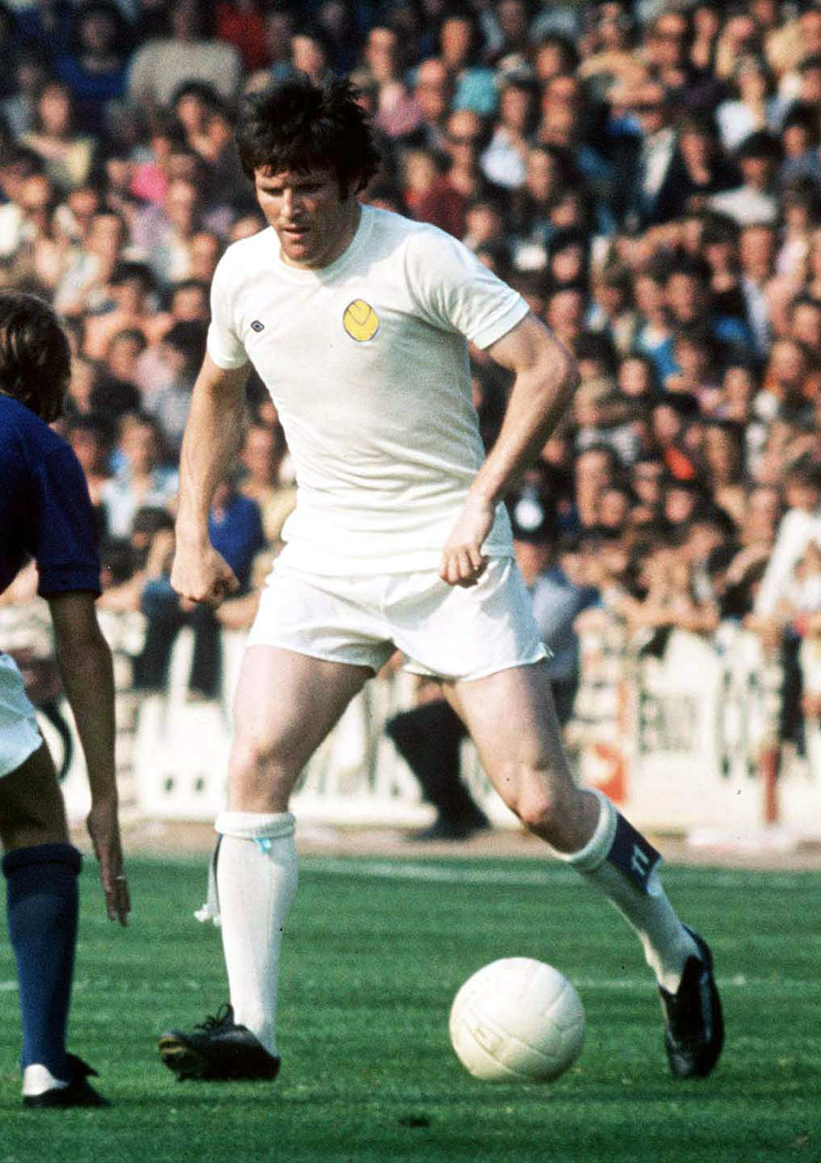
Eddie Gray signed for Leeds United aged 16, and scored a memorable goal on his debut on 1st of January 1966.
Image © Varley Picture Agency

Slide 7
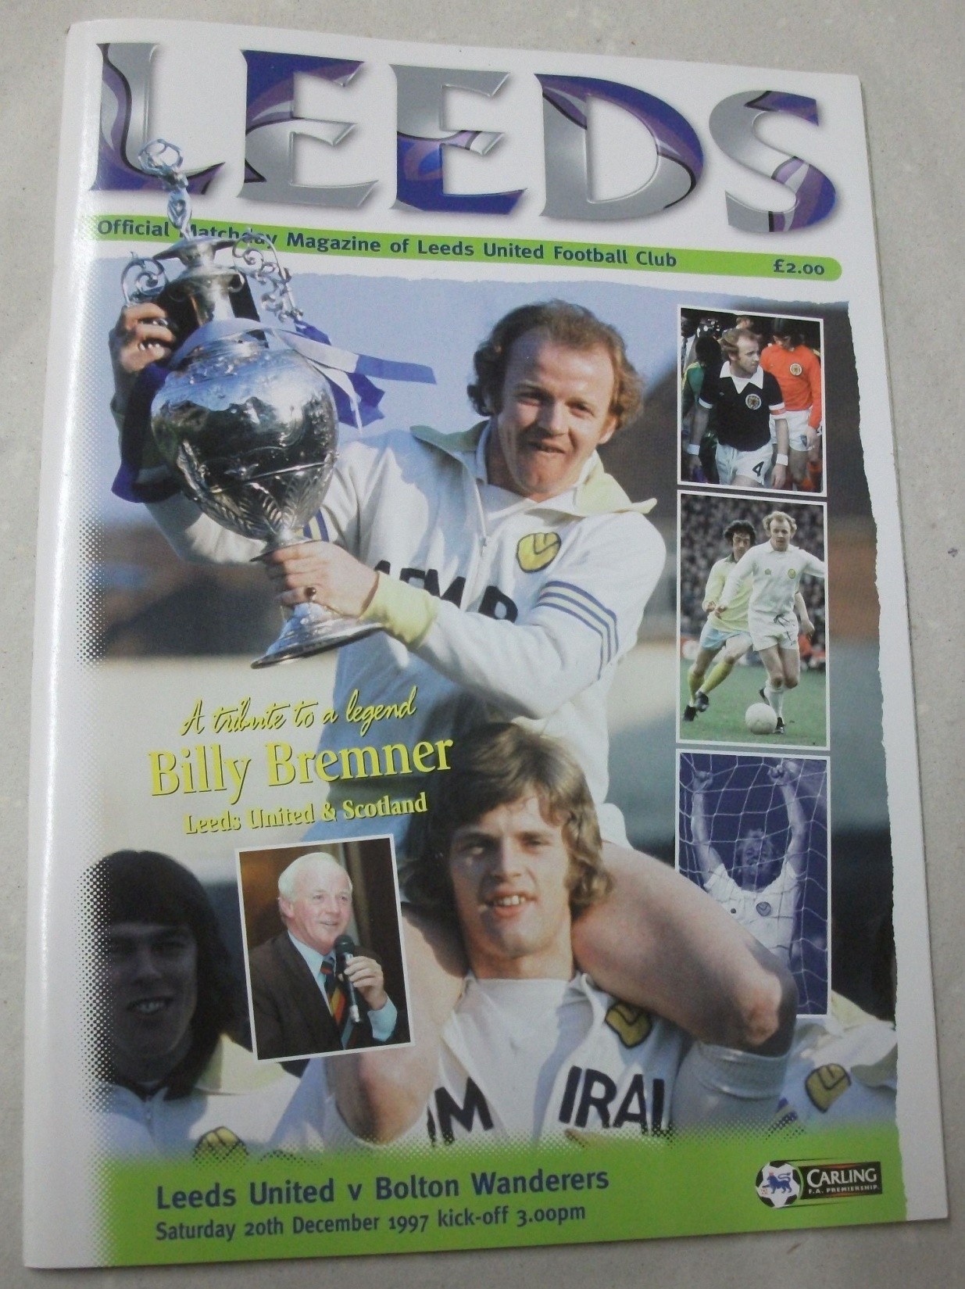
Billy Bremner was listed at number one in the ‘Leeds United 100 Greatest Leeds Players’.
Image © Leeds United Football Club

Slide 8
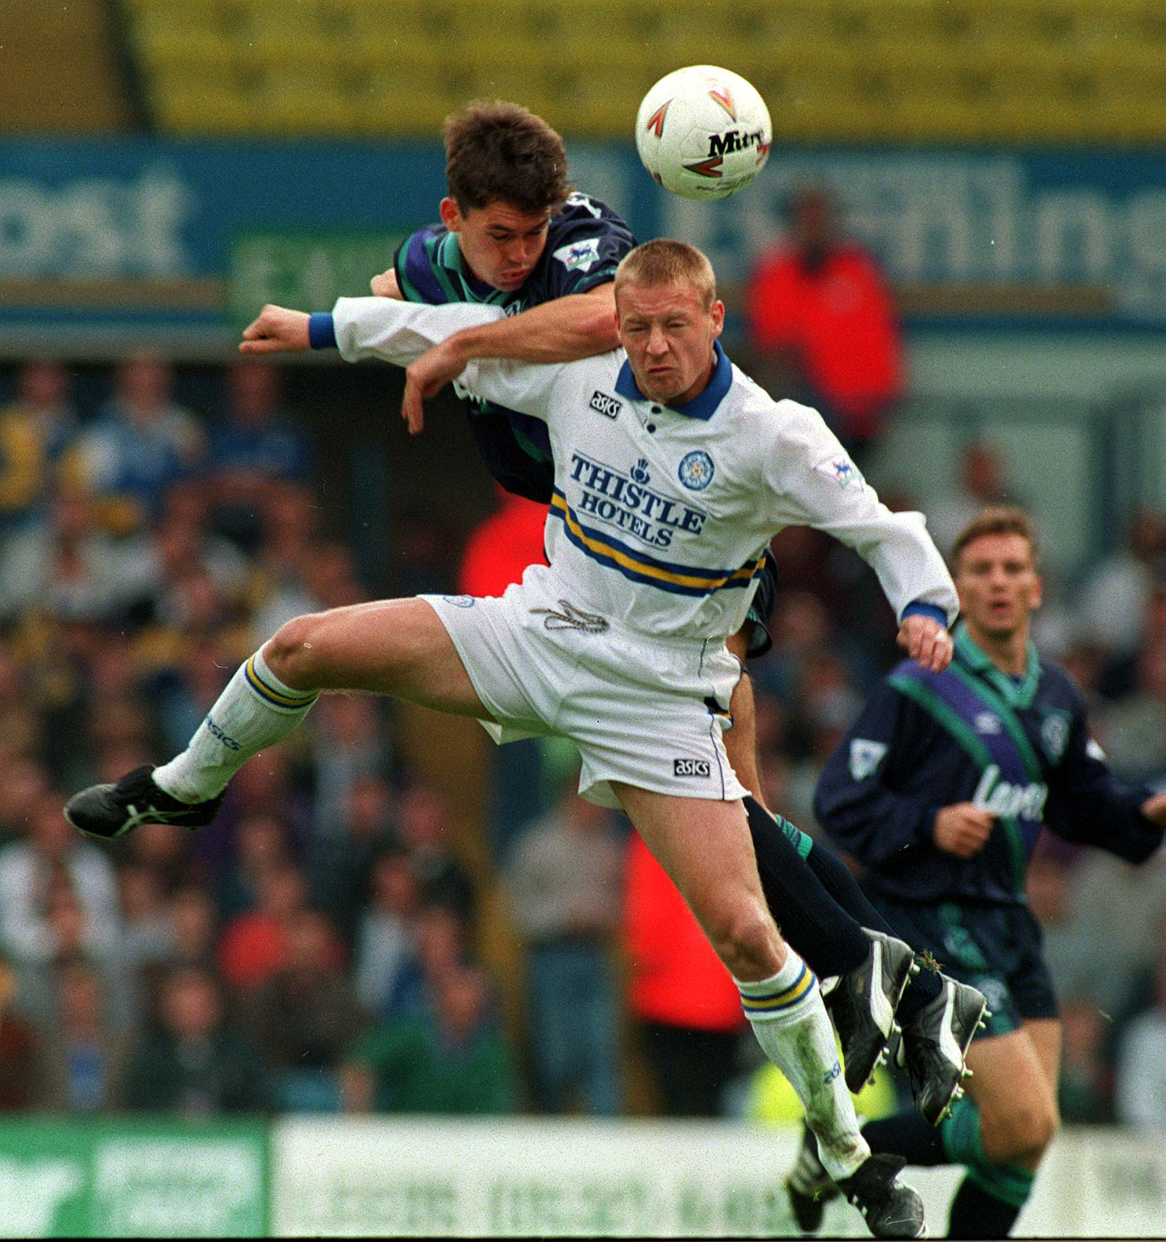
David Batty made his debut for Leeds aged 18 and was to make a significant impact on the team.
Image © Varley Picture Agency

Slide 9
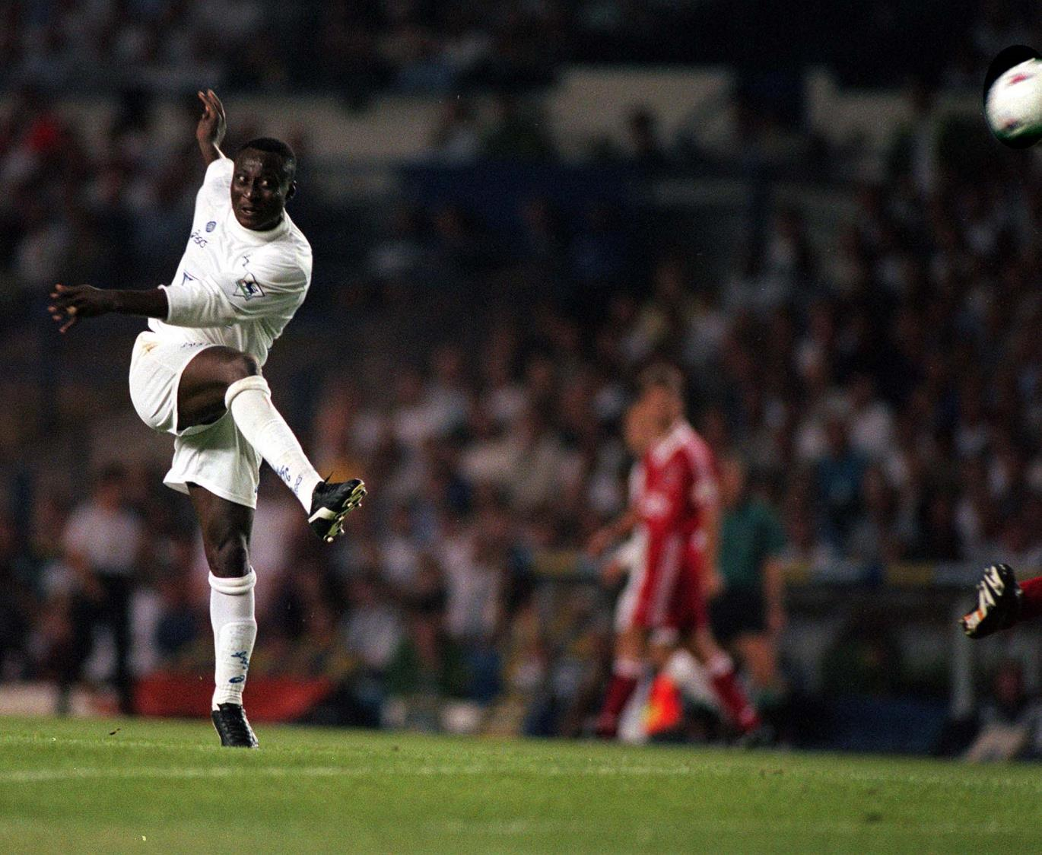
Tony Yeboah scores a goal in a game against Liverpool
Image © Varley Picture Agency

Slide 10
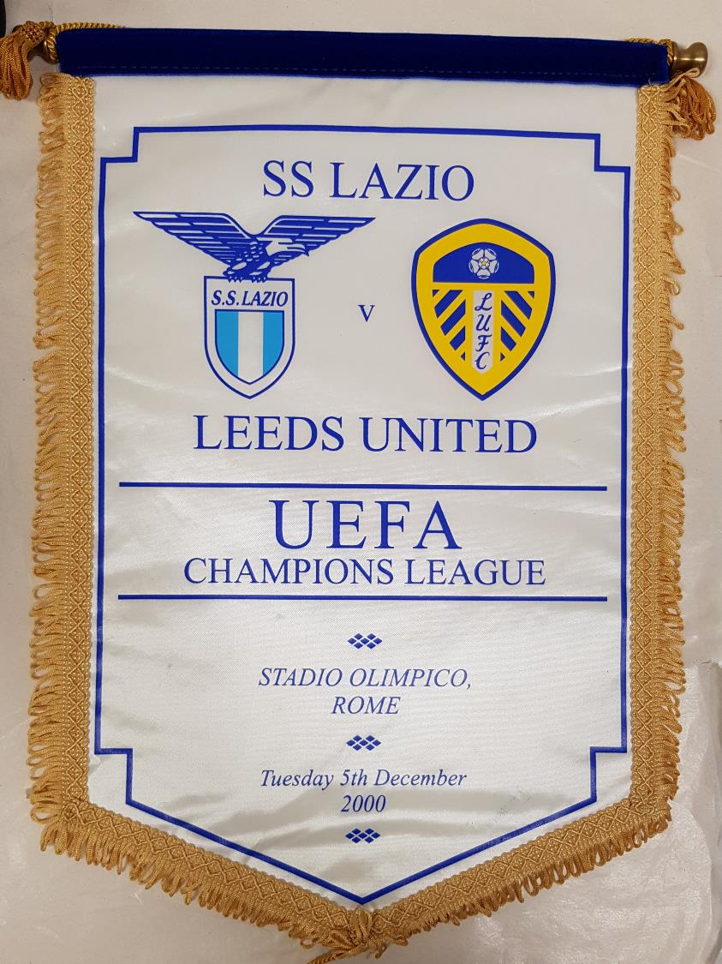
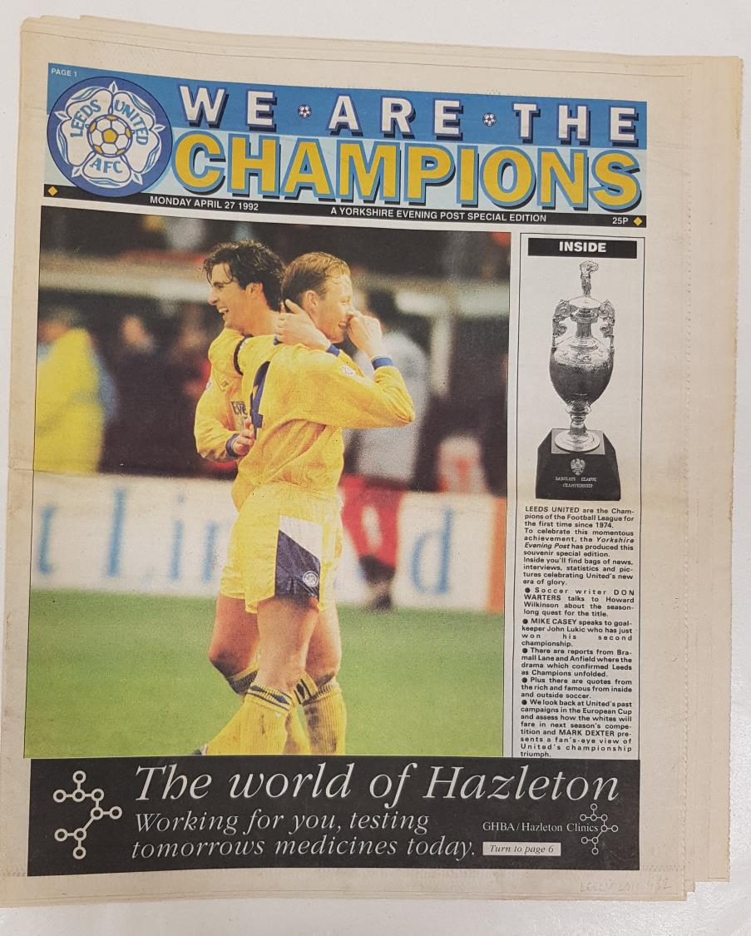
Images © Leeds United Football Club

Slide 11
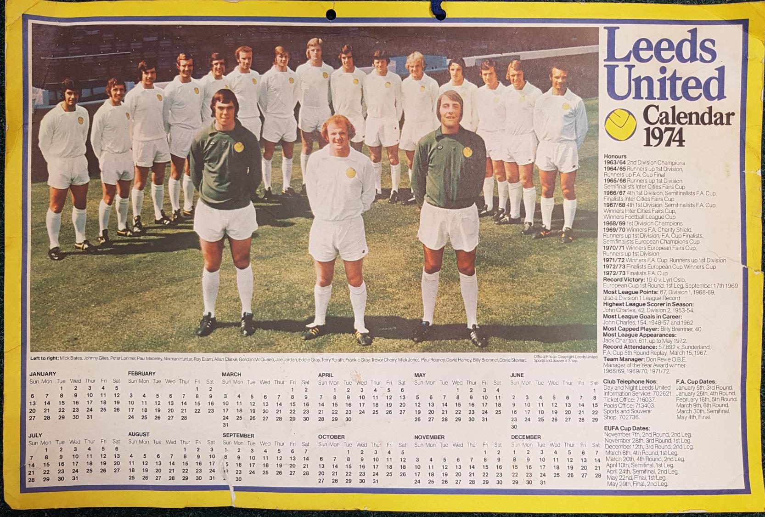
A souvenir calendar from 1974 with information about the team and the club on the right hand side.
Image © Leeds United Football Club

Slide 12
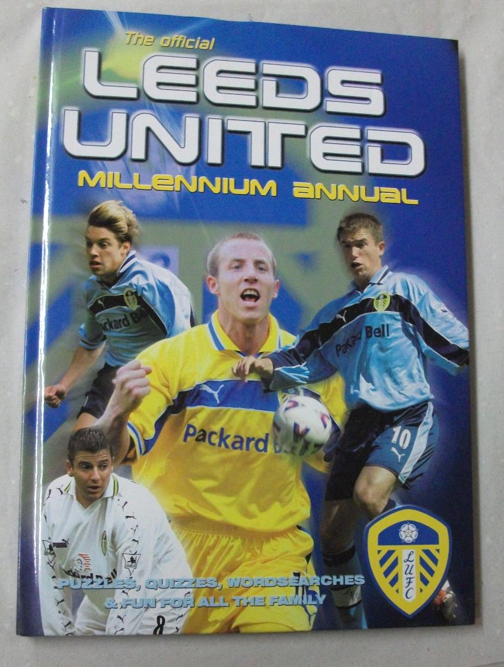
Leeds United Millennium Annual showing members of the team in various team kits.
The annual is sold as a souvenir for all the family, catering for the multi-generational fan base that the club enjoys.
Image © Leeds United Football Club

