Slide 1

Ancient Greece
Greek Gods Interactive
Hannah Lear, Megan Miller and MyLearning
Free learning resources from arts, cultural and heritage organisations
^{mylearning.org}

Slide 2
Greek Gods Interactive
To set up this PowerPoint as a touchscreen interactive on a smartboard:
  Go to ’Slide Show’ on the command ribbon
  Choose ‘Set Up Slide Show’
  Select ‘Browse at Kiosk (full screen)’
If you do not have a smartboard, this PowerPoint can be used with a mouse as usual.
Free learning resources from arts, cultural and heritage organisations
^{mylearning.org}

Slide 3
Greek Gods and Goddesses
Over 2000 years ago, the people of Ancient Greece believed in many gods and goddesses.
The gods had control over people’s lives. The Greeks prayed to the gods and goddesses when they needed help.
The Greeks created special places in their homes and dedicated temples to them. They were decorated in carvings and statues.
Statues were also placed around the city to remind people of the gods and goddesses throughout the day.
People believed that If the gods or goddesses were unhappy with them, then they would be punished.

Slide 4
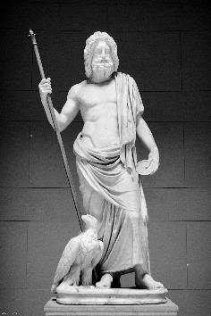
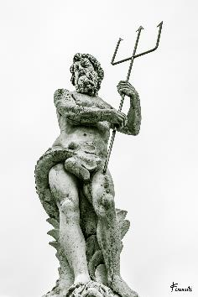
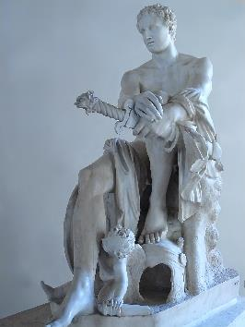
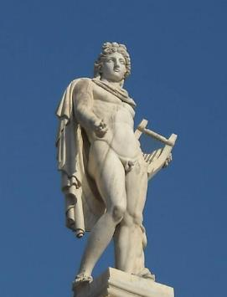
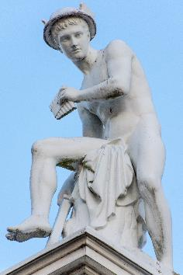
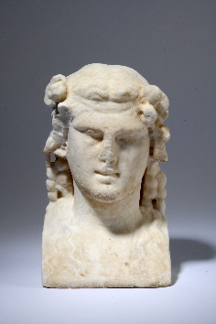
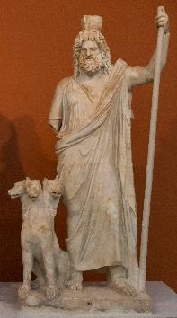
Discover a God
Click on a god to find out more information
Image: Marcus Crafter | Flickr |
CC BY-NC-SA 2.0
Image: Fernando Insausti| Flickr
| CC BY-SA 2.0
Image: Mary Harrsch| Flickr
| CC BY-NC-SA 2.0
Image: Jeffery Doonan| Flickr | CC BY-NC 2.0
Image: Don Sniegowski | Flickr
| CC BY-NC-SA 2.0
Image: Leeds City Museum
Image: Egisto Sani| Flickr
| CC BY-NC-SA 2.0
^{mylearning.org}

Slide 5
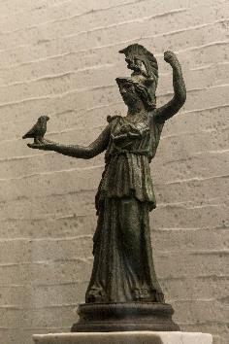
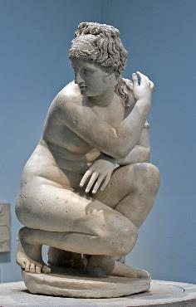
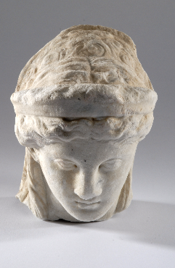
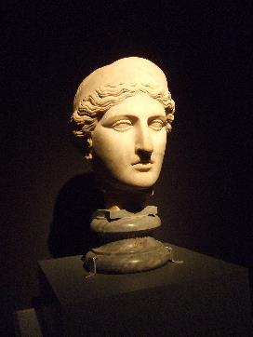
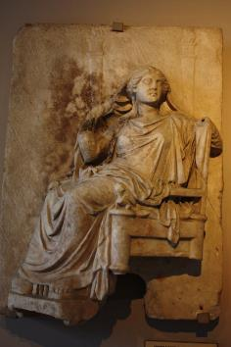
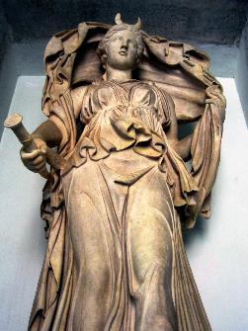
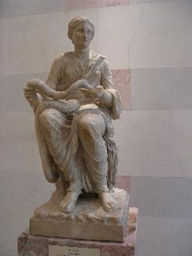
Discover a Goddess
Click on a goddess to find out more information
Image: Egisto Sani| Flickr
| CC BY-NC-SA 2.0
Image: Frans Vandewalle| Flickr
| CC BY-NC 2.0
Image: Leeds City Museum
Image: virgi.pla| Flickr | CC BY-NC-SA 2.0
End
Image: Gloria Rodríguez Leal| Flickr
| CC BY-NC-SA 2.0
Image: Anthony Majanlahti| Flickr
| CC BY 2.0
Image: thisisbossi| Flickr
| CC BY-NC-SA 2.0
^{mylearning.org}

Slide 6



Zeus
Click on me to find out what I mean.
Zeus was the leader of the gods. He was in charge of the rain and the sky. He was the most powerful of all gods.
He was the King of Mount Olympus.
He was married to Hera, who was the goddess of family and marriage.
When Zeus was angry he would affect the weather, and sometimes he threw thunderbolts!
Image: J_Alves| Clipart
^{mylearning.org}
Image: Marcus Crafter | Flickr | CC BY-NC-SA 2.0

Slide 7

Poseidon
Poseidon was one of the most powerful gods, but wasn’t as powerful as his brother, Zeus.
Poseidon was god of the sea, and he lived in a palace under the sea.
He had a temper like his brother and when he was angry, Poseidon liked to cause earthquakes.
^{mylearning.org}

Slide 8
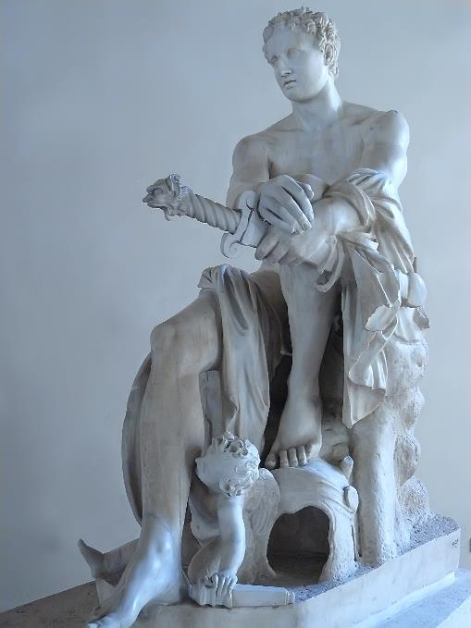

Ares
Ares was the god of war.
Many people thought he was a coward and was cruel.
This included his own mother and father, Zeus and Hera, who did not like him.
Ares and Aphrodite (who was the goddess of love and beauty) had a child together who was called Eros, but most people know him as Cupid.
Image: Mary Harrsch| Flickr | CC BY-NC-SA 2.0
^{mylearning.org}

Slide 9

Apollo
Apollo was the god of the Sun.
It was believed that he moved the sun using his chariot pulled by golden horses.
As well as being the god of the sun he was also the god of healing, truth and archery.
He had a twin sister, Artemis, and was the child of Zeus and Leto.
Image: Jeffery Doonan| Flickr | CC BY-NC 2.0
^{mylearning.org}

Slide 10

Hermes
Hermes was the youngest son of Zeus.
He was the messenger and knew of everything going on in the mythical world.
He was well trusted because he was clever and loyal. On the other hand, he could be seen as a trickster, because he was cunning.
He was born in a cave on a mountain.
Can you spot his wings on the
statue pictured?
Image: Don Sniegowski | Flickr | CC BY-NC-SA 2.0
^{mylearning.org}

Slide 11


Mount Olympus
Mount Olympus is the largest mountain in Greece. It was believed that the 12 Olympian gods and goddesses would meet there as a council to make all important decisions.
Hades and Poseidon were also members, but they preferred to stay at home.
These 12 Olympians are believed to be:
(Look of for the laurel wreath throughout the slides)
Aphrodite – goddess of love and fertility
Dionysus – god of Wine
Apollo – sun god, but also god of archery
Hephaestus – god of fire
Ares – god of war
Hera – Queen of gods, goddess of marriage
Artemis – goddess of wildlife
Hermes – messenger of the gods
Athena – goddess of war
Hestia – goddess of house and hearth
Demeter – goddess of harvest
Zeus – leader of gods
Image: J_Alves| Clipart

Slide 12
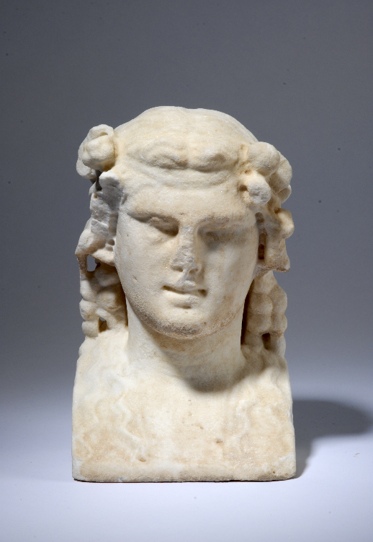

Dionysus
Dionysus was known as ‘The god of the vine’.
He was the god of fertility and wine.
He was known for encouraging people to be drunk.
He was also the god of theatre.
The original Greek plays were performed to honour him.
Did you know…
^{mylearning.org}

Slide 13

Hades
Hades was the god of the underworld, and ruled people after they had died.
The Greeks were very afraid of him.
If they wanted something bad to happen, they would make sacrifices to him.
He had a 3-headed dog called Cerberus who guarded the gates to the underworld.
Hades was also the god of wealth, this was because he possessed all of the
precious metals of the earth.
Image: Egisto Sani| Flickr | CC BY-NC-SA 2.0
^{mylearning.org}

Slide 14
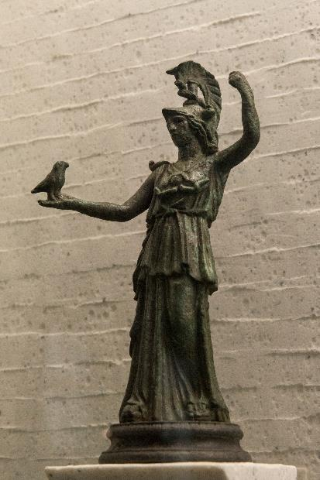
Athena
Athena was goddess of war.
She was the daughter of the leader of the gods, Zeus, and was his favourite child.
The present day city of Athens in Greece, is named after Athena.
She is known for turning Medusa into the snake-haired monster she is known as today.
Her biggest and most well known temple is the Parthenon. You can still see this temple today.
Image: Egisto Sani| Flickr | CC BY-NC-SA 2.0
^{mylearning.org}

Slide 15
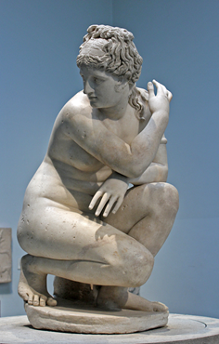
Aphrodite
Aphrodite was the goddess of love and beauty.
She was born from the foam in the waters of Paphos, which is in Cyprus.
She drove through the air using a swan drawn cart.
She is the mother of Harmonia, who is the goddess of harmony and concord.
She was married to Hephaestus, who was the god of fire.
Image: Frans Vandewalle| Flickr | CC BY-NC 2.0
^{mylearning.org}

Slide 16
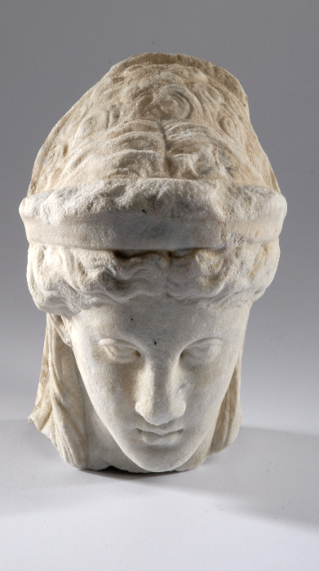
Artemis
Artemis was the goddess of hunting and wildlife.
She was the twin brother to Apollo, and a daughter of Zeus.
She was the protector of children, but was also known for bringing and relieving disease in women.
On statues, she is often carrying a Bow and arrow.
One of the seven wonders of the ancient world, the Temple of Artemis, which is situated at Ephesus, is dedicated to her.
Image: Leeds City Museum
^{mylearning.org}

Slide 17

Hera
Hera was the Queen of the gods, and goddess of marriage and family.
She was married to Zeus, who was the leader of the gods.
Hera was a jealous wife and was always arguing with Zeus about his children that he had with other women.
Hera was not well liked among people.
^{mylearning.org}
Image: virgi.pla| Flickr | CC BY-NC-SA 2.0

Slide 18

Demeter
Demeter was best know for being the goddess of agriculture and harvest. She was also known for being the goddess of life and death.
Her daughter, Persephone, was taken from her by Hades, god of the underworld and he only allowed Demeter to spend four months of the year with her daughter.
Demeter is often pictured with a wreath of corn, to show the harvest. But she was also often pictured with a torch, to show her search for her daughter.
^{mylearning.org}
Image: Gloria Rodríguez Leal| Flickr | CC BY-NC-SA 2.0

Slide 19

Selene
Selene was the goddess of the moon.
She is often associated with Artemis, who is also often called the goddess of the moon.
Selene is often pictured riding a horse, but when she isn’t, bull horns on her head are used to symbolise the crescent moon.
Image: Anthony Majanlahti| Flickr | CC BY 2.0
^{mylearning.org}

Slide 20

Hygiea
Hygiea was the goddess of health and medicine.
Her name inspired the word ‘hygiene’ , meaning cleanliness and preventing disease.
Hygiea is often pictured holding or feeding a snake. A lot of people believe that this is because she feeds the snake all bad illnesses and diseases.
^{mylearning.org}

Slide 21
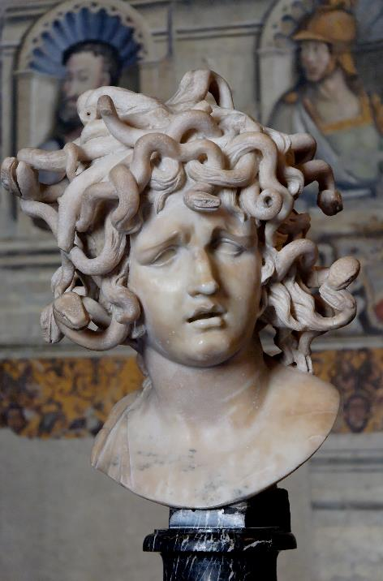

Medusa
Medusa was a priestess of Athena and promised to never ever marry a man or have children.
Medusa then went against her word and married Poseidon.
For this, she was punished by Athena. Her beautiful long blonde hair was turned into snakes or serpents, and her eyes which had often attracted men, now turned people in to stone.
Image: Gian Lorenzo Bernini | Wikimedia | CC BY-NC-SA 2.0
^{mylearning.org}

Slide 22
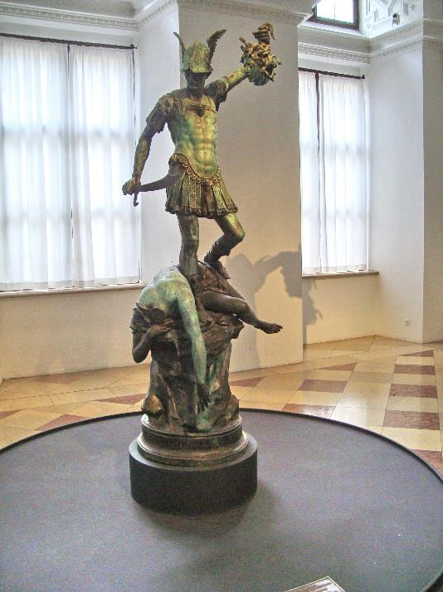

Perseus, son of Zeus, shone his polished shield at Medusa. The shield acted like a mirror, turning Medusa to stone and Perseus then chopped her head off!
Image: I, Sailko | Wikimedia |CC BY-SA 3.0
^{mylearning.org}

Slide 23
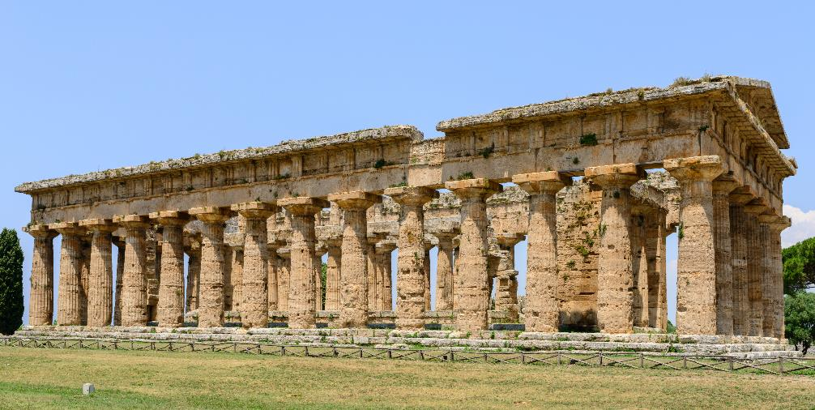
Hera was so important that temples were built in her honour at Argos and Samos, in Greece.
Image: Norbert Nagel |Wikimedia |CC BY-SA 3.0
^{mylearning.org}

Slide 24
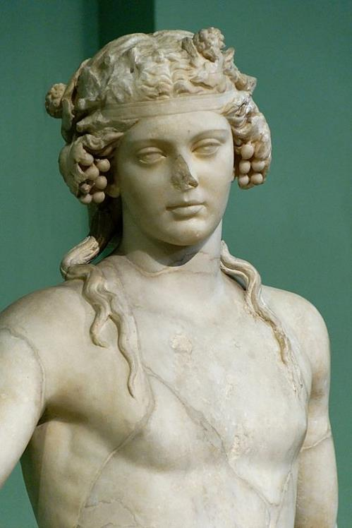
Dionysus was one of the few gods who could bring someone back from the underworld!
Image: Marie-Lan Nguyen| Wikimedia | CC BY 2.5
^{mylearning.org}

Slide 25
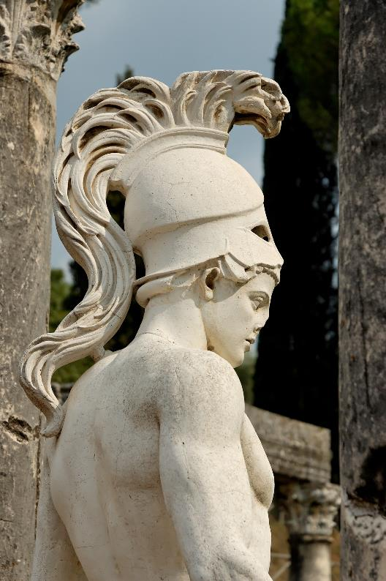
Ares sat upon a throne which was made from human skin!
How gross is that?
Image: Jastrow | Wikimedia |Public Domain
^{mylearning.org}

Slide 26
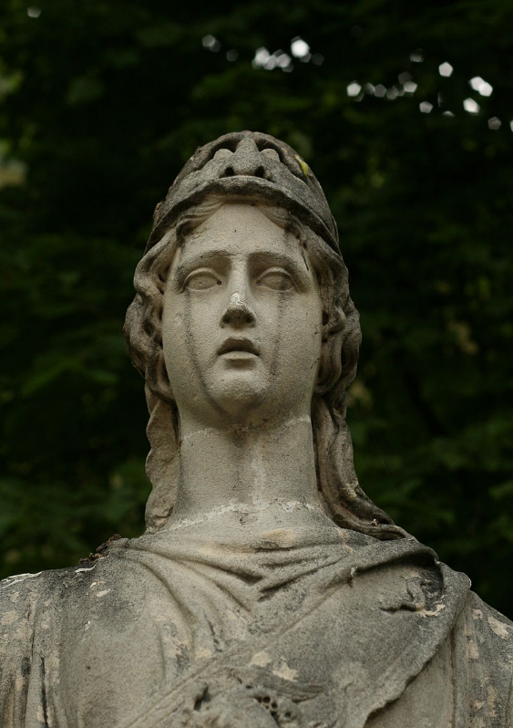
Athena was also the goddess of art, literature and intelligence.
^{mylearning.org}
Image: Max A. Khlopov | Wikimedia | CC BY-SA 3.0

Slide 27
Ancient Greece
Why not explore a nearby museum’s
Ancient Greek collection?
You’re bound to discover something amazing!
^{mylearning.org}

