Slide 1

Photo Album
Covid 19 Pandemic Infographics
These infographics were designed by artist Becci Kenning (Art in Transit) based on a survey of Year 5 and 6 students at Frith Manor Primary School.
Activity suggestions using the infographics
Pupils can work in small groups to add post-it notes to infographics identifying parts of the design they like / don’t like and why, plus anything they find interesting or surprising in the design.
Carry out a class survey based on the same questions, or different ones.
Develop infographics based on the class data, using the information collected on the post-it notes to help with effective design.
If the same questions were used, the results can be compared for similarities and differences, and the potential causes of these can be discussed.
by Bartley, Izzy
Images © Becci Kenning

Slide 2
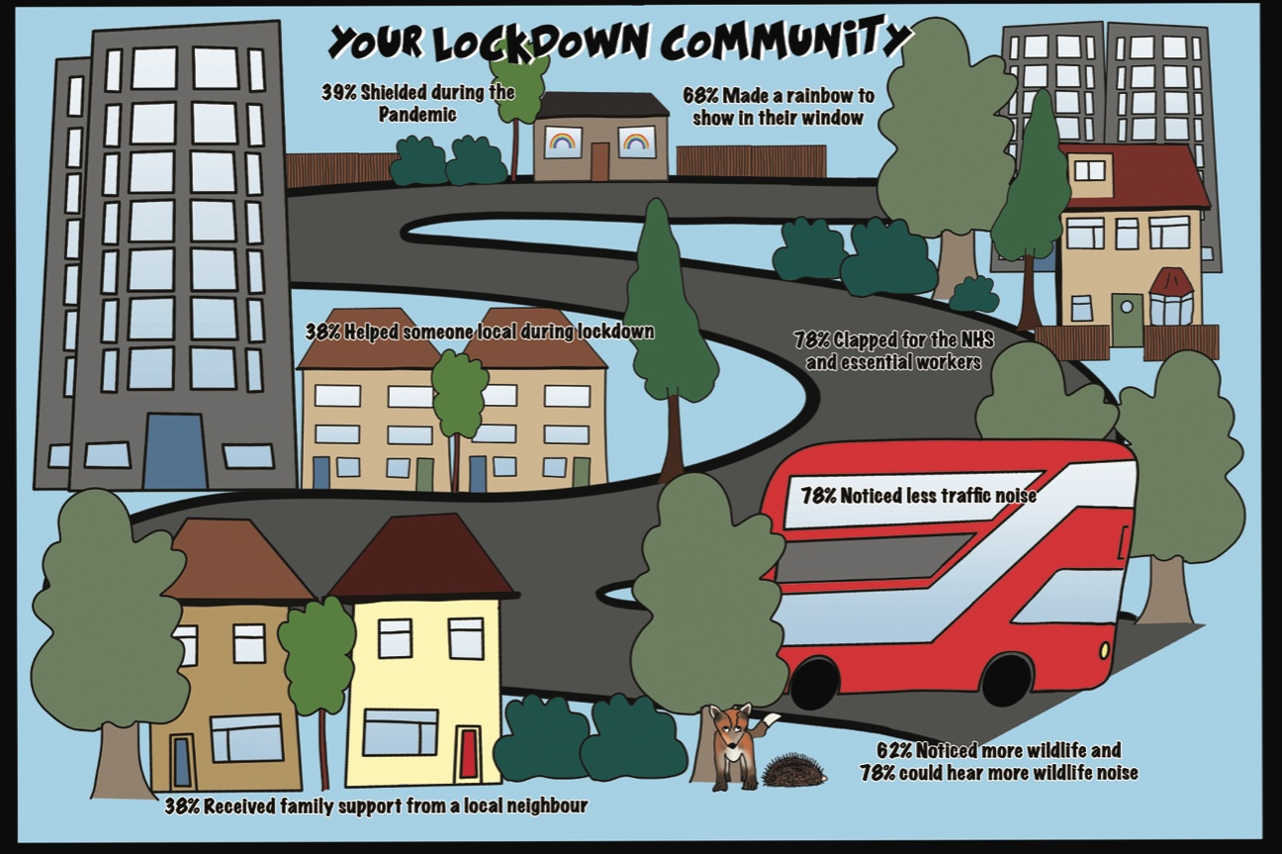

Slide 3
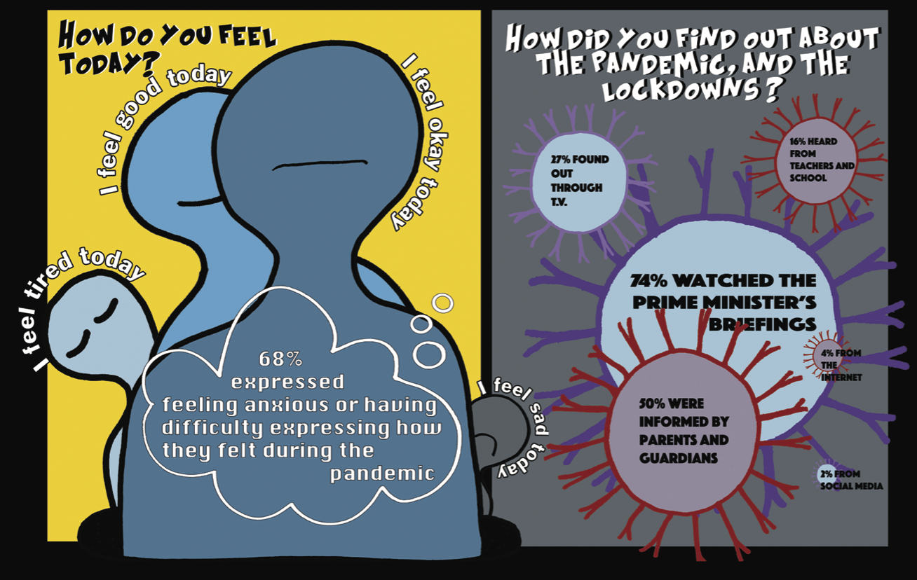

Slide 4
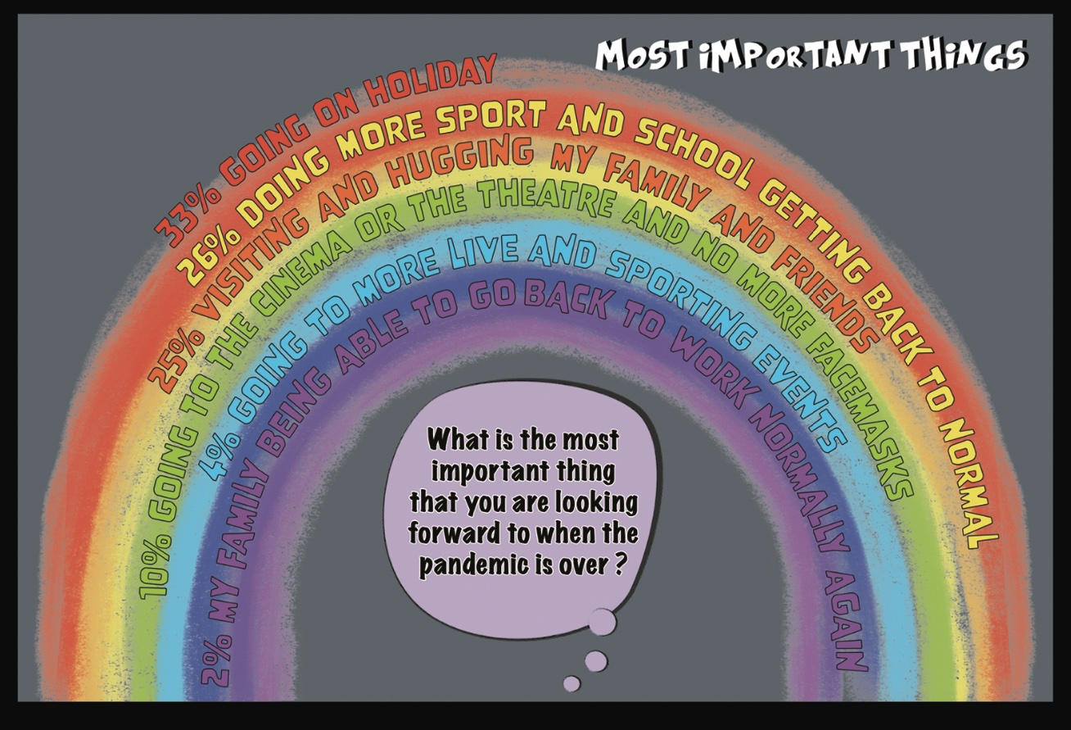

Slide 5
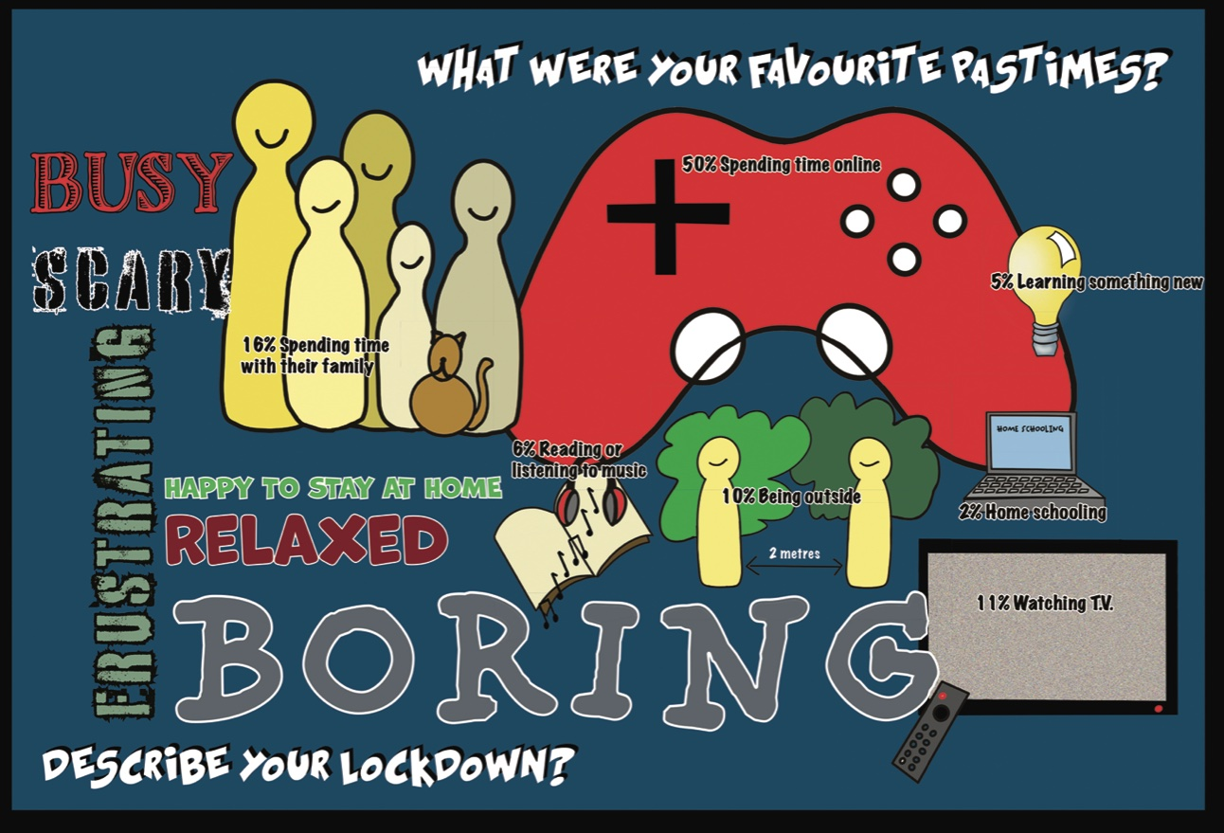

Slide 6
