Slide 1
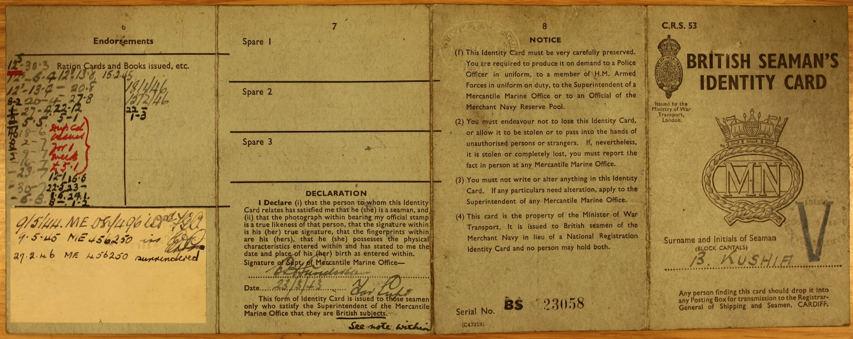
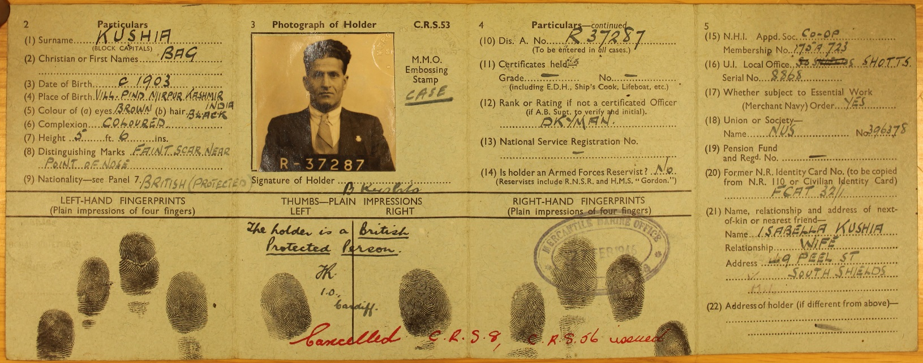

Using Archive Documents as Primary Sources
What can you find out about Bag Kushia from his British Seaman’s identity card?
Where was he born and when?
What is his nationality?
Who is he married to?
What nationality do you think she is, why?
What type of work does he do as a seaman? )Look at his ‘Rank or Rating’ You can find out what this meaning by looking at another of the documents).
Where does he live?
Is this identity card still valid? How do you know?
This ID card contains Bag’s photograph, signature and fingerprints. What can you infer or suggest about him from this information?
Source 1
Outside
Inside
Logo to be replaced (currently a screenshot)

Slide 2
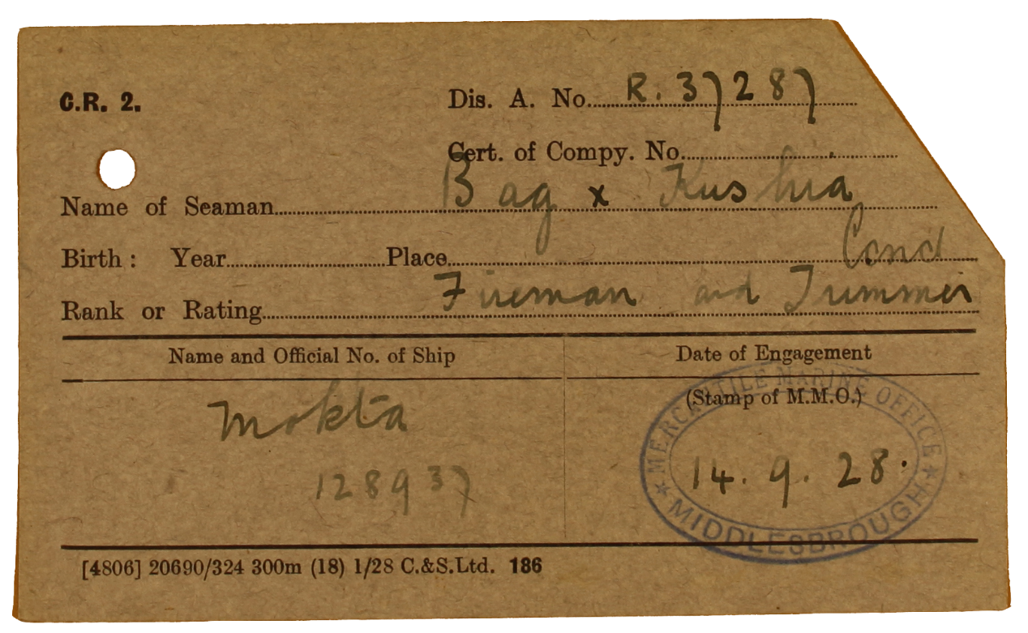
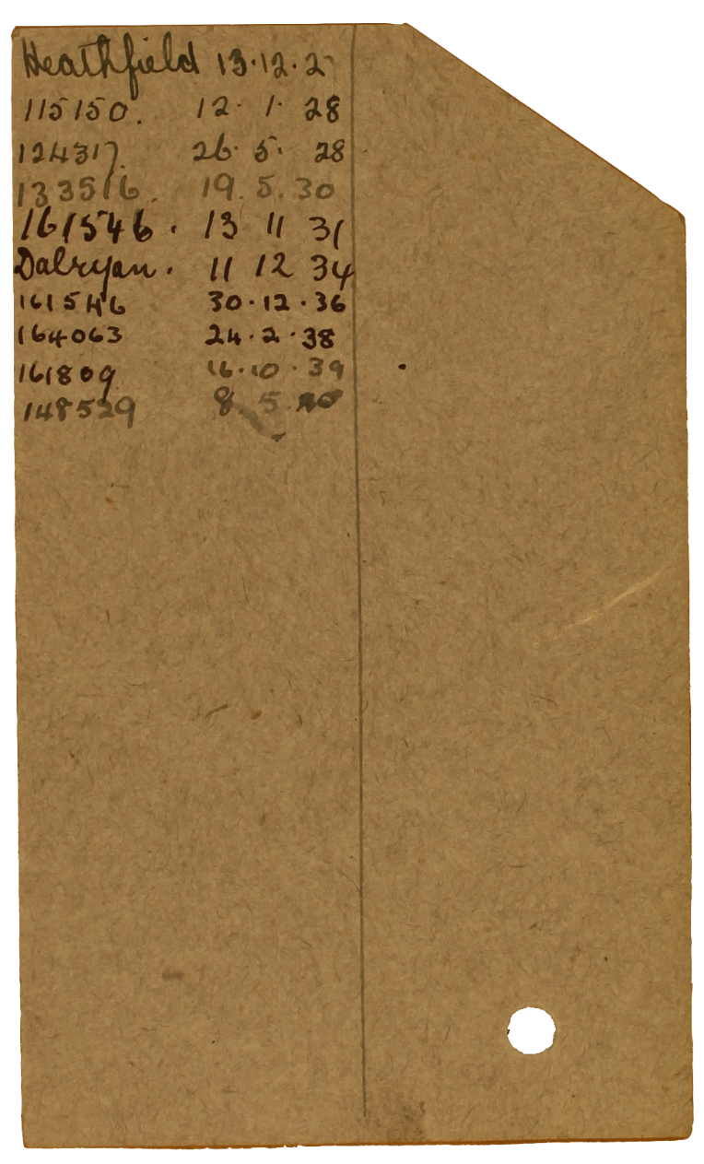
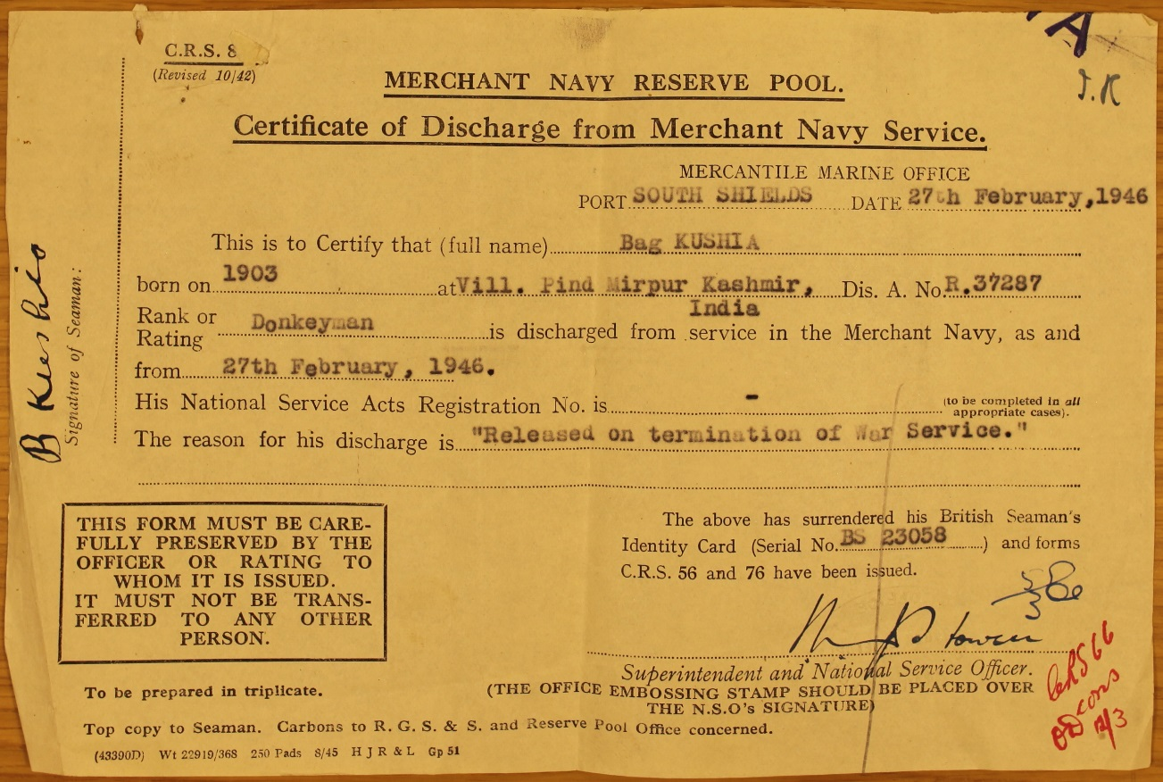
Source 2
Back
What more can you find out about the work that Bag Kushia did as a Seaman?
Look at the back of this card. How many ships has he worked on?
Can you give the names or numbers of two?
How many years has he been working as a Seaman?
What more can you discover about the type of work he does? Look at his ‘Rank and Rating’
Have you seen the number R.37287 on the previous document? What do you think it means?
Front
Source 3
What more can you find out about Bag Kushia from this final document?
What is the purpose of this document?
How does the information about him and his work compare to the other documents?
Think about where he lives, where and when he was born.
Logo to be replaced (currently a screenshot)

