Slide 1


Slide 2
Design a Stadium Challenge
This cross-curricular project can be adapted to suit different lengths of time and levels of difficulty.
Design a stadium for a sport of your choice.
Curriculum Links:
  KS2 History: Leisure and Entertainment in the 21st Century
  KS2 Maths: Measurement Geometry
  KS3 Maths: Ration and proportion | Geometry and measures
  KS2: Design and Technology: Design | Make | Evaluate
  KS2 Computing: Design, write and debug programs
    (for example using microbits to program LEDs for floodlights,
    or servo motors for gates etc.)
Materials Needed:
  Squared paper
  Rulers
  Calculators
  Recycled materials such as cardboard, cardboard rolls, packaging etc
  Glue and sellotape
  Scissors
  Paint and other decorating materials
W

Slide 3
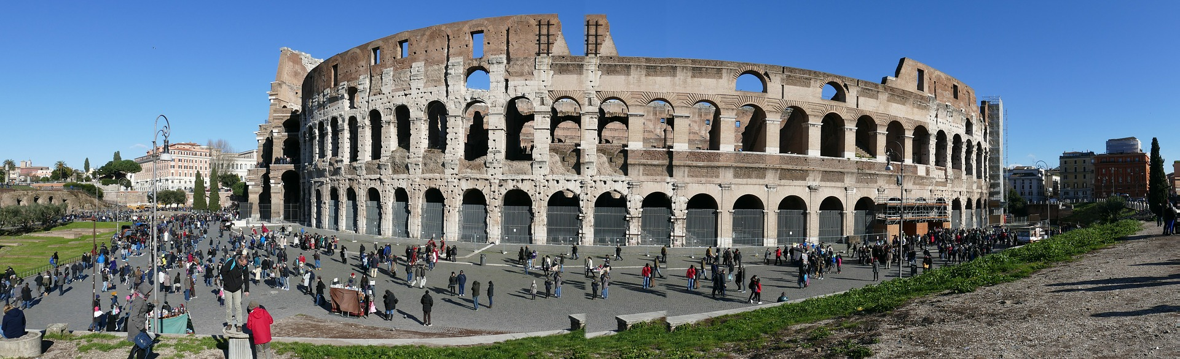
The Colesseum, Rome, Italy
Humans have been building structures for sport and games for thousands of years! The Colesseum was finished in AD 80, and took just eight years to build. It was the largest amphitheatre ever built at the time, and held around 50,000 spectators. It was used for lots of different forms of entertainment, including gladiator battles and re-enactments.

Slide 4
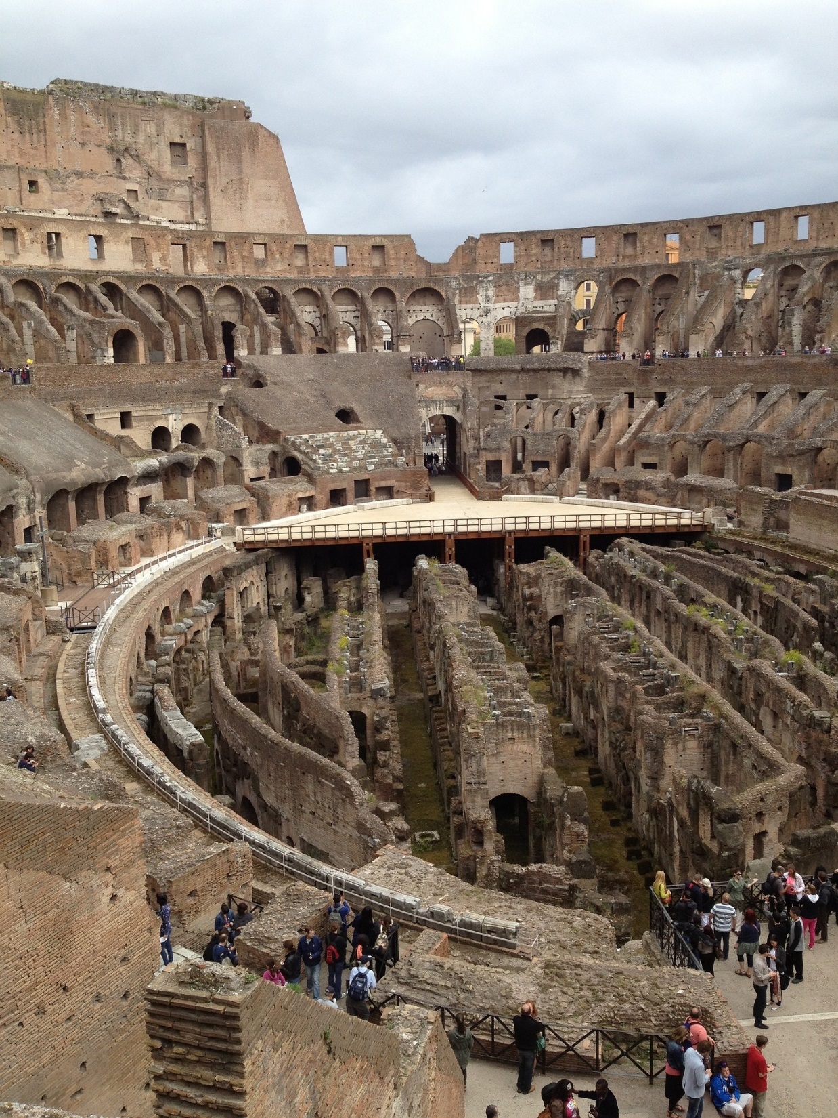
This image shows the structure under the floor of the Colesseum. It housed the slaves and the wild animals that were used in gladiator battles and other forms of entertainment that were popular with the Romans.

Slide 5
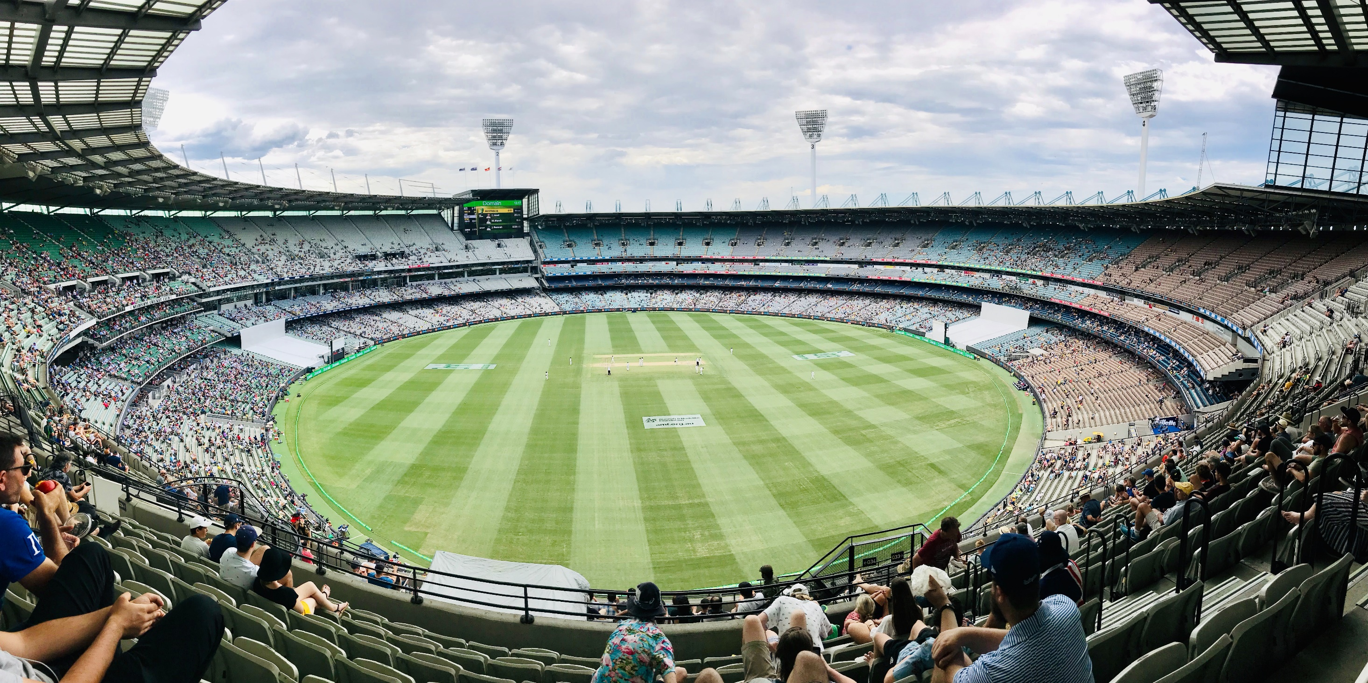
Cricket Ground, Melbourne, Australia

Slide 6
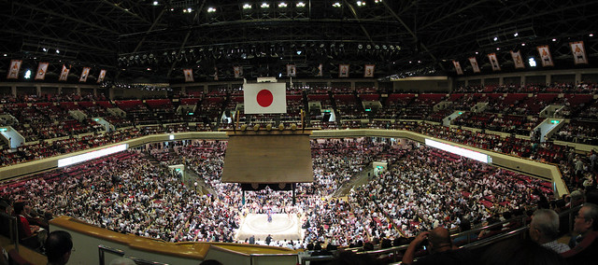
Sumo Wrestling Stadium, Tokyo, Japan

Slide 7
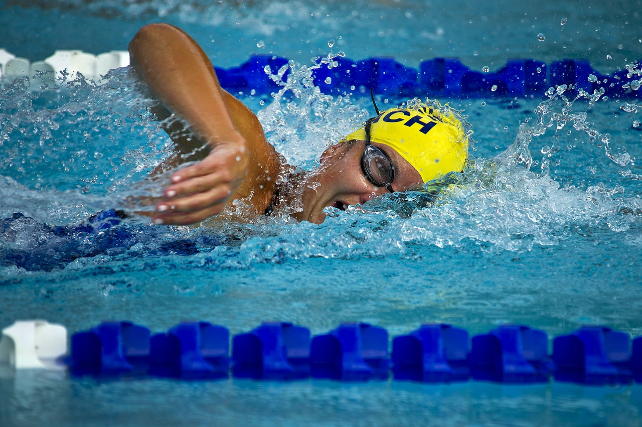
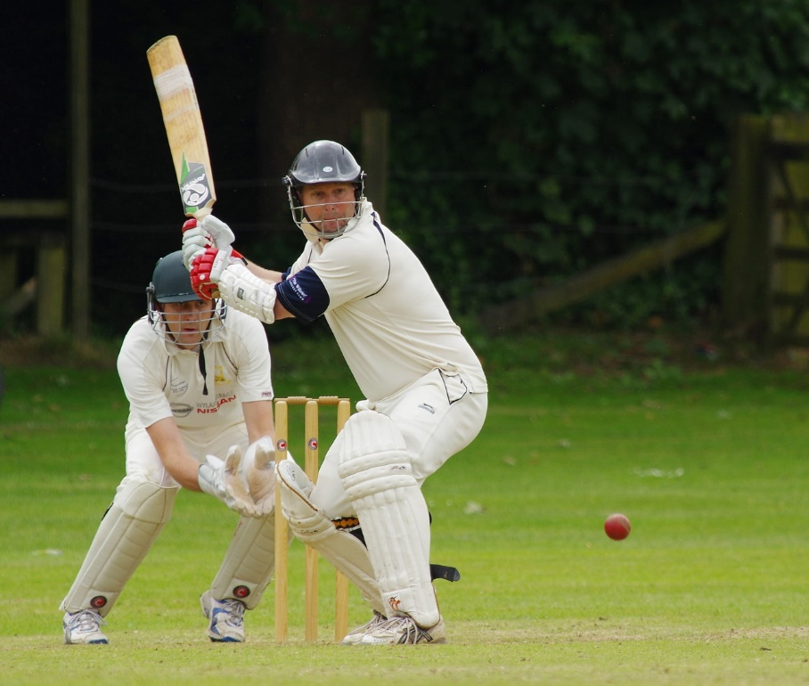

Today there are so many different kinds of sport that everyone can probably find one that they enjoy!
Some of these need specialist place to play them in, sometimes one venue can be home to several different sports.
Think about the different places and stadiums needed for the sports pictured on this slide and the next.

Slide 8

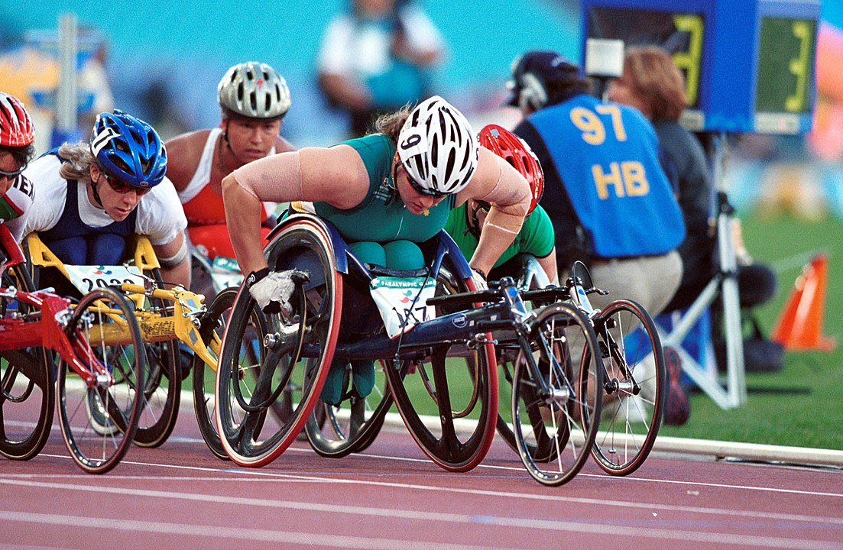
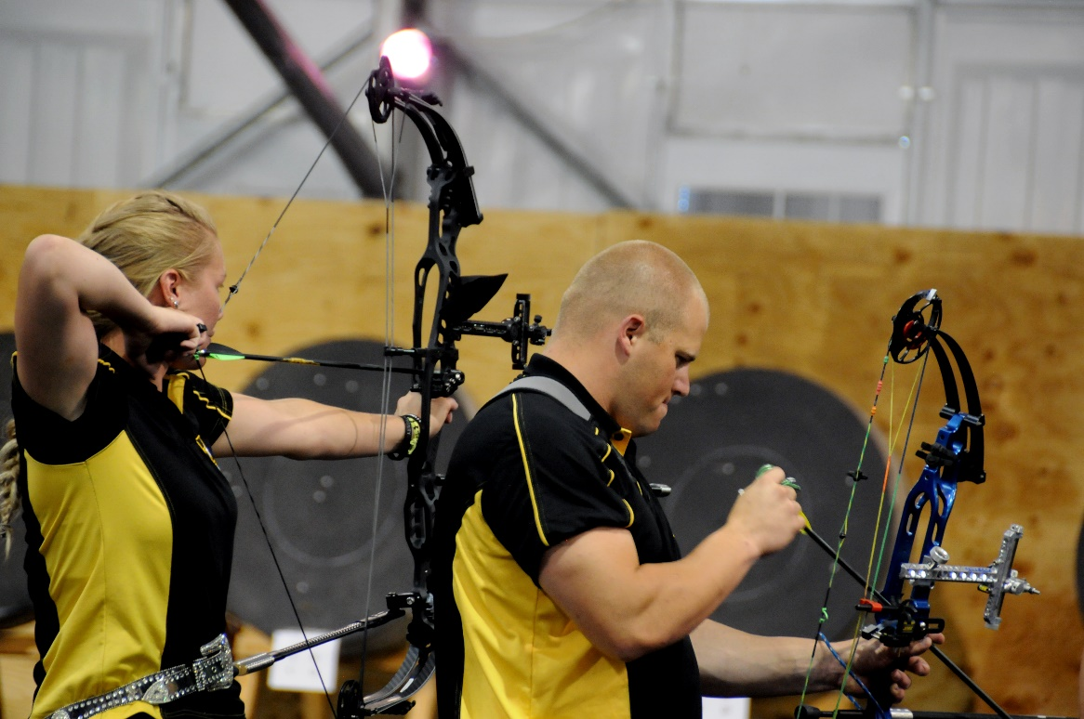
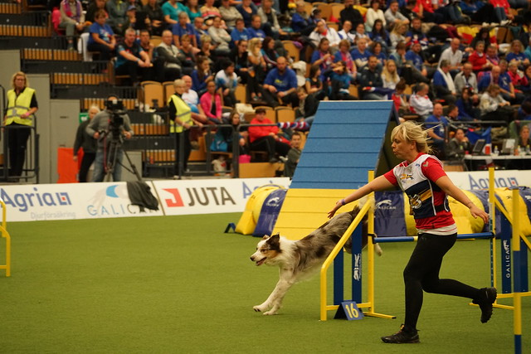

Slide 9
Design a Stadium Challenge
Design a stadium for a sport of your choice.
Be creative with your design, how will it be different from existing stadiums?
What will make yours special?
Your stadium will need to include:
  Playing area
  Space for fans to sit or stand, including disabled fans
  Toilets (including accessible ones)
  Refreshment stalls
  Souvenir shops
You will need to think about:
  How people can move around your stadium (including people who can’t walk)
  How you want people in your stadium to feel
  How you make your design environmentally friendly. (e.g. living (green) roof, solar panels, water recycling, car park underground?)
W

Slide 10
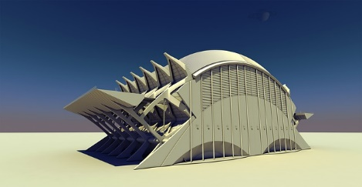
Design a Stadium Challenge
Draw your design out carefully on squared paper
What scale will you use?
  For example 1 cm squared = 1 metre.
Calculate the area of:
  Your play area
  The fans area
  Souvenir shops
  Refreshment stalls
  Toilets
Create a scaled 3D model of your stadium using recycled materials.
Decorate the outside of it to help create the kind of atmosphere you would like people to feel when they visit your stadium.
W

