Slide 1

Birds in Art and Nature
Leeds Recovery Curriculum PACE Resource

Slide 2
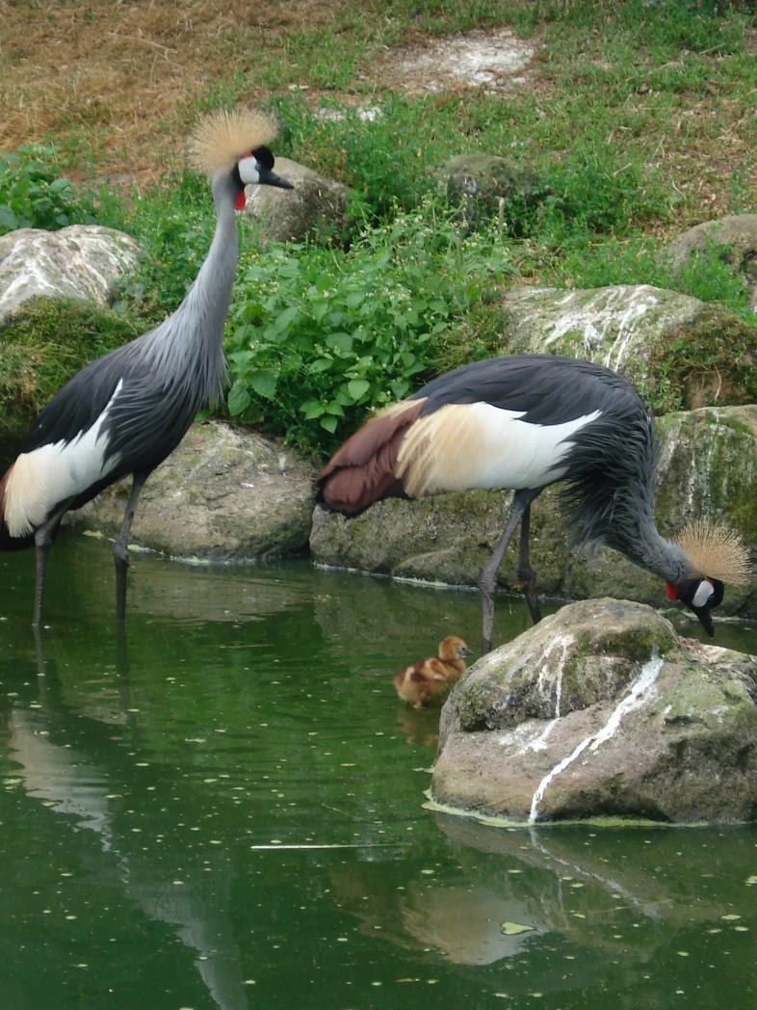
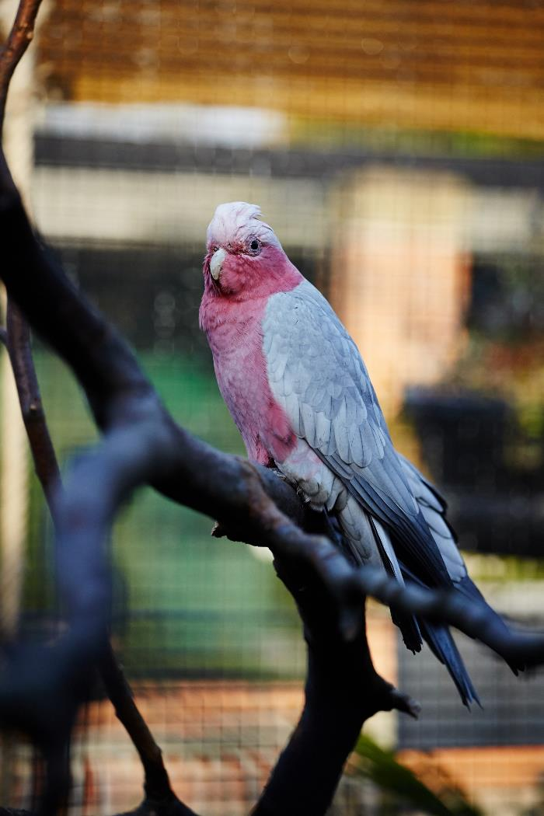
© Leeds Museums and Galleries

Slide 3
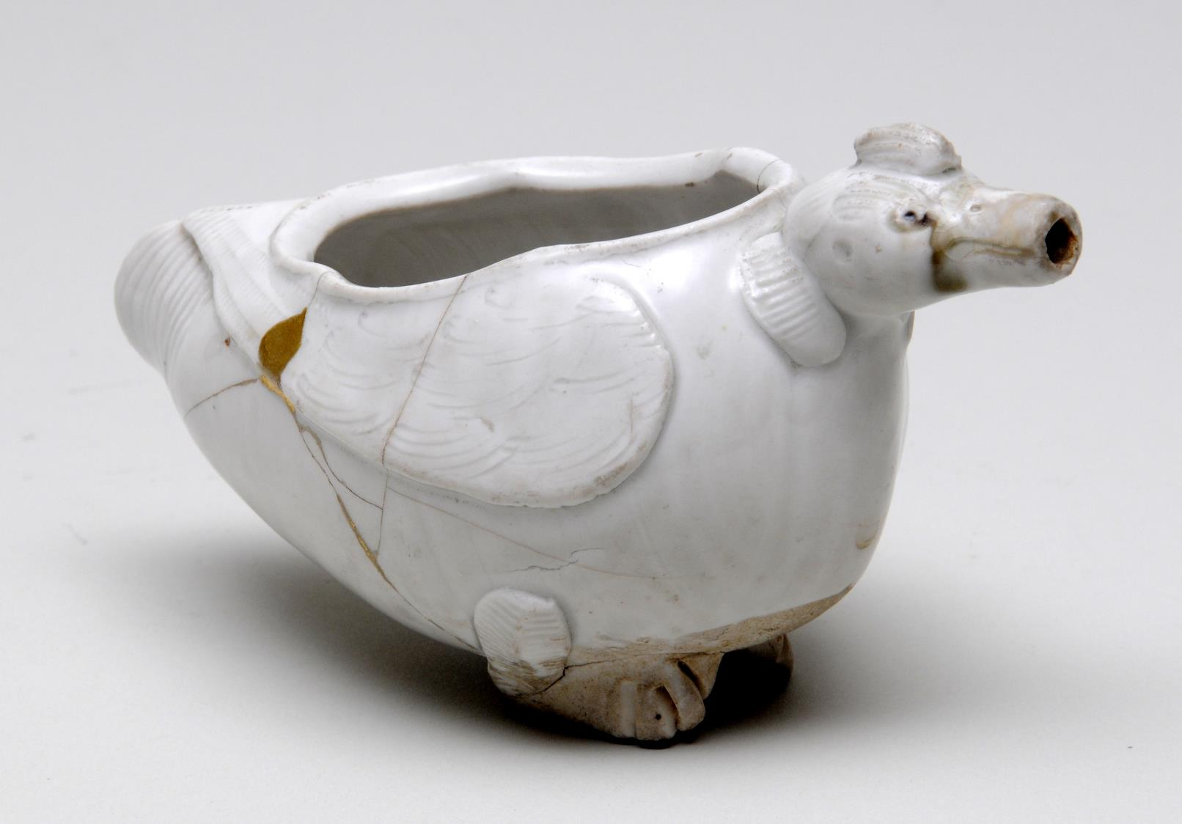
© Leeds Museums and Galleries

Slide 4
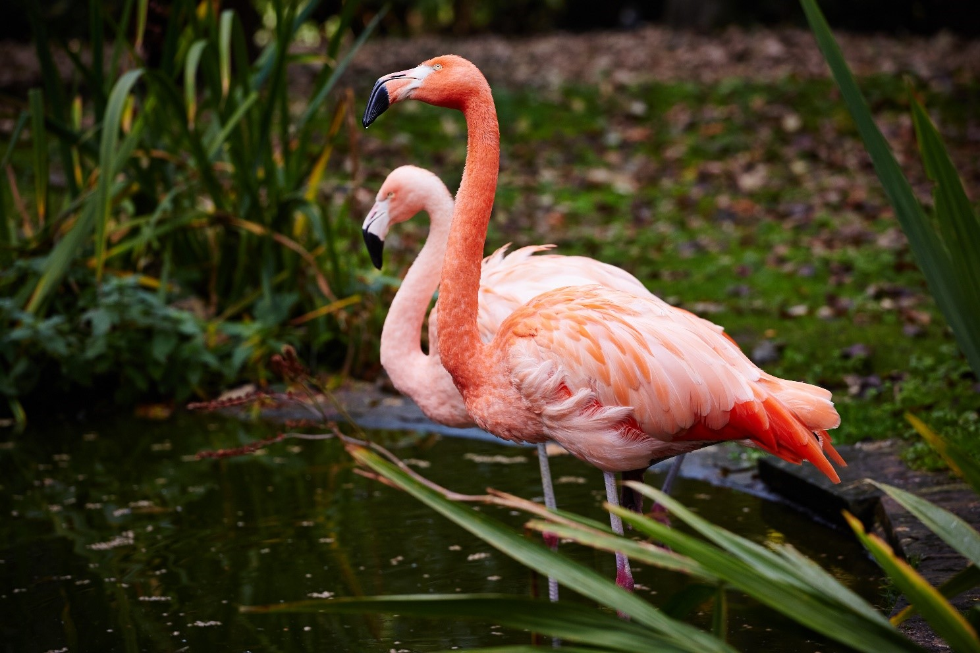
© Leeds Museums and Galleries

Slide 5
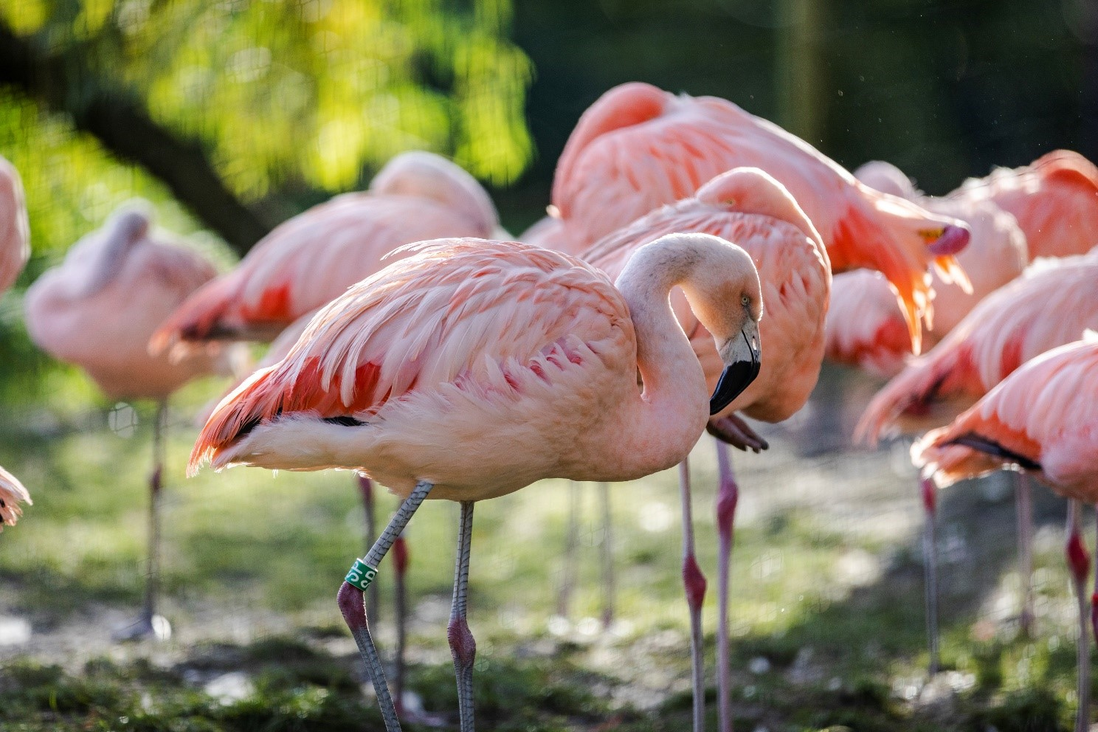
© Leeds Museums and Galleries

Slide 6
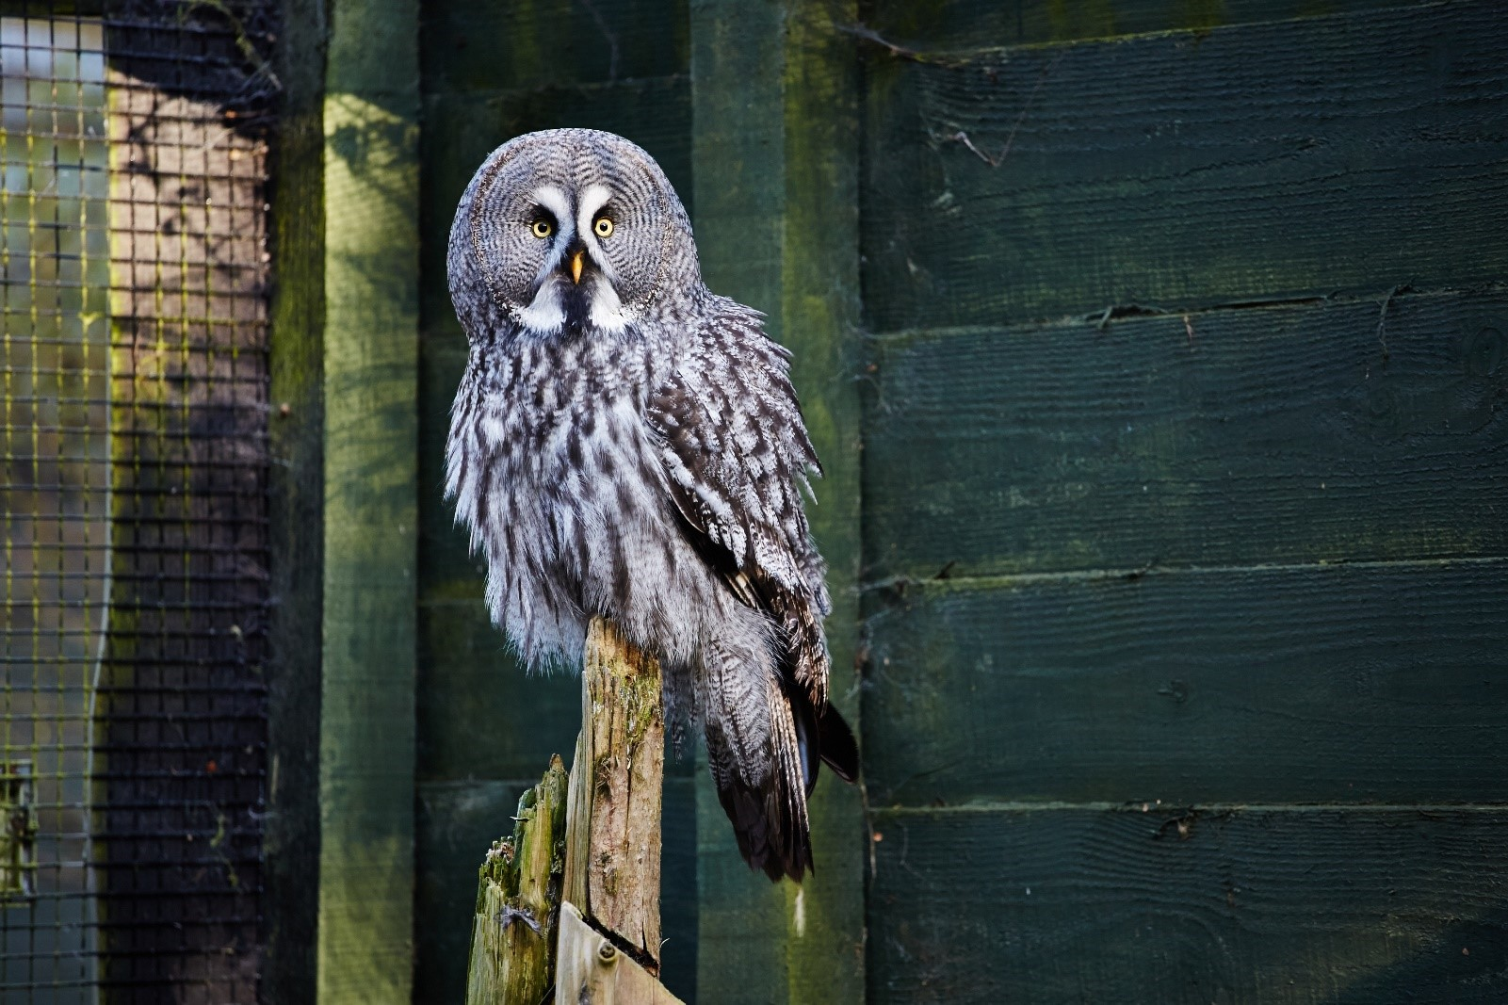
© Leeds Museums and Galleries

Slide 7
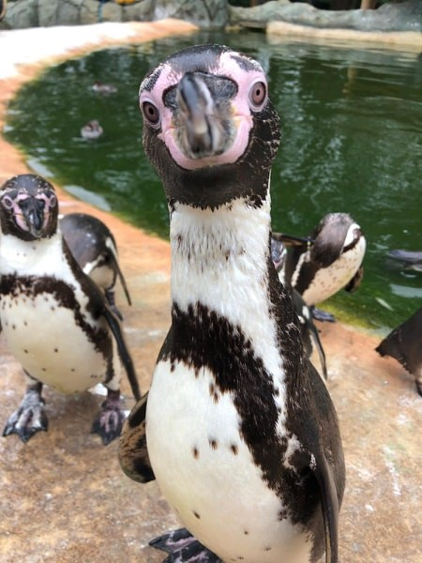
© Leeds Museums and Galleries

Slide 8
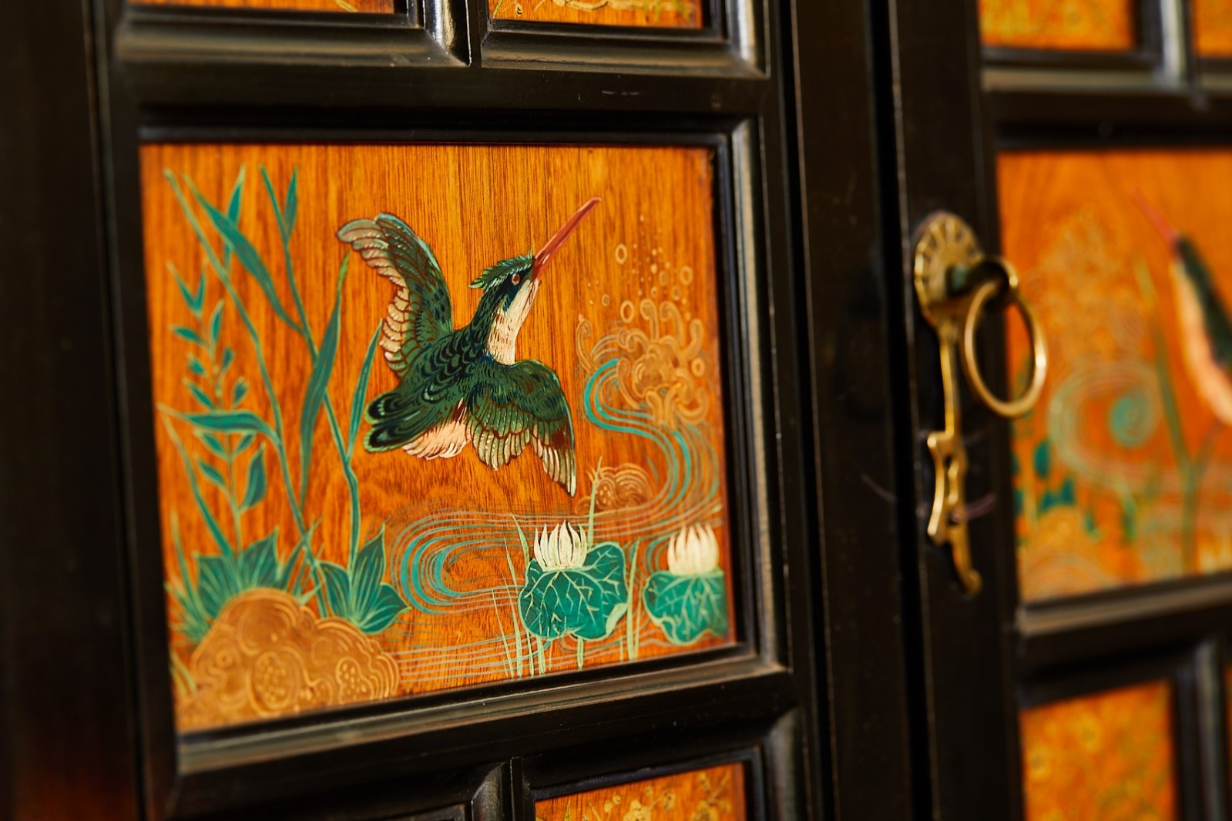
© Leeds Museums and Galleries

Slide 9
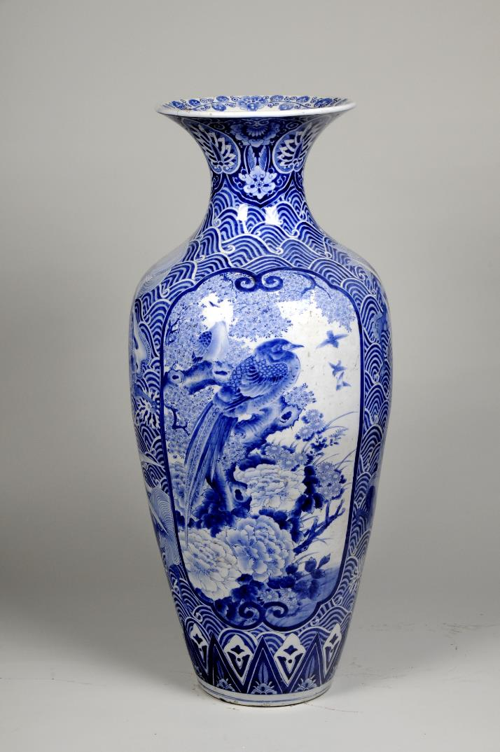
© Leeds Museums and Galleries

Slide 10
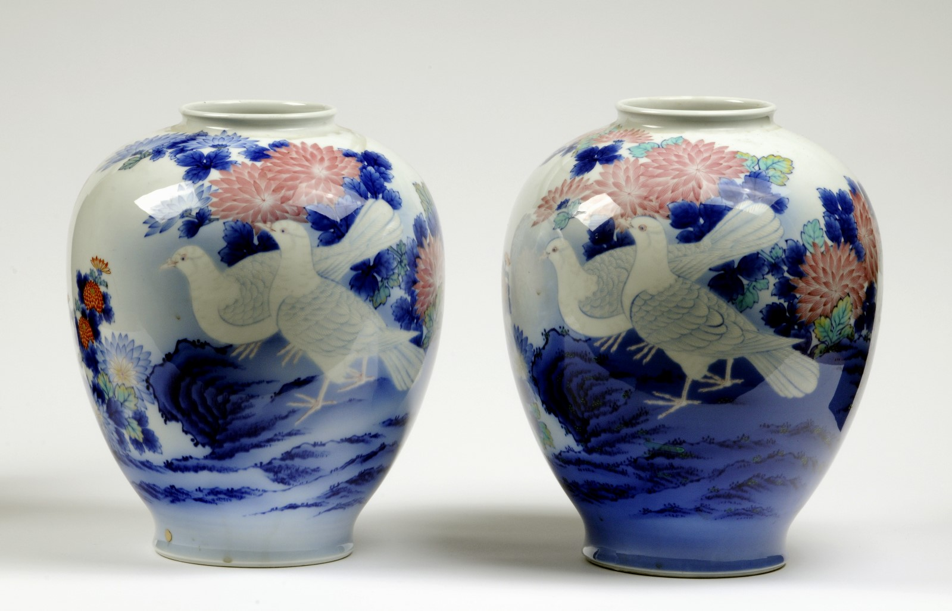
© Leeds Museums and Galleries

Slide 11
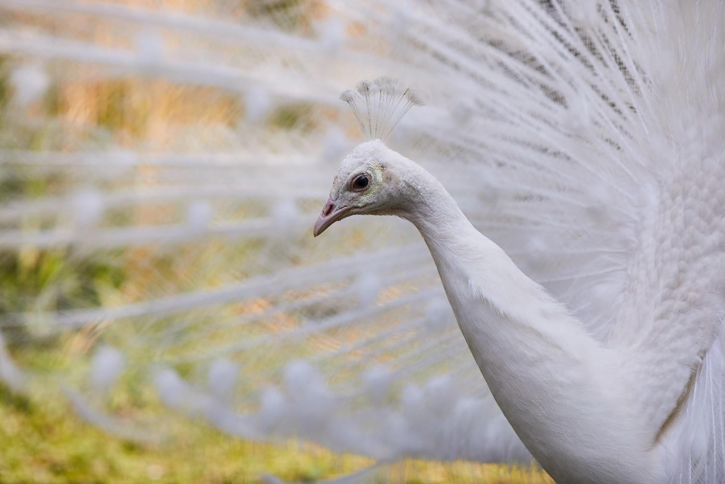
© Leeds Museums and Galleries

Slide 12
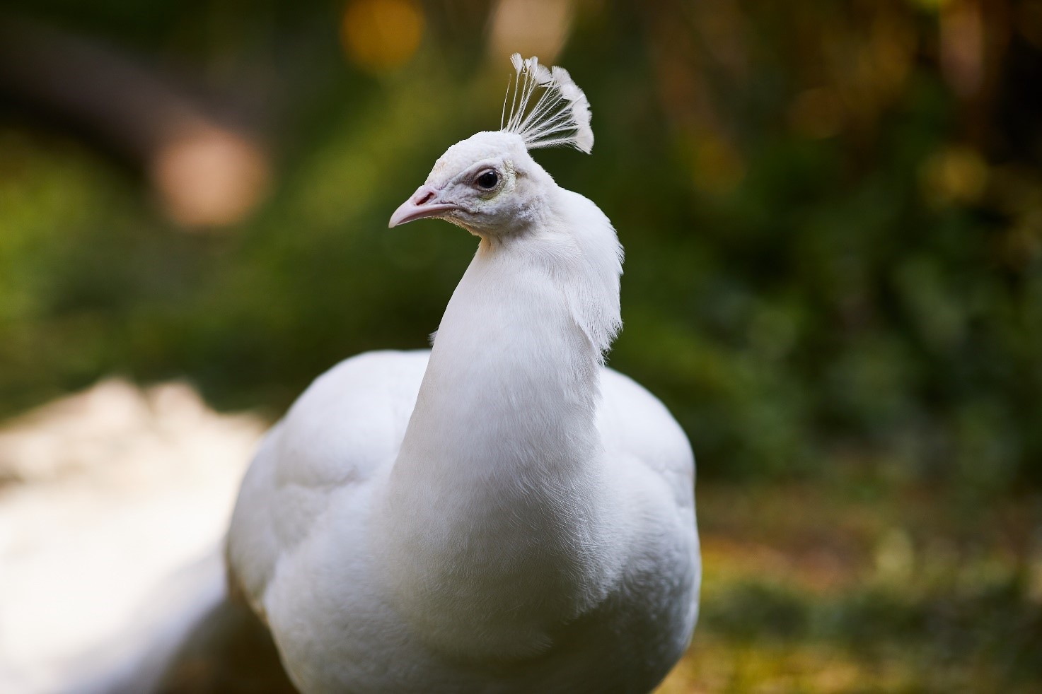
© Leeds Museums and Galleries

Slide 13
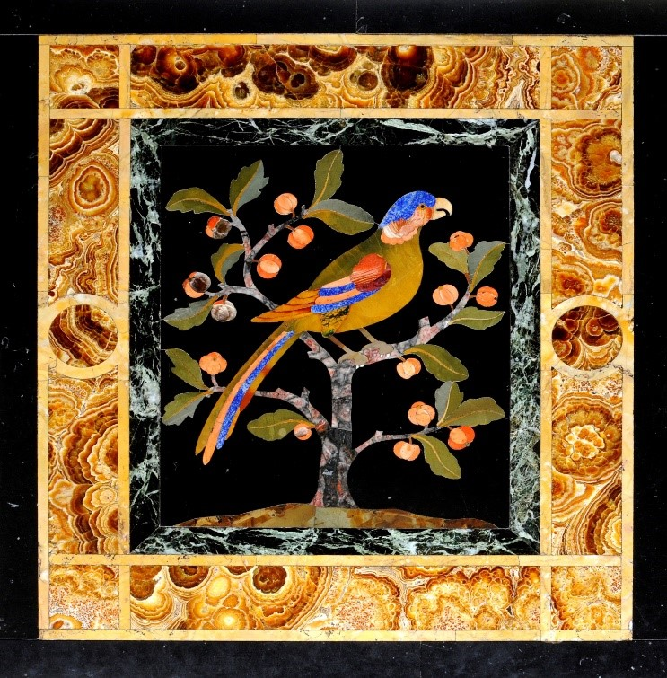
© Leeds Museums and Galleries

Slide 14
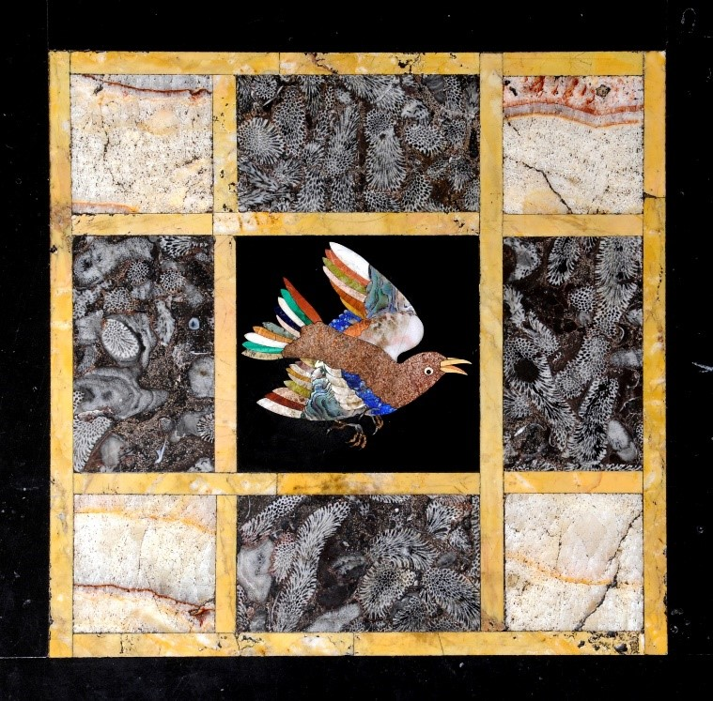
© Leeds Museums and Galleries

Slide 15
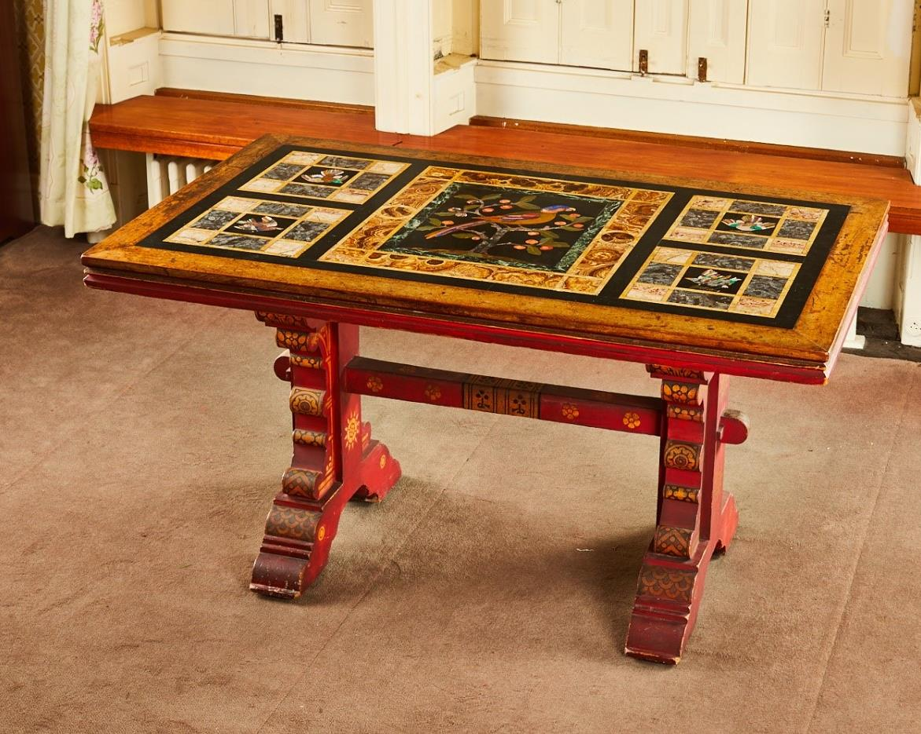
© Leeds Museums and Galleries

