Slide 1
Amazing Snails
To set up this Powerpoint as a touchscreen interactive on a smartboard:
  Go to ’Slide Show’ on the command ribbon
  Choose ‘Set Up Slide Show’
  Select ‘Browse at Kiosk (full screen)’
If you do not have a smartboard, this Powerpoint can be used with a mouse as usual.
Free learning resources from arts, cultural and heritage organisations
^{mylearning.org}

Slide 2
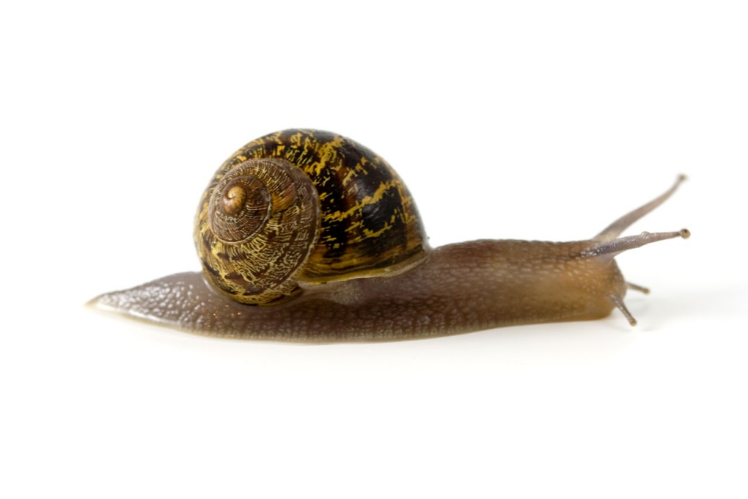
Amazing Snails
^{mylearning.org}

Slide 3

What is a snail’s shell made from?
Can snails see?
Do snails have teeth?
What is snail slime?
Snails in museum collections
End
^{mylearning.org}

Slide 4
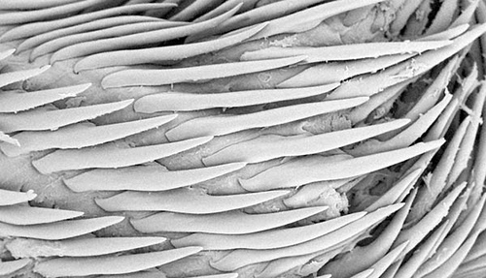
YES!
And not just a few either.
The average snail has around 12,000 teeth!
Here’s a close-up photograph showing some of the teeth from a single snail.
Imagine being chomped by these…it’s lucky that snails don’t hunt humans!
Image: CC-BY-NC-SA-4.0 | National museum of Wales | Flickr.
^{mylearning.org}

Slide 5
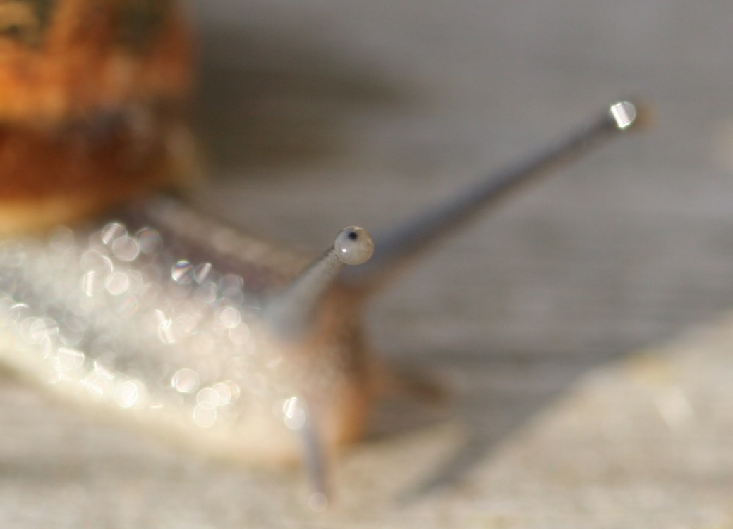
YES!
Snails can see.
Their eyes are on the end of eye-stalks, which means they can move them around to get a better view.
What would you be able to do if your eyes were on eye-stalks?
^{mylearning.org}

Slide 6
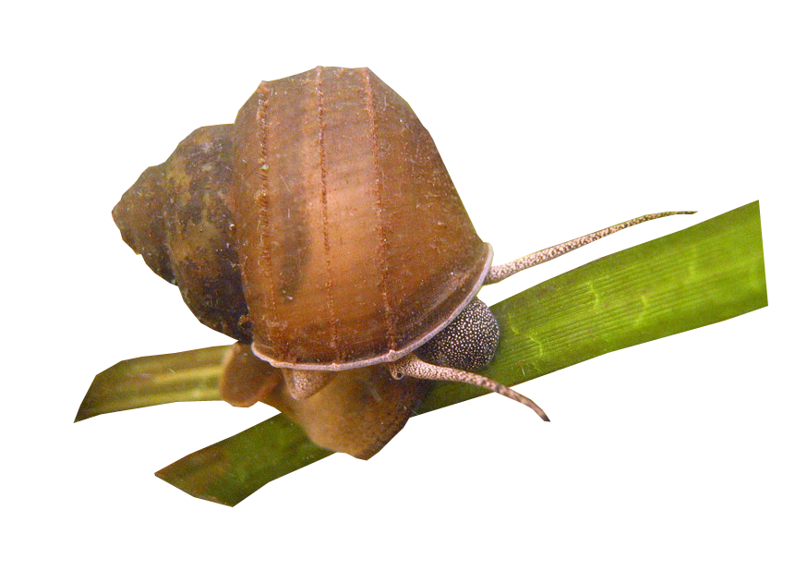
Aquatic Chinese Mystery Snail
AMAZING!
Mystery snails (yes, that is their actual name) can completely regenerate their eyes.
That means if they lose an eye, they can grow a new one!
Image: CC-BY-ND-2.0 | Wisconsin Natural Resources| Flickr.
^{mylearning.org}

Slide 7


Snail Shells
A snail’s shell is made from calcium carbonate.
The snail’s shell protects its body from the sun.
Why do you think it needs protecting?
Can you think of any sources of calcium in your diet?
^{mylearning.org}
Notes:
The snail’s shell protects it from drying out. It also protects the soft body of the snail.

Slide 8
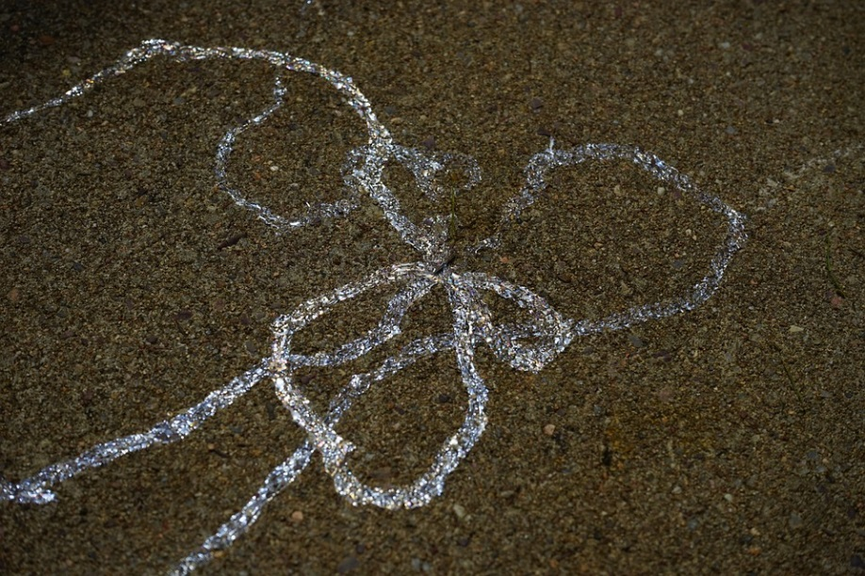
Bogies!
Snail slime is a kind of mucus, similar to what comes out of your nose when you have a cold!
The mucus is a cross between glue and a lubricant.
The glue lets the snail climb vertical surfaces.
The lubricant lets the snail move along smoothly.
^{mylearning.org}

Slide 9
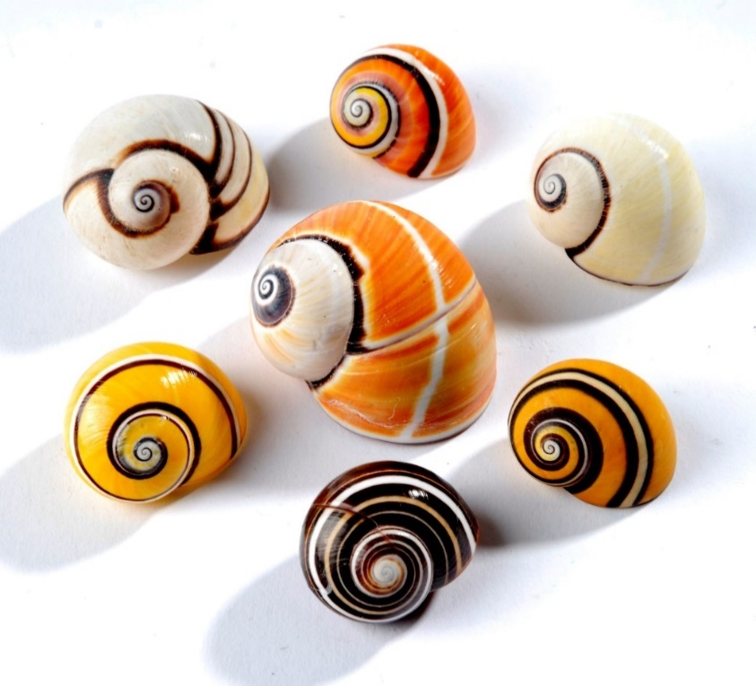
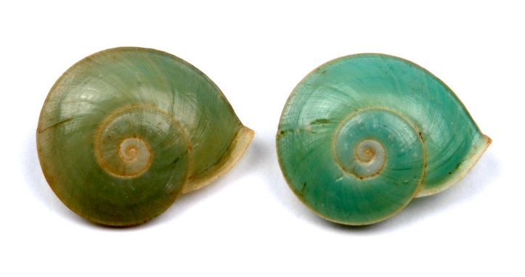
Snail shells in museums
Snail shells are easy to collect and store and can tell us a lot about the natural world.
Natural scientists can use the snail shells for research.
These shells above may look different, but they are all the same species of snail.
Images: CC-BY-NC-SA-4.0 | Leeds Museums & Galleries
^{mylearning.org}

Slide 10
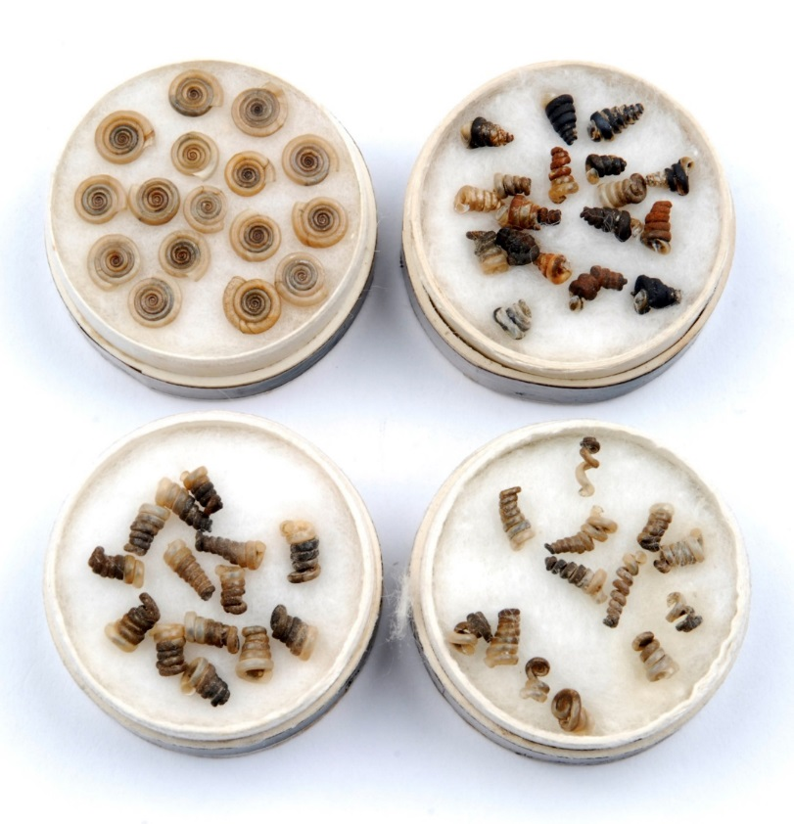
Tracking pollution using museum collections
These shells are the correct
shape
The snail shells shown here are all from the same type of snail.
Pollution, for example from cars, has caused the shells of some of these snails to grow in different ways.
Which snails lived in a clean habitat?
Which snails lived in a dirty or polluted habitat?
How can we use museum collections of dead snails to help protect living ones?
These shells are deformed (they are the wrong shape)
Images: CC-BY-NC-SA-4.0 | Leeds Museums & Galleries
^{mylearning.org}

Slide 11
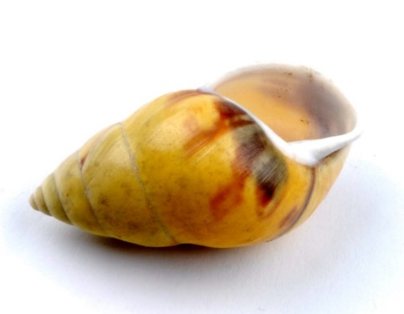
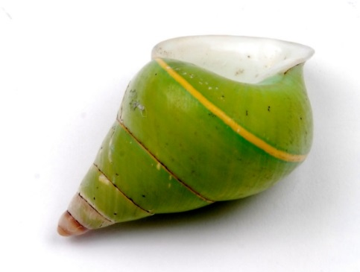
Amazing Snails
Why not explore your local museum’s
Natural Science collection?
You’re bound to discover something amazing!
Start
again
Images: CC-BY-NC-SA-4.0 | Leeds Museums & Galleries
^{mylearning.org}

